Slide 1
O Guia Prático da Justiça
é uma ferramenta digital
que permite o acesso rápido
e simplificado a informação
da área da justiça.
CEPEJ Webinar
Generative AI in the field of Justice
20 February 2024
____________________________
Practical Guide to Access to justice
(GPJ – Guia Prático de Acesso à Justiça)
Carlos Gandarez, DGPJ

Slide 2
From a chatbot to a virtual assistant with the advance of Artificial Intelligence.
Can we change the way we delivery services to citizens and companies?

Slide 3
Virtual assistant in development by Portuguese Ministry of Justice
… witch aims to provide quick and simplified access to information
… in a interactive conversational way
… without out any decision tree.

Slide 4
Excessively dispersed legal information
Lack of uniformity in the organization of the available information
Transform the use of “Legalese” in plain language
Overburdening of justice services personnel
Redirect the citizens automatically to digital service channels.
Problems to address

Slide 5
Benefits of use GPT
Increased communication efficiency
Better understanding of information
Understand natural language and interaction in a conversational manner
Gives an immediate answers
Enhanced personalized experience
Helps citizens with primary issues
Interacts in two langages (PT and EN)

Slide 6
Purpose and scope (1st step)
Focus on new areas of justice
To inform and forward to online platforms
Able to identify conversation context
Without saving the conversation
Without suggesting or advising
Just answer about Marriage, Divorce and company

Slide 7
Expanded to new areas
Expanded to Alternative Dispute Resolution and Online Criminal Record
Gradual expansion to new areas and services
Interoperability with other source of data from public databases and other services.

Slide 8
A Simple look
It is necessary to easily reach the Citizen
Don't lose focus on essential messages and how to really help the Citizen

Slide 9
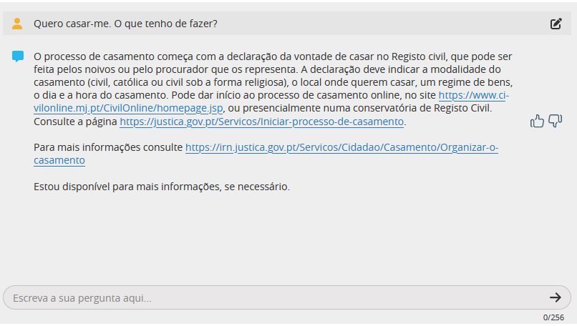
Intuitive look for any age
With thumbnails to collect feedback from the given answers

Slide 10
Architecture (1st step)
Azure
USER
CHAT UI
Open AI Service
GPT 4
Citizen asks a question
The Open AI Service “improves” the user’s question
The Open AI Service generates the answer to the Prompt

Slide 11
Current architecture – How does GPJ Works?
?
USER
CHAT UI
Prompts
GPT 4.0
Bing Search
Knowledge database
Metrics database
External Data (webpages)

Slide 12
New knowledge base
GPT 4
By using “our own” Database, we guarantee data validation and quick updates without increasing effort
All GPT knowledge is blocked here, leaving only the narrative capacity
Control the intelligence of a large linguistic model
Narrative
Knowledge Validated

Slide 13
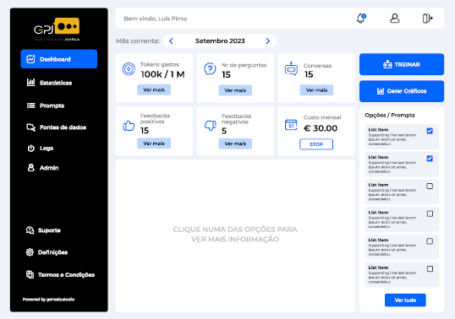
Take a look in the Backoffice

Slide 14
Some insights for the future …
More complex tasks and better interoperability, with other databases and services
More powerful and accurate capabilities to rapidly deploy new contexts
Improve sophisticated conversional skills
More Intuitive type of interface with voice conversation
Notes:
Implement the capacity to see, hear and speak

Slide 15
Justice Practical Guide
Obrigado!
Thank you

