Slide 1
EUR-OPA Major Hazards Agreement Committee of Permanent Correspondents / Directors of Centres 10 - 11 February 2022
Anton Micallef

Slide 2
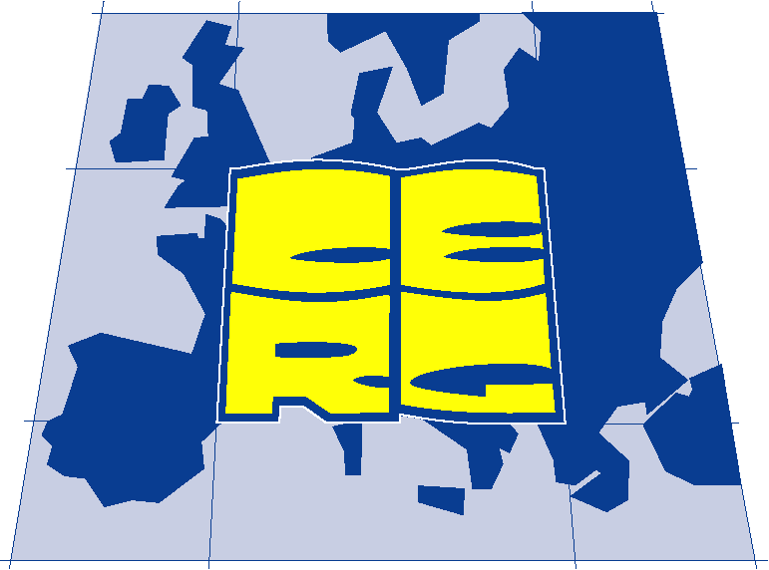
EUR-OPA project on Coastal Risk Assessment and Mapping - 2016-17 development of geomorphological maps; - 2018/19 coastal hazard susceptibility / vulnerability maps; - 2020/21 coastal risks maps (of inundation by SLR)
ICoD
Euro-Mediterranean Centre
on Insular Coastal Dynamics
EUROPEAN CENTRE FOR GEOMORPHOLOGICAL HAZARDS
(Coordination : Anton Micallef, ICOD)
Notes:
This project proposal on Coastal Risk Assessment and Mapping is based on an earlier initiative to develop a simplified but scientifically sound methodology for the assessment of risks related to coastal hazards. It is linked to a need identified in a 2016 initiative for a stepped approach to the identification and mapping of coastal risk. A 2016-17 project saw the development of geomorphological mapping skills and datasets in the participating centres and country coastlines. A subsequent 2018/19 proposal addressed the production of hazard susceptibility mapping and identification and mapping of coastal vulnerability.
The current 2020/21 project addresses the long-term objective of Risk Assessment and Mapping.The global objective of the overall project is to provide national authorities / ministries responsible for planning and civil protection with a well-defined methodology for Risk mapping via a stepped approach of hazard susceptibility, vulnerability and risk assessment and mapping of coastal hazards.

Slide 3
Coastal Risk Assessment & Mapping of coastal risk to inundation by SLR Study Area
Notes:
Figure 2. Examples of the main coastal landscape features in the study area:
the sandy beach of Ramla Bay;
b) the coastal village of Marsalforn;
c) Blue Clay outcrops at Marsalforn;
d) terraced slopes in Blue Clay terrains affected by rock falls detached from the limestone plateau of Upper Coralline Limestone at Ghajn Barrani, between Ramla Bay and Marsalforn Bay;
e) sloping coast near Dahlet Qorrot Bay;
f) plunging cliff in the Lower Coralline Limestone

Slide 4
Coastal Risk Assessment & Mapping Study Area
Notes:
Figure 2. Examples of the main coastal landscape features in the study area:
the sandy beach of Ramla Bay;
b) the coastal village of Marsalforn;
c) Blue Clay outcrops at Marsalforn;
d) terraced slopes in Blue Clay terrains affected by rock falls detached from the limestone plateau of Upper Coralline Limestone at Ghajn Barrani, between Ramla Bay and Marsalforn Bay;
e) sloping coast near Dahlet Qorrot Bay;
f) plunging cliff in the Lower Coralline Limestone

Slide 5
Risk Assessment - Methodology
Preliminary evaluation of:
hazards potentially affecting the investigated area (potential impact on the coast; depends on susceptibility of coastal area to inundation);
Exposure of natural & anthropic elements
related physical & social vulnerability.
Coupling susceptibility with exposure (E) & vulnerability (V), expresses the Risk:
R = H * E * V
Notes:
Risk assessment requires the preliminary evaluation of the
hazards potentially affecting the investigated area,
the exposed elements (natural and anthropic),
and the related physical and social vulnerability
Susceptibility information needs to be coupled with exposure (E) and vulnerability (V), expressing respectively “the presence of people; livelihoods; species or ecosystems; environmental functions, services, and resources; infrastructure; or economic, social, or cultural assets in places and settings that could be adversely affected” and their “propensity or predisposition to be adversely affected”.
Hazard/susceptibility, exposure, and vulnerability are combined by applying the general risk formula (eq. 1), which allows obtaining a zonation of the investigated area according to the different risk level.
R = H * E * V

Slide 6
Risk Assessment – Methodology
Sea level values used in this study for the susceptibility evaluation and risk assessment are indicated as underlined and in bold.
IPCC Sea Level Projections | Baseline | Scenario | Scenario
 | 1985-2006 | RCP2.6 | RCP8.5
Global (AR5, 2013) | 2100 | 0.44 (0.28 - 0.61) | 0.74 (0.52 - 0.98)
Global (SROCC, 2019) | 2100 | 0.43 (0.29 - 0.59) | 0.84 (0.61 - 1.10)
 | 1995-2014 | SSP1-2.6 (m) | SSP5-8.5 (m)
Global (AR6, 2021) | 2050 | 0.19 (0.16 - 0.25) | 0.23 (0.20 - 0.29)
Global (AR6, 2021) | 2100 | 0.44 (0.32 - 0.61) | 0.77 (0.63 - 1.01)
 | 1995-2014 | SSP1-2.6 (m) | SSP5-8.5 (m)
Local (AR6, 2021) | 2050 | 0.19 (0.11 - 0.28) | 0.23 (0.14 - 0.33)
Local (AR6, 2021) | 2100 | 0.40 (0.22 - 0.62) | 0.73 (0.52 - 1.03)

Slide 7
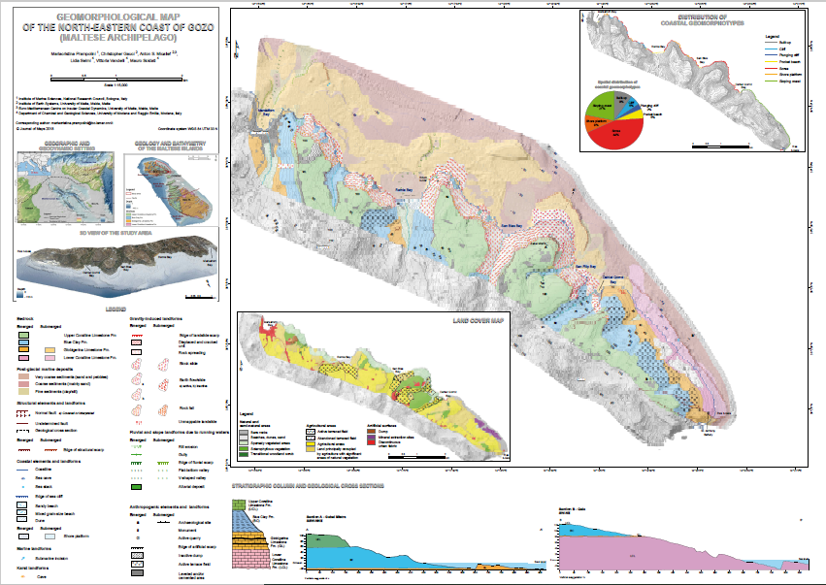
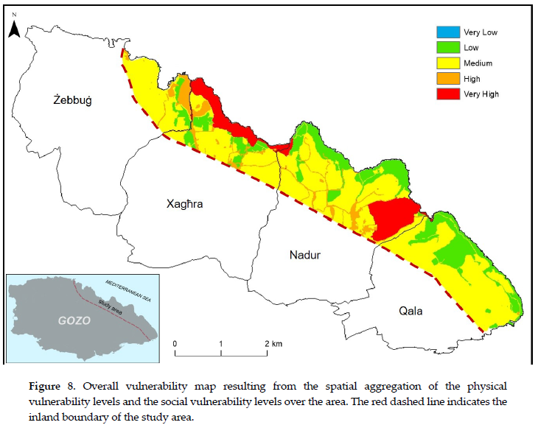
Risk Assessment – Methodology
For the assessment of the exposure and vulnerability levels, the analysis was based on the results obtained in our previous study
Geomorphological map (left); Vulnerability map (right)
(Rizzo et al., 2020)
Geomorphological map (Prampolini et al., 2018)

Slide 8
Risk Assessment – Methodology
For the assessment of the exposure and vulnerability levels, the analysis was based on the results obtained in our previous study

Slide 9
Risk Assessment – Methodology
Results of the susceptibility analysis for different global sea level projections under the worst-case climate scenario
 | Scenarios in 2100
 |  | SSP5 - 8.5 (AR6) 0.77 m |  | RCP - 8.5 (SROCC) 0.84 m
Susceptibility class | elevation range (h) | km² | % | km² | %
S0 | h>5 m | 8.97 | 95.01 | 8.96 | 94.96
S1 | 1<h≤5 m | 0.29 | 3.05 | 0.29 | 3.06
S2 | 0.5<h≤1 m | 0.03 | 0.35 | 0.03 | 0.35
S3 | 0<h≤0.5 m | 0.04 | 0.45 | 0.04 | 0.44
S4 | h≤0 m | 0.11 | 1.14 | 0.11 | 1.20
Notes:
Figure 5. Areas in susceptibility class S4 for the bays of a) Marsalforn and b) Ramla
based on the local sea level projections in 2100 under the worst-case climate scenario.

Slide 10
Risk Assessment – Methodology
susceptibility, exposure, & vulnerability data were overlaid to calculate the risk level and to zone the investigated territory in different levels of risk;
the different informative layers were combined into a comprehensive Coastal Risk Index, using the following:
$Coastal Risk Index =\sqrt{C_{Susc}∙C_{OVI}}$
C_{susc} - susceptibility value; C_{OVI} - overall vulnerability.
coastal risk values were calculated in GIS environment;

Slide 11
Risk Assessment – Methodology
Risk values were classified in four classes
(Class R1 (low risk) - Class R4 (very high risk).
Class R0 includes all the areas where the risk can be considered null. These areas correspond to those included in the susceptibility Class S0,
The results of the coastal risk analysis are presented as risk maps showing in red the areas expected to be below the future sea level (Figure 6).
The coastal inundation risk maps for different future sea levels and under different climate scenarios represent the main output of this study.

Slide 12
Results of the risk analysis for different local and global sea level local projections under two climate scenarios:
(a), (b) medium-term scenarios (2050) by accounting for the local sea level projections under the best (SSP1-2.6) climate scenario (0.19);
(c), (d) medium-term scenarios (2050) by accounting for the local sea level projections under the worst (SSP5-8.5) climate scenarios (0.23 m);

Slide 13
(e), (f) long-term scenarios (2100) by accounting for the local sea level projections under the best (SSP1-2.6) climate scenarios (0.40 m);
(g), (h) long-term scenarios (2100) by accounting for the local sea level projections under the worst (SSP5-8.5) climate scenarios (0.73 m);

Slide 14
(i), (l) long-term scenarios (2100) by accounting for global sea level projections under the worst-case (RCP-8.5) climate scenarios (0.84 m).

Slide 16
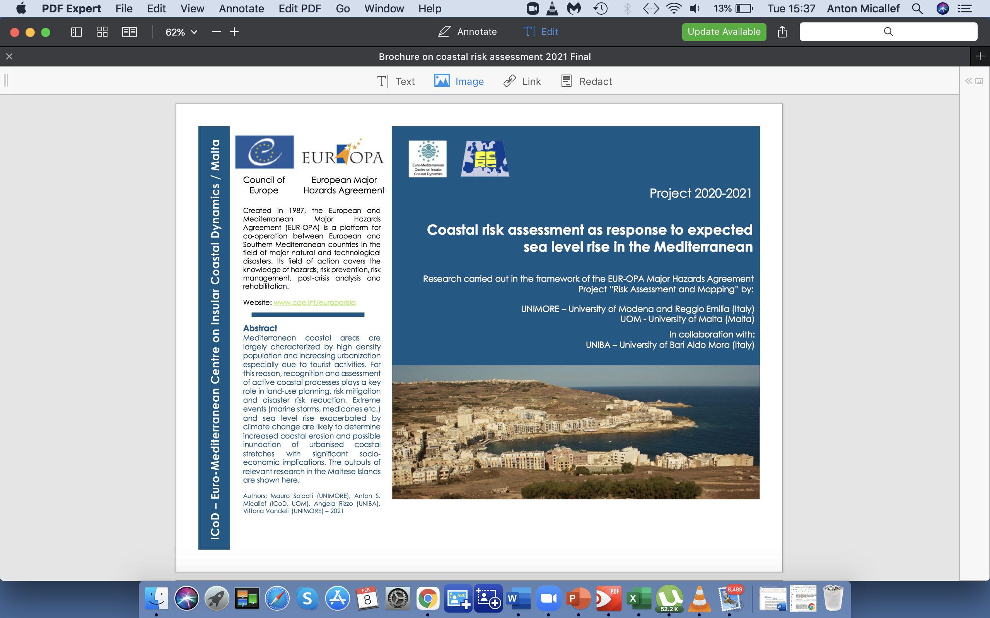
BROCHURE

Slide 18
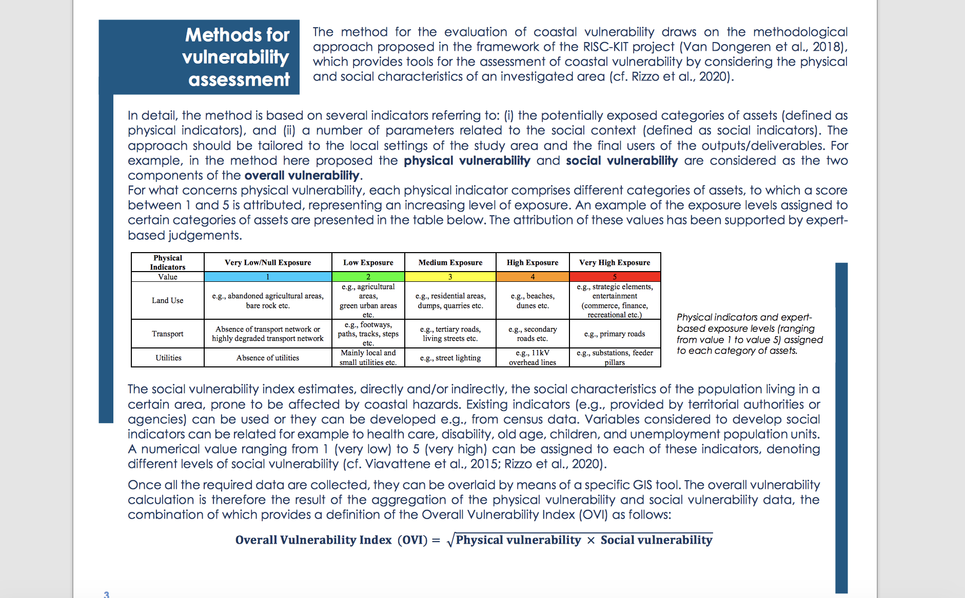

Slide 19
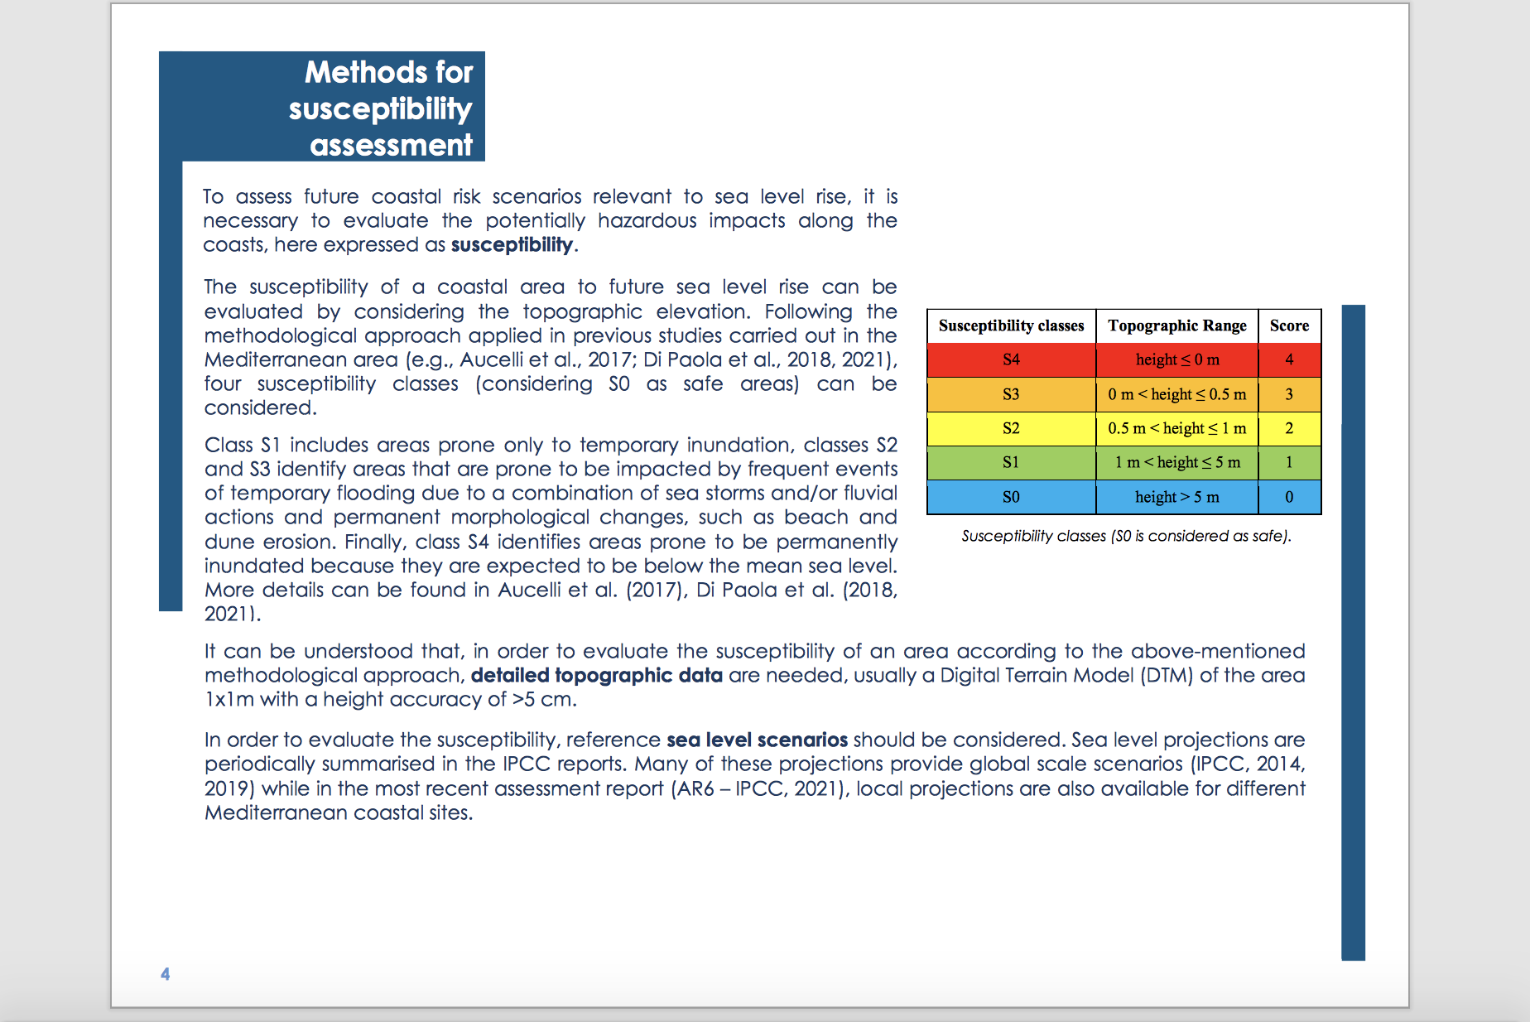

Slide 21
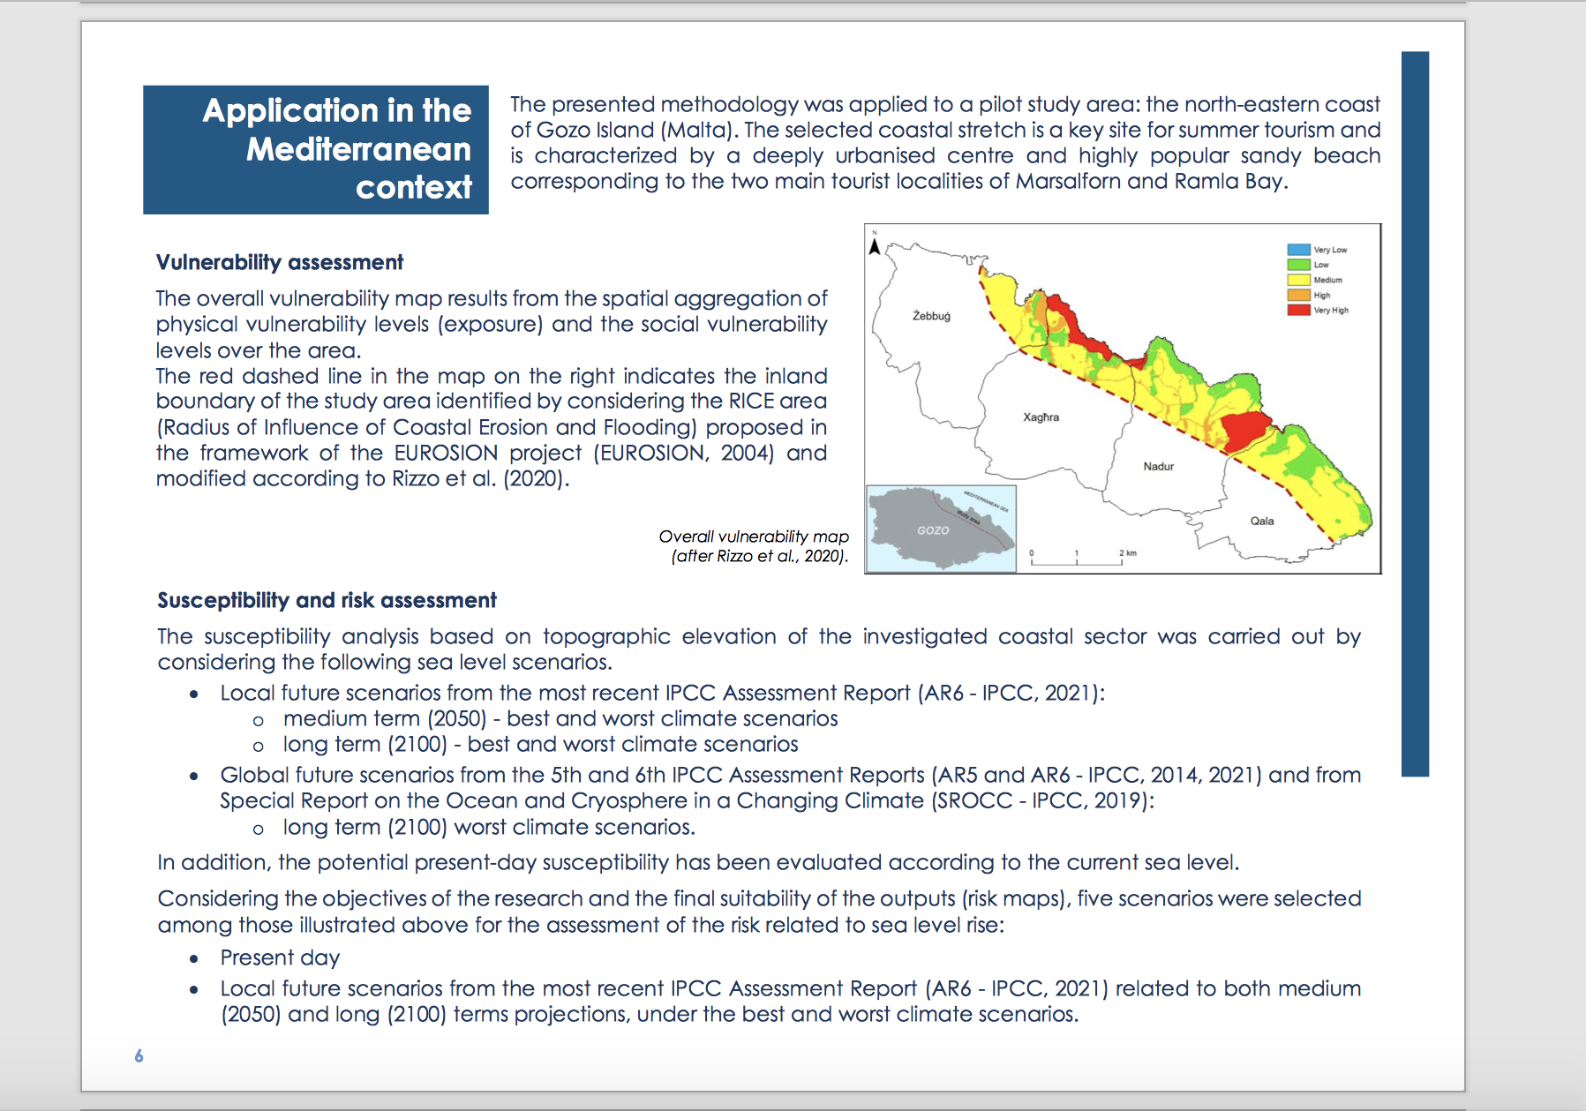

Slide 22
