Slide 1
CERU
European Centre on Urban Risks
Activities developed in 2021
Activities planned to 2022
Paula Teves Costa
(ptcosta@fc.ul.pt; ceru.europa@gmail.com)
Strasbourg (videoconference) – 10 and 11 February 2022

Slide 2
2021
Local Knowledge and Schools Against Natural Disasters (LoKSAND)
Coordinator Centre: CUEBC(Italy)
CERU Activities:
Selection of a pilot area
Implementation of PYT page devoted to main risks
Awareness raising campaigns (1 school)
Cooperation with the local Civil Protection for dissemination of the project/page

Slide 3
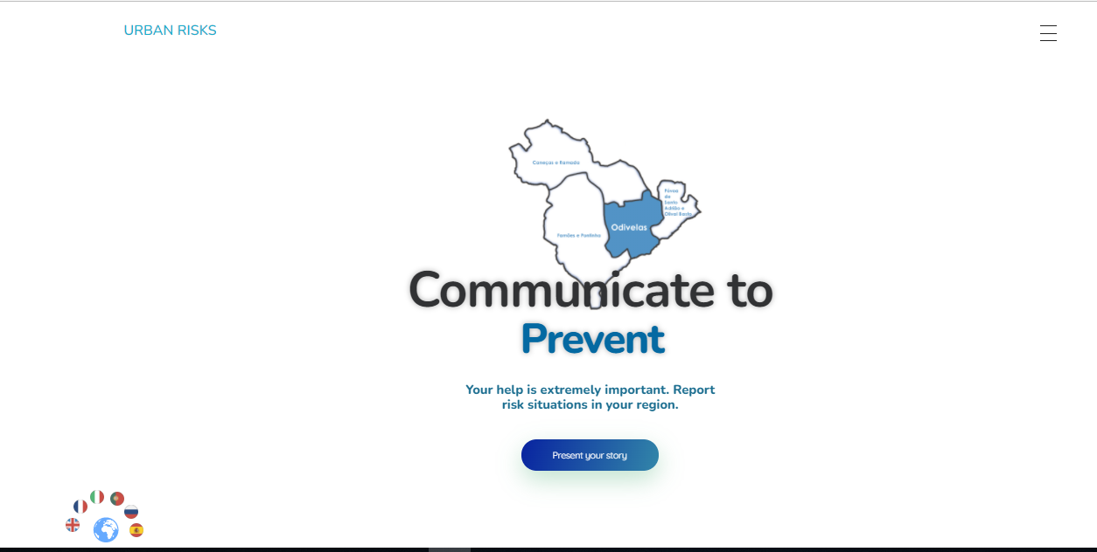
https://riscosurbanos.pt/
Advantages: It can be used as an app in your mobile
It can be automatic translated in 6 languages (English, French, Italian, Portuguese, Russian and Spanish)

Slide 4
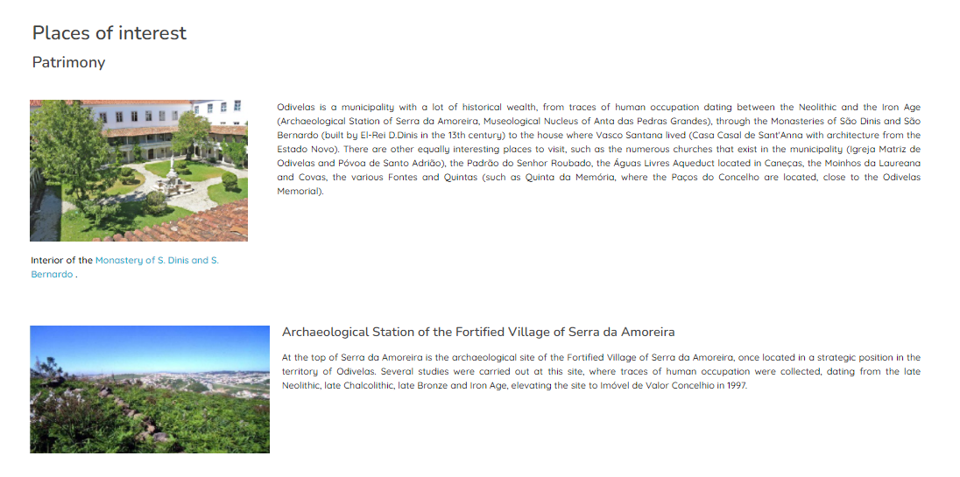

Slide 5
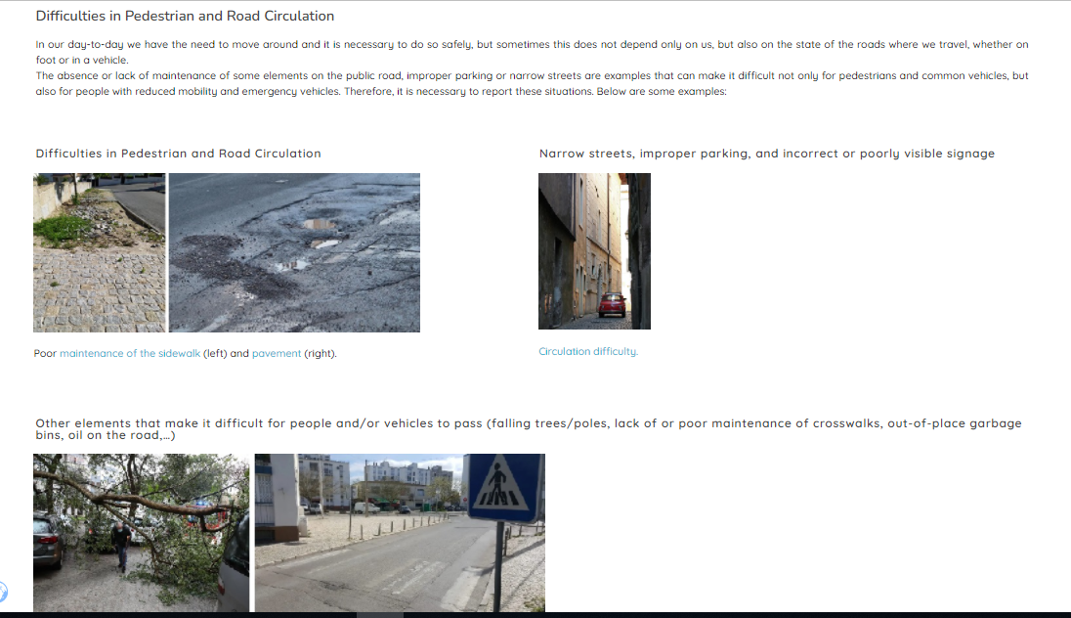

Slide 6
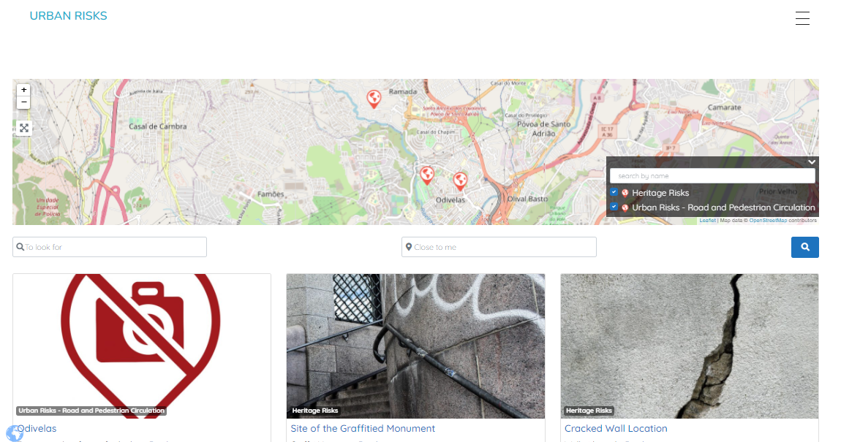
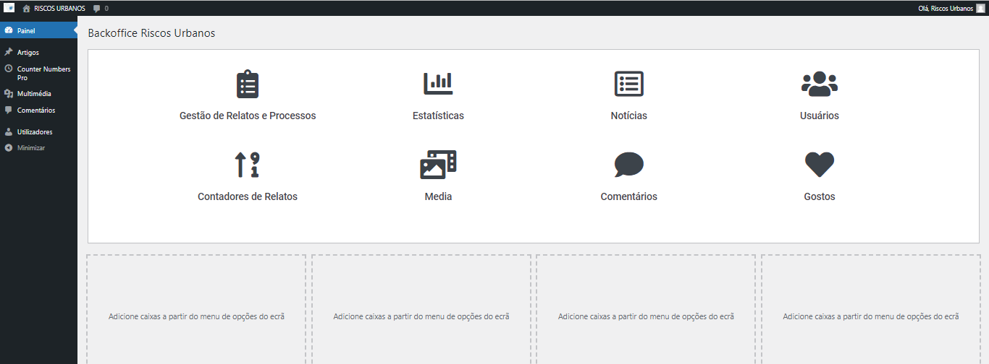
Reports
Back Office

Slide 7
Project Proposal for 2022-23
POPIRiM. POPulation Involvement on RIsk management and Mitigation - Testing in small communities
The project aims to test the public participation in governance and DRR in different communities exhibiting susceptibilities to one or more risks, in different countries.
In Portugal it will be applied to a peripheral area of the city of Lisbon, (Serra da Luz, Odivelas), in France (CERG), it will be applied to the city of Barcelonnette (South Alps). Both sites present characteristics of strong susceptibility to landslides, floods and earthquakes.
Social characterization and critical analysis of population participation in awareness previous projects (Italy, Almafi, CUEBC) and risk perception.

Slide 8
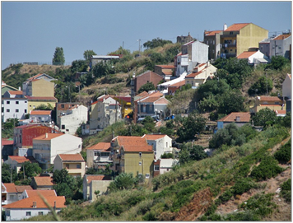
POPIRiM. Population involvement on risk management and mitigation - Testing in small communities
It is intended to characterize the social content of the area, in its demographic, socio-economic, urban and cultural components, so that, in association with the dangers present in the region, to identify the main social vulnerabilities and perceptions that are constructed about these types of risk on the part of the resident population.
Through this survey and diagnosis, we intend to build a formative and informative program providing citizens with the conditions and tools needed to act in the field of disaster risk reduction, in order to adequate their behavior and to promote the public policies of local resilience.

Slide 9
POPIRiM. Population involvement on risk management and mitigation - Testing in small communities
Expected Results
Identification of the main risks and local vulnerabilities as well as the existent social capacities
Definition of local mechanisms for public participation of residents in the management of their security, enhancing the creation of groups of volunteers to support the subsequent development of the project
Synchronization of the action of the Civil Protection local department, in order to develop a concerted intervention with the population of the studied areas, to identify the main risks and establish measures for their management – mitigation, reduction and elimination.
Training exercises for the population on the management of the main risks.

Slide 10
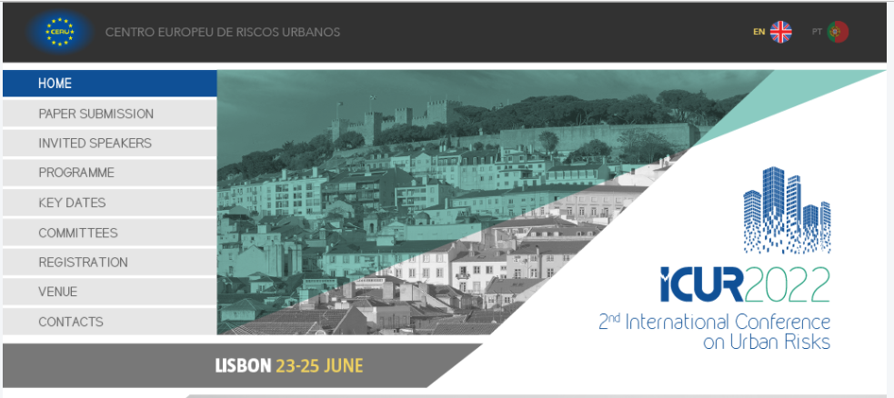
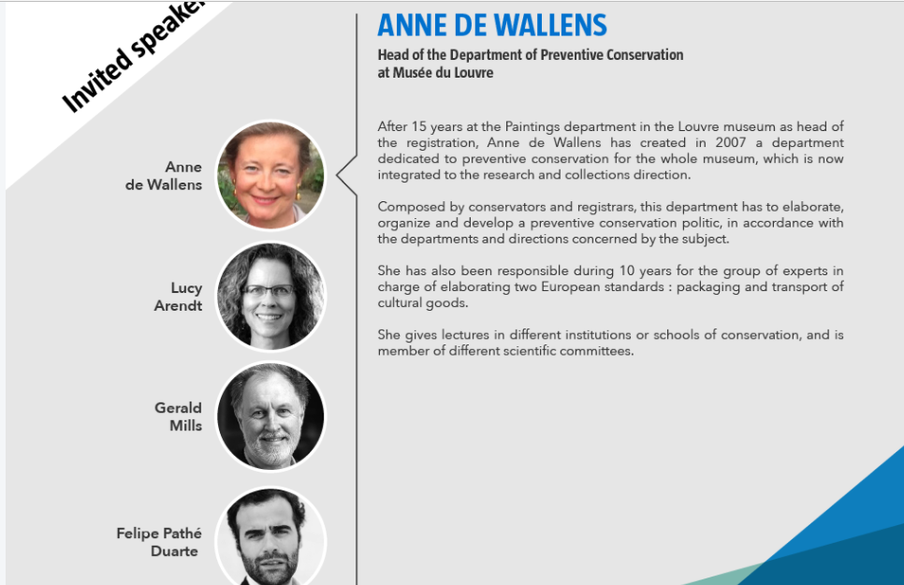
https://www.ceru-europa.pt/icur2022/en

Slide 11
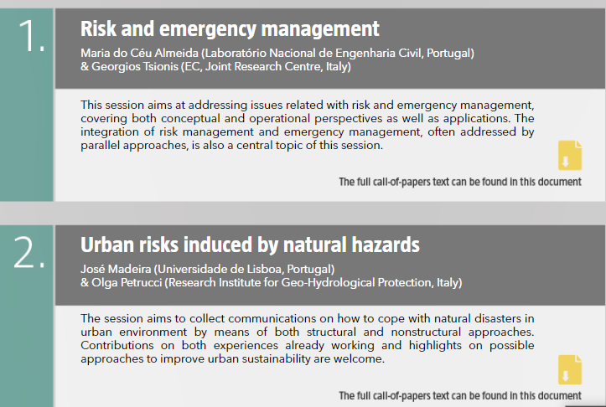
7 Topics + 1 Special Session
Risk and emergency management
Urban risks induced by natural hazards
Critical infrastructures and cascading effects
Urban environmental health risks and sustainability
Risk protection on cultural heritage and historical centres
Societal risks in a changing world
Citizen engagement and risk communication
SS: Multi-hazard risk assessment for resilient and sustainable urban areas
https://www.ceru-europa.pt/icur2022/en

