Slide 1
European Center for Disaster Awareness “BeSafeNet“
Demetris Christou
Cyprus Ministry of Interior
February 2022

Slide 2
What is BeSafeNet?
BeSafeNet is a tool for promoting risk culture among populations.
Natural and technological disasters cause great human and economic losses. We cannot prevent many of them but there is a way to minimize the risk of disaster by sharing internationally valid and reliable information on the nature, causes and consequences of natural and technological disasters.

Slide 3
Who are we?
Leader: European Centre for Disaster Awareness - Cyprus Civil Defence.
Partners:
TESEC: European Centre of Technological Safety in Kiev.
ICOD: Euro-Mediterranean Centre on Insular Coastal Dynamics in Valletta.
CERG: European Center for Seismic and Geomorphogical Hazards in Strasbourg.

Slide 4
What is the aim?
The aim of BeSafeNet is to become an educational tool in the hands of teachers, focusing at risk prevention, preparedness, immediate reaction and rehabilitation.
What are BeSafeNet’s goals?
Promote a culture of safety among a new generation of people
Disseminate knowledge to multilingual societies
Establish the website as an Interactive tool

Slide 5
What is BeSafeNet dealing with?
Natural Hazards
Geological Hazards
Volcanic Eruptions
Earthquakes
Tsunami
Landslides
Landscape fires
Hydro-Meteorological Hazards
Floods
Drought and Desertification
Avalanches
Hurricanes and Storm Surges
Sea Level Rise
Biological Hazards
1.Pandemics (New)
Technological Hazards
Chemical Emergencies
Radiological Emergencies
Dam failure
Related to Hazards
Cultural Heritage (Soon)

Slide 6
What have we done in 2021?
Olympiad 2021 was organized to launch the BeSafeNet interactive tool as an online competition between schools on the theme “Better knowledge against disasters”. It was open to secondary schools in the member States of the Agreement. The age limit to participate was 16 years and under. The competition gave students a chance to increase their knowledge on natural and technological hazards that they could face even outside of school. The students have learned the adequate behavior in these situations and how to reduce/prevent as much as possible the potential impact of disasters.

Slide 7
During the competition, more than 500 students and more than 130 teams from 12 different Countries competed together for Olympiad 2021.
Olympiad 2019-2021 Statistics
Also, it is good to note that more than 100 new different Essays on Natural and/or technological Hazards, expressing student’s point of view, were submitted during the competition and are now available on line.
 | Olympiad 2019 | Olympiad 2020 | Olympiad 2021
Registered Teams | 167 | 339 | 144
Participated Teams | 113 | 272 | 135
Countries | ALBANIA ARMENIA ALGERIA BOSNIA AND HERZEGOVINA BULGARIA CYPRUS GREECE MALTA MONACO ROMANIA SLOVAK REPUBLIC UKRAINE | ALBANIA ALGERIA BULGARIA CYPRUS GEORGIA GREECE MALTA ROMANIA SLOVAK REPUBLIC | ALBANIA BULGARIA CROATIA CYPRUS GEORGIA GREECE MALTA MONACO ROMANIA RUSSIAN FEDERATION SLOVAK REPUBLIC SAN MARINO
Schools | 99 | 176 | 92
Students | 796 | 1015 | 508

Slide 8
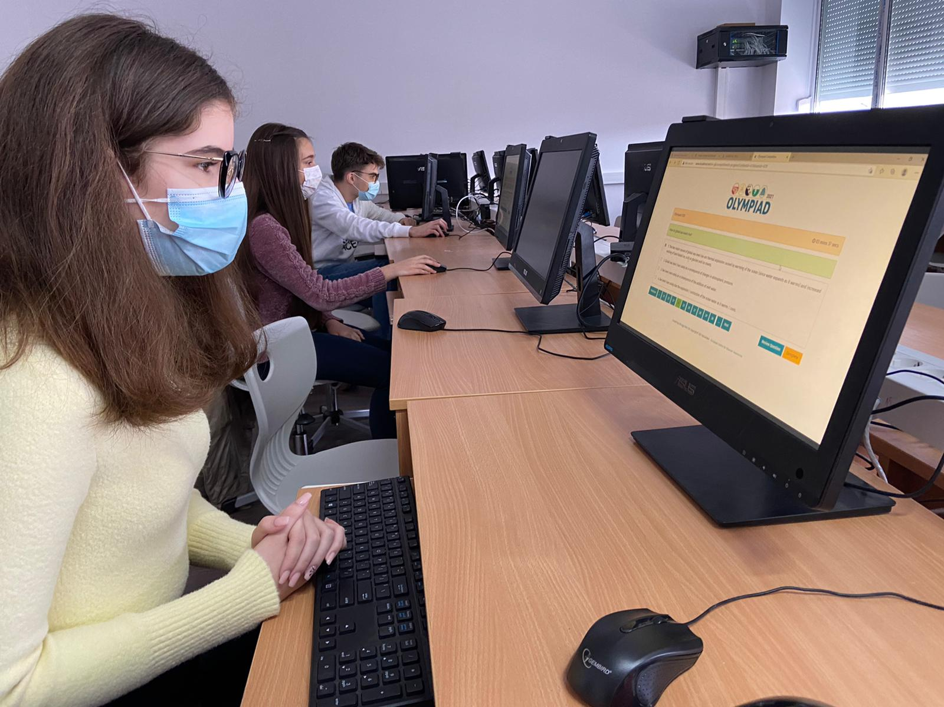
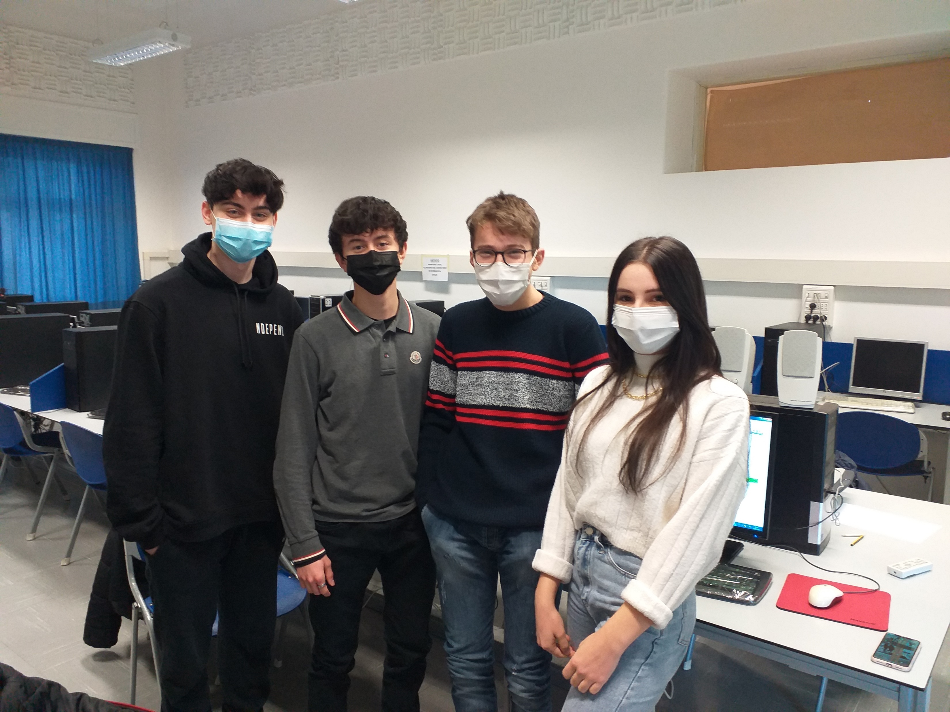
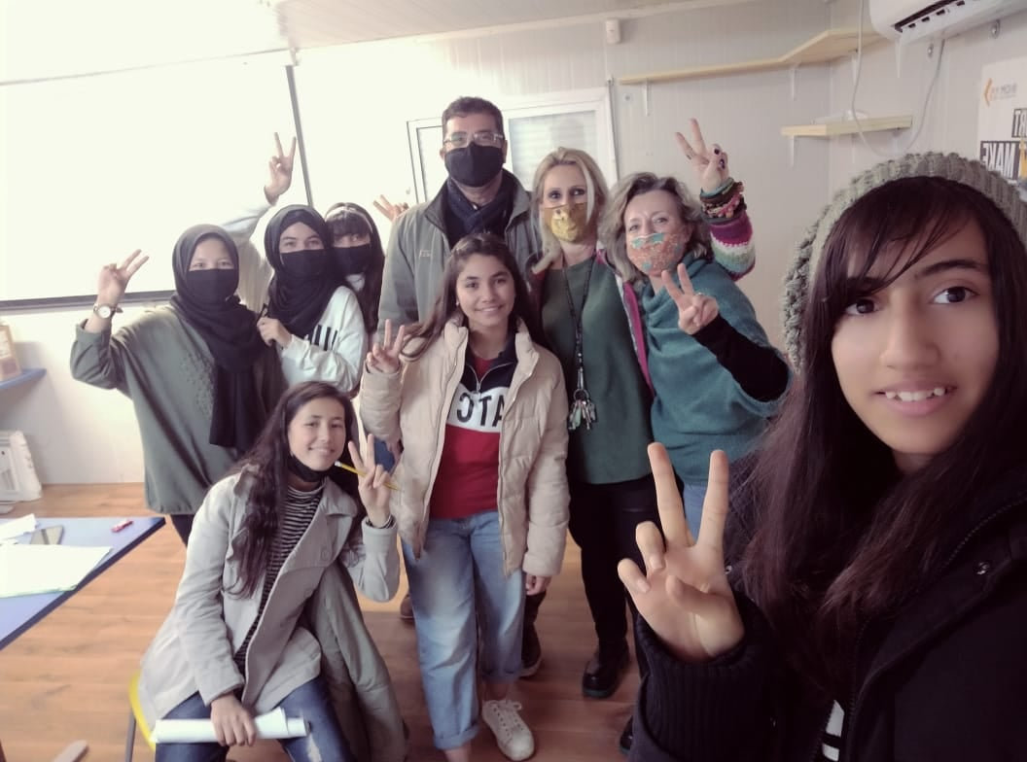
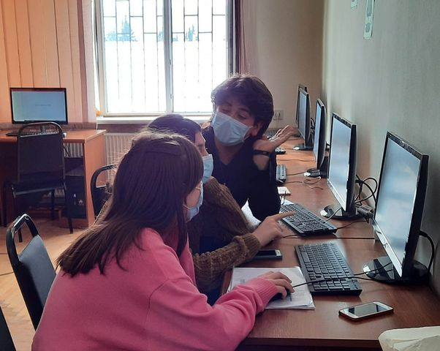

Slide 9
A virtual Award Ceremony was organized, very different than the one we planned.
The three best teams were:
1 | Country: Romania Team: Terra Blue School: ”Gheorghe Lazăr” National College
2 | Country: Croatia Team: Labin team School: High School Mate Blažine
3 | Country: Romania Team: Detectives of Hazards School: Liceul ”Regina Maria”

Slide 10
In cooperation with European Center for Disaster Medicine, CEMEC, a topic on Pandemics is now live on our website.
In cooperation with European Centre on Prevention and Forecasting of Earthquakes a topic on Cultural Heritage is almost finished.
Continuous update of our Facebook page.
In cooperation with our new IT partner in BeSafeNet, the new website and the competition page are finally ready.
Preparation and Dissemination for Olympiad 2022.
A promotional poster and banners for Olympiad was created and is ready for dissemination.

Slide 11
What’s next? Project Proposals 2022-2023
Q1–Q2
Foster in Promoting the Olympiad competition among the participating Countries in order to engage as many participating teams as possible.
Launch the Olympiad 2022 competition on the 18th of February 2022.
Evaluate the tests and essays.
Organize an Award Ceremony.
Translate new topics.
Prepare a guide on how to add new hazards and MCQs to the competition will be prepared.

Slide 12
What’s next? (2) Project Proposals 2022-2023
Q3–Q4
Finalize and upload topic on Cultural Heritage.
Enrich the content of the website.
Seek for cooperation in presenting a topic on Climate Change.
Update the content with new hazards.
Start preparations on the new Olympiad.
Launch Olympiad 2023 registration.

Slide 13
The Olympiad competition “Better knowledge against disasters”
Is between school classes open to students up to secondary school.
Its purpose is to enchase more and more children to enrich their knowledge against disasters.
The competition is conducted in English Language.
Olympiad 2022 will be on the 18th of February 2022.
The registration of participants is open until the 18th of February 2022.
Participants must be organized in teams of maximum four students and should be endorsed by a teacher.
The schools of the three best teams and their team members will be awarded.

Slide 14
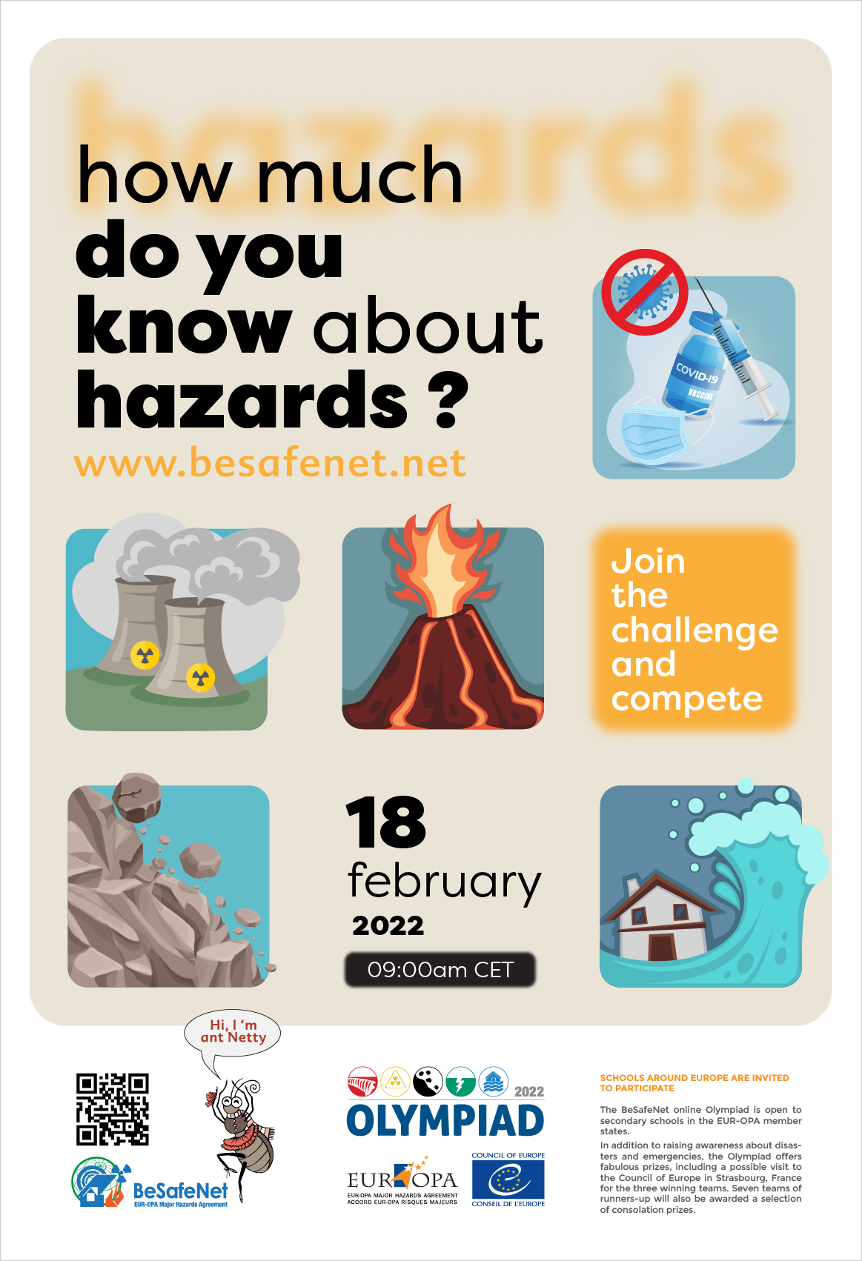

Slide 15
You can contact us at:
BeSafeNet:
info@besafenet.net
Demetris Christou – Director of the Specialized Center
dchristou@cd.moi.gov.cy
Mikaella Mala – Committee Permanent Correspondence
mmala@cd.moi.gov.cy
Facebook page:
www.facebook.com/BeSafeNet

Slide 16
Ευχαριστώ! Thank you!

