Slide 1
Agenda Item 6.2: Files Opened Greece: Recommendation No. 9 (1987) on the protection of Caretta caretta in Laganas bay, Zakynthos
41st Meeting of the Standing Committee
Bern Convention
29th November – 3rd December 2021

Slide 2
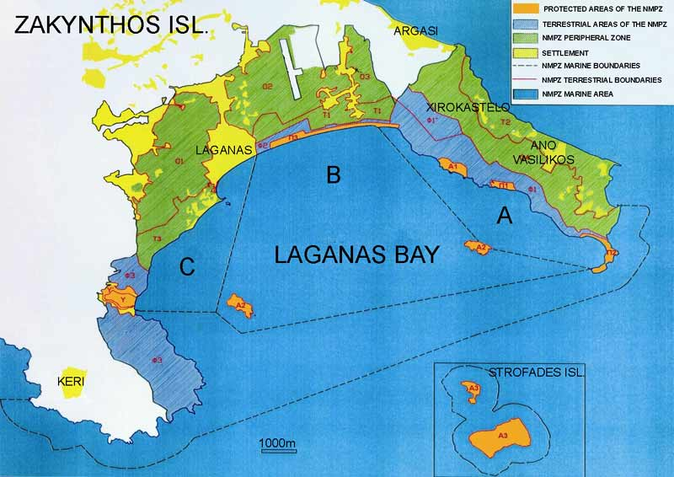
Violations of National and EU Legislation & Lack of Enforcement of Zakynthos National Marine Park (ZNMP) Protection Measures
SURVEY 2021
Zakynthos (Laganas Bay)
Hosts one of the largest Loggerhead sea turtle breeding aggregations in the Mediterranean (Av. 1,200* nests/yr1). During 2021 nesting season over 1,300* nests were recorded
Nesting primarily occurs along six beaches, approx. 5.5km
The ZNMP was established in 1999 and the Management Agency (MA) in 2000
* Data provided by ARCHELON
Maritime zonation of the NMPZ

Slide 3
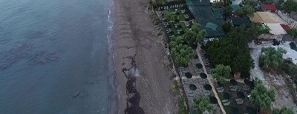
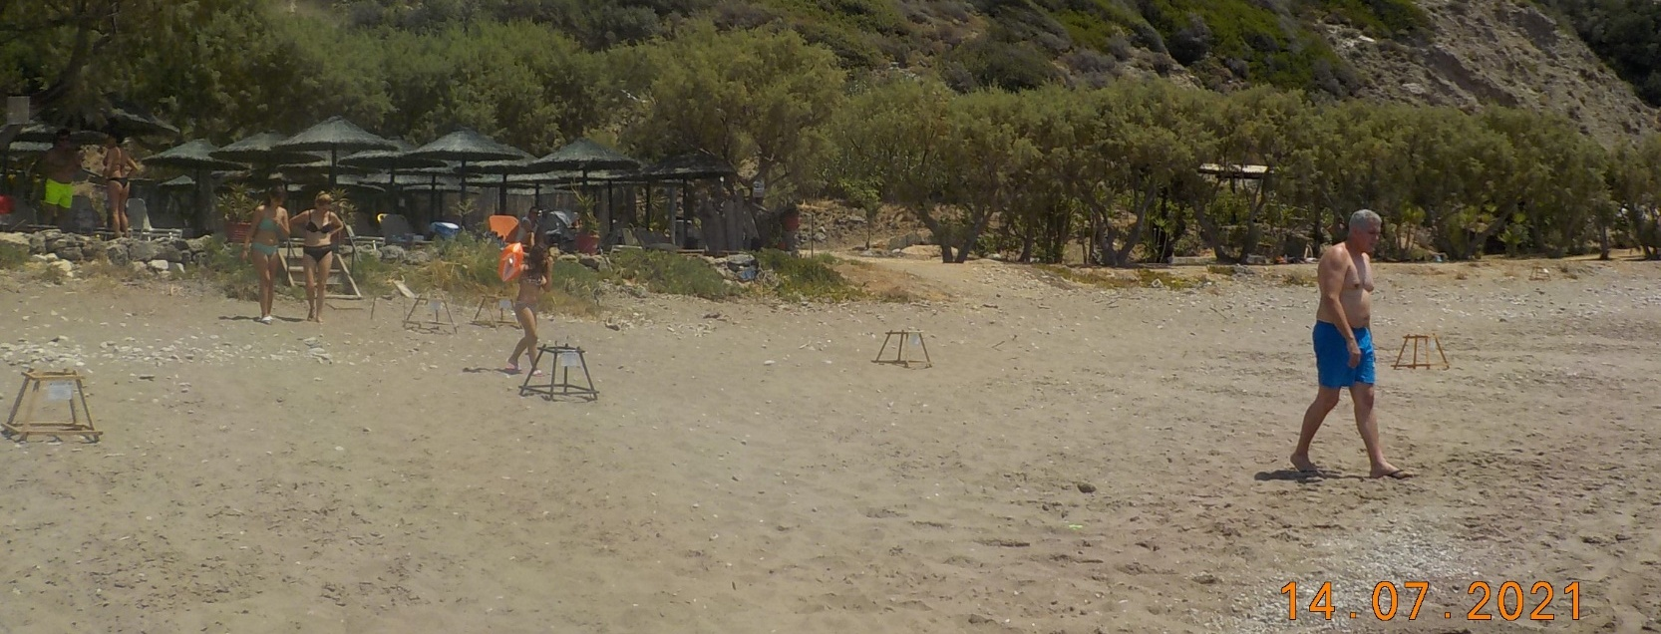
VIOLATIONS OF Recommendation. No 9 (1987)
(Measure No 1) Remove the prefabricated houses in Dafni
Illegal Constructions & lack of compliance
ARCHELON
SURVEY 2021
(a)
Illegal construction and expansion of businesses have continued to operate unhindered on the protected sand dune system, behind Daphni nesting beach.
The sand dune system has now been completely destroyed.
Lack of zonation management on nesting beach. Visitors are able to walked in-between and in close proximity to caged nests.
ARCHELON
(b)
(c)
©ARCHELON 2021: Daphni
(a)
(b)
©MEDASSET 2021: Daphni

Slide 4
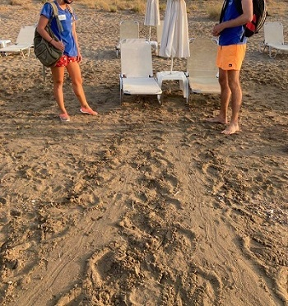
VIOLATIONS OF Recommendation. No 9 (1987)
(Measure No 5) Remove trees and ban and penalize the use of deck chairs, sunshades and pedalos on the nesting beaches of Gerakas, Kalamaki, eastern Laganas and Marathonisi
ARCHELON
©ARCHELON 2021:
(a)
FAILED NESTING ATTEMPT
ARCHELON
©MEDASSET 2021: Laganas East
(c)
(b)
No sunbeds were observed to be removed from the front of the beaches at night; all were placed on their sides in-situ.
(a)
(b)
Maximum permitted No. of umbrellas & sunbeds was greatly exceeded :
Laganas east and Kalamaki nesting beaches: 645 on 15th July and 683 in August (Arhcelon) instead of 450 permitted
Gerakas: 188 sunbeds in August (Arhcelon) instead of 120 permitted
Increases in beach furniture and failure to remove from the front of the nesting beaches, increases obstacles for both emerging females to reach the suitable beach nesting areas and emerging hatchlings reaching the sea.

Slide 5
VIOLATIONS OF Recommendation. No 9 (1987)
(Measure No 5) Remove trees and ban and penalize the use of deck chairs, sunshades and pedalos on the nesting beaches of Gerakas, Kalamaki, eastern Laganas and Marathonisi
ARCHELON
SURVEY 2021
(a)
ARCHELON
Number of boats anchored along the nesting beach of Marathonisi greatly exceeded the maximum limit of 10 at any one time. (19 boats counted at 15:15 on 15th July 2021).
No sea platform was observed at the time of the survey.
©MEDASSET 2021: Marathonisi
(b)
(c)
(a)
(b)
©MEDASSET 2021: Marathonisi

Slide 6
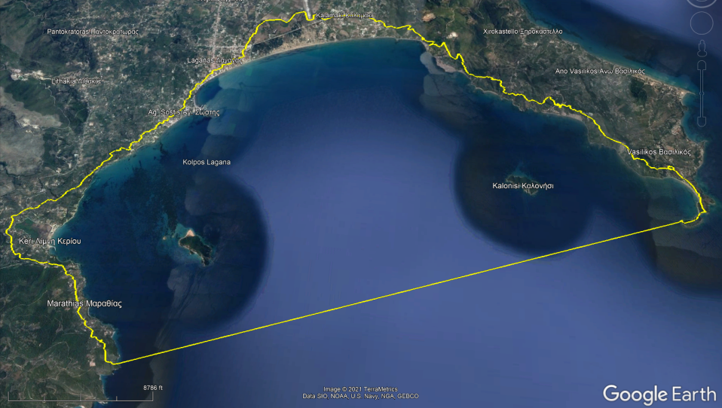
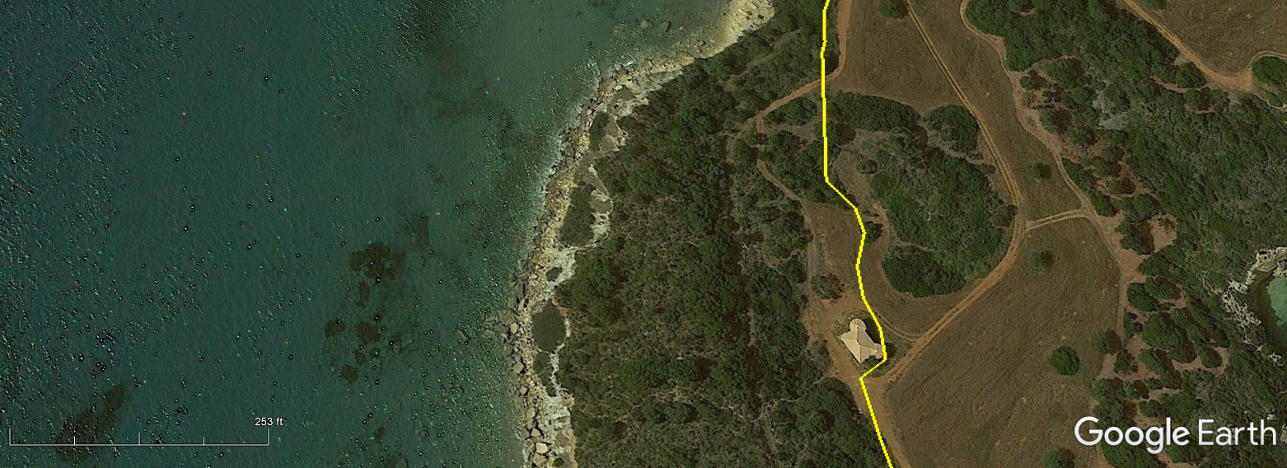
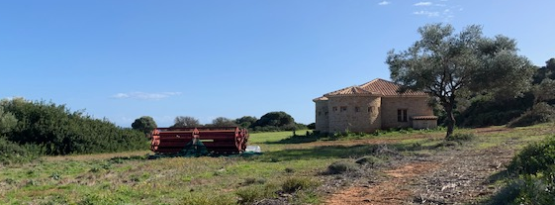
VIOLATIONS OF NATIONAL LEGISLATION – ILLEGAL DEVELOPMENTS
Gerakas - Ιllegal constructions & lack of compliance
SURVEY 2021
Google Earth Image 05/2020
Illegal building at Gerakas built in 2017 within the boundary of the Natura 2000 site has yet to be demolished.
Natura 2000 site GR2210002 is defined in Google Earth maps (top) by the yellow line. Boundary taken from https://natura2000.eea.europa.eu/ . White star on map insert shows location of illegal building.
ARCHELON
© WWF GREECE 2020

Slide 7
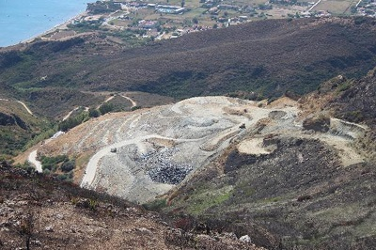
VIOLATIONS OF NATIONAL LEGISLATION- ILLEGAL DEVELOPMENTS
Illegal landfill not restored
SURVEY 2021
The saturated illegal landfill that operated within the ZNMP boundaries and the Natura 2000 site has still to be restored despite its closure since December 2017
ARCHELON
©ARCHELON 2021

Slide 8
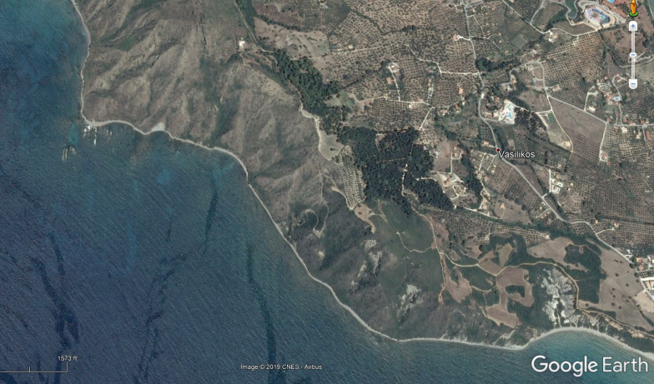
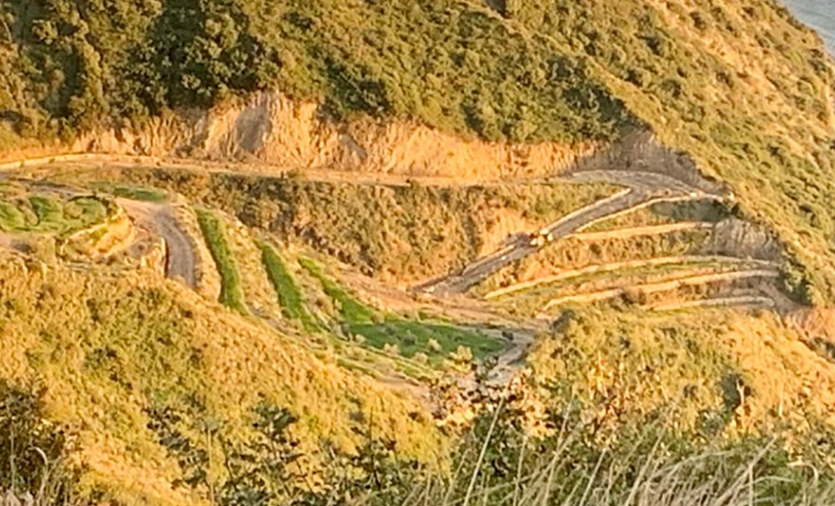
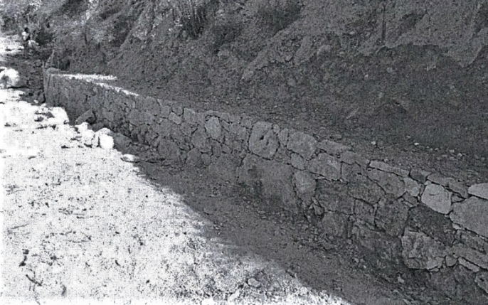
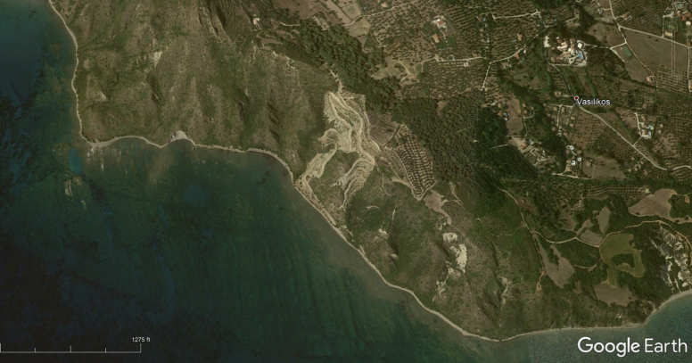
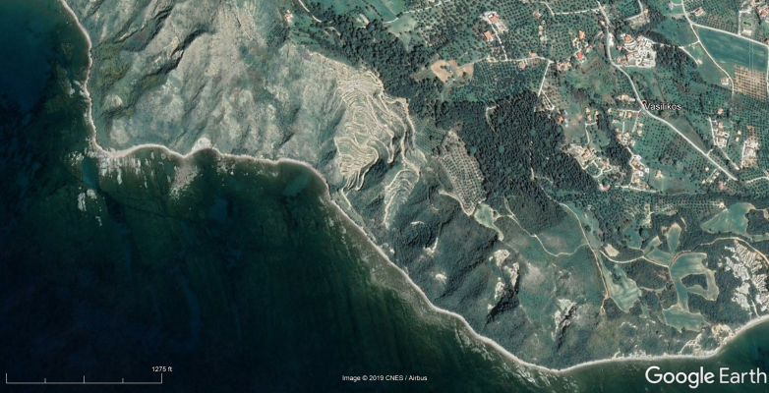
VIOLATIONS OF NATIONAL LEGISLATION – ILLEGAL DEVELOPMENTS
Ιllegal constructions & lack of compliance
SURVEY 2021
2017
Pre illegal Construction: Google Earth Image captured: 13th April 2013
Illegal Road
2013
2019
Post illegal Construction: Google Earth Image captured: 28th June 2017
© WWF GREECE 2020
© WWF GREECE 2020
Despite the issue of fines and orders after the construction and for the restoration of the illegal road since 2016, further illegal construction works have been observed during 2021, with the reinforcement of a stone wall along the illegal road.
Post illegal Construction: Google Earth Image captured: 24th March 2019

Slide 9
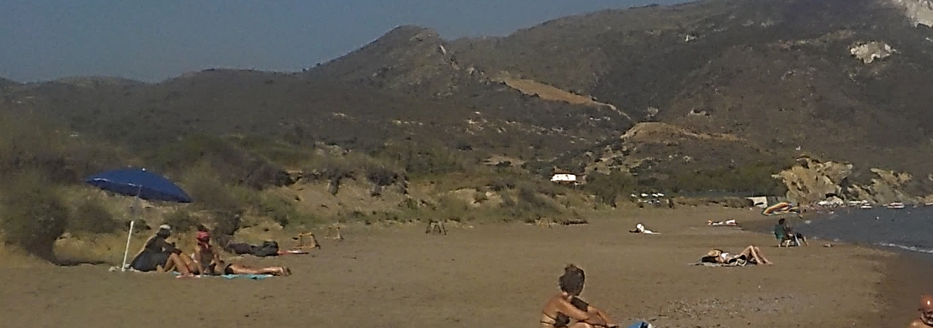
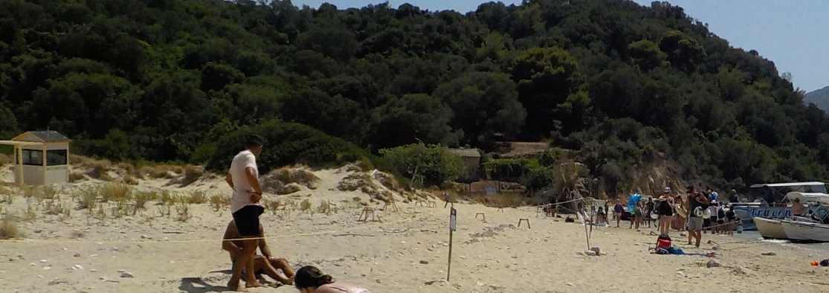
Insufficient presence of wardens resulting in a lack of enforcement
of protective management measures on nesting beaches:
Non compliance by beach users in restricted nesting areas during the day
©MEDASSET 2021: Laganas East
Visitors
©MEDASSET 2021: Laganas East
©MEDASSET 2021: Laganas East
Visitors located at the back of Laganas East nesting beach (red arrows), one group observed using an umbrella. White stars show location of caged nests.
©MEDASSET 2021: Laganas East
NMP sign & rope
Visitors on Laganas East walking along the back of the beach next to a closed warden hut, through a high density nesting area. Caged nests highlighted by stars.
©MEDASSET 2021: Marathonisi
People entering the restricted roped nesting areas on Marathonisi Islet

Slide 10
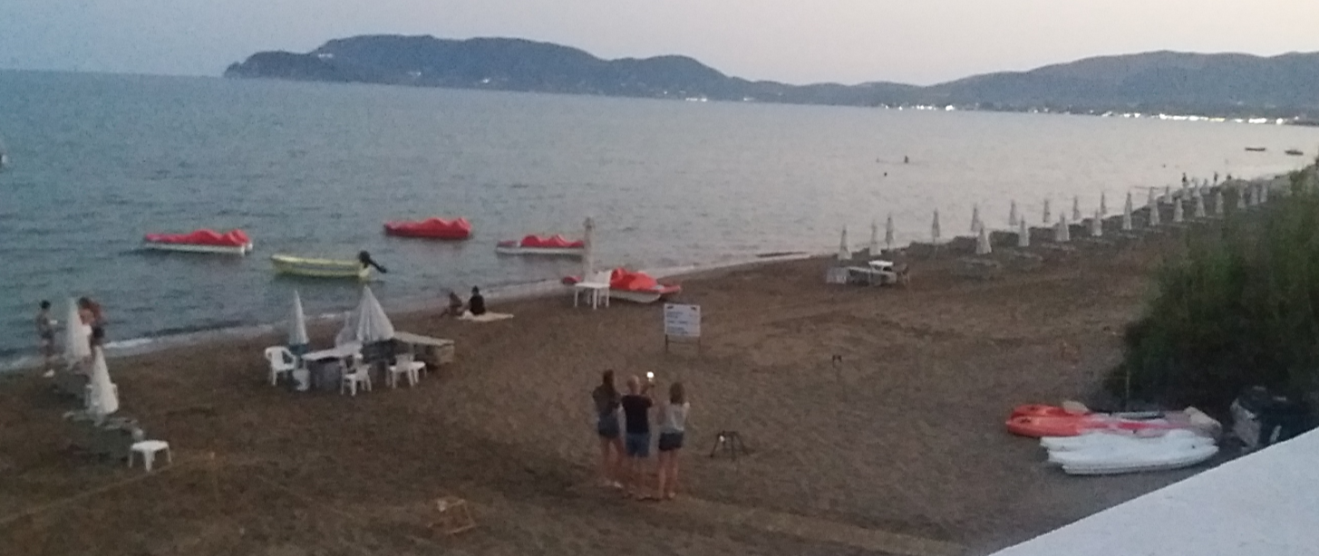
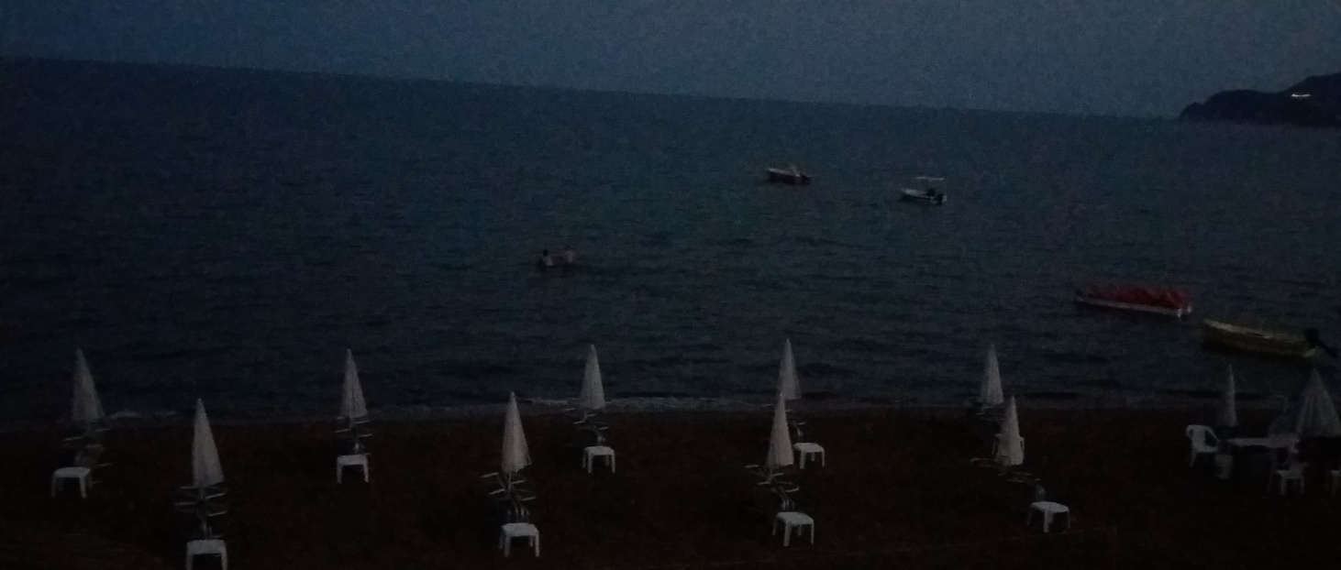
Insufficient presence of wardens resulting in a lack of enforcement of protective management measures on nesting beaches:
Violations of restricted access to the nesting beaches at night
SURVEY 2021
Photo taken 14/07/2021 at 21:19
Lack of wardens at Kalamaki nesting beach enabled visitors to freely access and remain on Kalamaki nesting beach after sunset.
The presence of humans on the nesting beaches at night presents a significant threat and risk of disturbing nesting females during this sensitive period.
©MEDASSET 2021: Kalamaki
Photo taken 14/07/2021 at 21:27 of swimmers
©MEDASSET 2021: Kalamaki

Slide 11
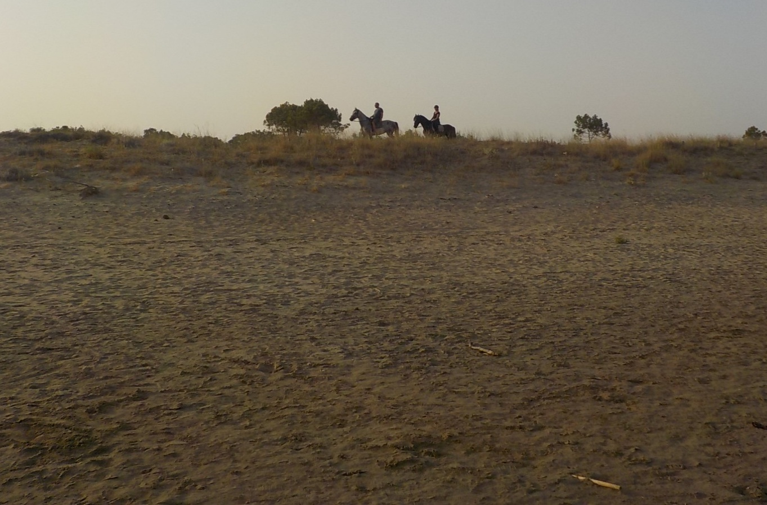
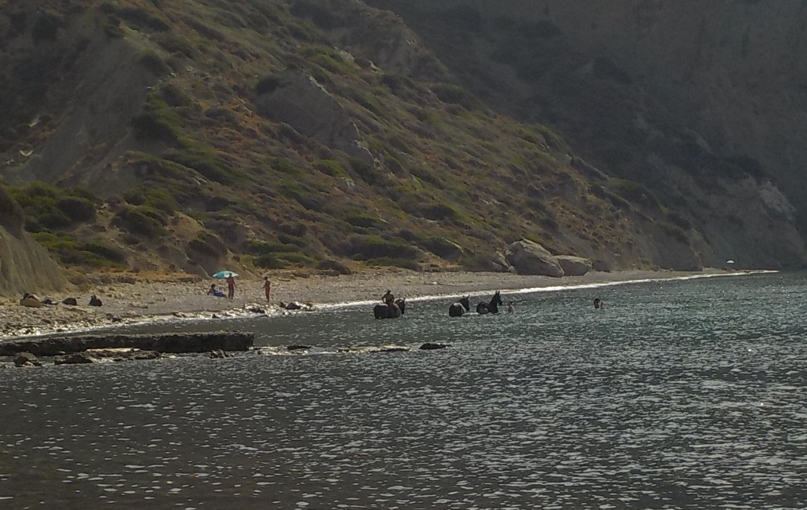
Lack of enforcement of protective management measures on nesting beaches:
SURVEY 2021
©MEDASSET 2021: Vrondonero
©MEDASSET 2021: Laganas East
Horse riding tours observed numerous times on the protected sand dunes of Laganas East
Horse riding tour at Vrondonero nesting beach

Slide 12
Insufficient presence of wardens resulting in a lack of enforcement of protective management measures in the Maritime Area:
Violations of the Bay’s Maritime speed restriction (Max. 6 knots)
SURVEY 2021
Numerous observations of boats exceeding the NMP 6 knot speed limit.
During 2021 2* fatalities were recorded by ARCHELON/NMP wardens with attributed collision injures
PHOTOS: a boat greatly exceeding the 6 knot speed limit.
* Data provided by ARCHELON
©MEDASSET 2021: Maritime Area
©MEDASSET 2021: Maritime Area
©MEDASSET 2021: Maritime Area

Slide 13
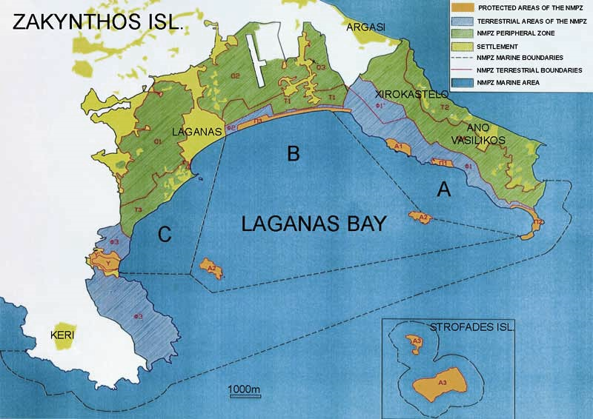
Insufficient presence of wardens resulting in a lack of enforcement of protective management measures in the Maritime Area:
Violations of Maritime Zonation regulations
SURVEY 2021
©MEDASSET 2021:Marathonisi Islet Zone B
Numerous vessels (private and tourist hire) observed anchored in Zone B and in the prohibited area of Zone A
Red star shows the approximate locations of the photos taken.
©ARCHELON 2021: Gerakas Zone A

Slide 14
At National Level
National governance framework for the management of the protected areas has been fundamentally changed with 36 Management Agencies reformed into 25 new Management Units- supervised and coordinated by “OFYPEKA”.
Great concerns also evoke the new national laws, which remove funding and responsibilities for biodiversity conservation from the newly formed “OFYPEKA”.

Slide 15
Conclusions
SURVEY 2021
Extreme pressure in Laganas Bay due to:
Tourism though not representative due to Covid-19
Poor implementation/ enforcement of EU, National Environment Legislation, PD and ZNMP Management Agency Measures
ZNMP’s Management Agency lack of financial resources and staffing.
Uncontrolled maritime activity

Slide 16
MEDASSET
Mediterranean Association to Save the Sea Turtles
SURVEY 2021
Calls on the Greek Government to:
Increase and secure funding to the ZNMP Management Agency
Enforce EU, National and NMPZ PD regulations Impose, implement and enforce appropriate fines and penalties to deter further illegal activity
Take action to stop operation of illegal businesses in Daphni & restore the habitat
Calls on the Standing Committee of the Bern Convention to:
Keep open the case file of Zakynthos, Laganas Bay
Follow-up through the Greek Government Recommendation No 9, and in particular Measure No 1 regarding Daphni
Perform an on-the- spot appraisal of Laganas Bay’s nesting beaches, in order to update and amend Recommendation No 9

