Slide 1

MENTAL HEALTH
Carné Joven de Aragón

Slide 2

Psychological Counseling
Free
14 -30 years
Confidential
Legal Advice
Free
14 -30 years
Confidential

Slide 3

Psychological Counseling
Due to the enormous increase in mental disorders during the pandemic
€
Price - the treatment is too expensive.
Shame - there is a serious problem of stigma in the field of mental health.
The last two years have highlighted the urgent need to improve mental health, especially among adolescents and young people, while investing significant financial resources in providing tailored responses and preventing more complex crises

Slide 4
How does Psychological Counseling work?
1h/session
There is a professional, a psychologist
They have to set a date online
Individual
https://www.aragon.es/-/asesoria-de-bienestar-emocional-para-jovenes

Slide 5
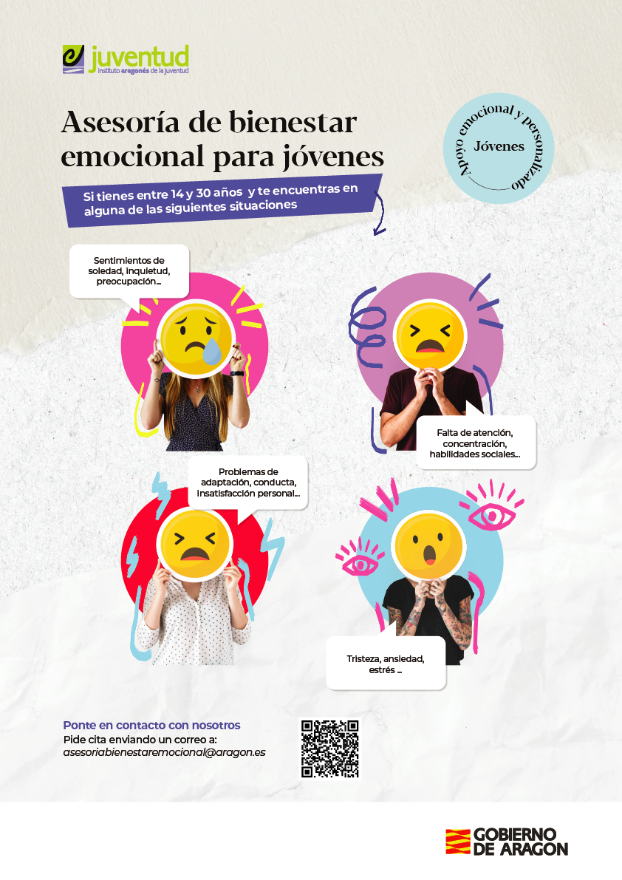
Psychological Counseling
Studies show that early intervention and initial treatment reduce the chance of exacerbation of a mental health-related condition, and even the onset of severe mental illness
There have been 230 psychological appointments until now (9 months)
The appointments take place in the facilities of the ‘Instituto Aragonés de la Juventud’

Slide 6


Legal Advice

Slide 7

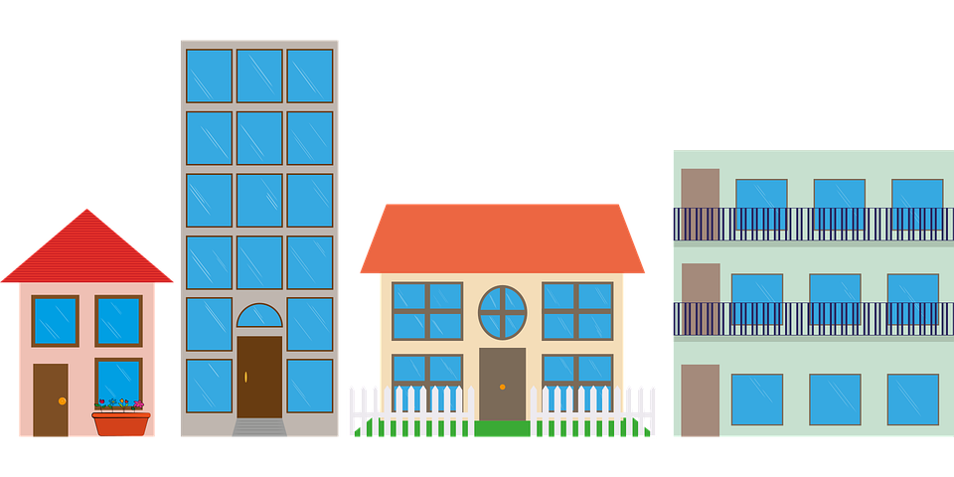
What topics do young people consult about?
Young people are among the most affected by the economic crisis as a result of the COVID‑19 pandemic
Job
Housing
Administrative Procedure
Purchase
About half of young people’s households have suffered some form of job-related disruption
e.g. Problems with rent
Fines for not wearing a mask
More than one in three young people report financial difficulties since the start of the pandemic.

Slide 8
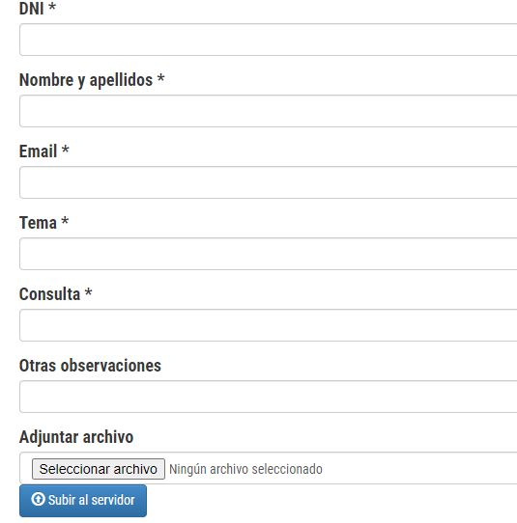
Legal Advice
1
They have to complete a form in our web
Despite being red, Mars is a cold place. It’s full of iron dust
2
Then, our lawyer contact them by email or phone
Neptune is the fourth-largest planet in the Slar System
The aim of this legal advice is to provide our users relevant information on theirs legal rights
It’s a gas giant and the biggest planet in the Solar System

Slide 9
Legal Advice
What kind of subjects worry to young people?
Unemployment benefit | 43,74%
Job | 27,55%
Accommodation | 16,19%
Freelance | 4,67%
Trips | 4,17%
Others | 3,67%
During the coronavirus (COVID-19) outbreak young people have needed legal advice.
h
Despite being red, Mars is a cold place. It’s full of iron dust
During the pandemic the service increased 42%
Then, our lawyer contact them by email or phone
599 queries in 10 months
(march - december)
It’s a gas giant and the biggest planet in the Solar System

Slide 10

h
Despite being red, Mars is a cold place. It’s full of iron dust
Then, our lawyer contact them by email or phone
It’s a gas giant and the biggest planet in the Solar System

