Slide 1
10th Platform CoE QL youth centres
18.06.2019

Slide 2
Some dates
2008: issue « relations ENYC and CoE »
2009: developing the concept for a QL
February 2010: 1st platform
January 2012: 1st exploratory visit to a YC
2014: 1st training
2018: new format of platform

Slide 3
2012: Adrasan (Turkey)

Slide 4
2012: Brezice

Slide 5
2013: North Pole ?
2013: Kokkola

Slide 6
2013: Kokkola

Slide 7
2014: Sremski Karlovci

Slide 8
2014: Lisbon
(in depth analysis)

Slide 9
2015: Destelheide

Slide 10
2015: Mollina

Slide 11
2015: Timisoara

Slide 12
2016: Killarney

Slide 13
2016: Stara Zagora

Slide 14
2017: Marienthal

Slide 15
2017: Plovdiv

Slide 16
Typical youth representative

Slide 17
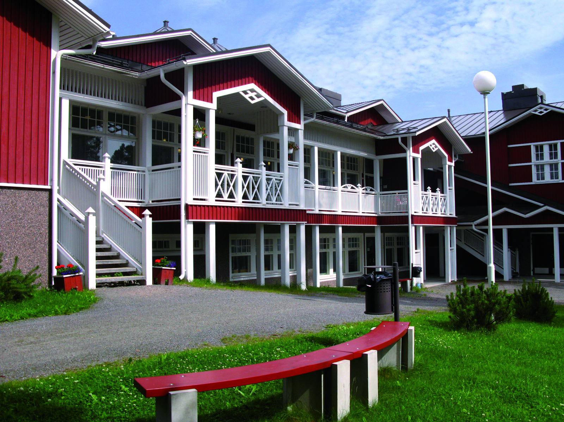
2018: Martinnen

Slide 18
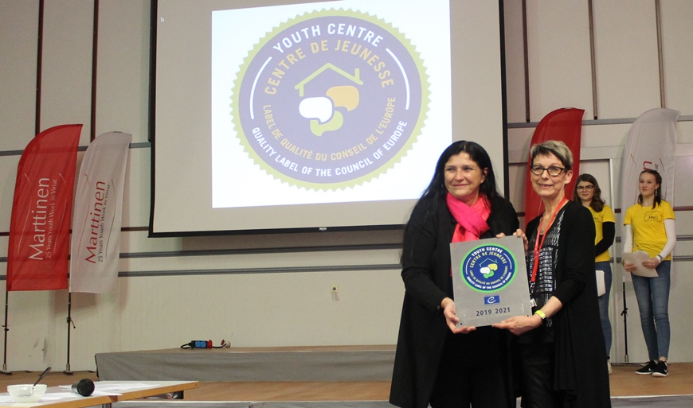
2018: Martinnen

Slide 19
2018: Berlin

Slide 20
Lessons learned
Some elements we didn’t foresee:
difficulty to reach out to the youth centres
diversity of youth centres
needs of the youth sector for guidance on quality
difficulty of the YC to contribute to the process
difficulty to link YC to the CoE values

Slide 21
Lessons learned
Some things that we should have done differently:
develop a consistent documentation first
be more selective
think more in terms of sustainability
focus on quality issues right from the start
reflect more in depth on the possibilities of bilateral and multilateral cooperation

Slide 22
Perspectives
Some ideas for the future:
focus (only) on issues related to quality during platforms
promote bilateral and multilateral cooperations
develop documentation of good practice, particularly in the fields where YC have difficulties

Slide 23
Great !
it is a great initiative
there are great youth centres
there are great opportunities
The project has a great future

