Slide 1
PRELIMINARY REPORT
LoKMeFiND Project Local Knowledge and Media Against Natural Disasters
by
Ferruccio Ferrigni
Zagreb, November 6-7 2018

Slide 2
YEAR 1 - SCHEDULED ACTIVITIES
Preliminary analysis of LK’s evidence in media, before/after disasters
Workshop between experts and journalists (WS1) to define analysis criteria and sites where implementing Pilot Project (PP)

Slide 3
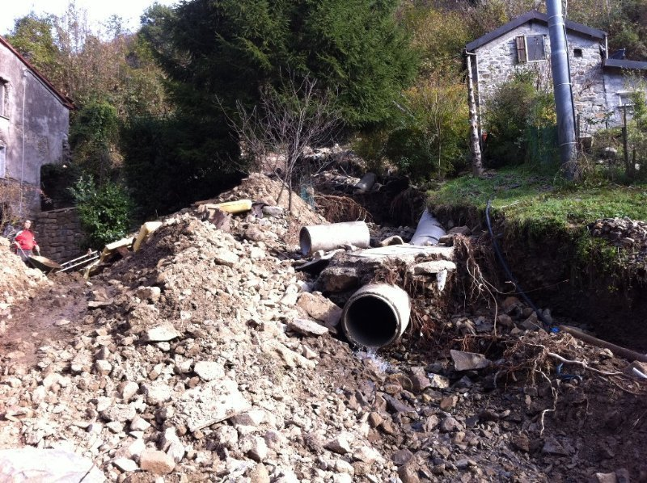
THE FLASH FLOOD IN FERDANA AND UNHEEDED WARNING
“Complaints without reaction"

Slide 4
BEFORE THE EVENT
Event? forecast
Prevention? failed
Why? «no funds for river’s maintenance»

Slide 5
AFTER THE EVENT
Civil Protection:
«quickly the river’s maintenance»

Slide 6
CULTURE AGAINST DISASTERS: FEASIBLE? USEFULL?
International Conference
CULTURE AGAINST DISASTERS
In the frame of
LoKMeFiND Project Local Knowledge and Media Against Natural Disasters
by
Ferruccio Ferrigni
Ravello, September 28 2018

Slide 7
CULTURE AGAINST DISASTERS: FEASIBLE? USEFULL?
Part one
TOWARD AN OVERTURNED APPROACH
The conceptual basis
The elements of CLs: tested by all local natural events
An overturned approcah: saving CL as disasters prevention action is usefull. Is it feasible too?
Part two
PROBLEMS AND POTENTIALITIES
Systemic elements of CLs: traditional / present
Problems in recovering the CLs’ traditional elements
The Local Knowledge’ s (LK) hidden potentialities in disasters prevention al human sustainable development
The role of media in recovering the LK

Slide 8
SOME DATA
22 + 24 presentations
10 news in media (3 in national newspapers)
Participants:
European Landscape Convention
Ministry of Agricultural, Food and Forestry Policies
Ministry of Cultural Heritage
Civil Protection Department
Agriculture Department of the Campania Region
Experts from Greek and Algerian research centres
Representatives from two of Italian cultural landscapes (Cinque Terre, Amalfi Coast)

Slide 9
THE NO-CULTURAL ORIGINS
OF CULTURAL LANDSCAPES

Slide 10
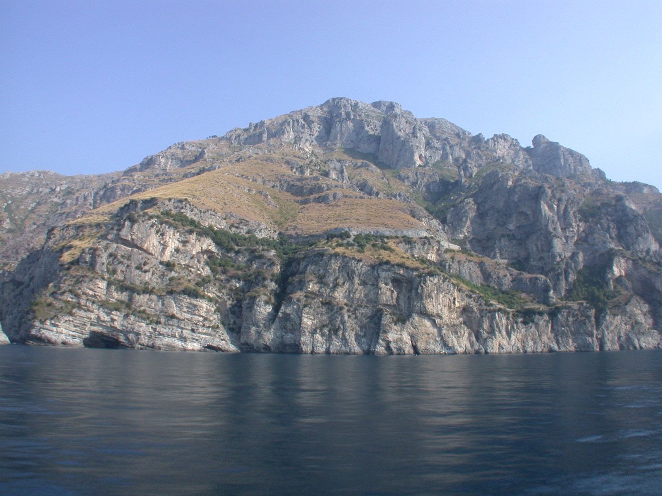
THE AMALFI COAST: RESULT OF A DEEP «ALTERATION»
Today
At century X

Slide 11
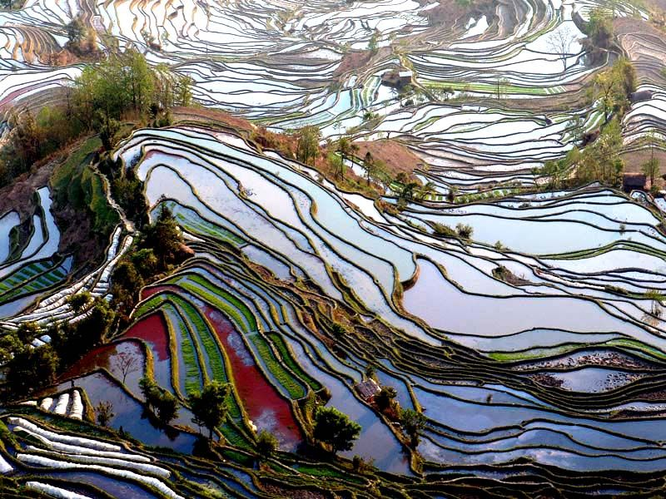
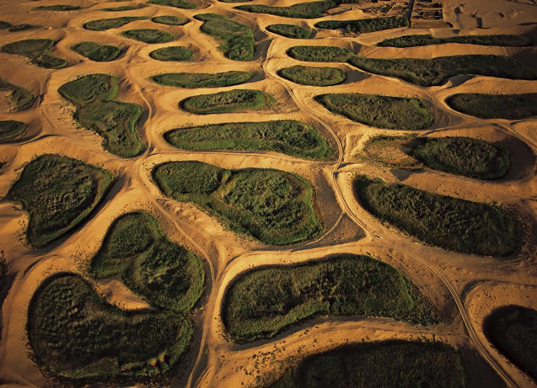
LANDSCAPE’S GRAPHISM AS RESULT OF SEARCHING BENEFTS

Slide 12
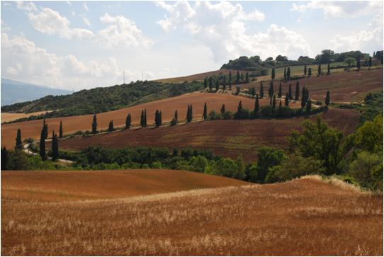
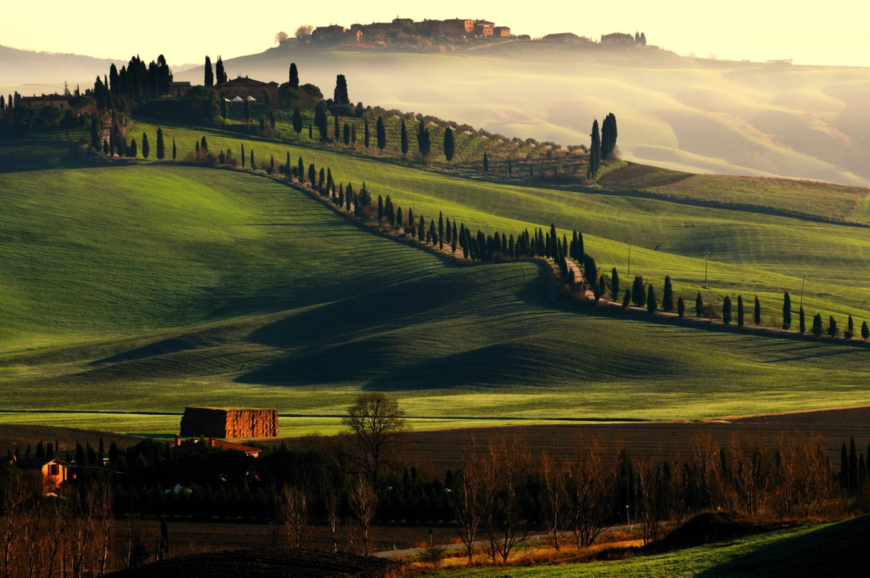
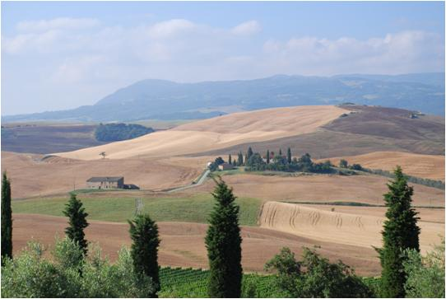
…. SOMETIME ARE HIDDEN

Slide 13
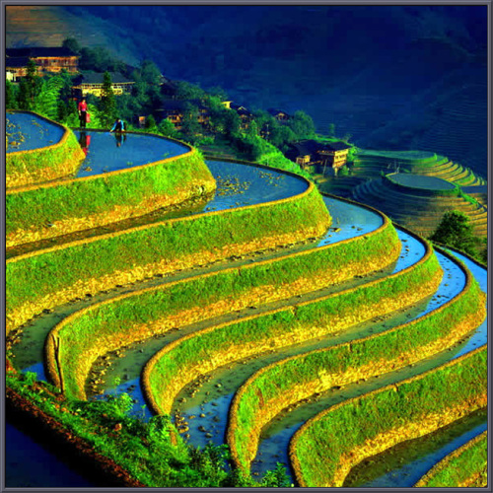
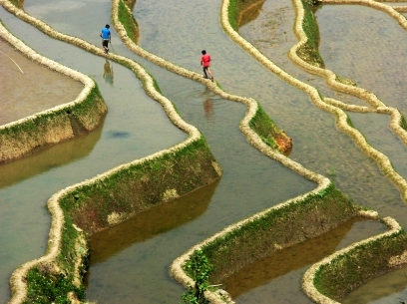
MORPHOLOGY + CLIMATE + LOCAL CULTURE = A PERFECT SCENE
(but a very eficient agro-system + an effective landslide prevention too)

Slide 14
THE FUNCTIONAL ELEMENTS OF THE BENEFITS SEARCHING
Soil adaptation
Water and irrigation management
Choise of “right” cultivations
and
Complete knowledge on cumulated effects of land modifications

Slide 15
IN CULTURAL LANDSCAPES
SOIL ADAPTATION, IRRIGATION SYSTEMS AND CULTIVATIONS
HAS BEEN POSITIVELY TESTED
BY HUNDRED OF EXTREME EVENTS
SAVING CULTURAL LANDSCAPES
CAN PREVENT LOCAL NATURAL DISASTERS
FEASIBLE TOO?

Slide 16
THE TRADITIONAL/CURRENT SYSTEMIC ELEMENTS OF CULTURAL LANDSCAPES

Slide 17
THE CHANGE OF SYSTEMIC ELEMENTS
AT ORIGIN
TODAY
UTILISATION
Agriculture
(necessarly sustainable)
Tourism
Ofen no-sustainable
PROFIT
Direct, immediate
Indirect, future
Diffused,
communitary
KNOWLEDGE
Just specialists
GOVERNANCE
One power
Multiple powers

Slide 18
SOME MISUNDERSTANDING TO REMOVE
To safe the CL is necessary forbid any trasformation
The safeguard of CL is alternative to the economic developpment
TODAY
THE PROTECTION OF CULTURAL HERITAGE IS CONSIDERED AS AN EFFECTIVE ACTION FOR SUSTAINABLE DEVELOPMENT.

Slide 19
PROBLEMS IN RECOVERING OF CLs’ TRADITIONAL ELEMENTS

Slide 20
KNOWLEDGE

Slide 21
A POLITICAL QUESTION
How stimulate the decision makers and researchers don’t considering as surpassed the traditional disaster proof techniques?

Slide 22
SOME METHODOLOCICAL QUESTIONS
To protect Cultural Landscape can we use both our knowledge and the ancient one?
How can we recognize it?
How can we validate it?
How can we improuve the historical techniques, if usefull?
How can we define protocols to validate no-standard techniques?

Slide 23
NEWS / NO NEWS
SYSTEMIC ORIGINS – Media environment
The unveiling of a new building is “a news”
The territory’s appropriate and continuous maintenance is “a no news”
The people’s knowledge about the local risks is “a news” after the event
It’s «a no news» before
BUT THE MEDIA RULES ARE STRONG: NOT INTERESTING, NO PUBLISHING

Slide 24
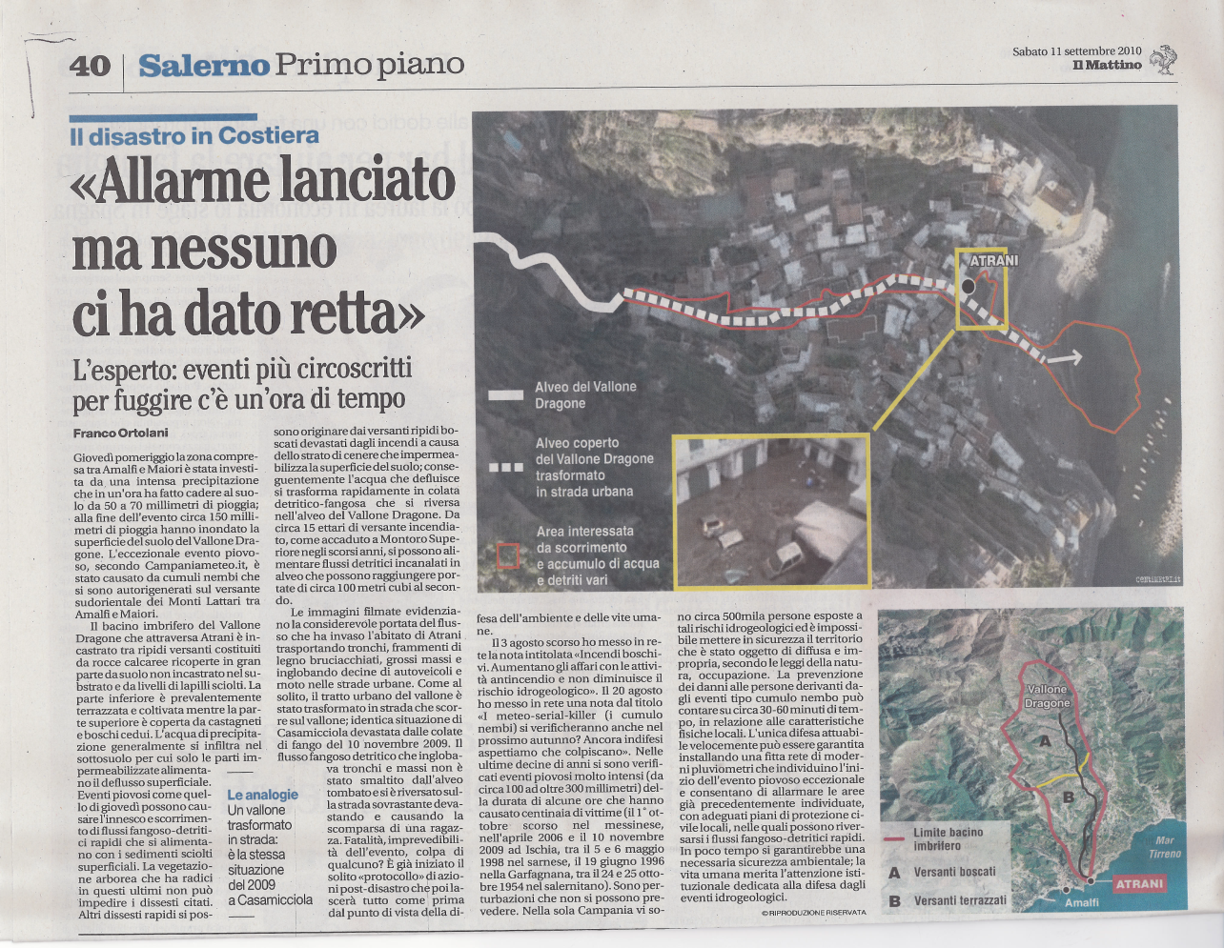
THE IGNORED LOCAL KNOWLEDGE
Often media services covering local disasters (avalanche, landslide, floods) record that people on the spot knew very well the hazard, but that authorithies have systematically ignored warnings and worries.
We sounded the alarm
but nobody heeded us

Slide 25
THE POTENTIALITIES OF THE «LOCAL RISK CULTURE»
The local knowledge is based on the effects of the events. So it’s inevitably «integrated»
The deep knowledge of the territory, of his history and of the local risks can offer more detailed informations to the experts
The local knowledge is a «complementary expertise» available free of charge
By involving the local population a permanent and more efficient monitoring can be organized

Slide 26
It’s possible a more effective contribution of media to disasters reduction?

Slide 27
SOME CONSIDERATIONS
Audience of specialized magazines protecting consumers' interests and
Interventions imposed to producers thanks to media campaigns
The media can contribute in a determinant way to turn people's fears/suggestions into changes in policies.
Programmes protecting land's consumers against risk situations may be egually interesting?
Becoming profitable for publishers. could they be useful support to disaster reduction public actions?

Slide 28
THE MAIN OUTPUT OF THE CONFERENCE
Conservation of cultural landscapes can be considered a means to prevent risk
A pilot project in order to develop a methodology with a bottom-up approach will be developed, with the leadership of CUEBC.
The Faro Convention methodology will be further explored to be utilized in this process.
The progress of the project elaboration will be shared with all relevant staeholders and media
Ministry of Culture, Ifalian Civil Protection, Campania Region and media declared to be interested to collaborate with EUR-OPA in implementing a PP involving two UNESCO italian CLs, Algeria and an other Mediterranean countrry

Slide 29
THE DEBATE IS OPEN
and
THANK YOU

