Slide 1
EURO-MEDITERRANEAN CENTRE ON INSULAR COASTAL DYNAMICS
(Malta)
Anton Micallef

Slide 2
Co-ordinator: Anton Micallef, ICoD, Malta Partners CERG / University of Normandy, France University of Modena, Italy
2018 Project Leader
Hazard & vulnerability assessment – the path to identifying Risk

Slide 3
2018
Specific objective
Identification of hazards & susceptibility in selected coastal areas of Malta & Normandy.
Expected results & deliverables
Production of susceptibility & hazards maps for selected coastal areas of Normandy, Malta & Gozo.
Deliverables
Susceptibility & hazard maps for selected coastal areas in Normandy, Malta / Gozo.

Slide 5
2018 RESULTS
Susceptibility mapping for selected coastlines in Malta
(North-Eastern coast of Gozo)

Slide 6
2918 RESULTS
Susceptibility mapping for selected coastlines in Malta
(North-Eastern coast of Gozo)

Slide 7
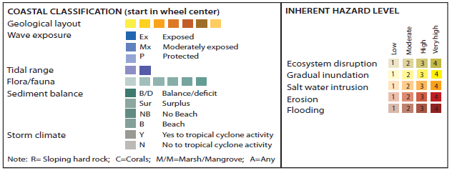
Coastal erosion
hazard
Notes:
Figure 2: A modified presentation of the Coastal Hazard Wheel Version 2.0, adapted from Appelquist, (2014) after application to the Maltese coast.
As an example, the CHW layer consideration for a wave exposed, micro-tidal, un-vegetated sloping soft rock coast having a unclear sediment balance and exposed to possible cyclonic storms and a very high level of coastal erosion hazard (SR-1 coded coastal environment) is highlighted by red borders.

Slide 8
Notes:
Figure 2: A modified presentation of the Coastal Hazard Wheel Version 2.0, adapted from Appelquist, (2014) after application to the Maltese coast.
As an example, the CHW layer consideration for a wave exposed, micro-tidal, un-vegetated sloping soft rock coast having a unclear sediment balance and exposed to possible cyclonic storms and a very high level of coastal erosion hazard (SR-1 coded coastal environment) is highlighted by red borders.

Slide 9
Notes:
Figure 2: A modified presentation of the Coastal Hazard Wheel Version 2.0, adapted from Appelquist, (2014) after application to the Maltese coast.
As an example, the CHW layer consideration for a wave exposed, micro-tidal, un-vegetated sloping soft rock coast having a unclear sediment balance and exposed to possible cyclonic storms and a very high level of coastal erosion hazard (SR-1 coded coastal environment) is highlighted by red borders.

Slide 10
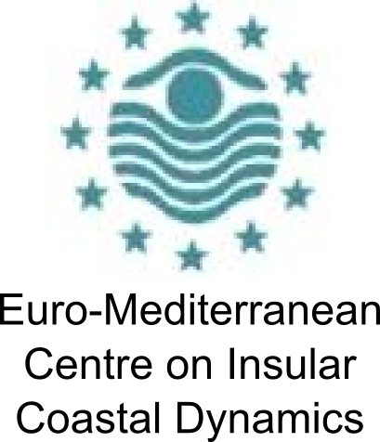
2019 Proposal: Vulnerability mapping
Workshop
“From hazard to vulnerability assessment in coastal areas: State of the art and perspectives”
Department of Chemical and Geological Sciences
University of Modena and Reggio Emilia
Meeting room 050 – 2nd floor
Modena, 17 October 2018

Slide 11
Methodology - Exposure assessment
Exposure and Vulnerability analysis
(EUROSION PROJECT)
Exposure assessment - EUROSION PROJECT (2004)
Population living in RICE (ISTAT, 2011)
Percentage of Urban area in RICE (CLC 2012)
Percentage of Natural area in RICE (CLC 2012)
Percentage increase in urban area in 10 km (CLC 2001; 2012)
Coastal Socio-Economic index (CSI)
CSI = P_RICE+U_RICE_E_RICE+U_10km
CSI | <=2 | 3 – 5 | 6 – 8 | ≥9
S | S1 | S2 | S3 | S4
Increasing socio-economic value
RICE - Radius of Influence of Coastal Erosion and Flooding
< 5 m a.s.l. and or 500 m from the coastline

Slide 12
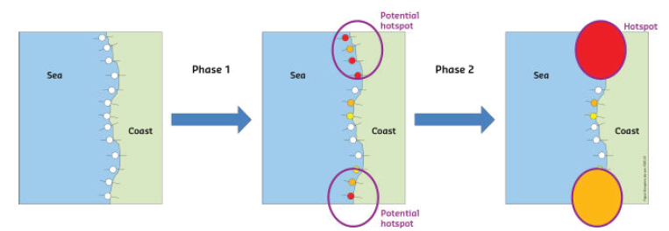
Methodology - Exposure assessment
Exposure and Vulnerability analysis
(RISC-KIT PROJECT METHODOLOGY)
Resilience Increasing Strategies for Coasts Toolkit (RISC-KIT)
Land use (CUAS, 2009; CLC, 2012)
Social vulnerability (ISTAT, 2011)
Transport Networks
(Photointerpretation)
Utilities
Business (Photointerpretation)
Coastal Risk Assessment Framework (CRAF)
CRAF
Phase 1
CRAF
Phase 2
Coastal_Exposure_Index =
(Exp_LU * Exp_SVu * Exp_Tr * Exp_U * Exp_Bs)^{1/5}
HOTSPOT IDENTIFICATION AND ANALYSIS
Van Dongeren A, Ciavola P, Martinez G, Viavattene C, Bogaard T, FerreiraO, Higgins R, McCall R (2017) Introduction to RISC-KIT: resilience-increasing strategies for coasts. Coast Eng.https ://doi.org/10.1016/j.coast aleng .2017.10.007

Slide 13
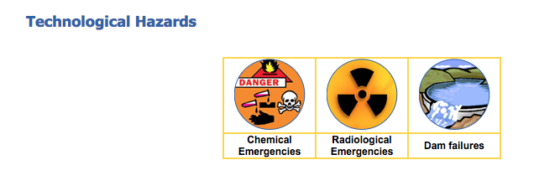
2018 Project Partner
BeSafeNet

Slide 14
Specific objectives:
Improve BeSafeNet website material.
Improve awareness & use of BeSafeNet initiative.
Activities carried out:
Improve text & presentation & completed website material regarding storm surges, sea-level rise, Tsunamis.
Preparation for organisation of BeSafeNet Olympiad competition.
Preparation of MCQs for use in Olympiad.

Slide 15
Results & deliverables:
Completed website modules on storm surges, sea level rise & Tsunamis.
Completed multiple choice questions.
Launched Olympiad competition
Promoted Olympiad locally

Slide 16
2018 Project Partner
BEACH & COASTAL RESORTS RISKS
2018 ICoD activities
Malta workshop
Participation to the IOC/UNESCO Tsunami Workshop-Preparing for the Next Tsunami: Reducing Losses and Damages in the Coastal Western Mediterranean Areas, Rabat 15-16 Nov 2018
Expected output
Introduction of Tsunami Ready Beach concept to local authorities & exploring feasibility / readiness for local implementation.
Notes:
Addressed to lifeguard associations, BM entities & tourism, professionals on risk culture, mitigation and dissemination
Under the auspices of the IOC of UNESCO, Tsunami Ready (TR-I) is an international performance-based community recognition pilot.
The initiative is modeled after the US NOAA National Weather Service’s successful TsunamiReady® Program.
Since June 20, 2001, the US National Weather Service (NWS) of the National Ocean and Atmospheric Administration (NOAA) has been implementing the recognition program, TsunamiReady®.
Coastal communities recognized by NWS are better prepared to save lives through better planning, education and awareness and emergency managers strengthened their local operations.
Recent tsunamis as in Japan (2011) and in Chile (2014, 2015) attest to the importance of readiness: when a tsunami arrives and communities are ready to respond, lives are saved and fewer people die.
This project aim to develop and implement seismic, tsunami and coastal risks mitigation. In particular the project intends to contribute for a Tsunami Ready Community working on two programs: a Tsunami Ready Beach (TRB) and a Tsunami Ready Hotel (TRH).
Besides, the project also intends to address other risks present on the beach.
All involved countries have a large coastal area which beaches are a holiday destination par excellence, and tourists are one of the most vulnerable groups concerning these risks. All the actions to be developed will be done in close collaboration with the local associations and authorities.
Relevance to EUR-OPA Medium Term Action Plan:
Using scientific and technological knowledge to better assess evolving risks and adapt accordingly the resilience strategies.
Promoting risk culture among population (children, adults and groups with special vulnerability).
Fostering population’s active participation (as individuals and as community) to DRR.

Slide 17
2019 proposal
Establishment of Tsunami Ready Beach (Hotel?) in Maltese Islands
Preparation & dissemination of TRB leaflets & beach signs aimed at raising beach user awareness
Participation to project seminar to present & discuss works carried out by all project partners.

Slide 18
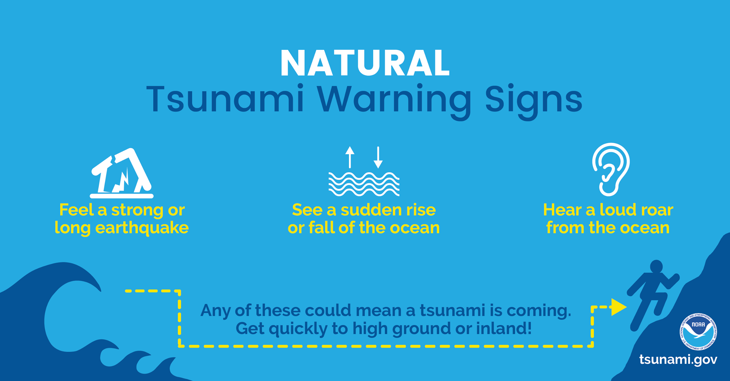
Project coordinator: CEMEC, San Marino, Meeting in San Marino, 29th September – 1st October, 2018 ICoD: contribution Tsunami & Flood Safety related information / warnings
2018 project partner Project AIDYOU

