Slide 1
COASTAL RISKS
By: NACER JABOUR
CEPRIS – RABAT - MOROCCO
EUROPEAN AND MEDITERRANEAN MAJOR HAZARDS AGREEMENT
(EUR-OPA)
JOINT MEETING OF THE COMMITTEE OF PERMANENT CORRESPONDENTS AND DIRECTORS OF SPECIALISED CENTRES
ZAGREB
6-7 NOVEMBER 2018

Slide 2
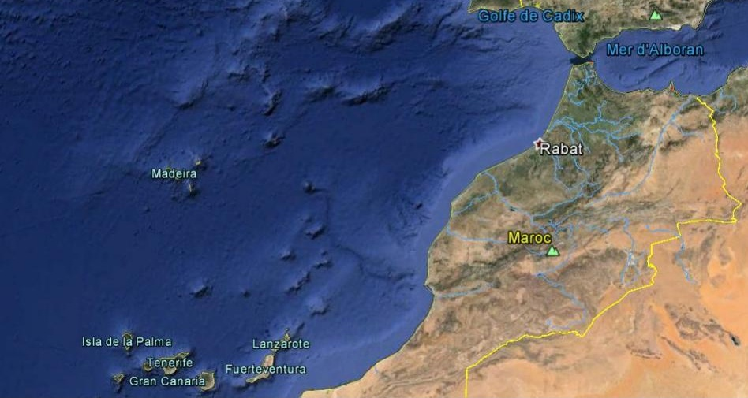
1755
1522
Tanger
Assila
Mahdia
Aljadida
Asfi
Location tsunamegenic earthquake in the Atlantic Ocean (1755). Sea mounts and islands are major tectonic and volcanic sources of tsunamis. The investigated coastal cities where the effects of tsunami waves were reported in historical documents.
TSUNAMI HAZARD AND RISK IN MOROCCO
WORKSHOP ON BEACH AND COASTAL RESORT RISKS
MALTA, 24th September 2018
Nacer Jabour
CEPRIS – Rabat - Morocco

Slide 3
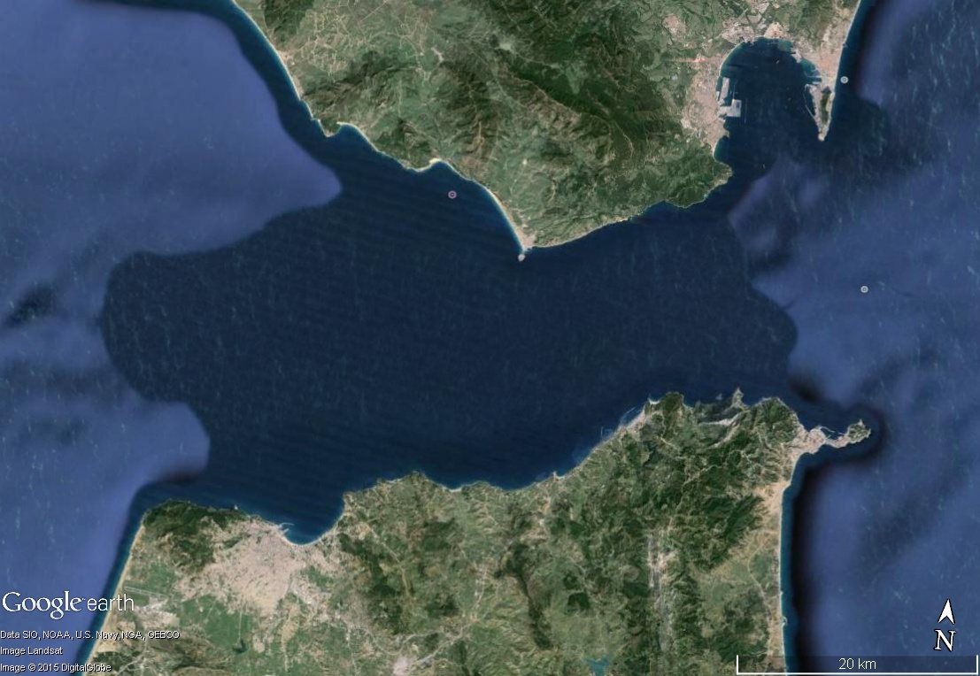
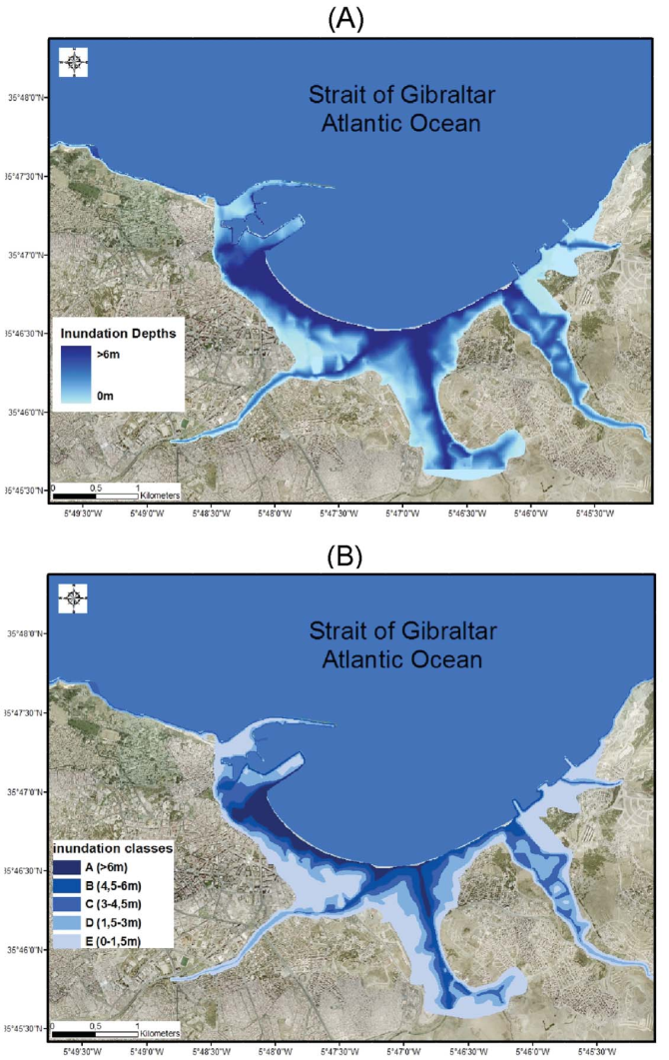
City | Run up elevation | Inundation distance
Tangier | 17 m
Tangier
Tsunami simulations, (A) and (B), Benchekroun et al (2010), Historical data (table), Elmrabet, (1998)

Slide 4
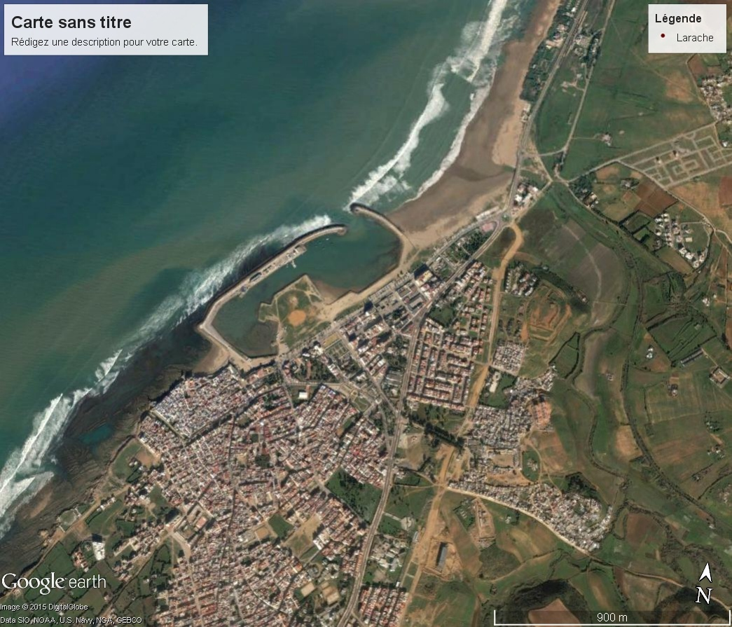
City | Run up elevation | Inundation distance
Assila | 14 m | 150 m
Historical data, Elmrabet, (1998)

Slide 5
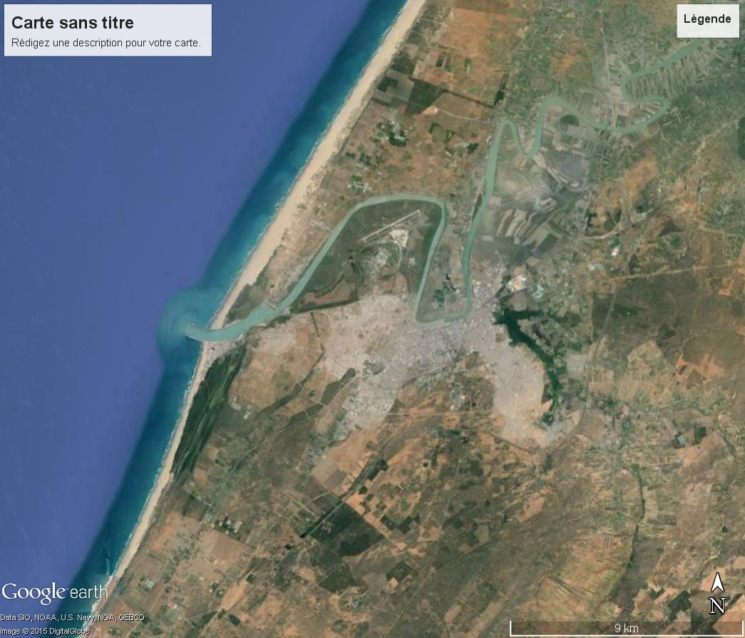
City | Run up elevation | Inundation distance
Mahdia |  | 4 Km
Mahdia
Kenitra
Historical data, Elmrabet, (1998)

Slide 6
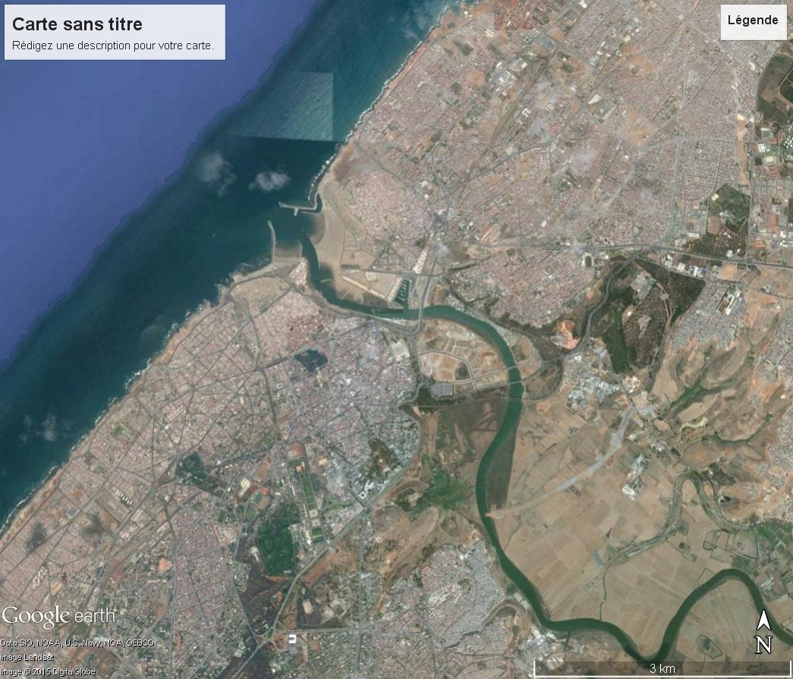
City | Run up elevation | Inundation distance
Rabat - Sala |  | 3 Km
Sala
Rabat
Historical data, Elmrabet, (1998)
Tsunami simulations, Atillah (2010)

Slide 7
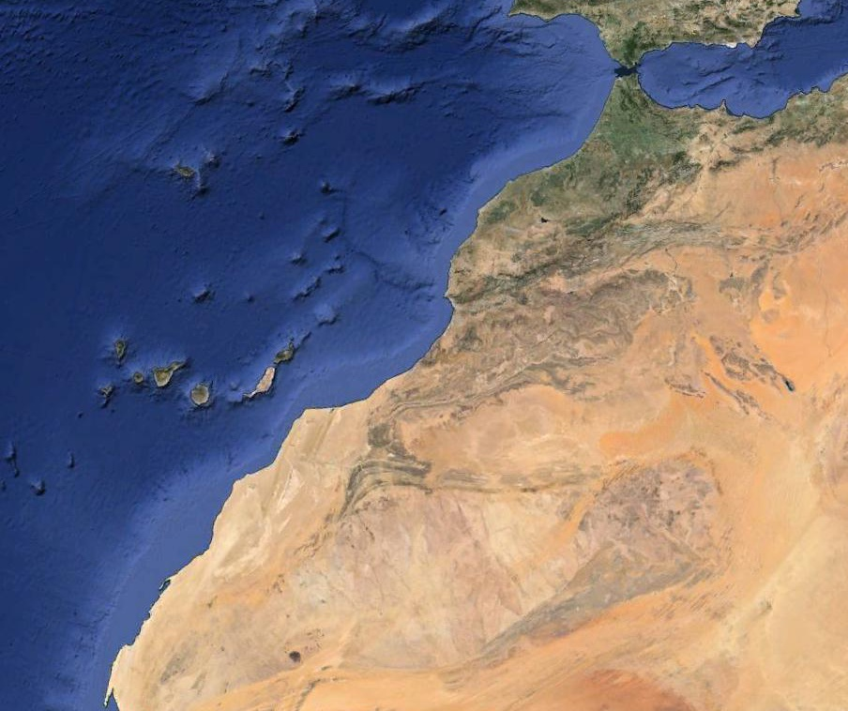
T
I
D
E
G
A
U
G
E
S
Tide gauges stations in Morocco
Harbors Autority
Meteorological Agency
Mapping Agency
National Geophysics Institute
TANGER
KENITRA
AL HOCEIMA
SAIDIA
NADOR
MOHAMEDIA
CASABLANCA
JORF LASFAR
SAFI
ESSAOUIRA
AGADIR
TAN TAN
LAAYOUN
DAKHLA

Slide 8
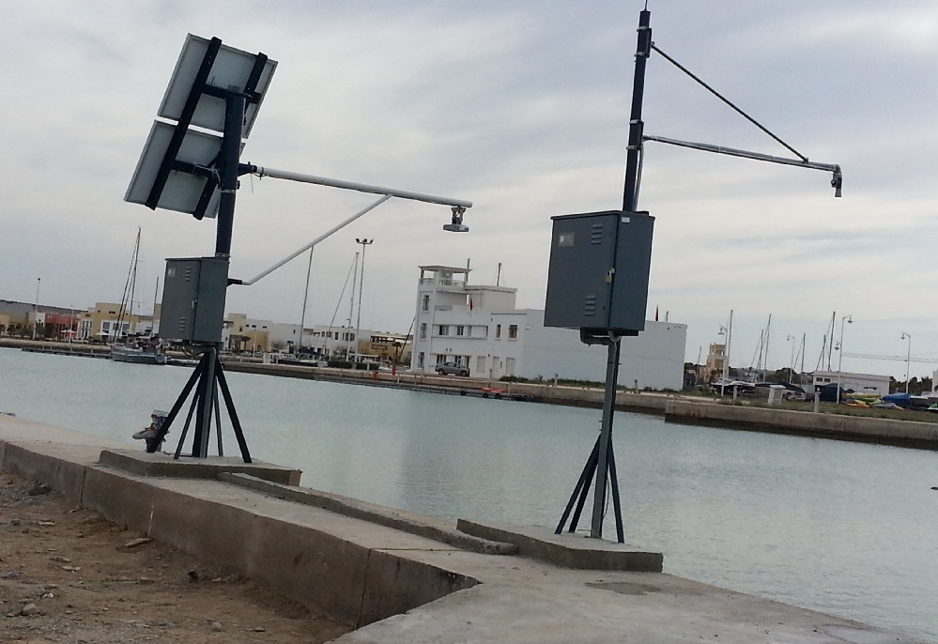
TIDE GAUGES IN SAIDIA, CNRST and JRC

Slide 9
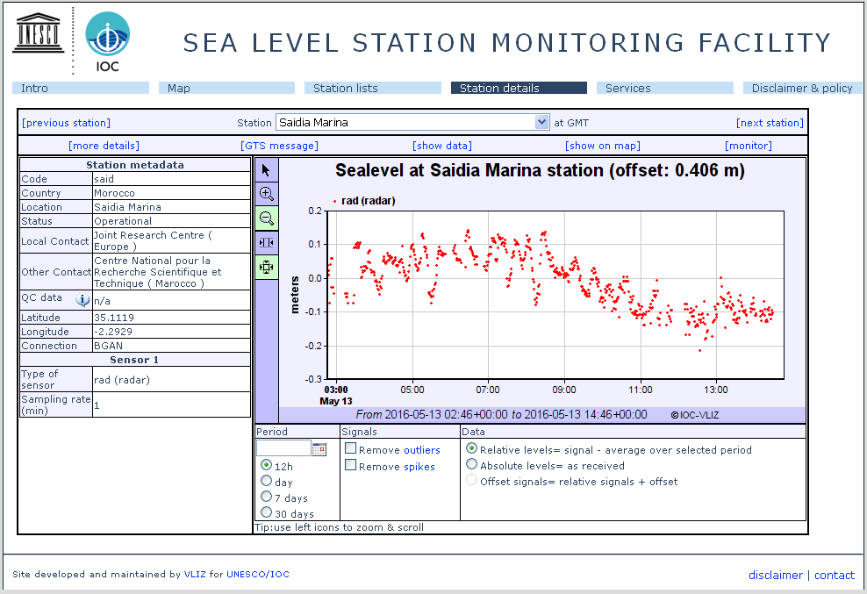
Enregistrement du niveau de la mer en temps réel à Saadia, CNRST

Slide 10
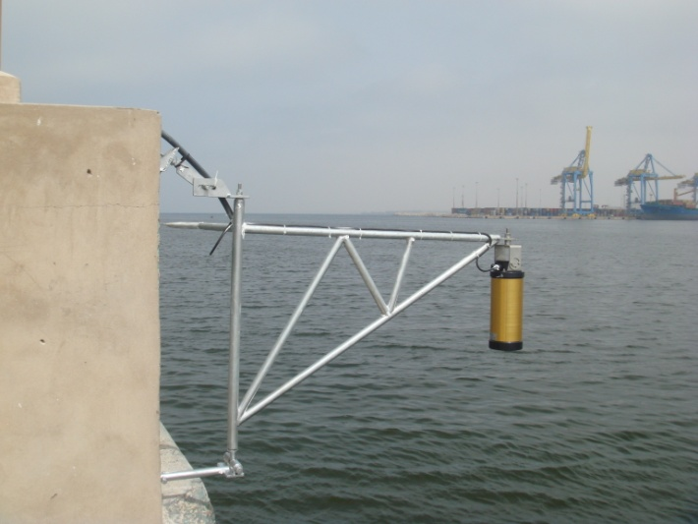
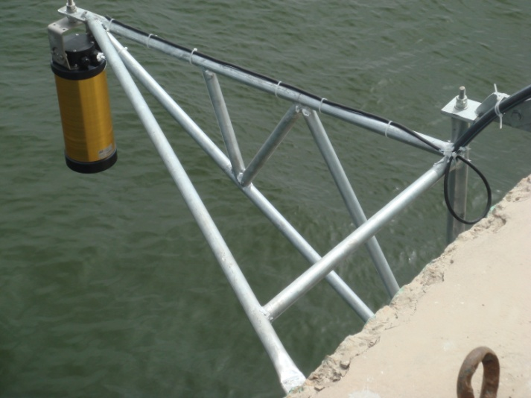
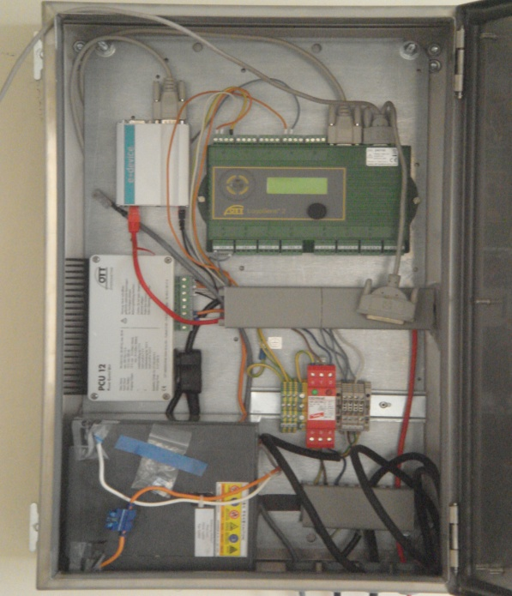
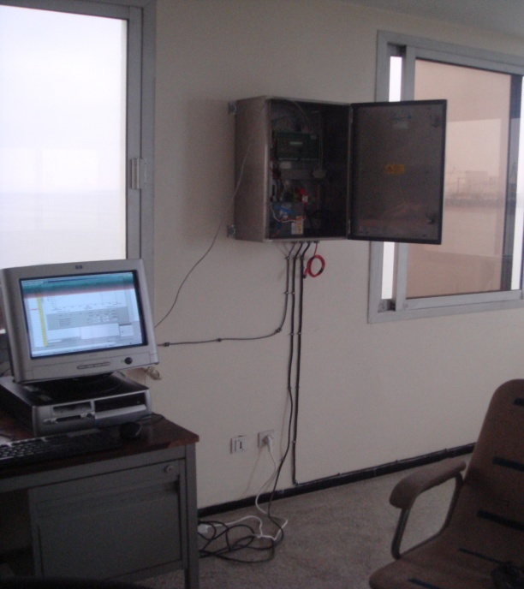
Casablanca harbour tide-gauge and data acquisition system
Notes:
10

Slide 11
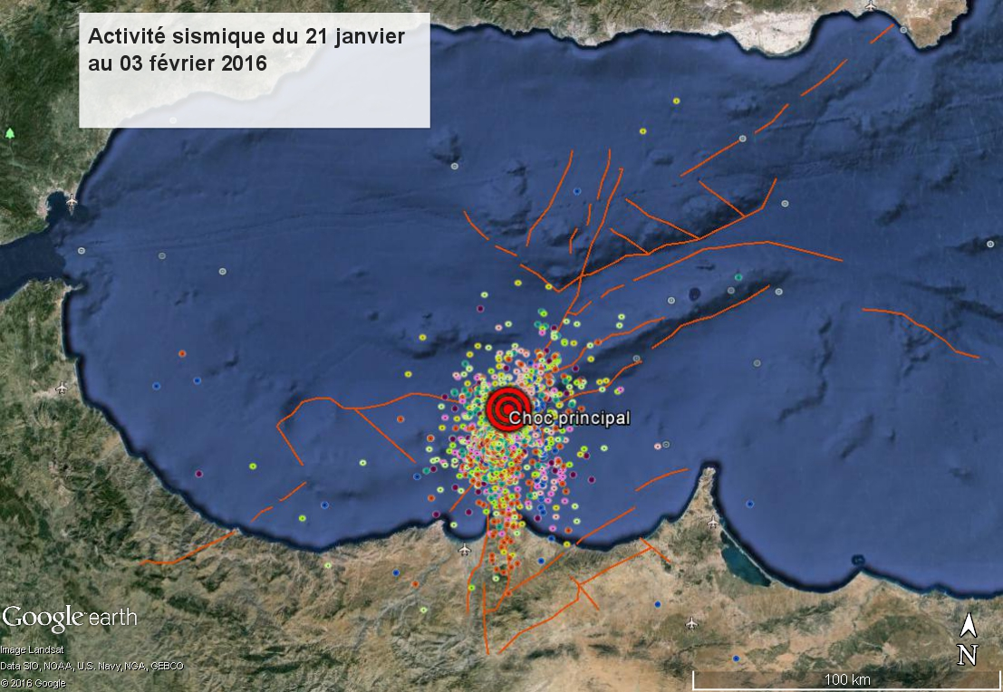
Seismic activity
January 21st to february 3rd 2016
Two weeks seismic activity associated with the earthquake of magnitude Mw=6,4

Slide 12
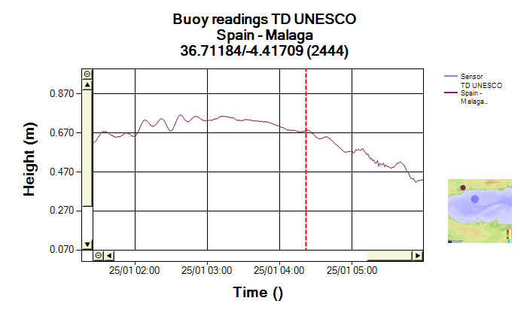
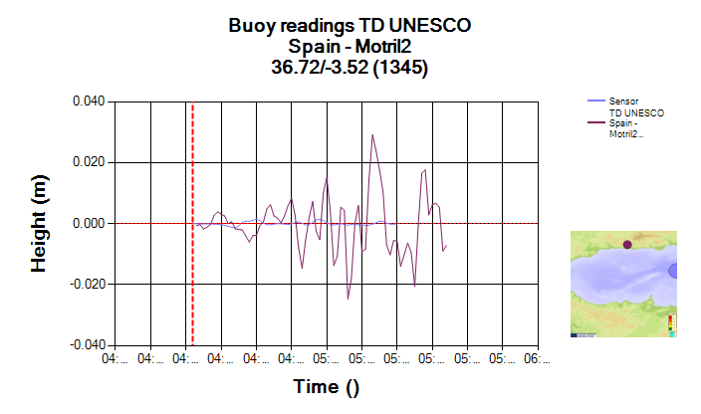
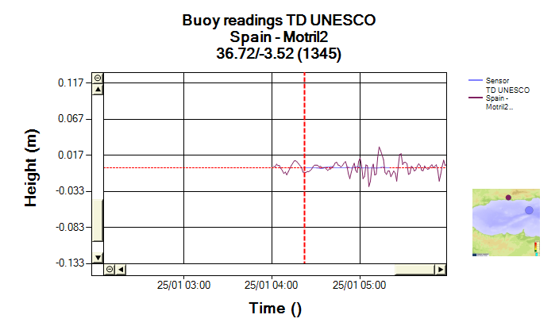
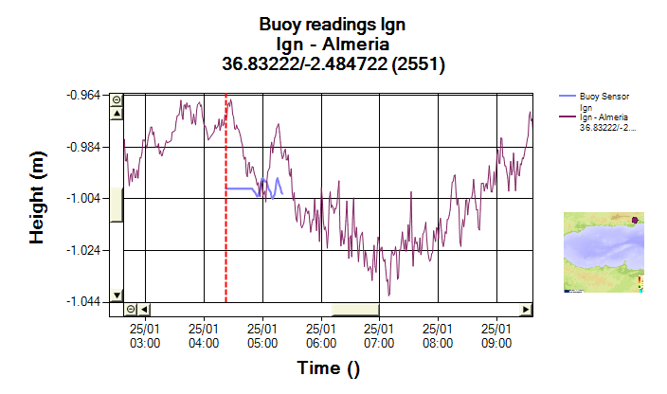
Recorded tsunami waves on the spanish coasts (few centimters)

Slide 13
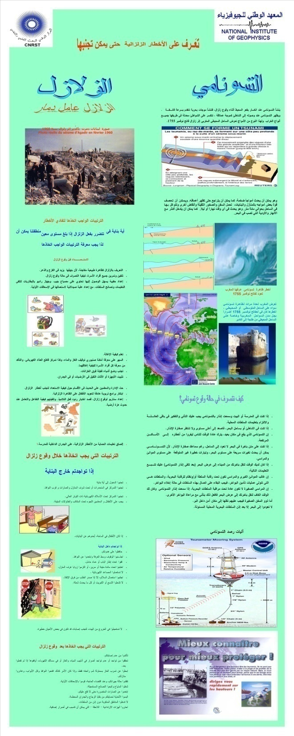
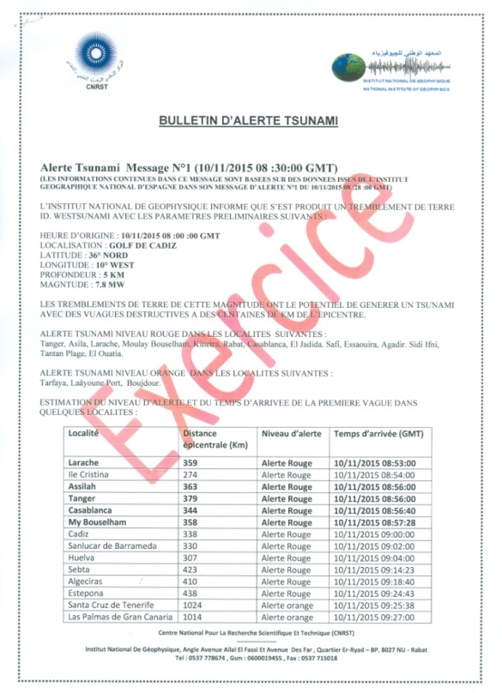
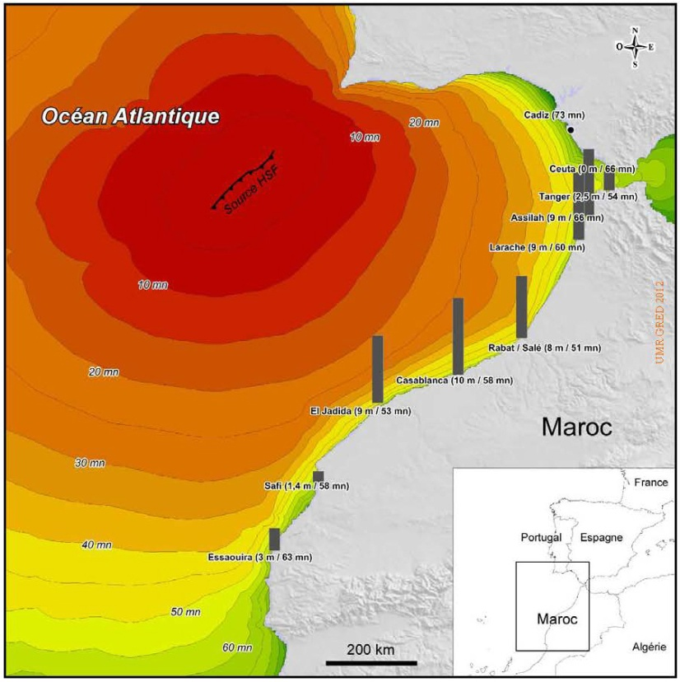
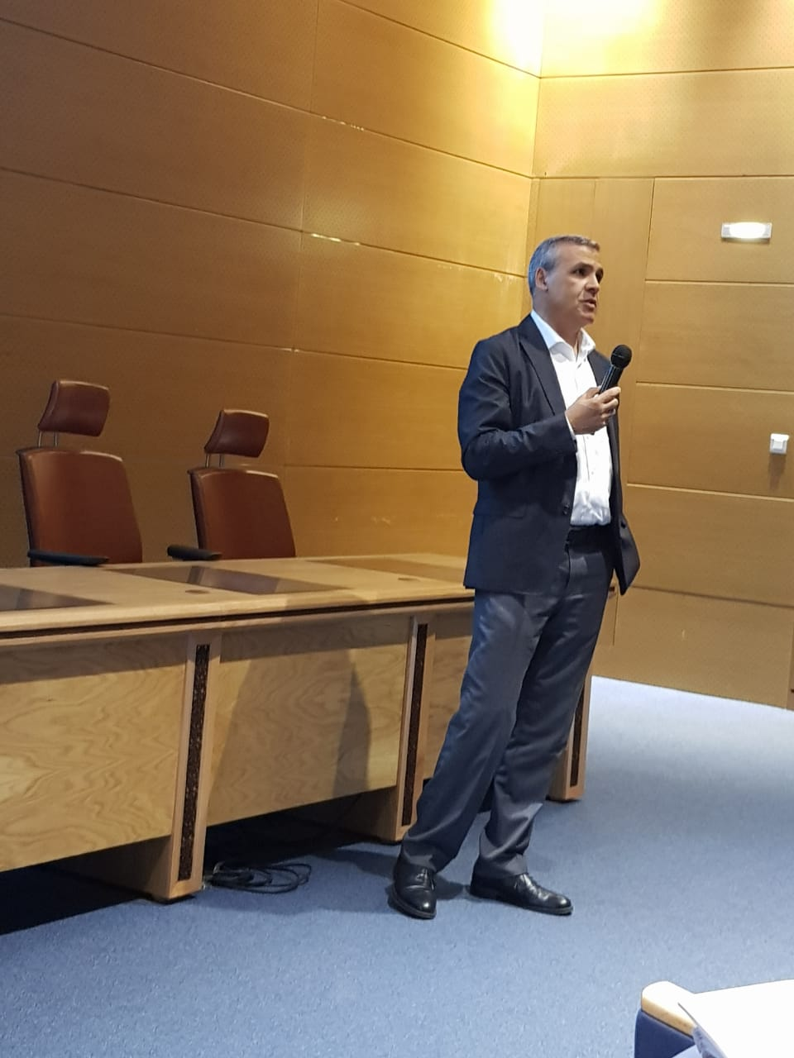
Tsunami impact studies
Educational material
Tsunami warning exercise

Slide 14
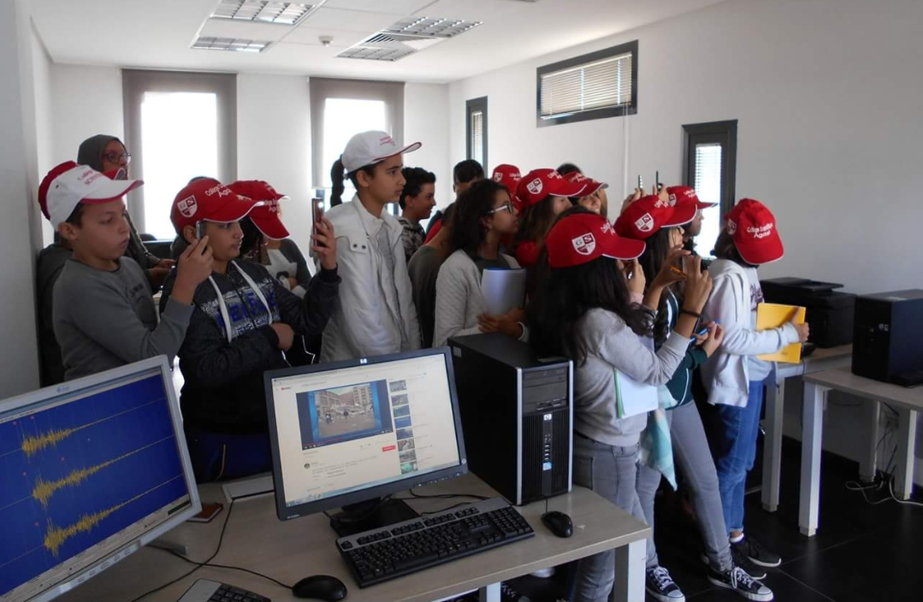
Schools visits to the observatory

Slide 15
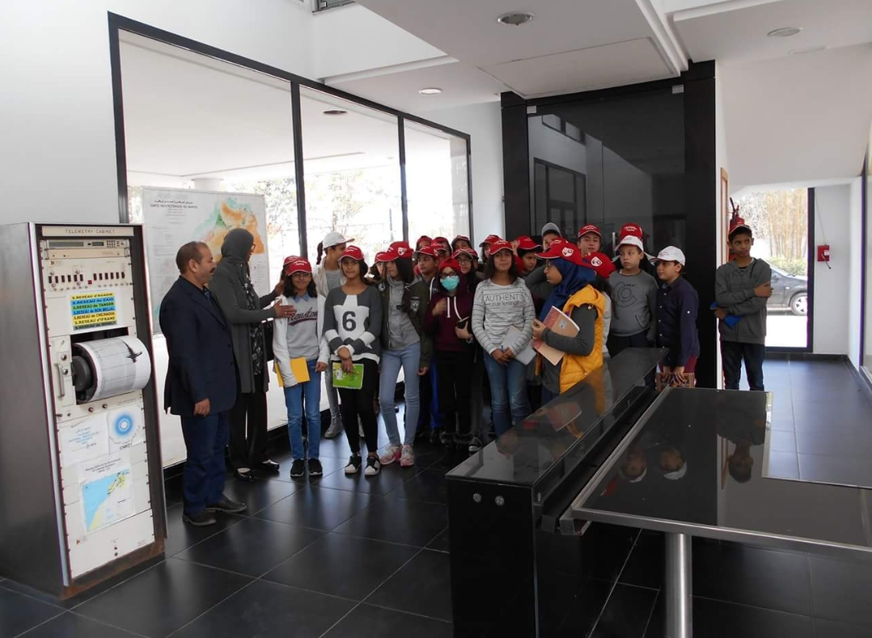
Schools visits to the observatory

Slide 16
Tsunami evacuation procedures
Preparation for the next beach exercise

