Slide 1
2017: App IMMIGRANT

Slide 2
2018 APP «AIDYOU»
The new App to inform people in case of emergency,”care yourself” and “safe yourself” in 5 languages

Slide 3
Download the app

Slide 4
Download the app from google play or apple play

Slide 5
To provide basic and easily understandable information for people (specially tourists and Migrants) able to help them in facing the majority of issues affecting their staying ALSO in a foreign country:
Educate people in emergency situation
Inform them what to do in case of emergency
and waiting for the rescue services
Manage the emergency situation without using language information
Increase the “sense of security” in the people

Slide 6
Target 2018
To develop a multi-language tool on electronic format (Smartphone App Android and IOS) able to help people to:
Inform and protect them in case of emergencies
Take advantages for primary care by nurses and physicians
Increase the culture of emergency and increase the “resiliency”
Stimulate the curiosity of the people in case of emergency situation

Slide 7
OFFICIALLY PRESENTED IN RIMINI ON 23 august 2018

Slide 9
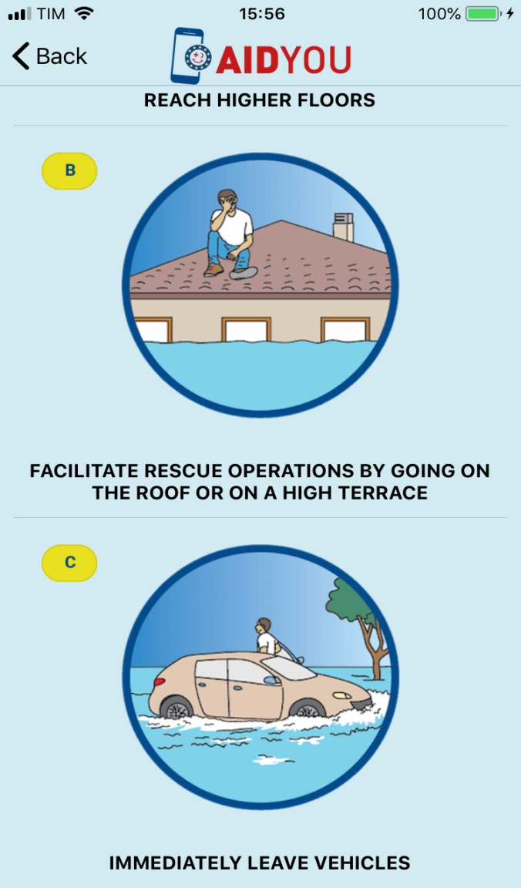

Slide 10
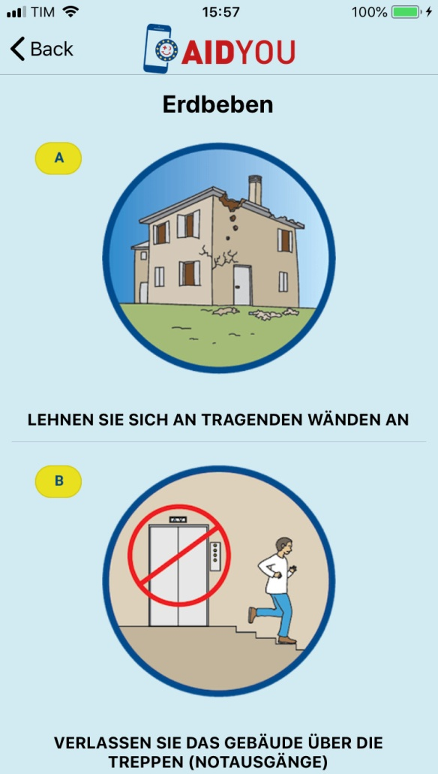
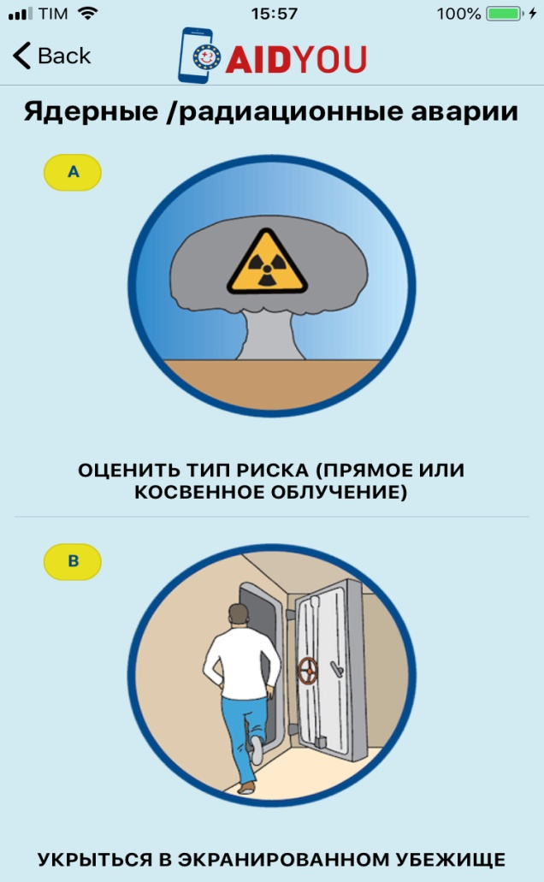

Slide 11
Actually in cooperation with:
Malta ICoD – Anton Macallef (Tsunami and flood emergencies)
Ukraine TESEC – Viktor Poiarkov (Nuclear emergencies)
Cyprus Civil Defense – Demetris Christou
University of Modena-Reggio Emilia, Italy
Doriano Castaldini
(Earthquake and landslide emergencies)

Slide 12
Target 2019
Possibility to choose what kind of emergency (police,health service,fire dep.) three different buttons
Multi-language information(12 or more languages)
Animated cartoons to explain better what to do in case of emergency
Possibility to choose “care situation” or “safe situation”
Indication of the seriousness of the situation(red,yellow or green circle around the cartoons)
Geolocalization (optional)
Direct connection with emergency service(112 or other)
Donnection with map(through Google Map) for local hospital or emergency services
Possibility to send photos or video of emergency situation
Additional information or links near the cartoons

