Slide 1
EUROPEAN ASSOCIATION OF INSTITUTIONS IN HIGHER EDUCATION
SHORT CYCLE HE:
Perspectives of Professional
Higher Education
Council of Europe QF correspondents meeting
Strasbourg, September 4, 2018
Michal Karpíšek, Secretary General

Slide 2
Content
Introduction
Professional Higher Education characteristics
Focus on SCHE
Focus of further activities?

Slide 3
MISSION & role
MEMBERSHIP

Slide 4
EURASHE Mission
EURASHE’s mission is to promote, within the European Higher Education Area (EHEA), the interests of professional higher education and of relevant higher education institutions that are recognised or financed by the public authorities of a EHEA member country

Slide 5
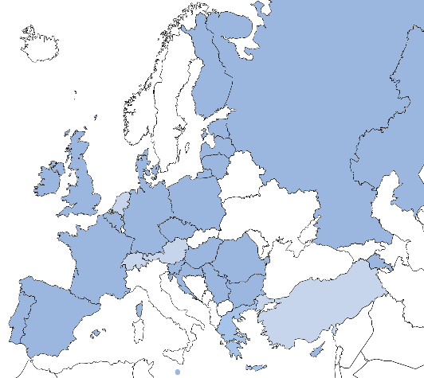
Membership
EURASHE represents universities of applied sciences and other institutions of PHE (colleges, universities with professionally oriented programmes/faculties)
  49 full members: 15 national associations, 34 individual institutions
  1 associate member
  12 affiliate members: 8 individual institutions outside the EHEA, 4 bona fide organisations

Slide 6
PROFESSIONAL HIGHER EDUCATION

Slide 7
Over the next years, industry demand for employees with qualifications combining practical skills and academic higher education will increase.
Source: HAPHE project survey, 2013
Notes:
5

Slide 8
Differences between PHEI & AHEI

Slide 9
Professional higher education
Professional higher education is a form of higher education that offers a particularly intense integration with the world of work in all its aspects, including teaching, learning, research and governance, and at all levels of the overarching qualifications framework of the EHEA.
Its function is to diversify learning opportunities, enhance the employability of graduates, offer qualifications and stimulate innovation for the benefit of learners and society.
The world of work includes all enterprises, civil society organisations and the public sector. The intensity of integration with the world of work is manifested by a strong focus on the application of learning achievements. This approach involves combining phases of work and study, a concern for employability, cooperation with employers, the use of practice-relevant knowledge and use-inspired research.

Slide 10
Features of professional higher education
A strong link with the world of work & with enterprises
Close involvement of all stakeholders (including students)
Regional embedding of education& research
Practice-orientated & competence-based
Accessible and labour market-orientated
Flexible schemes and study programmes for new groups of learners, following new requirements of the labour market
within the complex mission of higher education addressing also personal and civic development, autonomy and academic values, service to society

Slide 11
Characteristics & Criteria
POLICY & STRATEGY | Policy and Strategy Integration
 | Objectives and Outcomes of PHE
 | Regional Integration
TEACHING & LEARNING | Methods of Curriculum Development
 | Learning Outcomes - WHY
 | Content for Teaching and Learning – WHAT
 | Learning Methodology - HOW
 | Learning Environment - WHERE
 | Programme Team –WHO
RESEARCH, DEVELOPMENT & INNOVATION (RDI) | RDI Agenda
 | RDI Process
 | RDI Outputs and Outcomes

Slide 12
Focus on short cycle HE

Slide 13
EURASHE SCHE related activities
Long term advocacy for development and respect to SCHE
Mapping the situation – Missing Link (2011, 2013)
Position paper on permeability between PHE and VET
Partnership with VET providers within VET4EU2 platform, cooperation with CHAIN5
Engagement with business/world of work representations

Slide 14
Presence of SCHE in Europe (2013)
Country | SCHE L5 | Intention | Country | SCHE L5 | Intention
BE (D) |  |  | IS | x | x
BE (FR) | x | x | IT |  | ?
BE (NL) | x | x | LV | x | x
BG |  | ? | LI |  | ?
CY | x | x | LU | x | x
CZ |  | ? | MT | x | x
DK | x | x | NL | x | x
EE |  |  | NO | x | x
ES | x | x | PT | x | x
FR | x | x | SI | x | x
HU | x | x | TR | x | x
IE | x | x | UK | x | x

Slide 15
Institutional Provision (2013)
Country | University | University of App. Science | Voc. HE College | Further Ed. College | Secondary School | Adult Education
BE (FR) |  |  |  |  |  | x
BE (NL) |  | x |  |  | x | x
CY |  |  | x | x
CZ |  |  | x |  | x
DK |  |  | x | x
ES |  |  | x |  | x
FR | x |  |  |  | x
HU | x | x |  |  | x
IE | x | x |  | x
IS | x
LV | x | x | x
LU | x |  |  |  | x
MT | x |  | x
NL |  | x
NO | x | x
PT | x | x |  | x | x | x
SI |  |  | x
TR
UK (E,W,NI) | x | x | x | x
UK (Sc) | x | x |  | x

Slide 16
Fields of study (2013)

Slide 17
Positives
Fairly good employability
Wide range of professions
  Business, administration, hospitality, ICT…
Access for non-traditional groups of students
Innovation of skills & competencies
Variety of access routes and pathways
Curriculum based on theory + practice + placements
Flexibility and responsiveness to actual needs
Clear involvement of business/employers

Slide 18
Challenges
Variety of awards/degrees and objectives
Integration within HE structures – “cycle within cycle”, transition to HE – addressed by Paris communique
Links towards VET
Limited involvement in internationalisation (credits, diploma supplement, mobility, projects…)
Quality assurance not corresponding HE approaches
Accreditation institutions often not independent

Slide 19
Issues for consideration
Mission (social aspect, widening access to HE, employability, LLL, up- and reskilling)
Target groups and their diverse needs
Identity including name and terminology
Recognition & permeability
SCHE x higher levels of VET
Role of research
Staff profile
Flexibility within requested QA procedures

Slide 20
Further steps
DEVELOPPING A PROJECT MAPPING SCHE

Slide 21
Objectives considered
Map the overall situation regarding the SCHE position and recognition within EHEA (the scope to be discussed)
Propose key mission and characteristics of SCHE respecting a variety of national settings, hopefully address also the terminology and understanding of this qualification
Identify key challenges and opportunities for its development and integration within HE, as well as within the wider LLL concept
Develop key policy messages for integration of SCHE, its recognition and fulfilling the expected role

Slide 22
Potential features and activities to be considered
Mapping of selected national policies and approaches in various EHEA countries
A review of data and indicators mapping the SCHE within Bologna implementation report
A survey among the EHEA countries
Stakeholders’ survey and workshop(s) with stakeholders
Analysis of gathered data and input
Expert group translating the findings into conclusions and recommendations
Final event presenting and consulting conclusions and recommendations
Policy input into Bologna ministers’ communique in Rome and other channels
Dissemination through series of workshops/webinars and other channels

Slide 23
Thank you for your attention!
Michal Karpíšek
Secretary General
michal.karpisek@eurashe.eu
www.eurashe.eu

