Slide 1
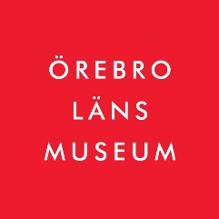
Birgitta Johansen, museum director and country curator/antiquarian at Örebro County Museum The first and oldest provincial museum in Sweden – 1856. Founded and financed by citizens. Today an independent foundation, financed by regional authorities. The regional history society is one of its founders. A classic drama, even a tragedy, starring WATER

Slide 2
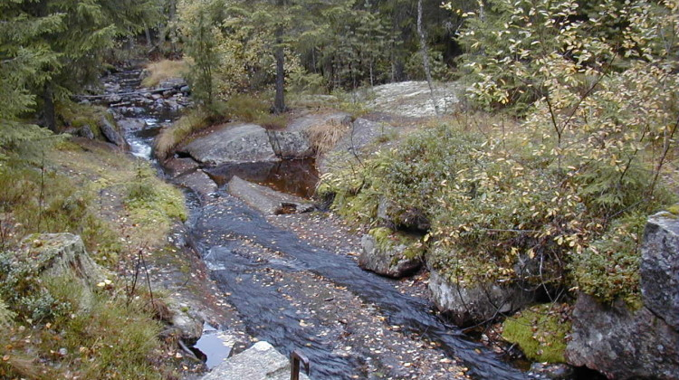
Cultural heritage of a small river in Örebro County Nora “bergslag” = mining and pig iron producing district
From the 12th century onwards there were blast furnaces in virtually all small streams.
In 1539 there were 47 tax-paying “hyttor”.
In 1340 mining statutes, were promulgated by the King for the Western Mountain in Närke.
WATER 150 m asl

Slide 3
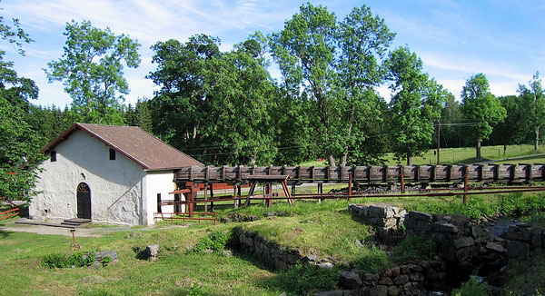
Pershyttan
WATER
145-135 m asl
The surroundings are peppered with iron ore mines and slag heaps. Farmhouses belonging to the “bergsmän” are scattered in between.
Now very beautiful and green today, it was once bare and black …

Slide 4
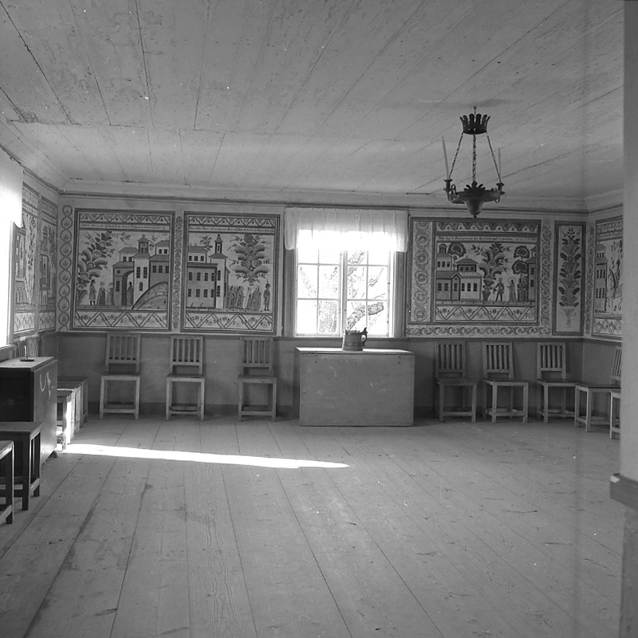
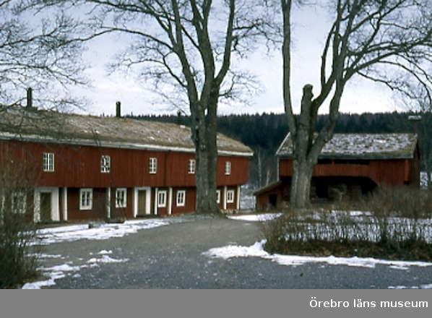
Bergsmän from 11th-12th Century:
- extracted iron ore and made pig iron in blast furnaces, involving the whole family;
- they were free farmers and skilled craftsmen who payed taxes to the King;
- some became wealthy. The Swedish economy relied on this for 8-900 years.
Siggebohyttans bergsmansgård
from 1790,
40 m long,
characteristic chimneys of
cast iron
WATER 120 m asl

Slide 5
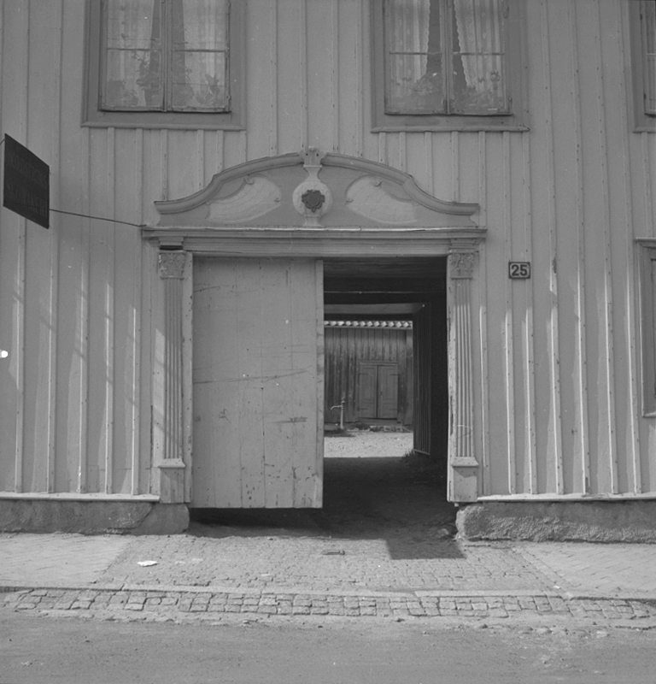
Nora – town privileges since 1643
Europa Nostra awarded to this small, picturesque wooden town
WATER 84 m asl

Slide 6
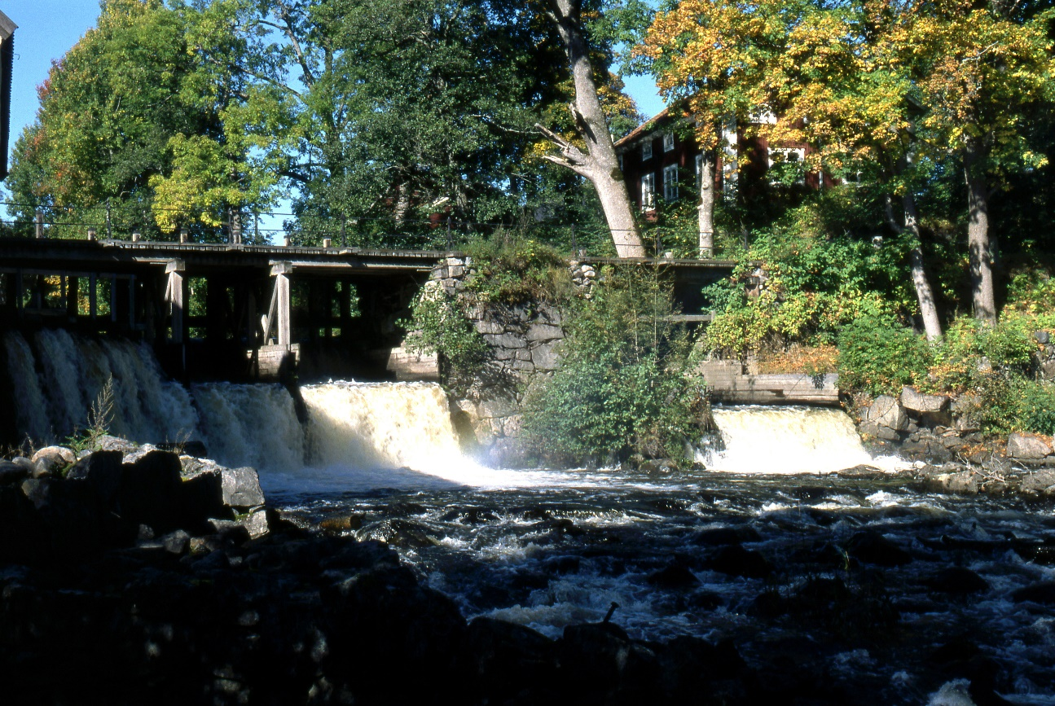
Järle – the last outpost of Nora bergslag – all the streams and lakes are dewatered through Järle
Up stream
Down stream
WATER 50 m asl Nature reserve since 1976

Slide 7
Jerle station building – the first in Sweden, 1854

Slide 8
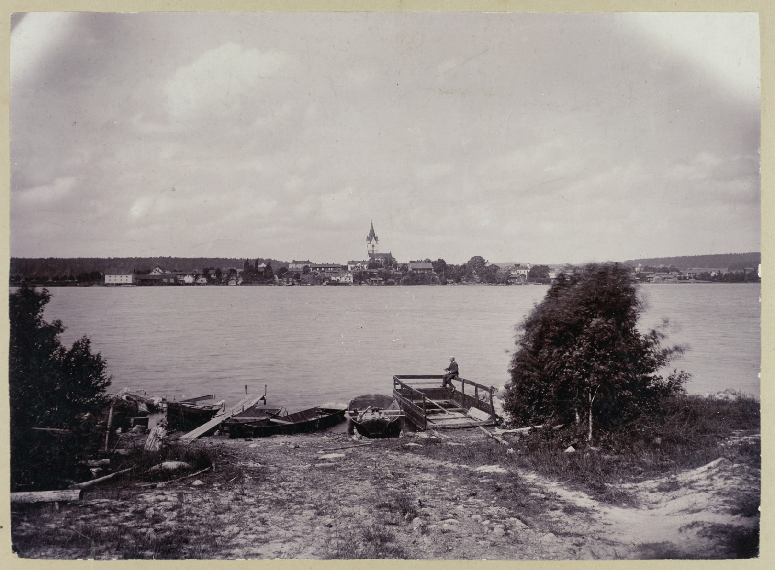
This is the landscape in question
Some 15-20 km radius with Nora in the centre
Many components – together telling a story about WATER, wood, iron and people

Slide 9
Örebro castle, a royal castle from the 13th century – bailiffs/taxation
From the cities, through Lake Hjälmaren, Lake Mälaren, the Baltic Sea and the North Atlantic all the way to markets in Europe from the Middle Ages
WATER 25 m asl

Slide 10
The EU Water Framework Directive – a destructive force, in the wrong hands
not the directive in itself but in its interpretation and implementation;
a disturbed power balance, power at national and regional, but not municipal level and only to environmentalists, none to heritage managers;
court decisions caused local people to feel unjustly treated when customary law was ruled out.

Slide 11
Social participation?
Information meetings disguised as open discussion – when the objective was to convince stakeholders that the authorities were doing the only possible and also the only right thing;
Consultants acting as middlemen between inhabitants and the real decision-makers;
Un-holy alliances between anglers, stream-savers and authorities – not acknowledging people in local history societies;
Angry owners, sometimes even threatening …;
Surprised and scared civil servants;
Sad and desperate stakeholders.

Slide 12
Public management
Under-financed regional heritage management;
Over-financed regional environment management;
Civil servant and activist in one person;
The environmentalists had the initiative and all the resources;
No landscape perspective or strategy;
Ecosystem grooming was not paired with a historic dimension;
The environmentalists say they cannot work with the ELC because it is based on people and “experiences”.

Slide 13
What has the museum done?
A silver plaque to a man for his work with the mill in Järle 2017;
A debate article in the regional news paper– RHS and ÖLM;
Two open conferences 2017 – RHS and ÖLM;
Debate articles 2018 in a national magazine and a regional newspaper;
Meetings, answers to different authorities at different levels, interviews, many telephone conversations with desperate stakeholders;
Film 2019 – showing owners, stake holders, researchers, authorities, from different sides, and with different views.

Slide 14
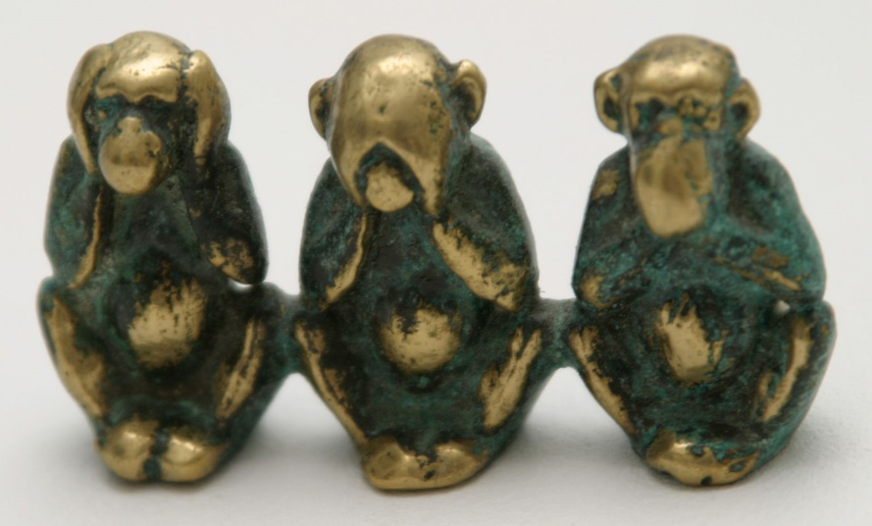
The role of the museum
Lending an ear to those feeling unheard;
Giving voice to those feeling silenced or muffled;
Offering visibility to those feeling unseen,
by being a platform for expressing opinions and formulating common questions;
By helping create a feeling that it is possible to fight back and to influence politicians.

Slide 15
Challenges and conflicts
Heritage managers – focus on the wrong point of entry. It is not the inventory of single dams and other remains that is essential – but a synthesis on landscape level, in this case the natural water catchment basin, and the history in the area.
Environmentalists – tend to be a-historical, “customary law” is just something old and in the olden days people did not manage the fish.

Slide 16
Challenges and conflicts
The city sets the agenda - today, the overwhelming majority live in cities and thus the rift between countryside and city is widening … The majority of people and politicians are convinced that removing dams is a good and noble thing to do;
New public management – to count dams is easy, counting effects of measures against acidification, wood fertilising, deforestation etc. is difficult.

Slide 17
Challenges and conflicts
Restoration is a difficult concept – but treated as obvious and simple by civil servants without proper training:
Restoration to what? Consequences?
Millions have been spent on transporting gravel and blocks to these small streams;
Financed by “Good environmental choice” a label owned by Swedish Society for Nature Conservation (SSNC);
Researchers doubt that this is the right thing to do.

Slide 18
Customary law
2106 – the Court decided that customary law did not apply for dams, and as a consequence owners had to seek permission;
Some CAB now gave owner “offers they could not refuse” – pay for a permission you might not get and possibly also for restoration costs – or let us pay for a removal!
2019 – a new law came into that gives customary law a legal status comparable to a permission – the politicians did listen;
January 2019 the same Court now ruled that customary law applies.

Slide 19
The moral of this story
Environmentalists believe they can only do good, and they are the only ones that can do good but power corrupts no matter how good the cause is;
administrative efficiency can be dangerous to society;
slow processes, handling different opinions and needs carefully – that is the cramped road leading to life.
I hope this sad story will end in a moment of reflexion and learning for the future and that the European Landscape Convention will be revitalised and used as inspiration for enhanced social participation by both environmentalists and heritage managers.

