Slide 1
KEK Media Pluralism and Transparency of Media Ownership
Brussels, 12th October 2016
Michael Petri
Deputy Head of Division Concentration in the Media / KEK

Slide 2
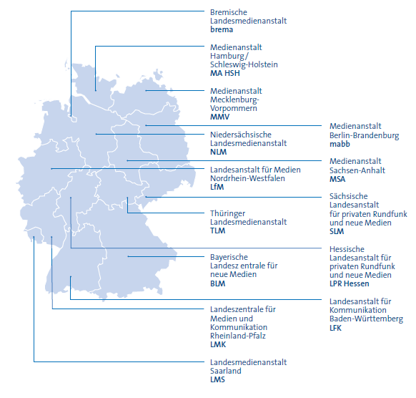
Regulation of private broadcasting: The State Media Authorities
16 States
14 State Media Authorities
Competences:
licensing
controlling
structuring
promoting
commercial radio and television in Germany

Slide 3
Legal Basis
State Media Laws
Legal framework at state level for the respective state media authorities
Can differ form state to state
Apply to regional broadcasters of radio and television
Comprise restrictions of shareholdings (e. g. publisher + radio broadcaster)
Interstate Treaty on Broadcasting
Uniform regulation for national issues
Ensures a level playing field for the regulation for nationally transmitted television and radio in Germany

Slide 4
Joint Commissions of the Media Authorities
KEK
KJM
ZAK
Commission on Concentration in the Media
Commission for the Protection of Minors in the Media
Commission on Licensing and Supervision
Specialized Expert Commissions involved in proceedings of state media authorities when a national context is given

Slide 5
KEK - Commission on Concentration in the Media
Independent regulatory body, not subject to instructions
Comprises: - six experts on media and economic law and - six members of the state media authorities
Involved in: - procedures concerning licensing - changes in broadcasters ownership structures
Decisions are binding for state media authorities involved in the proceeding
Tasks: - Achieving transparency in all matters regarding the development of concentration in the media
- Ensuring a plurality of opinion in nationally-transmitted private television

Slide 6
Regulatory Concept
Audience Share Model
Unlimited number of television services unless acquiring a “dominant power over public opinion”
Legal Presumptions:
30 % viewer share is reached with all associated tv-programmes or
25 % viewer share is reached + a dominant position in a related, media relevant market or
Overall assessment of a company’s media activities corresponds to 30 % viewer share

Slide 7
Determination of TV Broadcasting Shares
agf - television research working group
Association of large TV-Broadcasters and advertisement industry (Joint-Industry-Committee)
At present developing a measurement standard for “moving images” independent from the way of transmission or the used devices
All broadcasters are obliged by law to cooperate to the determination of their viewer ratings in KEK-proceedings
Managing Board
TV-Broadcatser
(Associates)
German Advertisers Association /Union of Media Agencies

Slide 8
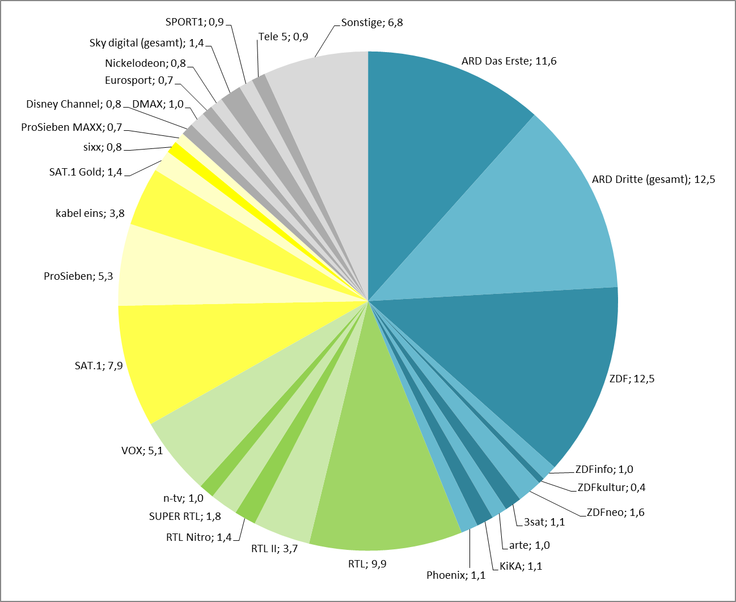
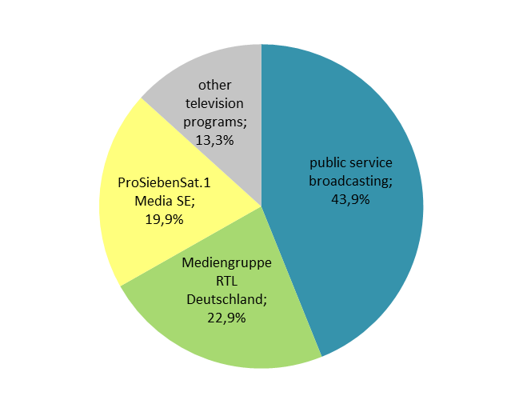
TV Broadcasting Shares
Average Channel Ratings 2015
Group Ratings 2015

Slide 9
Shareholder structure and TV-activities of the RTL Group in German nationwide TV
Bertelsmann Stiftung
77,6* (Z)
Bertelsmann Verwaltungs-
gesellschaft mbH **
3,3* (Z)
Familie Mohn
19,1* (Z)
Reinhard Mohn Stiftung
Bertelsmann SE & Co. KGaA
100
BAG Business Information Beteiligungs GmbH
100
74,9
25,1
59,9
Bertelsmann Capital Holding GmbH
Gruner + Jahr GmbH & Co. KG
Motor Presse Stuttgart GmbH & Co. KG
Jörg Schütte
75,1
51
49
Streubesitz
24,14
RTL Group S.A. (Eigenbesitz 0,76 %)
100
RTL Group Germany S.A.
Motor Presse TV GmbH
100
0,28
99,72
RTL Group Deutschland GmbH
auto motor und sport channel
Streubesitz
CLT-UFA S.A.
100
UFA Film und Fernseh GmbH
50
27,3
100
RTL DISNEY Fernsehen GmbH & Co. KG
RTL 2 Fernsehen GmbH & Co. KG
Mediengruppe RTL Deutschland GmbH
8,6
100
n-tv Nachrichten-fernsehen GmbH
RTL II
RTL Television GmbH
*: Simplyfied structure with focus on indirectly held capital rights, all voting rights held by Bertelsmann Verwaltungsgesellschaft mbH
**: Shareholder: Prof. Dr. Dieter Vogel, Prof. Dr. Werner Bauer, Prof. Dr. Joachim Milberg and three members of the Mohn family (Elisabeth Mohn, Dr. Brigitte Mohn, Christoph Mohn) as well as the Bertelsmann Verwaltungsgesellschaft Stiftung
(Z): intermediate companies not shown
SUPER RTL
100
50
RTL Television
n-tv
TOGGO plus
31,5
RTL Crime
50
Heinrich Bauer Verlag KG
RTL Living
VOX Television GmbH
BVI Television Investments, Inc.
50
(Z)
Tele-München Fernseh-GmbH & Co. Medien-beteiligung KG
31,5
RTL NITRO
99,7 (Z)
VOX
100 (Z)
RTL Passion
0,3
Walt Disney Company
Burda GmbH
1,1
GEO Television
DCTP Entwicklungs-gesellschaft für TV-Programm mbH
RTL Plus
As at 10/2016

Slide 10
Media activities of Bertelsmann SE & Co. KGaA in Germany
TV
Online
Radio
Print
RTL Group
RTL Group/Gruner+Jahr
RTL Group
Gruner+Jahr/Bertelsmann
Programme
More than 40 media offers of Mediengruppe RTL Deutschland, i. a.:
Online-Auftritte der RTL-TV- Programme (RTL.de, RTLNITRO.de, VOX.de, n-tv.de, Toggo.de (SUPER RTL), RTL2.de)
TV NOW (Livestream und Abruf der Programme RTL, VOX, n-tv, RTL NITRO, SUPER RTL und RTLII)
Video-on-Demand-Angebote (clipfish.de, RTL Next)
Communities, Information (GZSZ.de, frauenzimmer.de, elementgirls.de, kochbar.de, VIP.de, wetter.de, sport.de)
Online-Auftritte der RTL- Radioprogramme
Online-Auftritte Gruner+Jahr-Printtitel
Broadband TV (Multi-Channel-Network)
RTL Radio (bundesweit)
104,6 RTL
105.5 Spreeradio
the wave - relaxing radio
HITRADIO RTL Sachsen (86 %)
89,0 RTL (57 %)
Radio Brocken (57 %)
Radio Leipzig 91,3 (55 % über RTL Sachsen)
Antenne Niedersachsen (49,9 %)
Sachsen-Funkpaket (55 % über RTL Sachsen)
Radio Hamburg (29,2 %)
radio NRW (16,1 %)
Antenne Bayern (16 %)
Rock Antenne (16 %)
Radio Regenbogen (15,8 %)
Antenne Thüringen (15 %)
radio TOP 40 (15 %)
Radio 21 (9,8 % + weitere indirekte Anteile)
+ weitere indirekte Beteiligungen an bigFM, Oldie 95, Radio NORA, Radio Galaxy, Radio TON, apollo Radio, Radio 21
Newspapers
Free-TV
RTL Television
RTL NITRO
VOX
n-tv
SUPER RTL (50 %)
RTL II (35,9 %)
TOGGO plus (50 %; geplant)
RTL plus (geplant9
Pay-TV
RTL Crime
RTL Living
RTL Passion
GEO Television
auto motor und sport channel (Mehrheitsbeteiligung)
Regionalfenster
RTL Nord (HH, SH, NI, HB)
RTL WEST (NW; 75 %)
RTL Hessen (60 %)
Sächsische Zeitung (60 %)
Morgenpost Sachsen (60 %)
Magazines
Art
Beef!
Brigitte
Brigitte (Mom, Woman, Wir)
Business Punk
Capital
Chefkoch Magazin
Couch
Deli
Dogs
Eltern
Eltern Family
essen und trinken
Flow
Gala
Geo (diverse Hefte)
Geolino
Grazia
Häuser
in – Das Premium Weekly
Jamie
Living at Home
National Geographic
neon
Nido
P.M.-Hefte
Schöner Wohnen
Spiegel (25,25 %)
Stern (crime, gesund leben)
View
viva!
Wunderwelt Wissen
11 Freunde (51 %)
Titel des Motor-Presse-Verlags (59,9 %; z. B. auto motor sport) und von dessen Gemein-schaftsunternehmen (u. a. Men´s Health, Women‘s Health (50 %))
Rights
FremantleMedia
CLT-UFA
UFA Sports
Music
Bertelsmann
Production
BMG Rights Management
UFA Film & TV Produktion
UFA FICTION
UFA SERIAL DRAMA
UFA SHOW & FACTUAL
infoNetwork
NORDDEICH TV
Screenworks
Book publishers
Penguin Random House (international)
Random House (deutsche Sparte mit 43 Verlagen, u.a. Blessing, C. Bertelsmann, Heyne, Knaus, Luchterhand, Siedler etc.)
Source: Company information, KEK
As at 10/2016

Slide 11
Sanctions
Give up attributable Shareholdings
Reduce influence in media related markets
Grant airtime to independent third parties
Establish an independent programming advisory council
Worst Case: Deny or withdraw of License or refuse a merger

Slide 12
Transparency
• Media data base
• Diagrams of ownership structures
• Viewer shares
• Published decisions
• Annual reports
• Media Concentration Report every three years
• Always up to date: www.kek-online.de

Slide 13
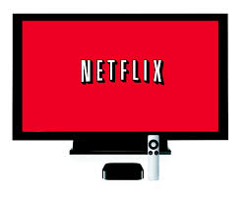
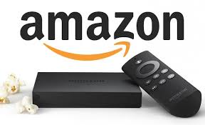
Future Tasks

