Slide 1
Media concentration – European & national market realities
Gilles Fontaine
Head of the Department for Information on
Markets & Financing
European Audiovisual Observatory

Slide 2
Overview
Objectives and methodology
A look at national markets
European groups and services

Slide 3
Background to the report
TV markets are structured primarily on a national basis (or by linguistic zones)
National players
National “tastes”
National advertisers
Are there signs of an evolution towards a more “European” market
Same services ?
Same players ?

Slide 4
Methodology issues
Difficulties to access full sets of revenues figures by company
On the advertising market
On the pay-TV market
Other indicators used by the Observatory
Audience market shares
Subscribers market shares
Cumulated market shares of the top 2, 3 , 4 groups
HHI (Herfindahl-Hirschman Index)
Subscribers data for major SVOD services not available
Non Linear TV viewing not available by players

Slide 5
Concentration on the national audience markets
The two main broadcasting groups have on average a 51% share of the audience, and the 3 main groups 64%.
But the concentration strongly varies between countries: the 3 main groups account for from 54% of the audience in Estonia, up to 82% in Czech Republic.
Sample: 30 European countries

Slide 6
2014 Vs. 2011: audience concentration
The cumulated market share of the 4 main TV channels has decreased by 4.3% between 2011 and 2014
BUT
The cumulated market share of the main TV groups only decreased by 1.8% over the same period
The leading broadcasting groups have managed to launch (or acquire) niche channels to compensate to an extent for the loss of audience of their main channels
Linear TV viewing time stagnating/decreasing, challenged by Internet viewing

Slide 7
Concentration on the national pay-TV subscribers markets
The two main TV groups gather on average 42% of subscribers, and the 3 main groups 68%.
The concentration strongly varies between countries: the 2 or 3 main groups account from 57% of subscribers in Lithuania, and up to 100% in Cyprus, Greece, Ireland, Italy and Malta.
Sample: 27 European countries

Slide 8
2014 Vs. 2011: subscribers concentration
The subscribers’ share of the 4 main TV groups has increased by 3.9% between 2011 and 2014, and it increased in 17 countries of the sample.
However the average HHI slightly decreased during the same period, indicating that the competition between the main groups has led to more balanced subscribers shares between them.
Netflix not included !

Slide 9
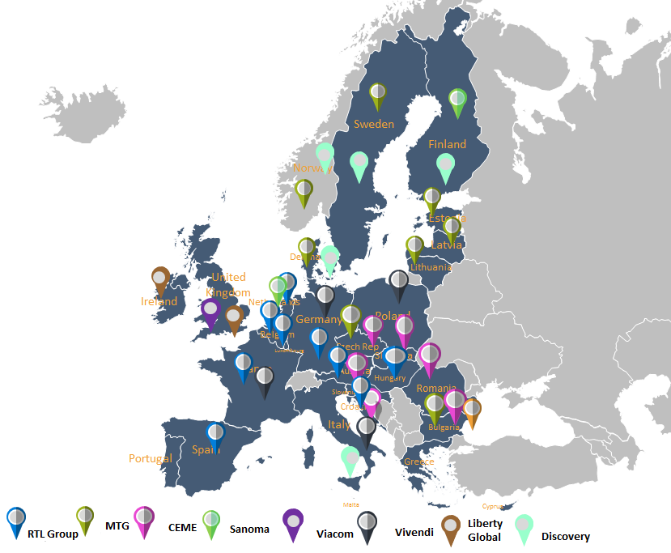
Evolution towards European players and services: Multi-countries broadcasters
“Intensive presence”: leading role in several countries
Number of viewers < of a single broadcasting group in a big country

Slide 10
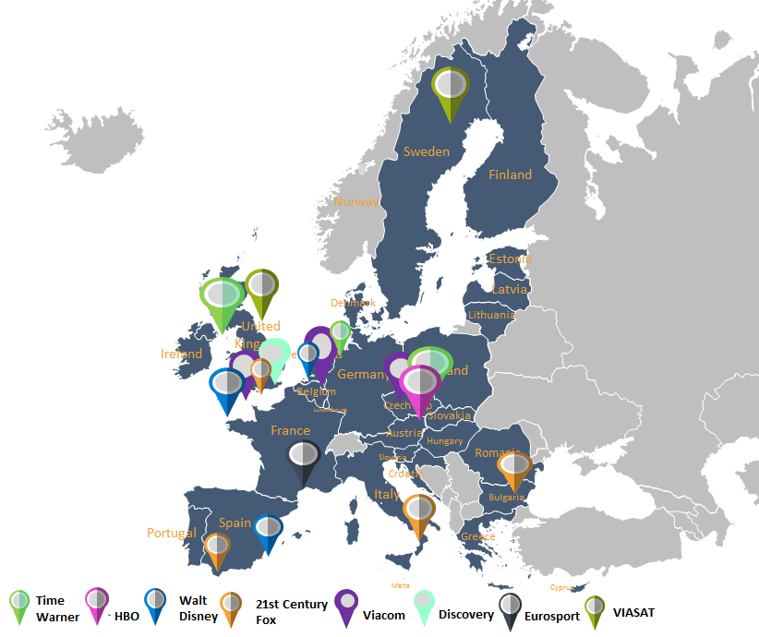
Evolution towards European players and services: European channel brands
“Extensive presence”: niche channels available all over Europe
Some brands get 1% of cumulated market share in Europe

Slide 11
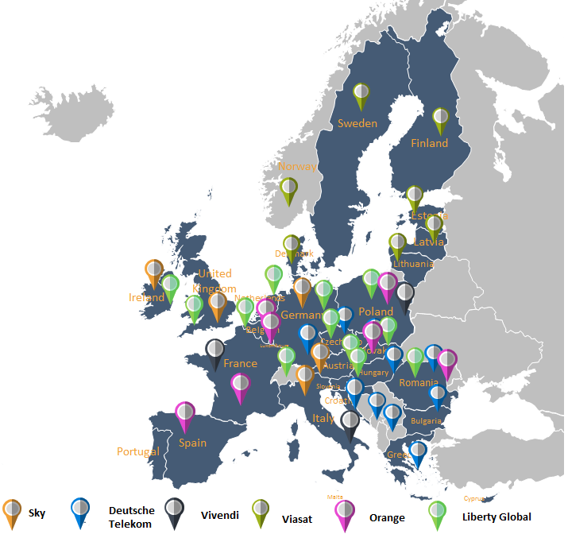
Evolution towards European players and services: European TV distributors
Top 15 pay-TV distributors serve 68% of EU pay-TV homes
Netflix not included !

Slide 12
For more information on TV channels and TV distributors in Europe
MAVISE
The data base of TV channels and on-demand services
42 countries
Origin of services
Availability on the main line-ups
Ownership
mavise.obs.coe.int

