Slide 1
The Commonwealth Cybercrime Initiative
David Tait, Cybercrime Policy Analyst

Slide 2
Policies, activities and initiatives on cybercrime of the Commonwealth
The Commonwealth Cybercrime Initiative;
Case study; and
Work in 2015/16

Slide 3
Commonwealth Secretariat’s Rule of Law Division
Commonwealth Cybercrime Initiative (‘CCI’)
National Needs Assessments
Legislative and regulatory reform: Commonwealth Model Law, Harare Scheme, London Scheme, Commonwealth Network of Contact Persons, Commonwealth Technical Guidance on Virtual Currencies, Commonwealth Guide on Cyber Security Strategies
Capacity building
University Partnerships
Establishment of Regional Cybercrime Networks
Twinning arrangements with other Commonwealth Jurisdictions

Slide 4
Commonwealth Heads of Government Meeting 2013
“Heads of Government… encouraged collaboration by member states with relevant international organisations and agencies, to develop appropriate programmes of technical assistance, in order to enhance capacity in resource-constrained settings. Heads noted the Commonwealth Cybercrime Initiative and the recent endorsement of its methodology by senior officials of Commonwealth Law Ministries in September 2013 and called for the provision of assistance to developing countries on their cybercrime issues.”

Slide 5
What is CCI?
Consortium circa 40 international organisations, including Interpol, OAS, Council of Europe, CTO, ITU and UNODC.
Responds to actual need within member states.
Mission
CCI aims to provide coherent, comprehensive and sustainable assistance to member states to build capacity to combat cybercrime
Methodology
Single assessment tool, CCI Checklist; and
CCI works with a range of international partners to provide support to member states with appropriate legal frameworks as well as investigative, technical, enforcement and criminal justice capabilities

Slide 6
Commonwealth strengths and opportunities
Commonwealth as a trusted partner with unique convening power and the principles of the Charter;
Pan-Commonwealth legal heritage;
Clear mandate from CHOGM and LMM;
Buy-in from key international organizations (Interpol, Europol, UNODC, CTO, ICANN, OAS, GPEN); and
Rapid response to member state requests.

Slide 7
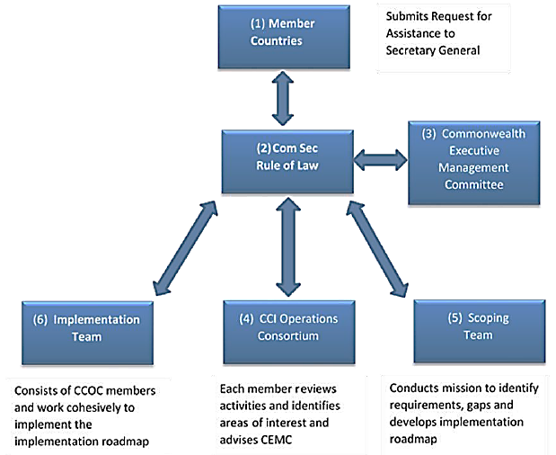
CCI structure

Slide 8
Member states engaged
Ghana
Botswana
Kenya (also UNODC assessments)
Uganda (also UNODC assessments)
Tanzania (also UNODC assessments)
Dominica (awaiting Cabinet Approval) and
Trinidad and Tobago
Regional meeting held in East Africa in May 2014 resulting in ‘Kampala Outcomes’.
FY2015/16 three further needs assessments in the Caribbean will be conducted in partnership with OAS and other Consortium partners.

Slide 9
Impact?
Proposed legislative amendments on definitions, evidence provisions, and data retention provisions in Ghana;
Established University partnership between Ghana and UK institutions developing capacity in higher education sector;
Cybercrime criminal justice advisor deployed to Ghana by CCI partner to provide on the ground support to law enforcement and prosecution authorities;
Supporting reform of cybercrime legislation in Botswana;
Assisting establishment of Information Commission in Trinidad and Tobago by drafting supporting regulations on personal data and information security;
Development of regional cybercrime outcomes for East Africa providing clear policy priorities; and
Hosting of Commonwealth Roundtable on virtual currencies to highlight risks, advantages and impact for Commonwealth.

Slide 10
Case study: Botswana
CCI needs assessment recommended review of Cybercrime Act 2007;
Funding secured by Secretariat from donor to undertake work in February 2015;
Expert report received in March 2015 by Government of Botswana;
Government of Botswana makes formal request for assistance with drafting of amendments of the 11 May 2015 in order to meet parliamentary deadline of July 2015; and
Secretariat team composed of expert in cybercrime legislation and legislative drafting advisor deploys for 1 week to assist Ministry of Defence and Attorney-General’s Office complete drafting.
Total time from request for assistance to deployment of team was 4 weeks

Slide 11
Highlights for 2015/16
Undertake 3 further needs assessments in the Caribbean region;
Review of the Commonwealth Model Law and Harare Scheme focusing on improved models of mutual legal assistance and electronic evidence rules;
Continued implementation of Kampala Outcomes with the establishment of networks on international cooperation, child online protection and university partnerships in Eastern Africa;
Creation of Expert Working Group to develop technical guidance on legislative, regulatory and criminal justice responses to virtual currencies across the Commonwealth; and
Joint Secretariat–Commonwealth Telecommunications Organisation project to enhance cooperation between law enforcement and telecoms sector to counter cybercrime in Nigeria.

Slide 12
Thank You cybercrime@commonwealth.int

