Slide 1

7th meeting of the Ad hoc Working Group on Reporting
Next steps of the 2019-2024 reporting

Slide 2
BEFORE DATA SUBMISSION
CoE-EEA developers 2025:
Test and correct validations rules scenarios (your data is welcome)
Publish Resolution No. 8 (2019-2024) dataflow in Reportnet 3 (production platform, users' environment): January 2026
Countries:
Test the range tool and provide feedback (November-December 2025)
Lead reporters and additional reporters-> create EU logins (January 2026)
Opening of the dataflow from the 15th January
Test period: from 15th January to 1st March mainly. Report any problem with BLOCKERS and ERRORS.
Reporting deadline: 31st of March (data submission from 1st March)
When questions are related to IT issues:
resolution8.helpdesk@eiont.europa.eu
Questions related to content:
Helpdesk.reporting-bernconvention@coe.int

Slide 3
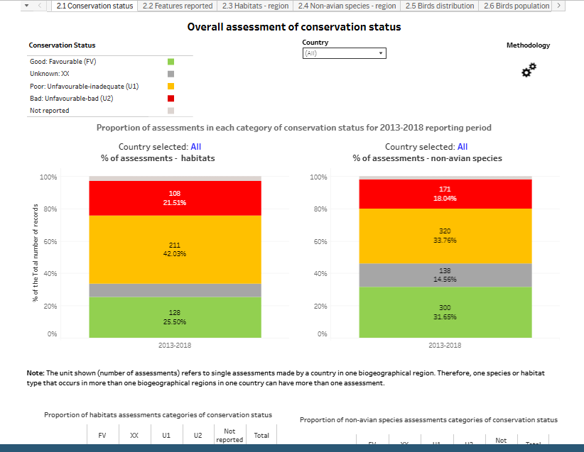
AFTER DATA SUBMISSION
Analysis of ERRORS: contact countries if their data needs to be corrected? Re-submission of data?
Analysis of data/ dashboards/ statistics
National reports & non-EU biogeographical reports
Pan-European assessment for a couple of habitat or species with good data quality
Presentation of results at COP-17 in Armenia in October 2026 (if no delays, problems with data quality, etc.)
Display results on the CoE website

Slide 4

Thank you for the attention

