Slide 1

7th meeting of the Ad hoc Working Group on Reporting
Spatial data for the reporting 2019-2024

Slide 2
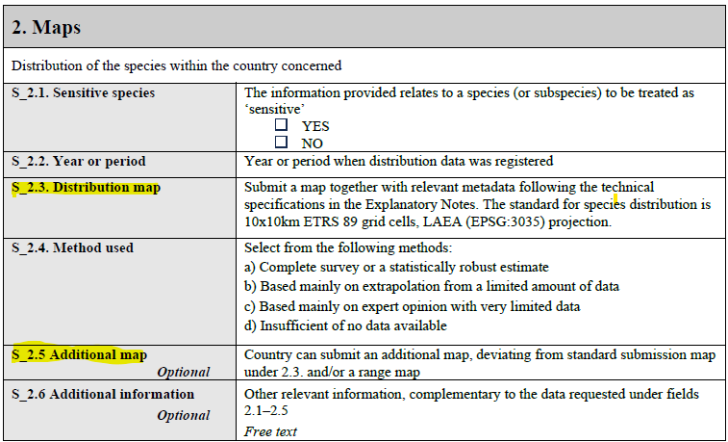

Slide 3
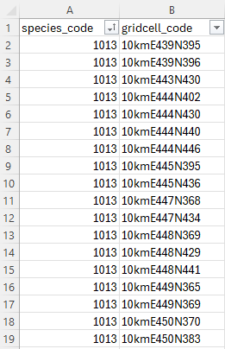
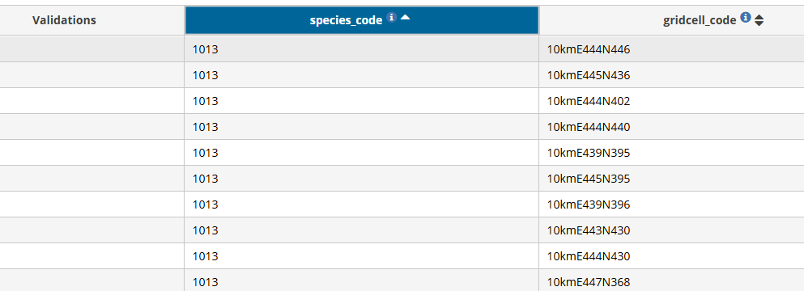
From the Extended Excel Template_Species Spatial : one 10x10km grid per entry.
1x1km or 50x50km also possible

Slide 4
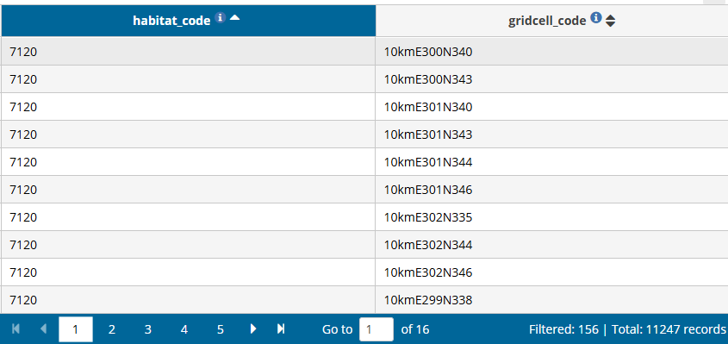
Habitat_distribution_GridCells (tabular information)
Gridded polygons can also be uploaded

Slide 5
Gridded polygons:
Zipped shapefiles (.shp, .shx, .dbf, .prj)
Unzipped geopackage files (.gpkg)
Gridded polygons, or individual grid cell polygons must precisely match the specific EEA reference grid
SRID (Spatial Reference System Identifier) should be EPSG:3035
Shapefiles can include multiple layers, it is acceptable multiple layers for the same species or habitat type
Files can contain dissolved or undissolved grid cell polygons at the proper European projection.
These files will not be stored in Reportnet 3! Only the tabular information of these files will be extracted and stored

Slide 6
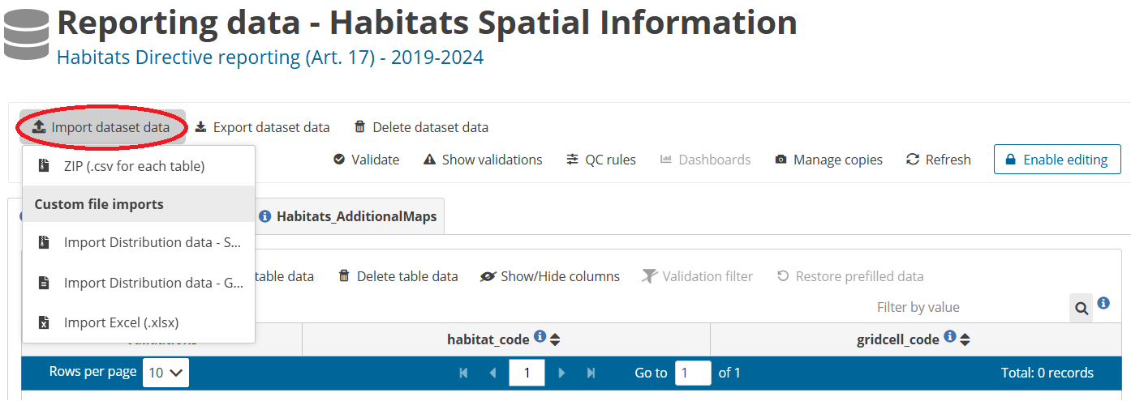
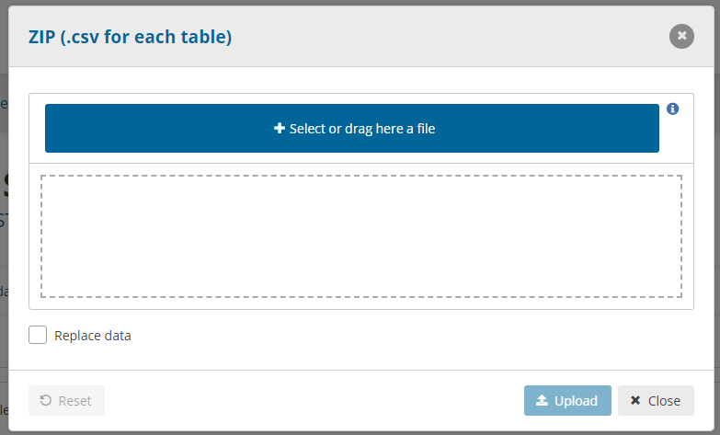
Only one file imported at a time!

Slide 7
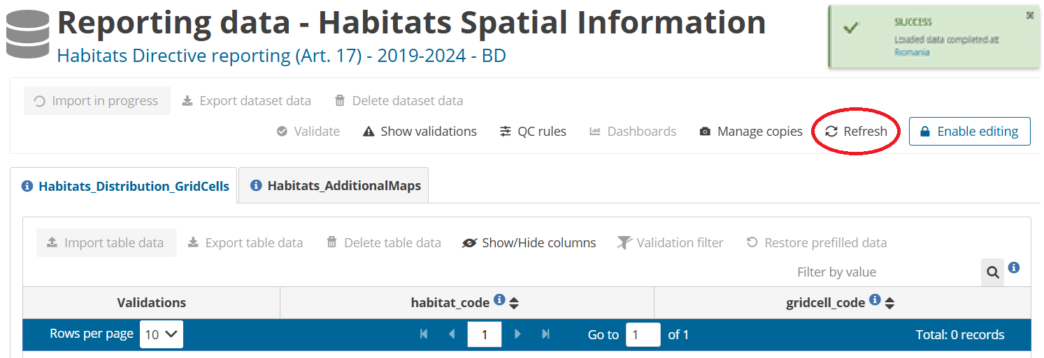

Slide 8
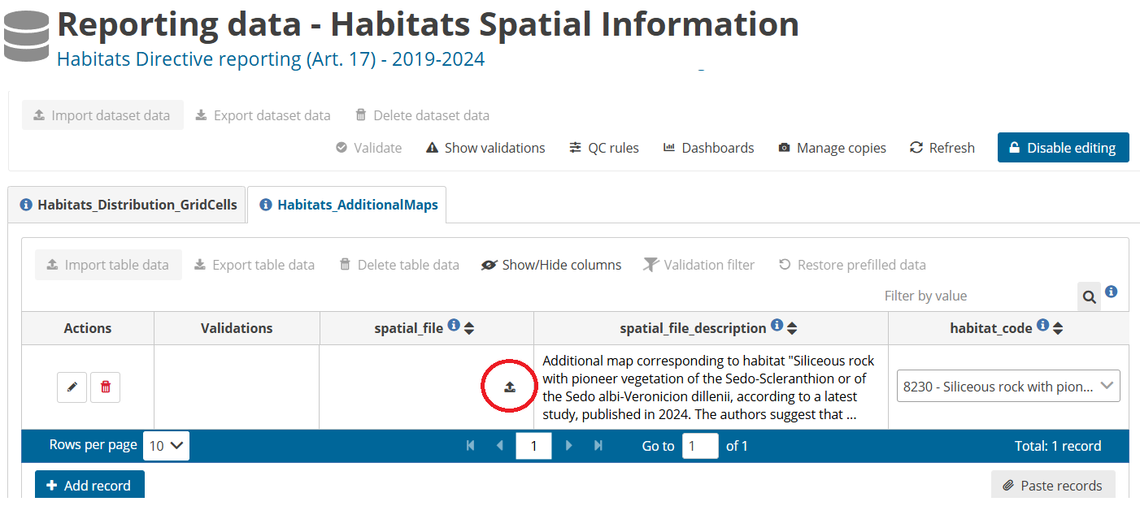
ZIP format are under 100 MB
No quality control checks for Additional Maps

Slide 9
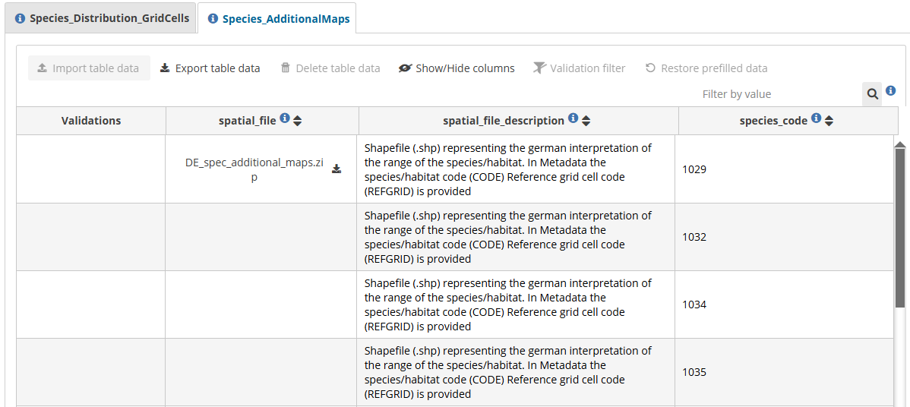

Slide 10

Thank you for the attention

