Slide 1

7th meeting of the Ad hoc Working Group on Reporting
Range tool

Slide 2
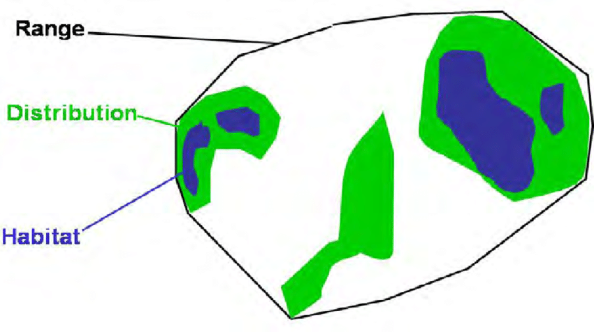
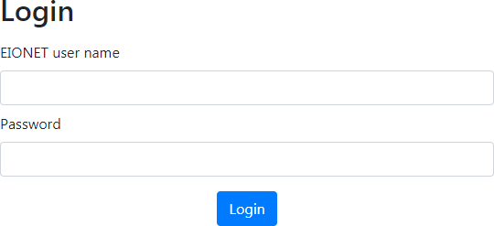


H_4_1 and S_5_1 section demand range
discomap.eea.europa.eu/App/RangeToolEurope/Auth/Login?ReturnUrl=%2fApp%2fRangeToolEurope
Tool created by the EEA (Guidelines for using this tool are included in the Reporting Reference Portal) to facilitate the task
10x10 km grid interface
1x1 km grid interface
EIONET user account

Slide 3
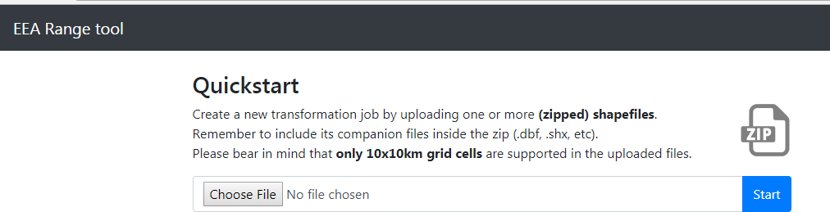
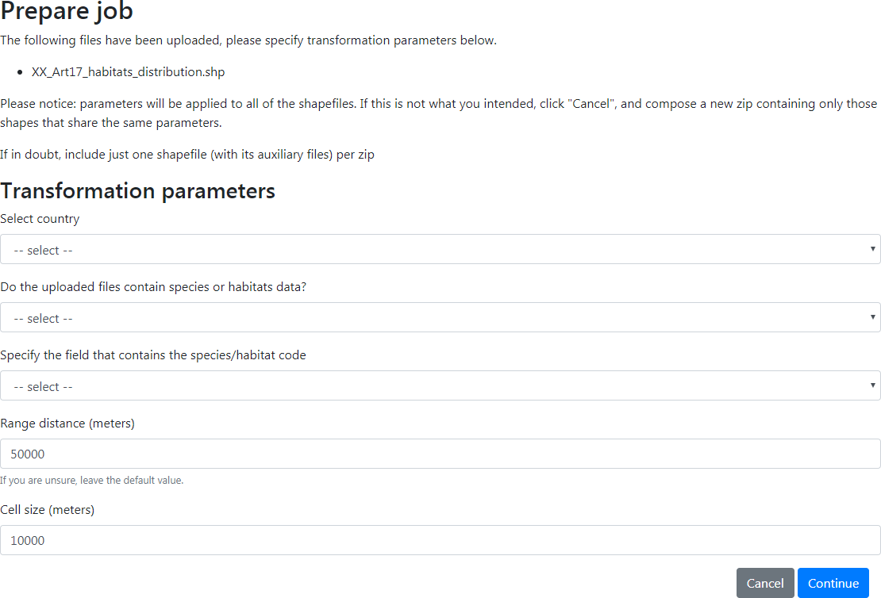
Upload the information
Upload a *zipped* shapefile containing all required files (.shp, .shx, .dbf, .prj)
Projection must be valid; tool reprojects automatically to EPSG:3035
Tool converts polygons to aligned grid cells
Choose gap distance (Reporting Guidelines)

Slide 4
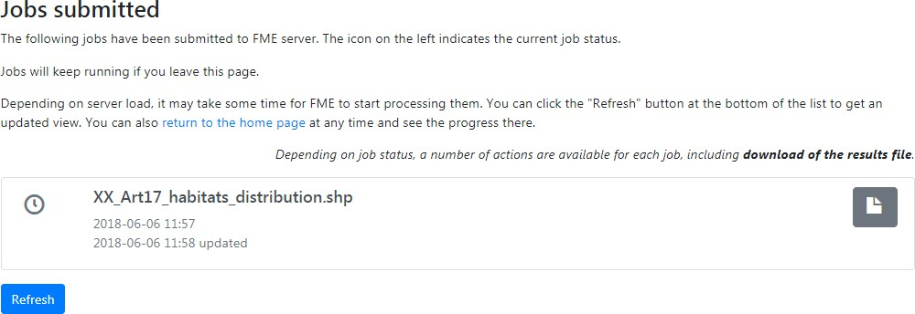
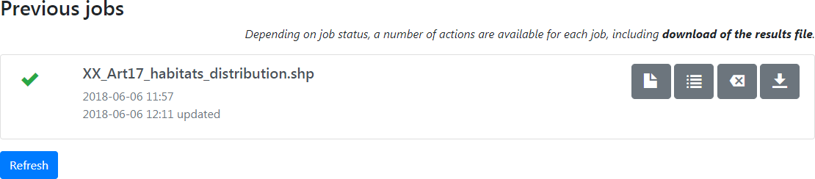
Submit job
Processing time depends on FME server
Status indicated by clock icon (queued)
Download file
Range shapefile
.csv files: full and filtered (excludes grids flagged for deletion)
2

Slide 5
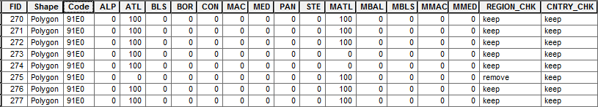
Results
the presence (100) or absence (0) of the feature per grid cell
Suggested grids for deletion (to be reviewed and manually adjusted)
Modifications require recalculating range values
Areas to be excluded: Marine areas mistakenly included for terrestrial features
Areas outside checklists for given region
1 km tool may report “no_info” for unclear regions
Grids crossing country boundaries

Slide 6

Some countries tried the tool and reported ERRORS (thank you !)
EEA is trying to solve these errors
Are you interested in using it or you will use your own tools?
We still ask for voluntary countries to test it and help us to fix it (ideally in December)

Slide 7

Thank you for the attention

