Slide 1
Training workshop on Gender equality and intersectionality mainstreaming for Council of Europe Gender Equality Rapporteurs (GERs) Strasbourg 5-6 November, 2024 Trainer: Dr. Patricia Munoz Cabrera (PhD)

Slide 2
Welcome and introduction
Programme and objectives
Interactive presentation of participants

Slide 3
Programme Day 1 – 5 November 2024
9:30 – 10:30
Welcome, introduction, Group Energiser
10:30 – 11:30
Session 1 – How to integrate Gender Equality and Intersectionality (GE&I) in our daily work/ committee/body? –Sharing good practices & challenges.
11:30 – 12:00
Coffee Break
12:00 – 13:00
Session 2 – What is the Role of a GER? - Ambassadors for Change.
13:00 – 14:30
Lunch break
14:30 – 16:00
Session 3 – How to do a gender and intersectional analysis/scan of our documents?-Practical exercise Short break (16:00-16:15)
16:15 – 17:25
Session 4 – Shifting Mindsets: how to deal with resistances to gender equality and intersectionality mainstreaming.
17:25 – 17:30
Wrap up of day 1

Slide 4
Programme Day 2 – 6 November 2024
9:15 – 9:25
Recap from Day 1
9:25 – 10:15
Session 5 – Building common ground on gender equality and intersectionality.
10:15 – 10:45
Coffee Break
10:45 – 12:15
Session 6 –Designing my GE&I Roadmap to put my Comm./Body in action.-Practical exercise with Tasksheet #3
12:15 – 12:30
Wrap up
12:30 – 12:45
Final words from Gender Equality Division and written evaluation of the training.

Slide 5
Objectives of the training workshop
To build and enhance the analytical and operational capacity of Council of Europe GERs to mainstream gender equality, intersectionality and women’s rights in their overall work, including working with Committees and other Bodies.
Notes:
Patricia’s Note:
Including their

Slide 6
Expected outcomes
By the end of the 1.5-day training, as GER you will have :
acquired a set of tools and entry points on how to mainstream gender equality and intersectional issues in your daily work, including working with your Committees and bodies.
enhanced your understanding of the key role you play as Gender Equality Rapporteurs, and developed compelling arguments to more effectively tackle resistances to gender equality and intersectional inclusion.
Designed your own “Roadmap” for putting your respective committees/bodies in action.
Notes:
The training aim at providing a safe space for discussions, express ideas, doubts and difficulties, sharing our experiences. Our exchanges are key to a successful training.

Slide 7
Methodology – key elements
the principle of transformative thinking on gender equality and intersectional inclusion. What does it mean? GERs = change agents.
a safe space for building individual and collective knowledge (concrete tools and insights to improve your GE&I mainstreaming work, neutralise resistances, and inspire others to engage with GE&I issues in a critically constructive way.
how to build your own Roadmap for encouraging your committees and bodies to take action on gender equality and intersectional inclusion, in line with human rights commitments and obligations of members states.
An empowering mix: analytical presentations, applied concepts, practical exercises and exchanges on good practices.
Notes:
Notes for slide on Methodology
An empowering mix: key elements are analytical presentations, practical exercises and exchanges on good practices.
The training methodology was designed on the principle of transformative thinking on gender equality and intersectional inclusion. What do we mean by transformative thinking? We start from the basis that GERs can be active change agents in their respective working milieus. This is why we chose the title of this training: Ambassadors for change.
A safe and interactive space: The training sessions will provide a safe space for building individual and collective knowledge through discussions, expression of ideas, doubts and difficulties, sharing of good practices in applying gender equality and intersectional perspectives in our work .
The sessions are intended to provide you with tools and entry points for operational integration of GE&I learnings into your daily work.
Special attention has been given to developing skills for building compelling gender-sensitive arguments, including how to neutralise/deconstruct resistance and how to inspire others to engage with these issues in a critically constructive way.
Training tools and practical tips will also help you to engage with gender equality and intersectionality on topics/sectors that are not commonly addressed in gender equality training, and which are relevant to GERs (based on responses to TNAs).
Last but not least, the methodology includes how to build your own Roadmap for encouraging your committees and bodies to take action on gender equality and intersectional inclusion, in line with human rights commitments and obligations of members states.
Please do not hesitate to ask questions, and put your issues forward anytime you want. We have also prepared two Charts (shows them, where you will be invited to post suggestions for follow up actions (their road map) and the other chart for posting doubts, request clarifications and make suggestions …

Slide 8
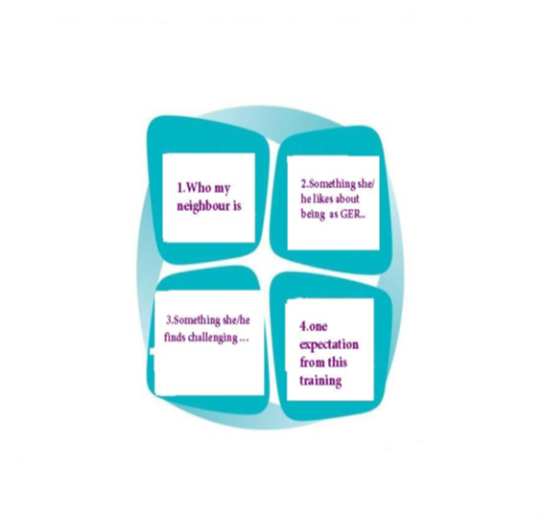
Interactive presentation of participants
Guidelines:
Participants turn to the neighbour on their right side and introduce each other based on the following (10 min):
Name – Country – Role in the Council of Europe.
Something each one likes about being a CoE Gender equality Rapporteur.
A challenge or difficulty you face regarding integration of gender equality and intersectional perspectives in their work.
One expectation from this Training workshop.
In plenary, neighbours introduce each other
(10 mins.)

Slide 9
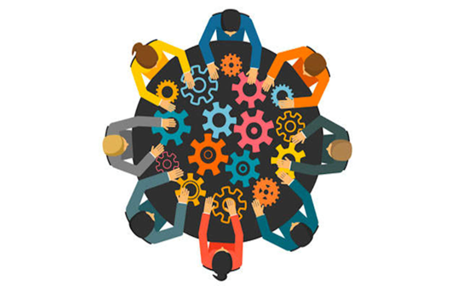
10:15 – 10:30. Group energiser: “The Elevator Pitch” (Tasksheet #1). “ Why is mainstreaming gender equality and intersectional issues important for the Council of Europe, especially in the context of multiple crisis?
Guidelines:
Please look at the list in next slide and organise in random subgroups.
Follow the guidelines in Tasksheet #1.
Duration: 25 mins. (10 mins. for group brainstorming + 15 minutes for reporting and plenary exchanges).
In this session you will be working in random subgroups to build compelling arguments on why it is important to integrate gender equality and intersectional issues in all of Council of Europe activities and areas.

Slide 10
The Elevator Pitch: Reporting and Exchanges in plenary
In the context of multiple crisis, mainstreaming gender equality and intersectional issues is important for the Council of Europe, because…
…………………………..
………………………......
…………………………...
Notes:
Notes:
Stress the fact that Building compelling arguments on why integrating gender equality and intersectional issues in all Council of Europe activities and domains is critical

Slide 11
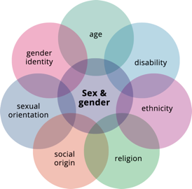
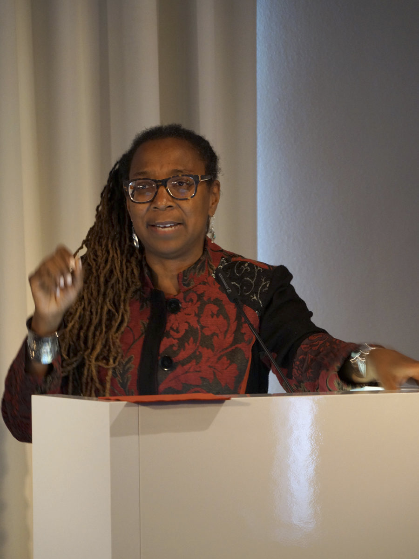
Intersectionality:
Certain groups of women (men and non-binary persons), due to the combination of their sex/gender with other factors, such as their race, colour, language, religion, political or other opinions, national or social origin, association with a national minority, property, birth, sexual orientation, gender identity, age, status, refugee or migrant status or other status*, are often subjected simultaneously to one or several other types of discrimination.
* Want to know more? : see Grounds of discrimination included in article 4§3 of the Istanbul Convention
Key to remember: focus is not only on identity but also on power systems that create multiple forms of inequality or disadvantage which have an impact on our daily lives.
Kimberle Crenshaw, one of the creators of the intersectionality theory
Notes:
The theory of intersectionality was first developed by Kimberlé Crenshaw, leading American scholar of civil rights and professor of law, who published a paper in 1989 entitled Demarginalizing the Intersection of Race and Sex and Mapping the Margins: Intersectionality,. Identity Politics, and Violence Against. Women of Color. Kimberle Crenshaw* She was inspired in particular by the legal case DeGraffenreid v. General Motors (US District Court for the Eastern District of Missouri, May 4, 1976) that involved racial, sex and class discrimination against five black women workers who were refused jobs in a factory. The court ruled that there was no instance of discrimination, as the factory hired both black people and women. However, the court failed to see that the factory did hire black men and white women but discriminated specifically against black women. The term intersectionality was coined by Crenshaw to capture this unique combination of discrimination.

Slide 12
Practical example of intersectional discrimination in employment
In France, an experiment showed that women with a French-sounding name had a 22.6 % of being called for an interview when applying for a job, compared with women with a Senegalese sounding name (8.4 % chance) and men with a Senegalese sounding name (13.9 %)
UNHRC 2017, “Impact of multiple and intersecting forms of discrimination and violence.” https://digitallibrary.un.org/record/1298043?ln=en&v=pdf

Slide 13
Example of intersectional discrimination in the area of finance:
In Finland a young man, was denied a loan online.
After investigating the case, the Equality Body (the Non-Discrimination Ombudsman) found that it was a case of multiple discrimination because the the company had used statistical models to assess credit worthiness that treated the applicant’s age (30s), his gender (male), his language (Finnish) and place of residence (rural) as factors of disadvantage in the assessment performed by the financial institution.
Source: CoE 2023 “Study on the impact of artificial intelligence systems and their potential for promoting equality
https://edoc.coe.int/en/artificial-intelligence/11649-study-on-the-impact-of-artificial-intelligence-systems-their-potential-for-promoting-equality-including-gender-equality-and-the-risks-they-may-cause-in-relation-to-non-discrimination.html
Notes:
A Muslim woman wearing the Hijab can be discriminated because she is a woman and because she is a Moslim. If she happens to be lesbian or Trans, she will be intersectionally discriminated on three important dimensions of her existence.
https://sharing4good.org/article/what-intersectionality-center-intersectional-justice

Slide 14
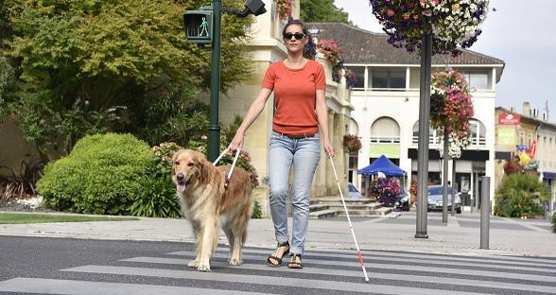
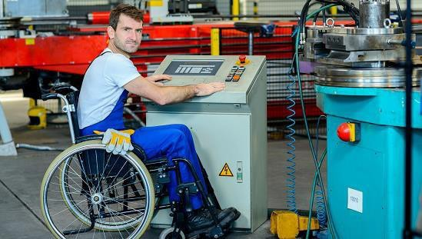
Added value of gender equality and intersectional analysis: it makes other grounds of discrimination visible ….transformative thinking
2017 estimate: By 2020, 20% of the EU
population is expected to have some form of disability. The CoE is committed to improving social and economic situation of persons with disabilities, building on the Charter of Fundamental Rights of the EU. CoE Disability Strategy 2017-2023.
2023 data: 27% of the EU population over the age of 16 had some form of disability. According to Eurostat, that equals to one in four adults in the EU.
https://www.consilium.europa.eu/en/infographics/disability-eu-facts-figures/
Source:https://ec.europa.eu/social/main.jsp?langId=en&catId= 1137&furtherNews=yes&newsId=9435

Slide 15
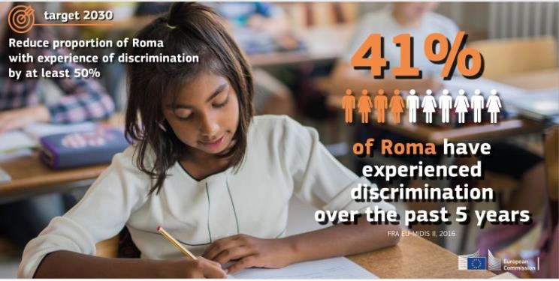
The impact of intersectional discrimination on children’s lives and rights - the case of Roma children
During COVID (2020 Data):
Mid-Term socio-economic impacts ( ex. lack of access to remote learning, no internet connection, electricity).
Long-term Impact: deepening of inequalities in education, rising unemployment.
Scapegoating during the Coronavirus crisis across Europe.
Before COVID
2023 data: 85% of Roma children are at risk of poverty compared to 20% of children in the general.
Intersectional question: what about Roma girls/boys compared to non-Roma children?
Source: https://commission.europa.eu/system/files/2020-10/factsheet_-_a_new_eu_roma_strategic_framework_en.pdf

Slide 16
Thinking intersectionally
Equality and non-discrimination are fundamental pillars of democratic societies and the condition sine qua non for the effective enforcement of human rights for ALL citizens, regardless of their gender, sex, race, ethnicity or any other marker of social differentiation.
Cf. adapted from CoE “Intercultural integration strategies: managing diversity as an opportunity,” Working Group on Intercultural (GT-ADI-INT)

Slide 17
A few entry points to build compelling arguments on why gender equality is crucial for the CoE
Gender equality is a fundamental human right and an area where structural inequalities persist.
It is also a question of social justice (CoE Gender Equality Strategy 2024-2029)
A precondition for participatory democracy and a robust rule of law.
An area where legal commitments have been made: for ex. legal and policy frameworks for gender equality and gender mainstreaming (UN-CEDAW, BEIJING+15); CEDAW, CSW, and Istanbul Convention.

Slide 18
10.30-11.30: Session 1 – How to integrate gender equality and intersectionality issues in our daily work/committee/body? – Plenary session Objective: to create a space for collective knowledge building as GERs. In this Session 1 or 2 GERs will share their experiences based on the following entry points:
what has worked?
2) what has not?
3) where are the obstacles/challenges?
4) where do I see opportunities for enhanced integration of gender equality and intersectionality issues in my work as GERs?

Slide 19
11:30 - 12:00 Coffee Break
30 minutes

Slide 20
12:00-13:00: Session 2 What is the role of a Gender Equality Rapporteur ? – Ambassadors for Change Cécile Gréboval Council of Europe Senior Equality Advisor

Slide 21
The role of Gender Equality Rapporteurs Workshop on gender equality and gender mainstreaming for GERs, Strasbourg, 5-6.11.2024 Cécile Gréboval, Programme Manager – Gender mainstreaming, Senior Gender Equality Advisor

Slide 22
Who are the GERs?
Gender Equality Rapporteurs (GERs) were first introduced in the Council of Europe through the launching of the Transversal Programme on Gender Equality (2012).
GERs are central actors for the implementation of gender mainstreaming throughout the Organisation.
As of November 2024, 50+ GERs have been appointed.
This has led to sustained efforts to introduce a gender equality perspective in a growing number of policies of the Council of Europe.
Notes:
GM an objective of the Council of Europe Gender Equality Strategy 2018-2023 and of the previous strategy 2014-2017)
52 GERs

Slide 23
The key role of Gender Equality Rapporteurs: what the CoE recommends
GERs play the role of ambassadors of gender equality and gender mainstreaming in their respective institutional setting.
“Handbook for Gender Equality Rapporteurs: gender Equality and Gender Mainstreaming in Practice,” April 2022
What does this mean in practice?

Slide 24
The three roles of Gender Equality Rapporteurs
Wear your gender and intersectional glasses
3. Be well connected and use networking
2. Multiply knowledge and inspire others
Notes:
1: change of perspective and look at your issues differently
2: what helps a lot is to find the right information, contacts, data
3: there are allies/ organisations that support your work

Slide 25
Compile information
Check previous gender mainstreaming activities of your committee (secretariat, previous GER)
Check the gender equality website (www.coe.int/equality) of the Council of Europe, contact the Gender Equality Division
Use the GER Handbook and the online course on gender equality and gender mainstreaming
Get information from GERs of committees working on similar issues.
Propose the drafting of a factsheet / study /information document on gender equality issues in your area

Slide 26
Invest in terminology and common language
Help colleagues in the committee know what they are talking about and ensure the use of the same terminology (for example, the difference between “sex” and “gender”). The Council of Europe Gender Equality Guidelines on the use of language as a driver of inclusivity can be of help in this regard.
Be aware of possible linguistic challenges about the term gender and its translation in different languages.
Raise the issue of gender-sensitive terminology and communication in the documents and tools produced by the committee
We all have assumptions and gender stereotypes that can impact our work. Check your own gender stereotypes and assumptions on the issues dealt with by your committee.

Slide 27
Use the programming process of the entity as an outline
Keep in mind the terms of reference /work programme /rules of procedure of your entity regarding gender mainstreaming + other commitments in this respect
Look at the long-term planning of your entity to identify priorities and possible actions, involve supportive colleagues
Before there are elections/nominations in the committee, remind of the need to achieve a gender-balanced representation (a minimum of 40% of each sex, parity 50/50 would be ideal).

Slide 28
Prepare the meetings of your committee
Before plenary meetings, look at the agenda and identify the potential topics/activities where it might be relevant to raise gender equality issues, contact the chair /secretariat
Look for allies and involve other members of the committee, find colleagues interested in the issue
Look for an evidence-based approach in the work of the committee: research and disseminate data and information on the gender equality perspective in relation to the topic at stake.
Notes:
Be aware of the potential existence of good-quality research that you could build on.

Slide 29
Organise a training session, hearing, round table or other event
Propose the inclusion of a session/hearing on gender equality or gender mainstreaming during a future committee meeting
Ask the Secretariat and/or Gender Equality Division to recommend potential experts, relevant international or civil society organisations
Ask other committee members to present examples from their country
Such work, especially in areas where gender mainstreaming is new may raise the profile of your committee and create new links

Slide 30
cecile.greboval@coe.int
Gender mainstreaming at the Council of Europe (coe.int)
www.coe.int/equality

Slide 31
13:00-14:30

Slide 32
14:30 - 14:40. Back from Lunch – Time for an energiser : “the controversial quiz.”
Guidelines: Working in random subgroups of 4, you will walk around the room, looking at a series of sheets with biased statements.
Draw a happy face if YOU AGREE……
And an unhappy face If you don’t.
Choose one statement and explain your choice

Slide 33
14:40 – 16:00: Session 3 – How to do a gender and intersectional analysis /scan of documents?
Practical exercise in 3 thematic subgroups on gender/intersectional scan with Tasksheet #2
Objective: to reinforce our skills for doing a gender equality and intersectional analysis of our documents.
For this practical exercise we will use the Tasksheet #2 and one short document that has been selected for your group.
Thematic Subgroups are shown on list in next slide.
Duration of this exercise: 1h20mins.

Slide 34
Three Thematic Subgroups
Group 1: Gender GE&I in human rights (including women and girls' fundamental rights, children's and minorities ‘rights etc.) Co-facilitator: Cécile Gréboval | Group 2: GE&I in the digital world, science (including tech-facilitated violence against women, online safety, inequality and artificial intelligence etc). Co-Facilitator: Yanna Parnin | Group 3: GE&I , non-discrimination, democracy and governance (including social inclusion, combatting racism, participation of civil society, women’s participation in all areas, minority languages). Co-facilitator: Patricia Munoz Cabrera
Panagiota MARGARONI | Martina BRIX-ZULEGER | Edwin LEFEBRE
Mabera KAMBERI | Jennifer ADAMS | Michael VASECKA
Stefania CHIRU | Käthlin SANDER | Mahulena HOFMANN
Viktoria SEBHELYI | Laura ALBU | Milena ČALIĆ-JELIĆ
Valerie POPPE | Flurina FREI | Anna STEINER
Evrydiki TSELIOU | Roza CSEBY | Maja CVETKOVSKI

Slide 35
Practical exercise: How to do a G&I analysis /scan of documents?
15:30: FEEDBACK IN PLENARY

Slide 36
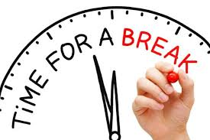
16:00- 16.15

Slide 37
16:15 – 17:25: Session 4 – Shifting mindsets: how to deal with resistances to gender equality and intersectionality mainstreaming?
Objective: to reflect on gender stereotypes and unconscious bias, and acquire skills to build convincing arguments for tackling resistances.
Energiser: inspirational video (“Drawing the balance”) + open discussion https://www.youtube.com/embed/p9cU6J2Df9o (15 minutes)
Short PPT with an interactive exercise on how to build convincing arguments to neutralise resistances (15 mins.)
Thematic subgroup work to rewrite a text in a way that is more sensitive to gender equality and intersectionality (20 mins). Presentations and discussion in Plenary (10 minutes).
Subgroup work: how to reformulate/rewrite policy documents in a way that is more sensitive to gender equality and intersectional issues

Slide 38
Energiser: inspirational video (“Drawing the balance”), followed by open discussion - Cécile Gréboval
Link to the video https://www.youtube.com/embed/p9cU6J2Df9o (15 minutes)

Slide 39
How to neutralise/deconstruct resistances: short PPT with an interactive exercise on how to build convincing arguments to neutralise resistances (15 mins.)
We will walk through a series of statements/arguments commonly used to resist gender equality.
You will express agreement or disagreement and substantiate your argument.
Some of you can play the devil’s advocate, so be ready to think of counter arguments based on your own experience!

Slide 40
1. Women have already achieved equal rights today. GERs are not
needed any more.
Agree
or Disagree?
WHY YES ?
What is your (counter) argument ?
WHY NOT?

Slide 41
1. Women have achieved equal rights. GER are not needed any
more.
Refer your interlocutors to CoE’ recommendations and standards on G.E. and the rights of disadvantaged social groups, EU Legislation & UN Resolutions
How to sustain your argument?
Use reliable data, provide facts/ figures that contradict this statement
Counter argument: de jure perhaps, de facto by no means

Slide 42
2. Women are too emotional to be good leaders. Men are better
decision-makers.
Agree
or Disagree?
WHY YES ?
What is your (counter) argument ?
WHY NOT?

Slide 43
2. Women are too emotional to be good leaders. Men are better
economic and legal decision-makers.
How to sustain your argument?
-refer your interlocutor to CoE fact sheets: https://www.coe.int/en/web/genderequality/justice
- Use facts & figures (evidence) from other data sources:
https://eige.europa.eu/publications-resources/publications/gender-justice?language_content_entity=en
https://www.apa.org/topics/women-girls/female-leaders-make-work-better
https://www.ddiworld.com/blog/women-leadership-statistics
https://www.oecd-ilibrary.org/docserver/2f520410-en.pdf?expires=1731847138&id=id&accname=guest&checksum=DCEC8863F589696C9F1791ACC35A989F
Counter argument: Are you sure? Have you not seen how women leaders in banks and women judges are performing well ? Don’t you aim to contribute a more inclusive economic and legal environment ?

Slide 44
3. Our policies, laws, projects are gender
neutral. They benefit all people in the same way
Agree
or Disagree?
WHY YES ?
What is your (counter) argument ?
WHY NOT?

Slide 45
3. Our policies, laws, project are gender neutral.
They benefit all people in the same way
Counter argument:
Gender neutral policies/Laws are a myth. They can sometimes be negative to women and men, as they are often the result of socially constructed gender norms/roles that subordinate/discriminate women
in real life.
How to sustain your argument? Example: find Case Laws from the ECHR
Example: the Carvalho vs.
Portugal case
Additional argument: justice providers can be (un)consciously biased: example Judicial stereotyping is a common and pernicious barrier to justice, particularly for women victims and survivors of violence (www. https://rm.coe.int/1680597b20)

Slide 46
4. Combatting gender inequality does not per se mean combatting the forms of inequality/discrimination affecting minorities or disadvantaged groups .
Agree
or Disagree?
WHY YES ?
What is your (counter) argument ?
WHY NOT?

Slide 47
4. Combatting gender inequality
does not per se mean combatting the forms of inequality/discrimination affecting ministries or vulnerable groups.
Counter argument: To a good extent it does, as within those groups there are women and girls, men and boys and Trans persons who will be discriminated or privileged by virtue of their gender, sex, ethnicity and class, among other forms of intersecting discrimination.
How to sustain your argument? find testimonies/proposals from NGOs, CSOs and representatives of marginalised groups in your country, bring their voices, proposals to the table or include them as empirical evidence in your discussions .
You can also find solid arguments at the UN website on intersecting forms of discrimination where MS report on progress vis a vis national legislation…..

Slide 48
5. There are no gender differences in attitudes towards corruption, accepting bribes or offering bribes. Corruption has
no gender.
Agree
or Disagree?
WHY YES ?
What is your (counter) argument ?
WHY NOT?

Slide 49
5. There are no gender differences in attitudes towards corruption, accepting bribes or offering bribes. Corruption has
no gender.
Counter argument:
True to a certain extent, as there is no robust evidence of the causal relation between gender and lower levels of corruption. However, evidence from the World Bank shows that when there are more women in Parliament, corruption levels tend to be lower.
How to sustain your argument?
Evidence from financial
institutions.
Case studies and good practices
can be found here: https://sherloc.unodc.org/cld/uploads/pdf/Issue_Paper_Organized_Crime_and_Gender_1.pdf

Slide 50
Thematic subgroup work: “Rewriting the balance”: how to reformulate/rewrite policy documents in a way that is more sensitive to gender equality and intersectional issues.
Guidelines for this exercise: working in thematic subgroups, you will rewrite a short text in a gender and intersectionally sensitive way.
After your group finish their rewriting exercise, they will post their texts on the wall, walk around the room and see how other participants rewrote their own texts.
If time allows, we will discuss in Plenary how they felt doing this exercise and what would be its added value for your own work.
Duration: 35 mins.

Slide 51
Thematic Subgroup #1 rewrites this text
Issue: disadvantaged youth
Research demonstrates that, because of the Covid-19 pandemic, young workers have experienced considerable loss of work and income. Access to political structures for young people remains difficult and prevents them from participating effectively in the political process.
The existence of a civil society network has been critical to the delivery of support in times of crisis, such as during the Covid-19 pandemic, to young people living in Ukraine and to young refugees fleeing the war.
In 2020, the Youth Partnership between the European Commission and the Council of Europe supported two studies that examined the impact of Covid-19 on the youth sector. the studies focused on the most affected areas in the youth sector: education and mobility, youth employment, youth work and youth organisations, mental health and well-being, youth participation, digitalisation and artificial intelligence, social inclusion and national realities.
The studies found that “young people are disproportionately affected by the Covid 19 pandemic compared to other population groups.” This is due to several factors, such as the closure of schools and universities, the increase in unemployment, lack of opportunities for (learning) mobilities and social interactions.
Research also showed that marginalised, migrant, homeless and LGBTQ+ youth are particularly vulnerable and more affected than the general population of young people.
In the pandemic period, the digitalisation of the youth sector made significant progress. However, the problem of unequal access of young people to technology and online activities emerged. This area deserves immediate attention, particularly with regard to the inclusion of different groups of young people, especially disadvantaged young people.
Source: 2022, CoE/EU Youth Partnership,
https://pjp-eu.coe.int/documents/42128013/72351197/Impact+of+Covid-19+on+youth+sector+and+relevance+of+the+EU+Recovery+and+Resilience+Plans.pdf/fe775e78-5954-e104-69ea-0a05f895ceba?t=1670233995955
Source: 2022, CoE/EU Youth Partnership, at https://pjp-eu.coe.int/documents/42128013/72351197/The+impact+of+the+covid-19+pandemic+on+youth+spaces.pdf/9bfe2c91-6cc1-2fdf-4d3f-7197b350fd7d

Slide 52
. Thematic Subgroup #2 rewrites this text
Issue: Imbalances in care responsibilities (care work, paid and unpaid work)
“It is a priority to support flexible and part-time work among women in order to enable mothers with childcare responsibilities a swift return to work. We should also invest in building more creches for daily care of children, ensuring that opening hours fit women’s working hours. Fathers should be encouraged to assume their care responsibilities whenever possible, but we should ensure that care work does not hamper their professional careers or career mobility.
Other initiatives aiming to support women in labour markets should be:
supporting the creation of “women care networks” to empower them to be better care givers .
creating mentoring schemes/programmes to encourage men to take more care responsibilities whenever possible.
Government investment to support breast-feeding mothers at the workplace.
Awareness-raising programme at schools to value women as care givers.

Slide 53
Thematic Subgroup #3 rewrites this text
Issue: Human rights, rule of law and diversity
Significant progress has been achieved in several member states through legislative measures advancing the rights of LGBTI persons. Measures include legal recognition of same-sex couples, legal gender recognition based on self-determination and bans of so-called sex-normalising surgeries on intersex children.
Several Council of Europe bodies have called for particular attention to be given to the heightened vulnerability of marginalised groups fleeing the war, notably LGBTI refugees from Ukraine, but also LGBTI asylum seekers from the Russian Federation and Belarus.
Education in minority languages continues to face many challenges. These include the lack of teachers, as well as the insufficient quality and quantity of educational materials.
There is a significant lack of progress in addressing the specific situation of Roma and Traveller women and girls.
There were online attacks against individual journalists. Some had their addresses revealed online, leading to physical attacks. Women journalists were particularly exposed to online gender-based violence, as highlighted by the Commissioner for Human Rights and in the June 2021 ministerial resolution on the safety of journalists. Threats of rape remain disconcertingly common.
Source: CoE 2023, “State of Democracy, Human Rights and the Rule of Law,” https://edoc.coe.int/en/annual-activity-report/11589-state-of-democracy-human-right-and-the-rule-of-law-2023-annual-report-of-the-secretary-general-of-the-council-of-europe.html

Slide 54
Collective discussion on the added value of rewriting texts in a gender and intersectionally sensitive way

Slide 55
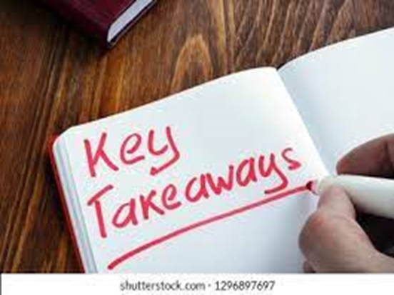
17:25- 17:30 – Wrap up from day 1
Key learnings

