Slide 1
41st meeting of the Standing Committee to the Bern Convention

Slide 2
Agenda item 3.1
Financing of the Bern Convention
Reports of the Intersessional Working Group on Finances T-PVS(2021)01, T-PVS(2021)03, T-PVS(2021)06, T-PVS(2021)22
Voluntary Contributions and Resolution No. 9 (2019) T-PVS/Inf(2021)07
3.1.1 Enlarged Partial Agreement (EPA) TPVS/Inf (2021)06rev – Draft Resolution establishing an EPA for the conservation of European wildlife and natural habitats, as amended by the GR-C
3.1.2 Amendment of the Bern Convention TPVS/Inf (2021)62 – Amendment of the Bern Convention – State of play

Slide 3
Agenda item 2
Agenda item 2
Bern Convention – where we are in 2021
Unsolved financing – more discussion needed to decide on financial options – need to finalized in 2022!!!
Continuing role of the Bern Convention at the pan-European level in nature/biodiversity protection
Cooperation EU/non EU countries,
Expert groups and networks
NGOs involvement
Opportunity of the Bern Convention within the Council of Europe priorities (environment and human rights, healthy environment) and within global biodiversity targets
Despite pandemic restrictions – meetings held virtually, on the spot appraisals could not be implemented – planned activities implemented

Slide 4
Agenda item 2
Bern Convention’s Work Programme in 2021
2 ordinary and 1 extraordinary Bureau meeting
Group of Specialists meeting on EDPA
4 meetings of Inter-sessional Working Group on Finances
2 meetings of WG on the Vision
Group of Experts meeting on IAS, Ruddy Duck, IKB, Amphibians & Reptiles, Protected Areas & Ecological Networks
Development of Emerald Network online tools
Marine Turtle initiative consultative meetings
38 case-files assessed including 8 new complaints, and 3 online OSAs
Ongoing work on other thematic topics such as plant strategy, sturgeon, and more

Slide 5
Agenda item 3.2
Vision for the Bern Convention for the post-2020 decade
Terms of Reference of the Working Group on a Vision T-PVS/Inf(2020)08
List of nominated members of the Working Group T-PVS/Inf(2021)2
Reports of the 3 meetings of the Working Group in 2021 T-PVS(2021)02, T-PVS(2021)07, T-PVS(2021)13
Draft Vision for the Bern Convention for the period to 2030 T-PVS(2021)14
Draft Strategy for the Bern Convention for the period to 2030 T-PVS/Inf(2021)50

Slide 6
Agenda item 3.3
Rules of Procedure - Possible modifications
Proposed amendments to the Rules of Procedure of the Standing Committee T-PVS/Inf(2021)44
Explanatory table of proposed amendments to the Rules of Procedure of the Standing Committee T-PVS/Inf(2021)38

Slide 7
Agenda item 4
Biennial reporting under Article 9 and ORS
Summary tables of reporting T-PVS/Inf (2021)58
Joint Note from the EU and Bern Convention
26 Parties submitted (full Bern report or all/part of 3 EU reports) for 2019/2020
Kindly submit 2019/2020 and any older reports as soon as possible.
Signed a maintenance contract with UNEP/WCMC to fix ORS technical issues

Slide 8
Agenda item 5.1
Invasive Alien Species
Group of Experts on IAS meeting took place virtually on 6 July 2021.
Guidance on e-commerce and IAS ready for possible adoption. Draft Recommendation on e-commerce and IAS T-PVS(2021)11
Draft position paper on non-native species and climate change presented to discuss, if appropriate, its possible follow-up.
Ongoing work of 2 studies:
Study on Alien Pathogens and Pathogens spread by IAS
Guidance on communication and IAS
FACE and IAF published the 2021 Report on the implementation of the Code of Conduct on Hunting and IAS.

Slide 9
Agenda item 5.2
Conservation of birds: eradication of illegal killing, trapping and trade of wild birds
Joint meeting of the Bern Convention Network of Special Focal Points on IKB and CMS Task Force took place virtually on 9-11 June 2021.
Updated assessment report of the 2nd Scoreboard reporting. Scoreboard original data published online.
Two documents presented for the Standing Committee’s possible endorsement:
Paper on the baseline and methodology for assessing
progress toward achieving the Rome Strategic Plan 2020- 2030
Proposal for future periodic assessment and frequency and format of future joint meetings

Slide 10
Agenda item 5.3
Amphibians and Reptiles
Group of Experts on Amphibians and Reptiles meeting took place virtually on 28 September 2021.
Contracting parties submitted their reports on the implementation of Recommendation No. 176 (2015) on the prevention and control of the Batrachochytrium salamandrivorans chytrid fungus.

Slide 11
Agenda item 5.4
Guidance tool for the Conservation of Marine Turtles
1st meeting of the ad hoc Working Group on marine turtles’ conservation took place virtually on 2 November 2021.
1st round of national online consultations with Cypriot stakeholders held virtually on 8-9 November 2021.
Ongoing work to identify global good practices in relation to the co-existence of economic development and marine turtles' protection.

Slide 12
Agenda item 5.5
Pan-European Action Plan for Sturgeons
Recommendation No. 199 (2018) on the pan-European Action Plan for the Conservation of the Sturgeon
List of nominated National Focal Points for the Pan-European Action Plan for Sturgeons T-PVS/Inf(2021)59

Slide 13
Agenda item 5.6
Eradication of the Ruddy Duck
Recommendation No. 209 (2020) on the eradication of the ruddy duck (Oxyura jamaicensis) in the Western Palaearctic by 2025
Report of the Expert Meeting on the Implementation of the Action Plan for the Eradication of the Ruddy Duck in the Western Palaearctic, 2021-2025 T-PVS(2021)18
Progress report on the implementation of the Action Plan T-PVS(2021)16

Slide 14
Agenda item 5.7
Review of the Plant Conservation Strategy
A Review of European progress towards the Global Strategy for Plant Conservation 2011-2020 published in Autumn 2021

Slide 15
Agenda item 5.8.1
Conservation of habitats: Protected Areas and Ecological Networks
Report of the 12th meeting of the Group of Experts on Protected Areas and Ecological Networks T-PVS/PA(2021)08
Legal framework of the Emerald Network
Obligations of Bern Convention Parties regarding the conservation of candidate and adopted Emerald Network sites: a legal analysis T-PVS/PA(2020)07
Future work on the legal framework of the Emerald Network – possible next steps T-PVS/PA(2021)01
Aspects to be considered in the future work on the legal framework of the Emerald Network T-PVS/PA(2021)09

Slide 16
Agenda item 5.8.1
Conservation of habitats: Protected Areas and Ecological Networks
Emerald Network Barometer and update on the Emerald Network IT tools
Emerald Network data mobilisation in the Western Balkans
Draft updated list of adopted Emerald Network sites and draft updated list of candidate Emerald Network sites
T-PVS/PA(2021)10 - Draft list of candidate Emerald Network Sites
T-PVS/PA(2021)11 – Draft list of adopted Emerald Network Sites

Slide 17
Agenda item 5.8.2
Conservation of habitats:
European Diploma for Protected Areas
Report of the meeting of the Group of Specialists on the EDPA T-PVS/DE(2021)06
Draft Resolution on the extension of the European Diploma T-PVS/DE(2021)04
Draft resolutions regarding the renewal of the EDPA to 2 Dutch sites T-PVS/DE(2020)11rev
Renewal of the European Diploma in 2022: List of areas which could be visited in 2021 T-PVS/DE(2020)20

Slide 18
Agenda item 5.9
Reporting under Resolution No. 8 (2012) on the conservation status of species and habitats
Opinions about the reporting under the Resolution No. 8 (2012): assessment of the past reporting exercise and pointers for the future T-PVS/PA(2021)04
Draft Terms of Reference for the Creation of an Ad hoc Working Group on Reporting T-PVS/PA(2021)06

Slide 19
Agenda item 6.1
Case-file system reflection and possible improvements
The need for a reflection and possible changes…
200 case files, 40 active, large proportion of Bureau & StC time
Good timing: WG on Vision & Strategy, WG on Finances, CoE and global ENV awareness
Possible elements
Submission of new complaints, complaint form criteria, registry and classification
Information request deadlines, and report sharing
Rules regarding decisions on case-files of the Bureau or Standing Committee (OSAs)
Cluster similar cases: use the GoEs, past experience
Collaborate more closely with the competent international organisation, relations with EC
Use more frequently experts (both OSAs and outside of OSAs)
Stricter follow-ups to Recommendations
Admin: template for reporting, create case-file dashboard, better accessibility
Next steps?
Endorse or adopt texts? Mandate a wider consultation and reflection?

Slide 20
Agenda item 6.2
Open file 2004/2: Bulgaria: Wind farms in Balchik and Kaliakra – Via Pontica
Rise in wind farm development on Black Sea coast – negative impact on main migratory routes in Europe
2020 Standing Committee:
welcomed certain developments, but regretted not receiving many concrete updates on progress on Rec 200 (2018) or collaboration with civil society.
Sep 2021 Bureau:
urged the authorities to ensure a participatory, multi-stakeholder approach when elaborating its Energy and Climate Plan, and to ensure the previous recommendations on this case, as well as other international guidelines are respected.
Government report received in August 2021 - T-PVS/Files(2021)73
Complainant report received in August 2021 - T-PVS/Files(2021)70

Slide 21
Agenda item 6.2
Open file 2013/1: North Macedonia: Hydro power development within the territory of Mavrovo National Park
Threats to ecologically valuable candidate Emerald site from construction of several hydro-power plants and supporting infrastructures
2020 Standing Committee:
Reiterated call for an OSA, which could be done online.
Again urged the authorities to suspend all developments until the expert mission delivers its recommendations.
During the online advisory mission, May 2021, meetings were held between all concerned stakeholders and the two independent experts.
Sep 2021 Bureau:
Thanked both parties and involved stakeholders for their excellent cooperation, and looked forward to feedback of the OSA at the StC.
Advisory Mission Report - T-PVS/Files(2021)76
Draft Recommendation on Hydro power development within the territory of the Mavrovo National Park - T-PVS(2021)23

Slide 22
Agenda item 6.2
Open file 2016/5: Albania: Presumed negative impact of hydro-power plant development on the Vjosa river
Threats from massive HPP developments on the Vjosa river and its tributaries, particularly the Poçem and Kalivac HPP projects; OSA and Rec 202 in 2018
2020 Standing Committee:
called on authorities to ensure EIAs, collaborate with local stakeholders and in compliance with international guidelines when developing the Vjosa river management plan and revised PAs network; concerned about Narta Airport
Sep 2021 Bureau:
deep concern regarding: urbanisation plans for Vjosë-Nartë PA including construction of airport; potential reduction of the national network of PAs; and delays of River Basin Management Plan preparation
Government report received in August 2021 - T-PVS/Files(2021)68
Complainant report received in July 2021 - T-PVS/Files(2021)57

Slide 23
Agenda item 6.2
Open file 2016/4: Montenegro: Development of a commercial project in Skadar Lake NP and candidate Emerald site
Threat to the site due to approval of Porto Skadar Lake project within the Zone III of the Skadar Lake NP; OSA and Rec. 201 in 2018
2020 Standing Committee:
noted some progress of authorities but true progress on Rec 201 seems low.
urged authorities to cancel any unsustainable construction developments; consider alternative routes for the Bar – Boljare Highway; encouraged a revision of the Spatial Plan; enforcement of existing legislation.
Sep 2021 Bureau:
Appreciated first steps of collaboration between parties.
Concerned about UNESCO rejection.
Reiterated key concerns and calls to the authorities.
Government report received in August 2021 - T-PVS/Files(2021)46
Complainant report received in October 2021 - T-PVS/Files(2021)17

Slide 24
Agenda item 6.2
Open file 1995/6: Cyprus: Akamas peninsula
Tourist developments with detrimental effect on valuable turtle nesting habitat; 2 OSAs (2002 & 2016), latter resulting in Rec. No. 191 (2016)
Sep 2021 Bureau:
welcomed progress in relation to the development of a Local Development Plan and the issuance of a Ministerial Decree, but noted that bureaucracy is slowing down progress;
noted the information provided by the complainant that several proposals for the expansion of existing or the creation of new quarries within and adjacent to the Akamas Peninsula Natura 2000 area have been put forward.
Government report received August 2021- T-PVS/Files(2021)60
Complainant report received November 2021 - T-PVS/Files(2021)61

Slide 25
Agenda item 6.2
Open file 2010/5: Greece: Threats to marine turtles in Thines Kiparissias
Unsustainable developments on a Natura 2000 site affecting valuable turtle nesting habitat; OSA in 2014 - Rec. No. 174 (2014)
Sep 2021 Bureau:
welcomed the adoption of the 6-year Action Plan on Caretta caretta and the development of the project on the regulation of human activities on the beaches within the jurisdiction of the Kotychi-Strophylia Wetlands Management Body;
took note of the concerns of the complainant that the government has achieved little progress on the implementation of Rec 174 (2014), due to insufficient enforcement.
Government report received November 2021 - T-PVS/Files(2021)47
Complainant report received in August 2021 - T-PVS/Files(2021)32
NGO report received in November 2021 - T-PVS/Files(2021)80

Slide 26
Agenda item 6.2
Open file 2012/9: Turkey: Presumed degradation of nesting beaches in Fethiye and Patara SPAs
Threats to marine turtles due to lack of adequate management; OSA in 2015 - Rec. 182 (2015) on Patara and Rec. 183 (2015) on Fethiye
Sep 2021 Bureau:
welcomed the information on renewal of lighting on the public beach of Fethiye;
renewed its request to the authorities to share more information regarding the management plan prepared for Patara;
noted that issues of illegal buildings have not been resolved and asked clarifications regarding the ongoing redetermination of the SPA’s zoning in Patara.
Government report received in November 2021 - T-PVS/Files(2021)28
Complainant report received in August 2021 - T-PVS/Files(2021)62

Slide 27
Agenda item 6.2
Open file 1986/8: Greece: Recommendation No. 9 (1987) on the protection of Caretta Caretta in Laganas bay, Zakynthos
Oldest active case-file: unsustainable developments affecting valuable turtle nesting habitat; Rec. No. 9 (1987)
2020 Standing Committee:
urged the national authorities to enforce existing legislation, to raise awareness and to impose penalties when the law is not upheld and re-opened the file.
Sep 2021 Bureau:
welcomed the national authorities’ monitoring and mitigation initiatives and encouraged them to strengthen efforts for the enforcement of national law.
Authorities were asked to clarify if the entirety of Laganas Bay qualifies as an area of ‘absolute nature protection’ according to Art 218 of Law 4782/2021.
Government report received November 2021 - T-PVS/Files(2021)48
Complainant report received in August 2021 - T-PVS/Files(2021)19
NGO report received in November 2021 - T-PVS/Files(2021)79

Slide 28
Agenda item 6.3
Possible file 2001/4: Bulgaria: Motorway through the Kresna Gorge
Alleged threat to the unique biodiversity of the Kresna Gorge due to construction of the 17 km-long Struma motorway
2020 Standing Committee:
Mandated an OSA in 2021, which could be held online.
Following a vote, File remained “Possible”.
During the online advisory mission, August 2021, meetings were held between all concerned stakeholders and the two independent experts.
Sep 2021 Bureau:
Thanked both parties and involved stakeholders for their excellent cooperation, and looked forward to feedback of the OSA at the StC.
Joint Govt/Comp report received in November 2021 - T-PVS/Files(2021)82
Advisory Mission Report - T-PVS/Files(2021)75
Draft Recommendation on the project to build a motorway through the Kresna Gorge - T-PVS(2021)24

Slide 29
Agenda item 6.3
Possible file 2019/05: Turkey: Habitat destruction in Mersin Anamur Beach
Unsustainable developments affecting extremely valuable turtle nesting habitats
2020 Standing Committee:
urged the national authorities to halt any current or future development works of the local Municipality on the nesting habitat and encouraged them to enforce the already existing legislation.
Sep 2021 Bureau:
noted that following the OSA of a group of scientific experts, the project on coastal development/beach arrangement had been amended to move certain components to more suitable locations.
Turkish authorities were invited to share more details on Mersin Metropolitan Municipality’s approval of the Municipality’s request to change the established protection zone.
Government report received in November 2021 - T-PVS/Files(2021)29
Complainant report received in August 2021 - T-PVS/Files(2021)27

Slide 30
Agenda item 6.3
Possible File 2020/09: Bosnia and Herzegovina: Possible negative impact of hydro-power plant development on the Neretva river
Background to new complaint:
Alleged violation of Articles 3 & 4 and Rec 157 (2011) on the status of candidate Emerald sites and guidelines on the criteria for their nomination.
Development of the Ulog HPP and the HES “Gornja Neretva” that consists of 7 small HPPs on the upper Neretva (Gornja Neretva) and its tributaries.
significant adverse impact on protected habitats and species in Appendices I, II and III and Res 4 (1996) and Res 6 (1998).
Sep 2021 Bureau:
Expressed deep concern that works are reported to have begun in the Emerald site, and decided to elevate the complaint to a Possible File.
Government report received in October 2021 - T-PVS/Files(2021)40
Complainant report received in August 2021 - T-PVS/Files(2021)65

Slide 31
Agenda item 6.4
Complaint on stand-by 2017/6: Iceland: Possible negative impact on Breiðafjörður NR’s authentic birch woods from new road infrastructure
New road to be built through potential candidate Emerald Site of high biodiversity value
2020 Standing Committee:
Mandated an OSA which could be done online, after which the status of the case would be assessed. Urged authorities to cease any works in the area until after the OSA.
Sep 2021 Bureau:
Recalled that it seemed unlikely that an OSA could take place this year due to delays including the change in national focal point of Iceland.
took note that road construction has begun despite the numerous calls of the Bureau and StC to halt any works until an OSA has taken place.
noted progress and willingness of the authorities to finally move ahead with the proposal of sites for the Emerald Network.
Government report received in October 2021 - T-PVS/Files(2021)64
Proposes an online OSA in 2022 focusing on mitigation measures.
Complainant report received in September 2021 - T-PVS/Files(2021)24

Slide 32
Agenda item 6.4
Complaint on stand-by 2018/1: Ukraine: Presumed threat to Emerald site “Polonina Borzhava” from wind energy development
Development of wind farms threatening valuable Emerald Site
2020 Standing Committee:
Mandated an OSA which could be done online, after which the status of the case would be assessed.
Called on the authorities to halt any works before the conclusions of the OSA.
During the online advisory mission, September 2021, meetings were held between all concerned stakeholders and the two independent experts.
Advisory Mission Report - T-PVS/Files(2021)77
Draft Recommendation on the presumed threat to Emerald Network site “PoloninaBorzhava” from wind energy development (UA0000263) T-PVS(2021)25

Slide 33
Agenda item 6.4
Complaint on stand-by 2017/02: North Macedonia: Alleged negative impacts to Lake Ohrid and Galichica National Park candidate Emerald Sites due to infrastructure developments
Infrastructure developments in 2 protected areas; UNESCO, Ramsar & IUCN also involved
UNESCO update August 2021:
Despite the draft decision to include the site on the List of World Heritage in Danger, an amendment meant this decision did not go through.
Sep 2021 Bureau:
Strongly regretted continued lack of a report from the authorities, and deeply concerned with the very negative picture painted by the complainant and intl’ organisations of the situation on the ground.
Decided to exceptionally bring this complaint to the agenda of the 41st StC.
No Government report received in 2021
Complainant report received in August 2021 - T-PVS/Files(2021)37

Slide 34
Agenda item 6.5
Follow-up of Recommendation No. 95 (2002) on the conservation of marine turtles in Kazanli beach, Turkey
The presence of a chrome factory, greenhouses and other developments as well as erosion issues on the Kanzali beach putting at risk the long-term conservation of this nesting site
2019 Standing Committee:
expressed its concern about the continuing pressures on the area and in particular the erosion of the beach;
urged the Turkish authorities to implement all conditions of Recommendation No. 95 (2002) and requested an updated report in two years.
Government report received in October 2021 – T-PVS/Files(2021)81
MEDASSET report received in August 2021 -T-PVS/Files(2021)78

Slide 35
Agenda item 6.5
Follow-up to Recommendation No.190 (2016) on the conservation of natural habitats and wildlife, especially birds, in afforestation of lowland in Iceland
Forestry activities impacting wildlife; OSA and Rec 190 in 2016.
2019 Standing Committee:
expressed its concern regarding the absence of a written report and reminded the authorities that they should send an annual report on the follow-up to Rec 190 to both the StC and AEWA.
Sep 2021 Bureau:
Welcomed reported progress of the government, but took note of concerns of the NGO that the draft nation-wide plan for forestry fails to take into account Recommendation 190 (2016) and that it undermines the progress made since 2016.
Government report received in November 2021 – T-PVS/Files(2021)74
NGO report received in July 2021 - T-PVS/Files(2021)69

Slide 36
Agenda item 8
Awareness and Visibility
#VoicesOfNature

Slide 37
Agenda item 8
Awareness and Visibility
World Forum for Democracy

Slide 38
Agenda item 8

Slide 39
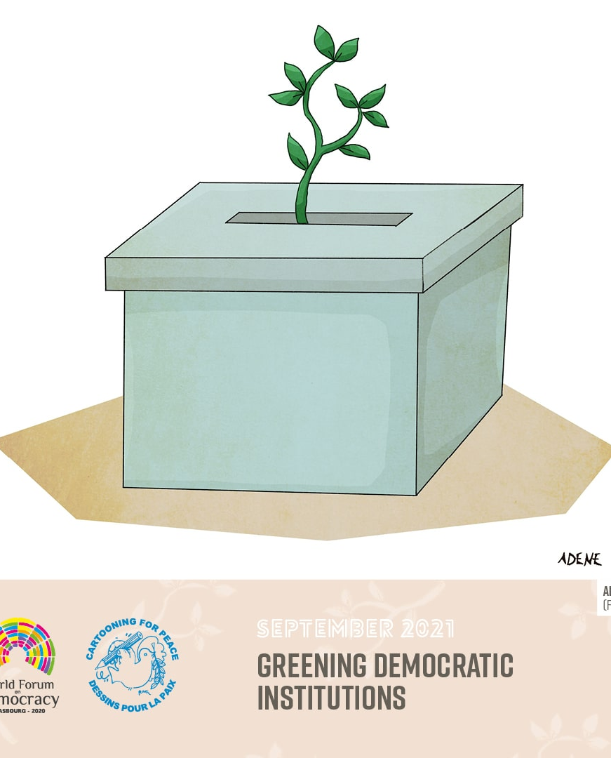
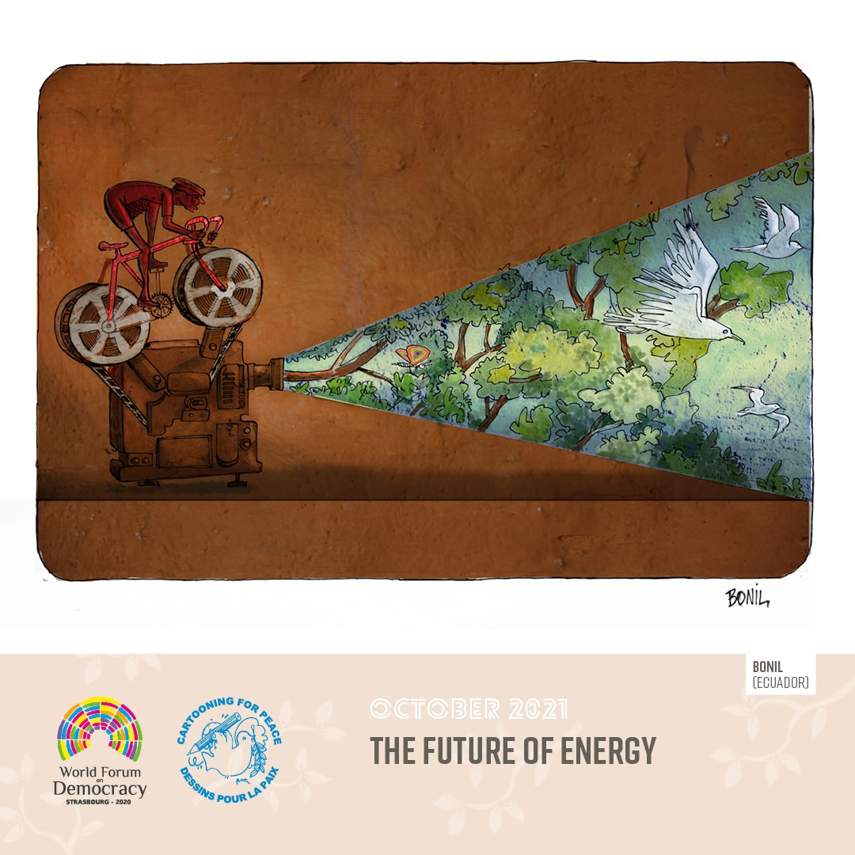
Agenda item 8

Slide 40
Agenda item 9
Draft Programme of Activities and Budget for 2022-2023
Draft Programme of Activities for 2022-2023 T-PVS(2021)26
Draft Calendar of meetings for 2022 T-PVS/Inf(2021)54

