Slide 1

Joint Meeting of Permanent Correspondents and Directors of Centers,
Zagreb, 6-7 November 2018
“Resume of Activities 2018
of the European Center for Forest Fires (ECFF)”
Sofia Karma, Dr. Chemical Engineer
Laboratory Teaching Staff, National Technical University of Athens
ECFF, Scientific Assistant
skarma@central.ntua.gr

Slide 2

1. Enhance Disaster preparedness focusing on vulnerable groups
(Priority 4, Sendai 2015-2030)
CASE STUDY: Evacuation of a Maternity Hospital
TARGET GROUP: Infants, pregnant women and/or people with special needs (e.g. wheelchair users)
DISASTER SCENARIO: Earthquake or a fire
SCOPE: Prepare a Table- Top Exercise template to be used for emergency response training

Slide 3
Main Objectives of the Table-Top Exercise Template
Education and Training of the Hospital’s personnel in order to effectively response in case of an earthquake or a fire
Prepare on the safe evacuation of vulnerable groups, such as infants and women after operation that encounter mobility difficulties

Slide 4
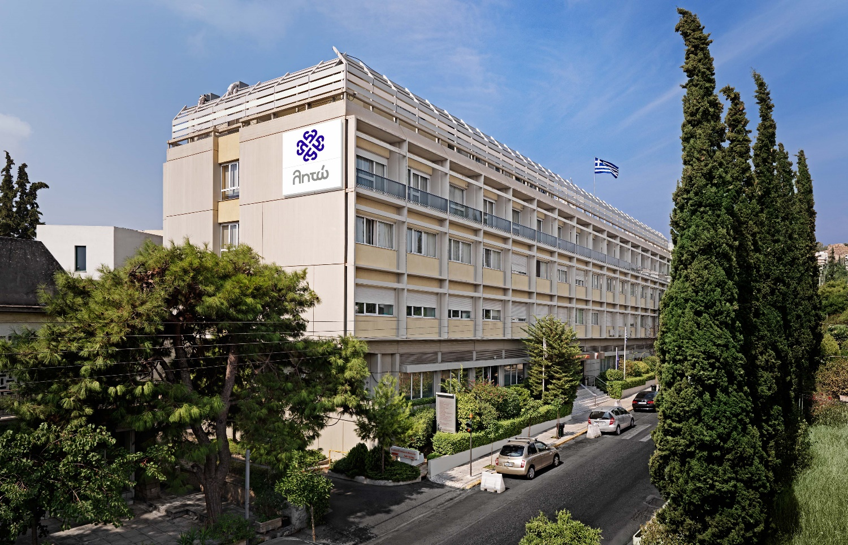
http://www.leto.gr/
The LETO Maternity Hospital in Athens

Slide 5
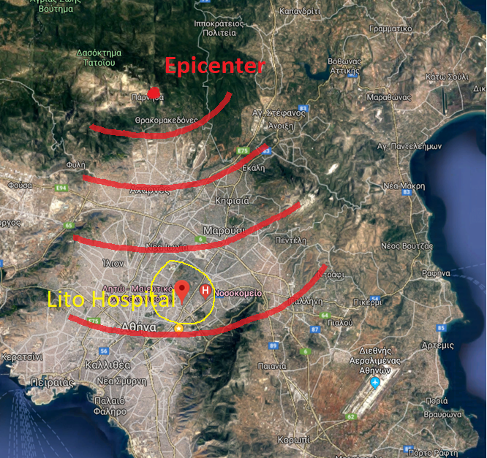
The Earthquake Scenario
On December 5, 2018 at 11:00 am there is a 6 degree earthquake of the Richter scale, of short duration and with a focus on Parnitha Mountain, which is particularly noticeable in Attica. The major earthquake follows trans-sections of up to 5.0 degrees of the Richter scale.

Slide 6
After the Earthquake
The Technical Support Team inspects immediately the entire Hospital Unit and the Head of the Team informs the General coordinator (GC):
A problem has been identified on the 3rd floor with cracks in the masonry, in the columns of the frame and there are fallen plasters from the walls
One of the patients on the third floor is injured by the fall of building materials
The emergency exit of the 2nd basement is blocked by a fallen object and hence two persons are trapped but they are not injured
The General Coordinator in conjunction with the CEO and the Nursing Director
decides to proceed in partial evacuation of Wing 319-326

Slide 7
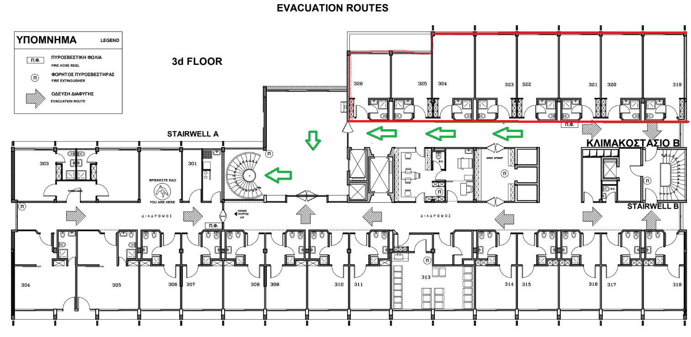
Announcement of Evacuation through the Central Speaker System
Vertical Evacuation of the 3rd floor to the 2nd floor through the Central Stairwell (Stairwell A)
The GC notifies the National Instand Aid Centre (H.Q.) (E.K.A.B.) (166) and the Hellenic Fire Service (199) and updates the situation. Two Fire Brigade Vehicles arrive within 15 minutes. A representative of the Fire Safety Team guides the fire fighters at the sites of the search & rescue operation

Slide 8
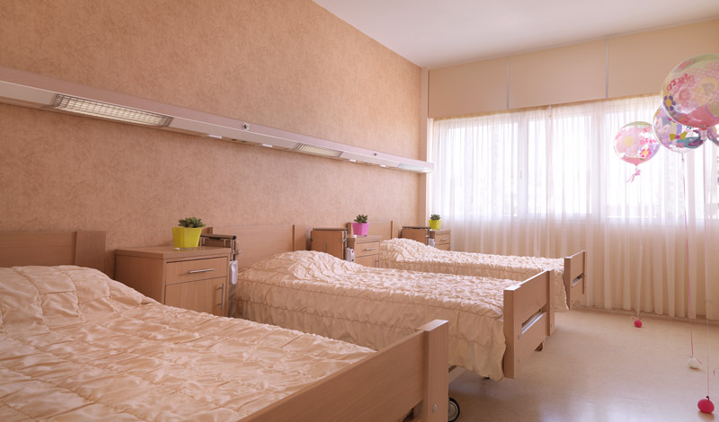
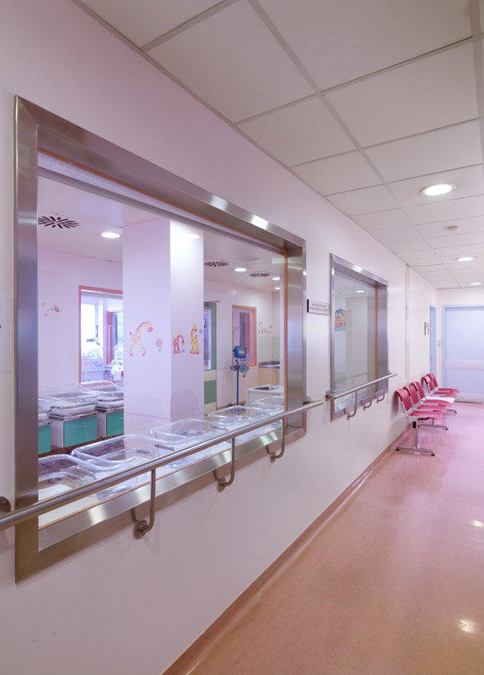
On the 3rd floor there is a total of:
10 ambulatory patients
2 with a wheelchair
6 newborns
1 doctor
4 nurses
5 guests-escorts
Room of the Wing 319-326 at Leto Hospital
The 6 newborns of the 3rd floor are transferred to the Infants Intensive Care Unit of the 2nd floor
The Head of the Evacuation Team asks the Coordinator for the assistance of four people to help the 2 wheelchair patients to evacuate through the Stairwell A and be transferred to the 2nd Floor’s Lobby Area (Refuge Area)
Infants Intensive Care Unit of the 2nd floor at Leto Hospital

Slide 9
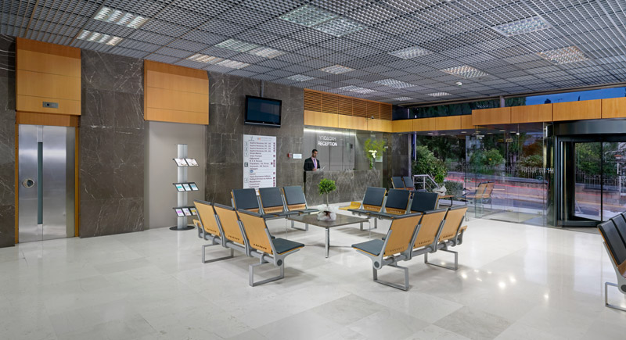
The Fire Scenario
On October 10, 2018 at 12:00 pm, a fire breaks out at the kitchen area, which is located at the 1st basement of the Hospital. Dense smoke is produced, which is mainly dispersed internally on the ground floor (Central Lobby of the Hospital) and partially on the first floor, where the Infants Intensive Care Unit (IICU) is situated. The outside windows of the IICU are always closed and the air condition is continuously in operation.
Central Lobby of the Leto Hospital (Ground Floor)

Slide 10
After the Fire Ignition
The automatic fire extinguishing system is activated to limit the spread of the fire and the air supply is deactivated to avoid smoke inflow into the building
The GC in conjunction with the CEO and the Nursing Director decide to immediately evacuate the 1st, 2nd basements, the Ground floor and for precaution reasons the Infants Intensive Care Unit (IICU) of the first floor.
Announcement of Evacuation through the Central Speaker System
The GC notifies the Hellenic Fire Brigade (199), informing on the location of the fire, its size, its rate of spread and the burning material. Two firefighting vehicles arrive in 10 minutes. A representative of the Fire Safety Team guides the Fire Brigades at the points they will act on. Four firefighters operate at the first basement to completely extinguish the fire.
The GC informs Hellenic Police Force (100) to arrange the traffic at the Central Entrance of the Hospital

Slide 11
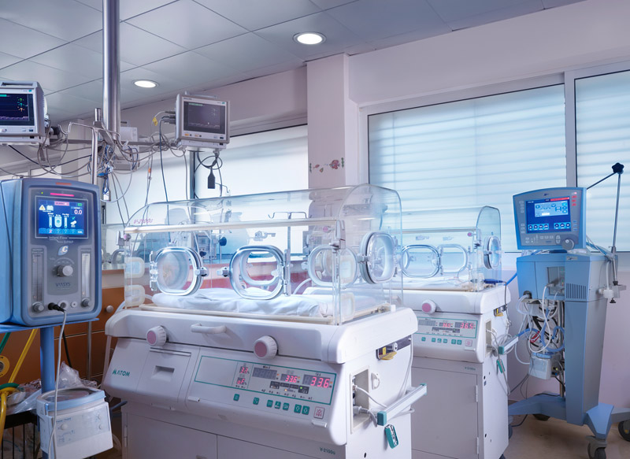
1st Floor- Infants Intensive Care Unit (IICU)
On the 1st floor there are is a total of:
8 newborns in baby cots
a newborn with mechanical support at incubator
2 ambulatory patients
8 nurses
2 doctors
2 guests at the lobby of 1st floor
Ιncubators at Leto Infants Intensive Care Unit

Slide 12
The 8 newborns are transported to the 3rd floor by 4 nurses, using special means (baby carrier of 2 positions). Stretchers lift is used after the order of the GC, in consultation with the Fire Safety Team and the Fire Brigade (alternatively via the auxiliary Stairway).
The newborn with the mechanical support needs to be preventively transferred to a nearby Maternity Hospital (with a portable incubator).

Slide 13
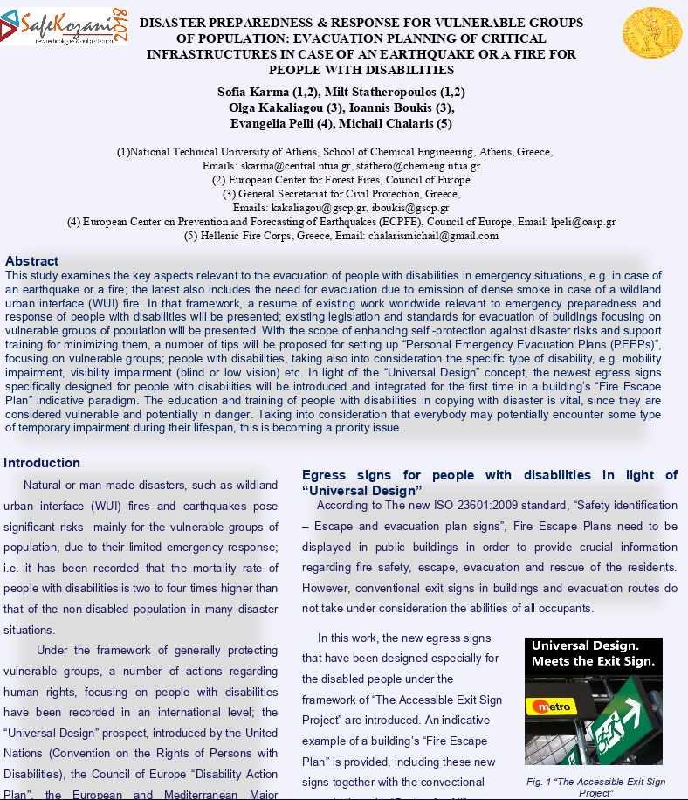
2. Dissemination Activities
Poster Presentation at the 5th International Conference for Civil Protection and New Technologies SAFEKOZANI 2018,
31 October- 3 November, Kozani, Greece
Title: Disaster Preparedness & Response for vulnerable groups of population: Evacuation Planning of Critical Infrastructures in case of an Earthquake or a fire for people with Disabilities
Prepared By:
S. Karma, M. Statheropoulos (NTUA, ECFF)
O. Kakaliagou, I.Boukis (GSCP)
E. Pelli (ECPFE)
M.Chalaris (Hellenic Fire Corps)

Slide 14
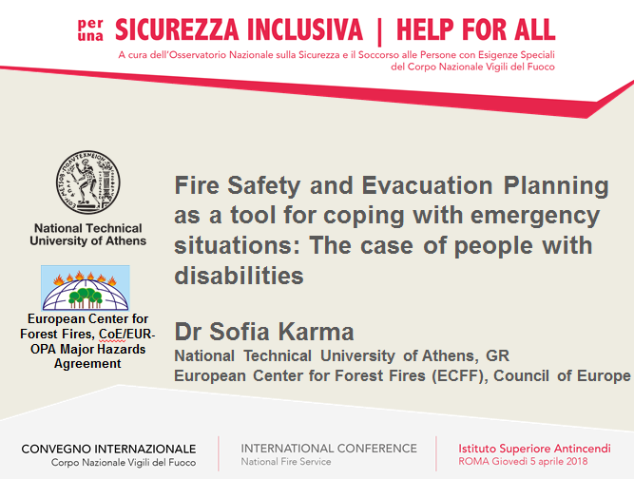
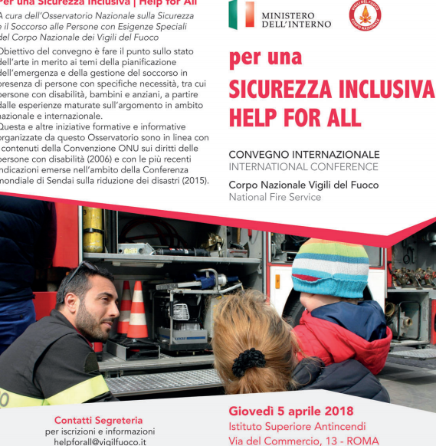
Oral presentation as invited speaker at the Conference:
" Help for All", organized by the Italian National Fire Department, National Fire Academy
5 April 2018, Rome
(http://www.vigilfuoco.it/aspx/notizia.aspx?codnews=47754)

Slide 15
Thank you for your Attention

