Slide 1
The Budget of the Courts and Judicial System in Ireland
Noel Rubotham
Head of Reform and Development Directorate
Courts Service

Slide 2
Our organisational and institutional environment
Courts Service established as agency in 1998 with statutory mandate to:
manage the courts; provide support services for the judges; provide information on
courts system to the public; provide, manage and maintain court buildings; provide
facilities for court users
Transfer of court administration from Ministry of Justice to independent agency -
“a fundamental shift in the “philosophy” of the courts system, requiring it to take
account of the concepts of quality, service and competitiveness more associated
heretofore with the private sector...”
Courts Service manages the courts – it does not manage the judiciary and is
precluded by law from interfering with the judicial function
Courts Service does not manage the prosecutorial function – completely separate
from and independent of the court system
Courts Service has a governing board chaired by Chief Justice - majority (10 out of 18) are judges. Includes nominee of Ministry of Justice (1), legal professional bodies
(2) court users (1), and the Trades Unions (1), an expert in commerce, finance or
administration nominated by Minister (1), and elected staff member (1)
Board assisted by committees including Finance Committee and Audit and Risk Committee

Slide 3
Courts Service Organisational Structure
Courts Service Board
Audit & Risk Committee
Finance Committee
Building Committee
Family Law Court Development Committee
Specific Issue Committee
Chief
Risk Officer
Internal Auditor
Office of the CEO
Chief Executive
Officer
Head of Superior Courts Operations
Head of Circuit & District Courts Operations
Regional Offices (4)
Head of Infrastructure Services
Information & Communications Technology
Estates & Buildings
Information services
Head of Reform & Development
Court reform initiatives
Modernisation of court rules, practices and procedures
Judges’ library
Head of Resource Management
Finance
Organisation Development & Training
Human Resources

Slide 4
Our organisational and institutional environment (contd.)
Courts Service is statutorily independent, but subject to limitations, viz.:
In performing its functions Board must have regard to
(a) need to secure the most beneficial, effective and efficient use of Courts Service's resources
and
(b) Government/Ministerial policies or objectives relating to Courts Service's functions
Ministry of Justice (Department of Justice and Equality) retained responsibility for
securing annual vote of funds from Parliament for Courts Service
Minister for Justice approves, with Minister for Public Expenditure and Reform's consent, Courts Service staff numbers, grades of staff and numbers in grades
Courts Service must submit for Minister for Justice's approval a strategic plan every 3 years – Minister remits plan to Parliament after approval
Courts Service must submit Annual Report to Minister for Justice on its activities /
performance - Minister remits plan to Parliament after approval
Minister may require Courts Service to provide information relating to policy and activities of Courts Service generally, any specific matter or account prepared by it, or an annual report
annual Agency Framework Agreement between Courts Service and Ministry defines the Ministry’s expectations of Courts Service, Court Service’s expectations of Ministry and the inputs, outputs and expected outcome of the activities of the Courts Service

Slide 5
Our budgetary environment
Ireland has:
lowest ratio of judges to population in Europe – 3.5 professional judges per 100,000 (Council of Europe average is 20.7 per 100,000)*
second lowest ratio of court support staff to population in Europe - 20 per 100,000
(Council of Europe average is 70 per 100,000)*
Global financial crisis of 2008 severely affected Ireland's public finances: major fiscal adjustment between 2008-2014 - total of 9 ‘budgetary events’ involving approx. €30 billion of consolidation measures
Between 2009 and 2014 funding for the Courts Service decreased significantly with a 44% reduction in non pay current expenditure, an 18% reduction in pay and a 73% reduction in capital provision
Since 2015, funding allocation to Courts Service gradually recovering
Ireland’s per capita spend in the courts (€48,1) is quite low in comparison with GDP
(Poland, with a quarter of Ireland’s per capita GDP, spends €48.5 per capita)*
Courts Service relies heavily on the Public Private Partnership (PPP) model for its courthouse building/refurbishment programme – enables costs of building and hard & soft facilities management to be spread over 20 to 25 year periods
High proportion of Courts Service budget represented by court fee income – approx. 60%
Judges' remuneration is not part of Courts Service's budget - paid from the Central Fund as “non-voted” expenditure
* CEPEJ European judicial systems Efficiency and Quality of Justice 2016 (2014 data)

Slide 6
The Budget Process
Courts Service’s annual budget comes from “voted expenditure” viz. expenditure proposed by Government to Lower House of Parliament to fund ordinary services of Government - broken into Vote Groups associated with the various Departments (Ministries) of Government.
Public moneys may be allocated for expenditure only on authority of Lower House of Parliament
Courts Service’s Resource Management Directorate liaises regularly with Courts Service Directorate budget-holders during year on spending trends and by June / July identifies proposed spend for following year in time to prepare spending proposals for approval by Senior Management and submission to Department of Public Expenditure (DEPR) and Department of Justice and Equality (Finance Committee and Board are briefed)
By 15th October each year, Government presents Estimates of expenditures and receipts based on projections provided by Government Departments and Agencies to Lower House for consideration
Each Estimate is given a Vote number and is associated with a Programme/Programmes of activity. The Courts Service Vote (No. 22) is included within the Department of Justice and Equality Vote Group , which also includes Votes of other Justice agencies (e.g. Police, Prisons)
Each Vote costs Financial & Human Resource Inputs and lists Key Outputs and Public Service Activities
Key Outputs and Public Service Activities are broken down into a set of:
(i) Key High Level Metrics and (ii) Qualitative Statements of Outputs and Activities
Lower House adopts budgetary measures for next year on provisional basis, followed by legislation of same
Courts Service CEO and Senior Management Team finalise annual budget based on funding allocation in the annual estimates approved by Parliament
Annual budget is recommended for approval by Finance Committee to Board.

Slide 7
The Budget Process – Multi-annual budgeting
The annual budget process takes place within the constraints of EU Stability and Growth Pact rules and national rules on multi-annual budgeting
The Medium Term Budgetary Framework sets out
- medium term expenditure ceilings in accordance with the EU Directive on Medium-Term Budgetary
Frameworks, acting as upper limit on expenditure for each year and
- limited circumstances under which revisions to the ceilings can be made
- further clarifies rules and procedures for how ceilings are to be set by DPER
- the responsibility of the Minister and Heads of Departments to ensure that the ceilings are adhered to and
to reprioritise as necessary within them.
Each year an Expenditure Report sets out Ministerial Expenditure Ceilings for the next three years, calculated to ensure compliance with the Expenditure Benchmark (one of the pillars of the fiscal rules).

Slide 8
Performance/Input-Output budgeting
Programme for Government (2011-2016) introduced significant reforms to the traditional budget system, including-
- a multi-annual expenditure framework allowing for greater transparency about the
allocations available to each Government Department/agency over a 3 year period
- an emphasis on performance-based budgeting, involving presentation of Estimates
in a new format, organised on the basis of “strategic programmes” rather than accounting
“subheads.”
Under performance-based budgeting approach, Estimate identifies financial and human resource “inputs” and public service and activity “outputs”
This is intended to link the Estimates process directly with the three-year Statements of Strategy which each Government Department/Agency is required to issue, and enable performance information to be scrutinised by Parliamentary Committees at the same time that public money is being requested.
The input/output-based approach will be evident from the Courts Service Vote Estimate (see following slides)
For Each Activity Programme:
(a) Financial & Human Resource Inputs are costed
(b) Key Outputs and Public Service Activities are set out.
Key Outputs and Public Service Activities are broken down into a set of:
(i) Key High Level Metrics and (ii) Qualitative Statements of Outputs and Activities

Slide 9
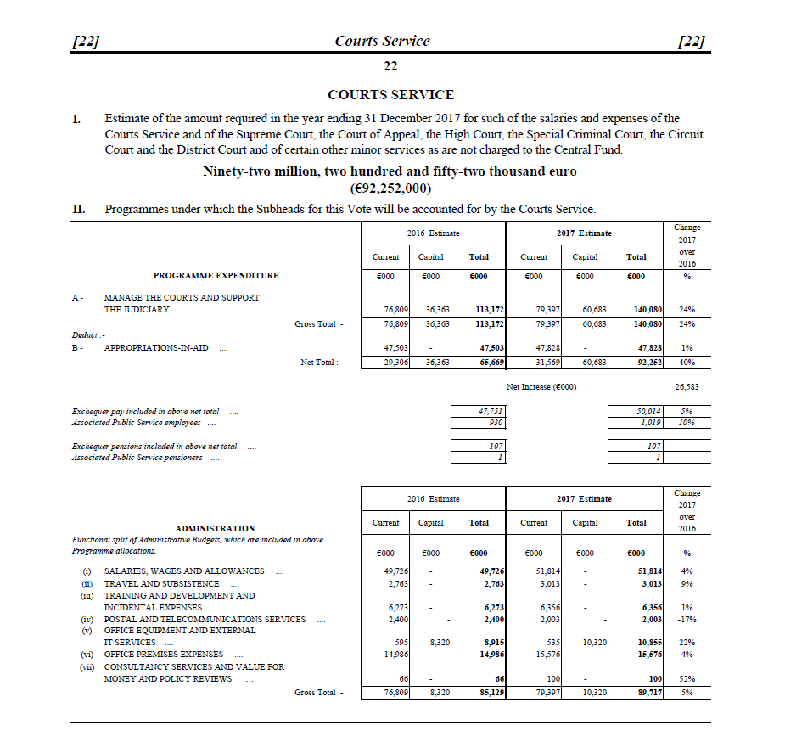
Courts Service Vote Estimate Parts I and II

Slide 10
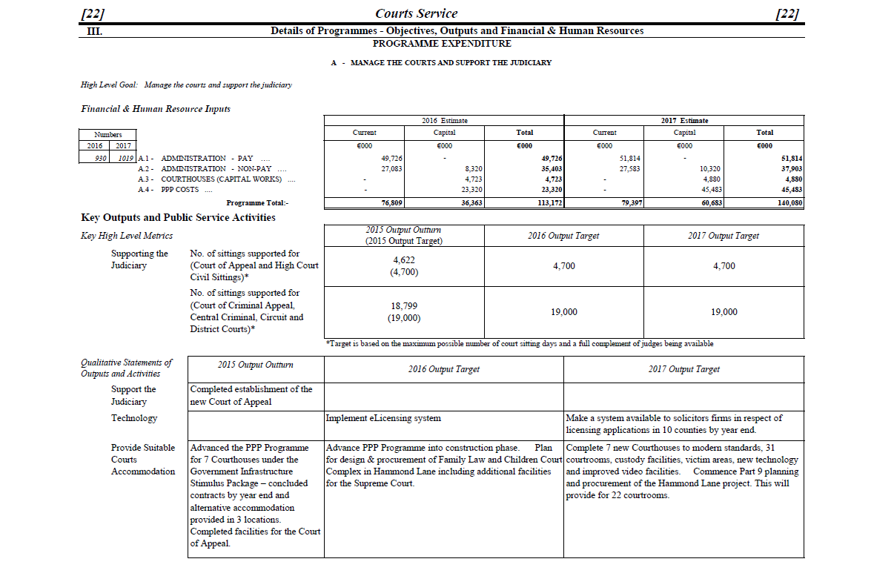
Courts Service Vote Estimate Part III

Slide 11
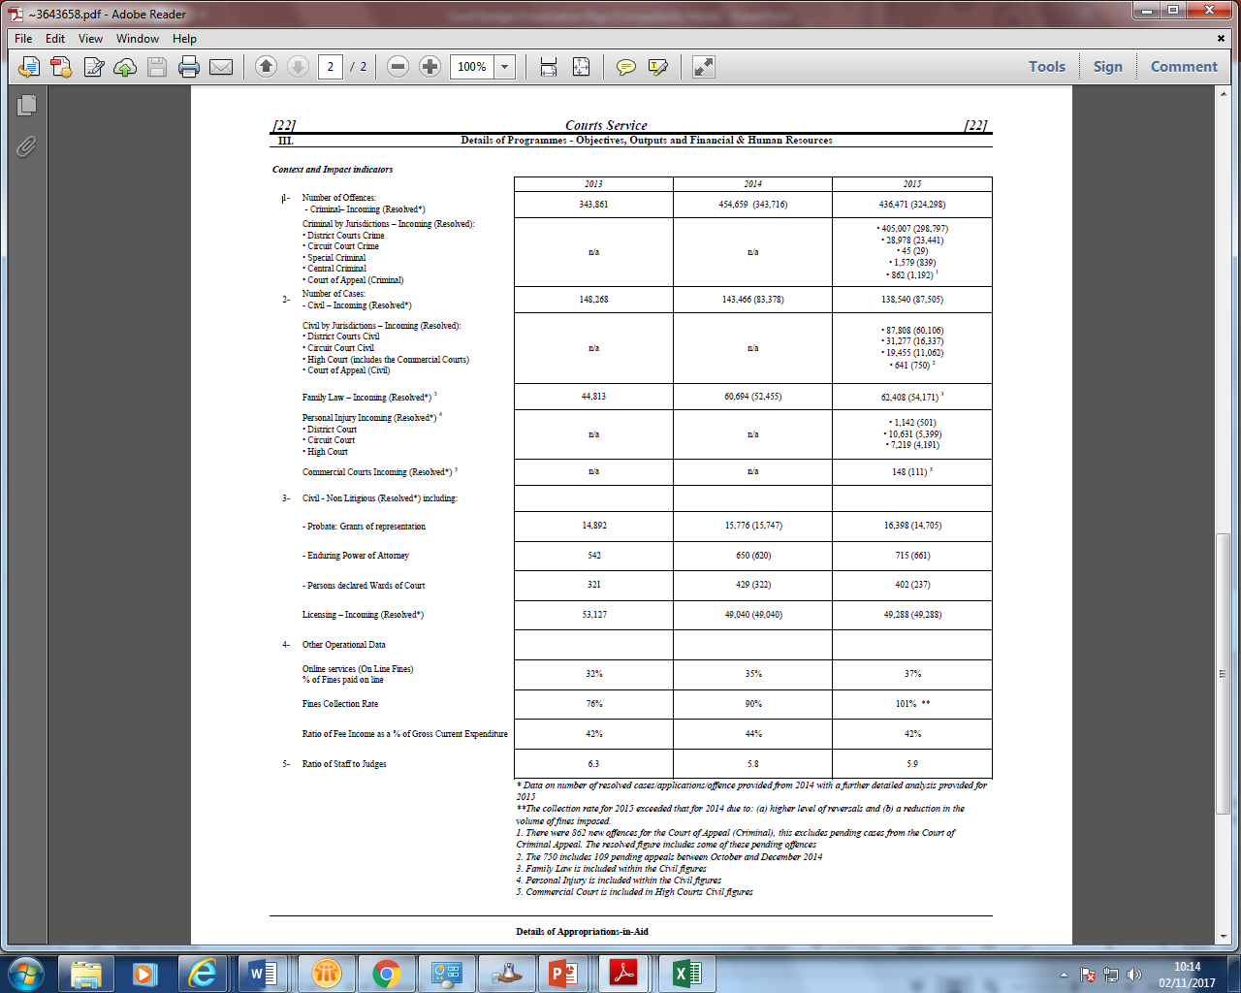
Courts Service Vote Estimate Part III contd.

Slide 12
Courts Service Vote Estimate Part III contd.

Slide 13
Budget Control/Monitoring (Internal)
Board has overall responsibility for the internal financial control of Courts Service, but delegates to Audit & Risk Committee monitoring of effectiveness of risk management and internal control environment
Audit & Risk Committee receives regular reports from management, Chief Risk Officer and internal audit
Responsibility for heads of expenditure devolved to the 5 Courts Service Directorates and CEO’s Office- expenditure may only be made if Directorate budget-holder authorises it
Directorate budget-holder reports monthly on expenditure to Resource Management Directorate
Monthly Financial Report provided to Senior Management Team of Courts Service covering:
1. Financial Position an end of previous month
2. Explanations of any variances (underspends or overspends) in expenditure over planned
expenditure on Pay, Non Pay, Capital (ICT, Courthouse Capital, PPP, Revenue)
3. Management Oversight items
- Details of purchase orders of a value greater than €20,000 are set out at Appendix B.
- Prompt Payment Interest Liabilities (if any) arising
4. Detailed Expenditure Chart (items on this are further broken down into more detailed
costs centres and court items in the Courts Service's Chart of Accounts)
Internal Audit Unit conducts a programme of audits each year on operational and support areas
- reports to Audit Committee of Courts Service (sub-committee of Board)
- Budget-holders attend before Audit Committee to answer inquiries
Audit Committee reports to Courts Service Board

Slide 14
Monthly Financial Report Expenditure and Income Chart
Description | Budget 2017 | Budget YTD | Actual YTD | Actual YTD V Budget YTD | Forecast
Current Expenditure | € '000 | € '000 | € '000 | € '000 | € '000
Salaries, Wages and Allowances
Overtime
Total Pay
Travel and Subsistence
Official Function Expenses
Staff Training
Judicial Training
Advertising
Contract Services
Conveyance of Cash
Judges Attire
Law Books
Meals Jurors
Newspapers
Other Misc
Refreshments
Interpreting
Medical Reports
DAR
Legal Services
Compensation
Postal Services
Telecommunication Current
Photocopying/Managed Print Service
Office Equipment
Printing/Online Publishing
Stationery
Courthouse Maintenance
Light, Heat & Fuel
Furniture & Fittings
General Premises Expenses
Leases
Consultancy
Total Non Pay
Total Current Expenditure

Slide 15
Monthly Financial Report Expenditure and Income Chart (Contd.)
Capital Expenditure
ICT
Capital Works - Courthouses
PPP - Unitary Payment
PPP - Regional Unitary Payment
PPP VAT payment
Carryover
Total Capital Expenditure
Total Gross Expenditure
Income (Appropriations in Aid)
Fees
Miscellaneous Income
Pension Levy
Total Income
Details of purchase orders of a value greater than €20,000
Supplier Name | Amount |  | Description | Paid Yes/No
 | Total:

Slide 16
Budget Control/Monitoring (External)
Courts Service CEO is statutory Accounting Officer for Courts Service
Courts Service’s annual financial account (the “Appropriation Account”) is submitted annually by CEO to State Comptroller and Auditor General (C&AG) for external audit
- for accuracy and regularity and
- carry out such examinations as C&AG considers appropriate in regard to economy and
efficiency on the use of resources and the effectiveness of management systems (i.e.
Value-for-Money Audit)
Appropriation Account is accompanied by Statement of Internal Financial Control signed by CEO certifying internal control environment within Courts Service including financial control environment, framework of administration, management reporting, compliance with procurement guidelines and internal control
Courts Service Audit Committee reviews with C&AG C&AG’s findings, including any major issues arise during audit resolved and unresolved; key accounting and audit assumptions underlying audit; levels of errors identified, obtaining explanations from management on issues / errors
Funds of beneficiaries lodged with courts are subject to external audit by a private audit firm

