Slide 1
Lanzarote Convention SITE Russian Federation Delegation March 1-3, 2017

Slide 2
http://lanzarote.rudn.ru

Slide 3
Design & Content: RF Ministry of Education and Science and RUDN University
Official registration under relevant legislation
Working languages: Russian & English

Slide 4
site goals
• disseminating information about legislation and promising tools and practices to protect children from sexual abuse in Russia and abroad in the framework of the Lanzarote Convention implementation;
• providing a platform for inter-agency cooperation in key areas of protecting children from sexual abuse and exploitation

Slide 5
Site pages
MATERIALS
NEWS
RUDN AND MINORS' PROTECTION
USEFUL LINKS

Slide 6
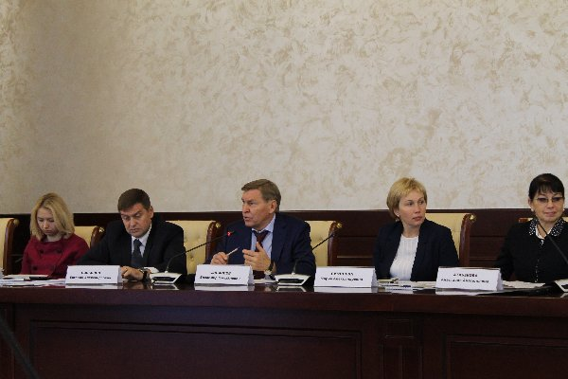
Interagency cooperation
Inter- department workshops in 2015 and 2016
Federation Council
Ministry of Internal Affairs
Ministry of Foreign Affairs
Investigation Committee
Interpol
Prosecutor's office
Civil and academic community

