Slide 1
Studies on health consequences of domestic violence in Norway

Slide 2
Sources of knowledge
Population surveys
Domestic violence surveys with questions about health consequences
Public health surveys with questions about violence
Clinical studies
Public registers

Slide 3
Types of consequences
Individual consequences |  |  |  | Collective consequences
Physical injuries | Psychological problems | Somatic illness |  | Stressing the health system | Economic costs

Slide 4
Physical injuries Population surveys
Thoresen and Hjemdal 2014:
Child abuse:
49 % of girls and 46 % of boys severely abused by parents reported physical injuries
Intimate partner violence
65 % of women and 50 % of men severely abused by partner reported physical injuries

Slide 5
Physical injuries Clinical research
Steen and Hunsgaar 2002: population from hospital emergency centre
Mostly minor injuries.
Cuts and bruises 41 %
Fractures 37 %
Concussions and head injuries 9 %
Eye injuries 5 %

Slide 6
Physical injuries Public registers
Egeland and Kopjar 2000: Analysis of data from Register of personal injuries
4 % of all injuries caused by violence
16 % of all injuries caused by violence led to hospitalization
For women: 40 % of violence in their home – for men: 15 %

Slide 7
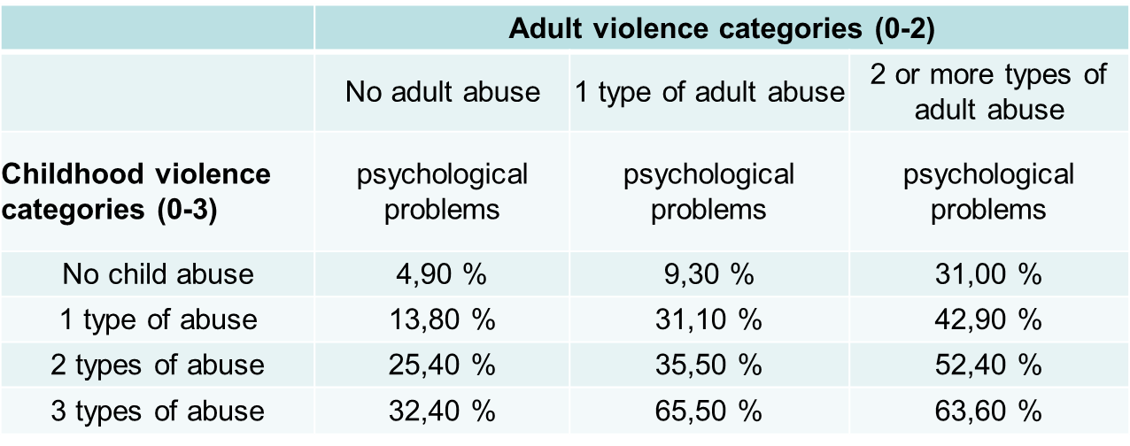
Multi-victimisation and psychological problems Population surveys
Thoresen and Hjemdal 2014

Slide 8
Polyvictimisation and somatic diseases
Population surveys
Hjemdal, Sogn and Schau 2012

Slide 9
Main problem: association is not causation
Does violence cause ill-health or does ill-health cause violence
Solutions:
Longitudinal studies
Combination of surveys and register studies

Slide 10
Thank you!

