Slide 1
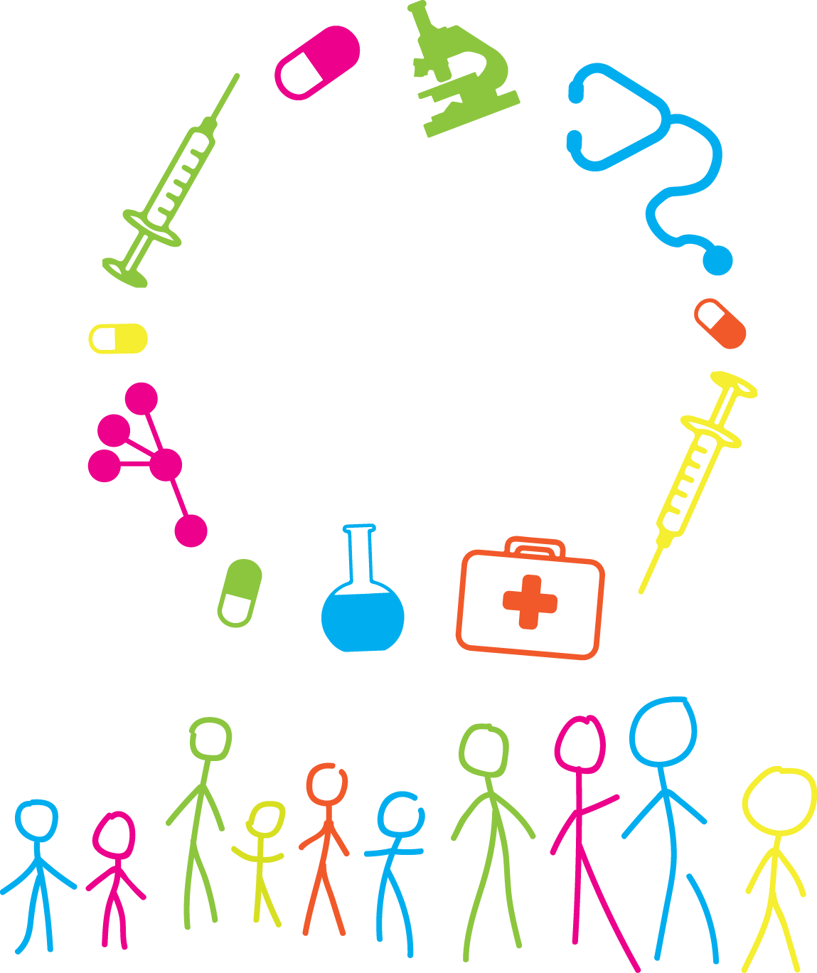
Autonomy Challenges raised by the evolution of practices for children's rights
Kavot Zillén

Slide 2
2016 report: The Rights of Children in Biomedicine – Challenges posed by scientific advances and uncertainties
2017 report: From Law to Practice: Towards a Roadmap to strengthen Children's Rights in the Era of Biomedicine
Some areas identified in 2016 report (Uppsala report)
= children's right to autonomy

Slide 3
The child’s right to participation in the Convention on Human Rights and Biomedicine
The Oviedo Convention explicitly address the issue of consent (Article 5 – General rule )
Regarding children - no explicit right for informed consent, but Art. 6 (2):
”The opinion of the minor shall be taken into consideration as
an increasingly determing factor …”
Opinion of minors matters!

Slide 4
Challenges related to the child’s right to participation
Example Children as living tissue donors:
A relatively common procedure
The clinical need for living (tissue) donation by children
A biomedical procedure increased over time
Challenges: Parental consent: Whose rights, interests and will?

Slide 5
Challenges related to the child’s right to participation
Example The practice of gender “normalizing” treatment on children:
Interventions to “normalize” children's bodies
“Treatments” carried out on infants
The child's right to consent to gender-related procedures

Slide 6
The child’s right to private life in the Oviedo Convention & some challenges identified
The right to know and not to know, Article 10
Example The childs right not to know genetic information
Considerable developments in the area of genetics and genomics
Genomic sequencing of newborns:
BabySeq Project
The loss of genetic privacy?
Notes:
NIPT) is being carried out on pregnant women. The genetic test has been developed as an alternative to other invasive forms of prenatal testing in clinical settings, such test carried out with the insertion of a needle into the amniotic sac or placenta, which has been associated with miscarriage

Slide 7
Questions raised
How can informed consent be collected when there are scientific uncertainties involved?
How can we safeguard the child’s right to autonomy when there is a lack of clarification as to how we should decide the child’s decision-making capacity?
When should children's opinion matter and to what extent?
Thank you!

Slide 8
Autonomy Challenges raised by the evolution of practices for children's rights

