Slide 1
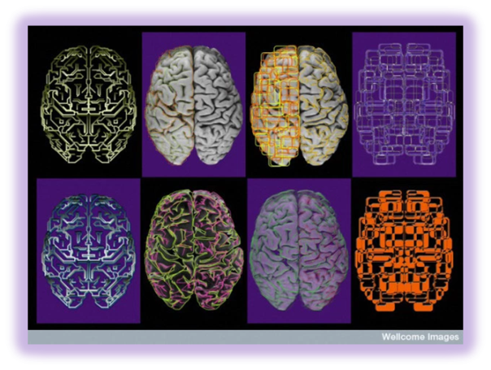
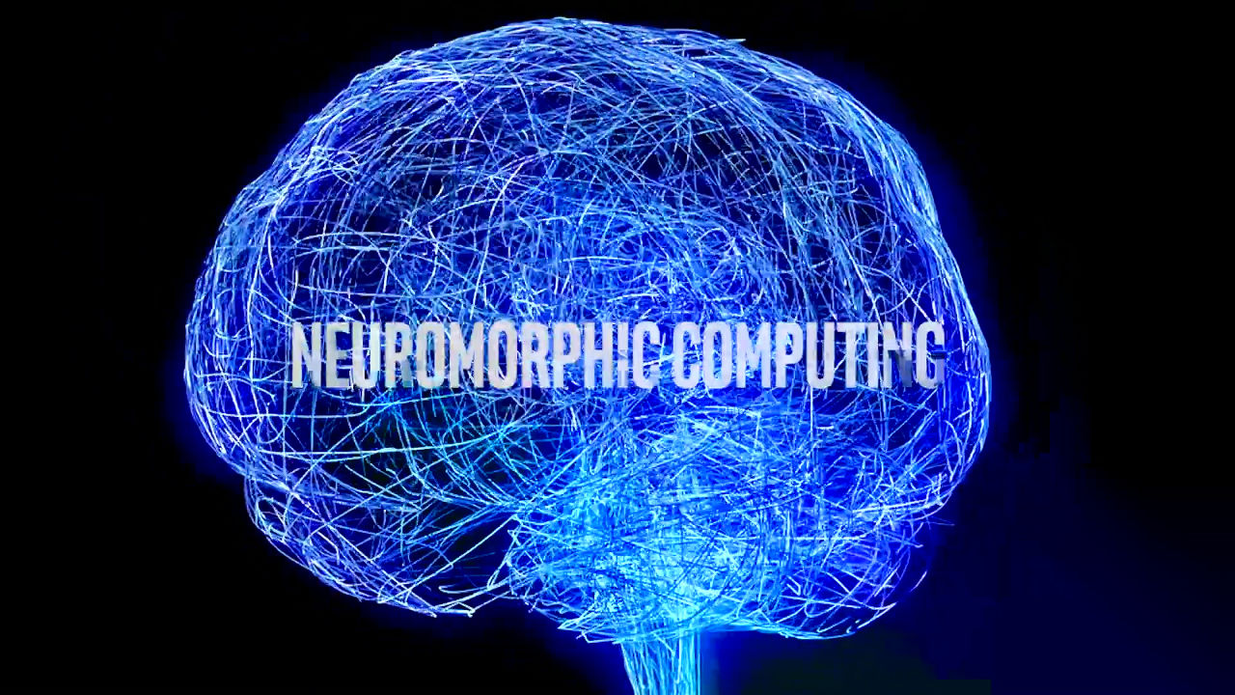
Neurotechnology and Society: Towards Good Governance David Winickoff OECD 20th Anniversary of the Oviedo Convention: Relevance and Challenge 25 October 2017 Council of Europe / DH-BIO Strasbourg, France

Slide 2
Introduction
The question of the human rights implications of neurotechniques have been raised in various contexts.
1998 French national bioethics committee says neuroscience may “pose a potential threat to human rights.” (Butler 1998)
U.S. Presidential Commission, Gray Matters II (2014: 104)
Nuffield Council on Bioethics (2013)
Rathenau Institute (2017)
Scholarship: Legal innovation required; human rights-based approaches would offer both relevant norms, and potential instruments (e.g., treaties)

Slide 3
Argument
Probably develop don’t invent.
Think process.
Human rights discourse should be one of many mutually reinforcing pathways of governance.
Multi-stakeholder discussions are necessary to reach the relevant actors, including business, consumers, governments, clinicians.
Role of standards (OECD)

Slide 4
National Brain Projects drivers: health, technology, innovation
US (BRAIN) Initiative. technologies to produce a new dynamic picture of the brain → individual cells and complex neural circuits interact in both time and space. ($500m FY2017)
Japan Brain/MINDS Project (2014). non-human primate brains to elucidate the neural networks involved in human brain disorders such as dementia and depression.
European Human Brain Project. Accelerate the fields of neuroscience, computing and brain-related medicine: advanced simulation and multi-scale modelling with the construction of an enabling Research Infrastructure.
China Brain Project. Elucidate neural basis of cognition, to develop new diagnostic and intervention approaches for brain disorders, and to develop brain-inspired computing methods and devices.

Slide 5
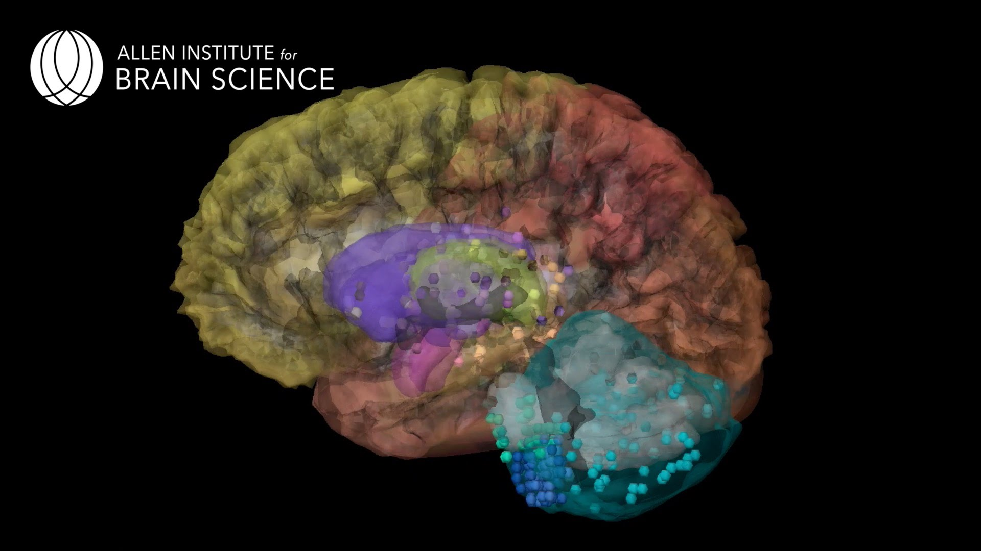
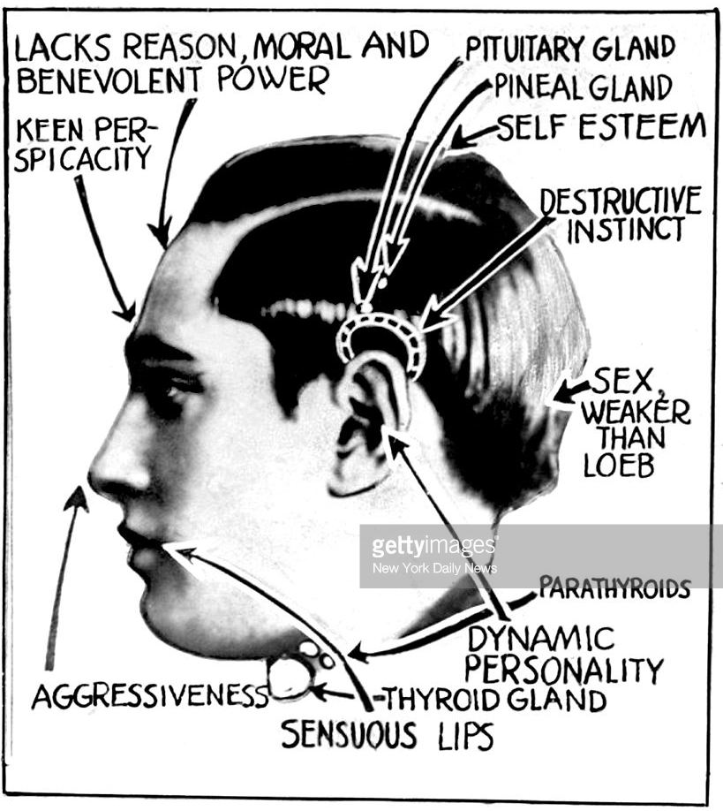
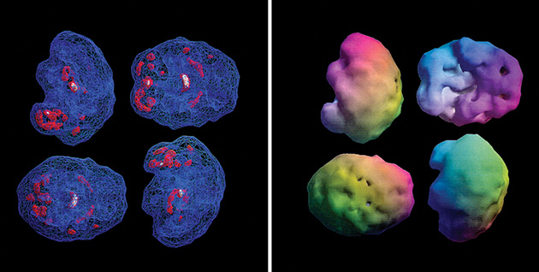
Reading the brain: fMRI and SPECT, new Brain maps/models
Redefining normal/abnormal
New classifications mean winners and losers
Prediction of health and behaviour based on mental states have consequences for the treatment of individuals
Health care / Insurance
Employment
Criminal law and legal liability
SPECT imaging. WIRED

Slide 6
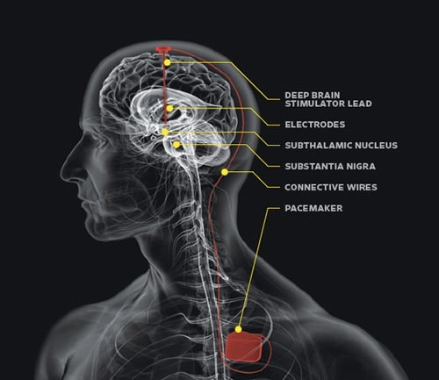
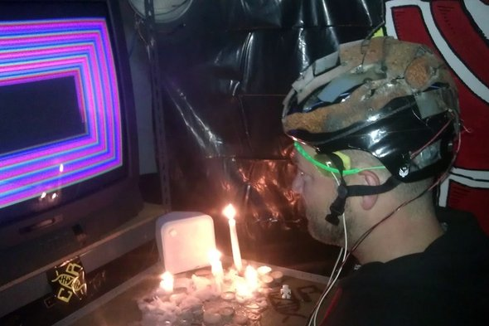
Modulation (manipulation): Invasive and Non-invasive
Transcranial:
Health impacts not well understood, especially longer term
Misleading claims
DYI
Deep Brain Stimulation
Potential misuses around asserting control, manipulating behaviour and memory
Non-medical uses generally not regulated
Enhancement questions
”Do DYI Brain Booster Devices Work?”
Scientific American, Jan 2017

Slide 7
Human rights Proposals on the table

Slide 8
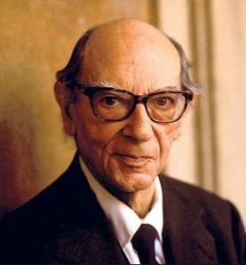
Cognitive liberty (two concepts of liberty via I. Berlin)
freedom from coercive and unconsented use (privacy, negative liberty)
One central concern is freedom from mind reading without consent
Mind reading and lie detection in criminal context
Manipulation of mental states through devices and stimulation
employers / military might intervene in employee’s brains to increase effectiveness, and also relevant in a military context (Robbins 2016)
Cf. Right not to be analysed, measured or coached (Rathenau 2017)
freedom to use, or refuse to use, brain stimulation and other techniques to alter their mental state (autonomy, positive liberty) [DYI]

Slide 9
Adequate?: Int’l human right to privacy
“no one shall be subjected to arbitrary interference with his privacy, family, home or correspondence, nor to attacks upon his honour and reputation. Everyone has the right to the protection of the law against such interference or attacks” (UDHR, Article 12).
“everyone has the right to respect for his private and family life, his home and correspondence” (ECHR, Article 8 para 1).
Oviedo Convention (Article 10) – Private life and right to information
“right to respect for private life in relation to information about his or her health.”
“Everyone is entitled to know any information collected about his or her health. However, the wishes of individuals not to be so informed shall be observed.”
Privacy law is good at protecting spaces; “fruits of the poisonous tree”

Slide 10
Psychological continuity
Aim: protect people from actions that may result in unintended alterations to personality and could harm their sense of identity.
Experiments involving brain electrodes in intelligence and military settings.
the psychological continuity of the person: experiencing oneself as persisting through time as the same person
Right to identity, developed by the European Court of Human Rights
Right to have and develop a personality (UDHR).

Slide 11
Human rights in the robot age (2017)
Recommend convening this meeting
They argue for two new human rights:
the right not to be measured, analyzed or coached
the right to meaningful human contact.
These rights are related, respectively, to the right to privacy and the right to respect for family life.

Slide 12
issues
The costs of rights inflation
spread skepticism about fundamental human rights as nothing more than wishful thinking; imposing a set of tests for human rights could guard against this risk. (Alston 1984)
Scope
Ripeness
“Law lag” discourse

Slide 13
Puzzles of scope: human rights and emerging technology
Problem of multiple spheres of use
Neurot’s run across many spheres of use
Instruments often use/sector specific (e.g. Oviedo on biomedicine)
Genetics as comparison
Technological frame dilemma
Overlap: e.g. Convention on human rights in the robot age (Rathenau 2017)
Convention on emerging technologies (Bergen Study 2015)
Argues for use of general and umbrella rights, with development?
Spheres of use for novel neurotechnology
Clinical/medical | Neurology/Neurosurgery Psychiatry Rehabilitation Pain Medicine
Occupational | Training Performance
Military | Intelligence Weapons
Public (DTC; DiY) | Educational Wellness/Lifestyle

Slide 14
Danger of “law lag” narrative
The idea that “law needs to catch up with the science and technology”
Idea that these general notions of privacy, for instance, are out of date if they are not specify the latest technology?
Especially regarding emerging technology: obviously true in some senses
To technology-specific rights dismantle core rights like privacy?
If you are a formalist/structuralist, you may want to “legislate” a priori
If you think rights can evolve, can be less specific

Slide 15
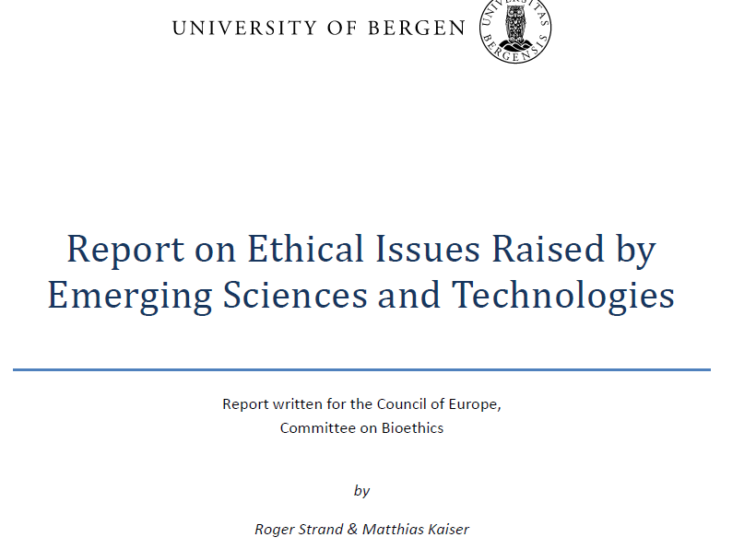
Engaging complex governance
Global governance is complex, multi-scalar, cross-sectoral, etc. (Ostrom). How/can/should governance of emerging technology engage?
“the challenges may be too big for academic researchers, sectorial public authorities or even individual national governments.”
Process component: New institutional mechanisms to assess and “monitor” on an ongoing basis
International collaboration and co-production of knowledge, understanding, practices and institutions

Slide 16
Complex Governance Approach: Nuffield Council on Bioethics (2013)
Key elements
Diverse duties
Elements of ‘responsible research and innovation’ (RRI) in the context of novel neurotechnologies:
Clearly identified need;
Securing safety and efficacy;
Generating robust evidence;
Continuous reflexive evaluation;
Coordinated interdisciplinary action; and
Effective and proportionate oversight.
Regulatory authorities
neurodevices should be regulated as medical devices and overseen by health regulatory agencies
Institutional ethics committees
ensure that non-therapeutic neurostimulation studies meet high standards
Clinicians working with the armed forces
Professional scientific organisations
Countering hype

Slide 17
neurotechnology and society at the OECD:

Slide 18
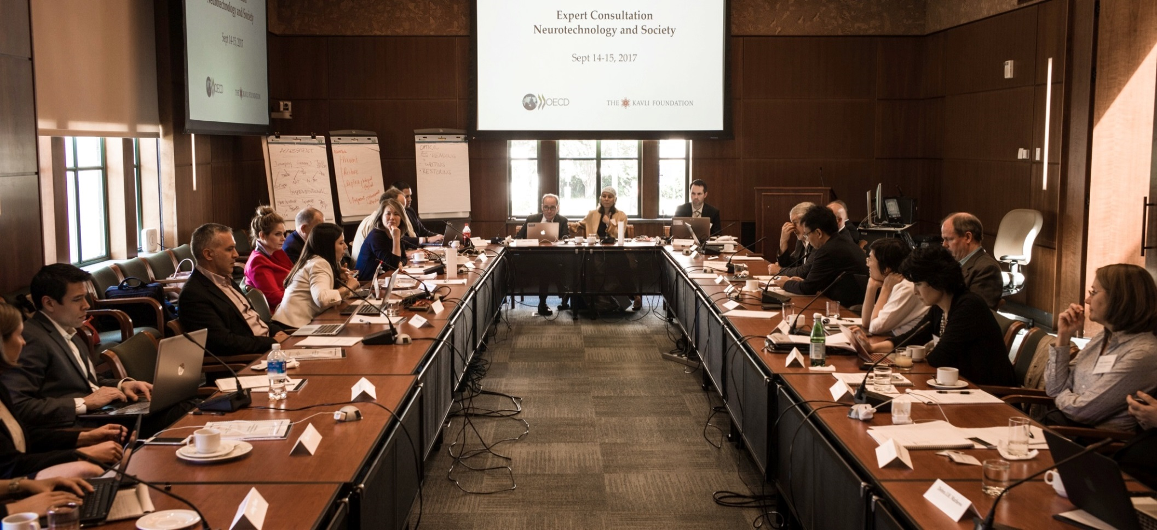
Expert consultation: 14-15 Sept. Washington D.C., National Academies

Slide 19
What is responsible innovation that can realise benefits and move towards positive social ends?
Dual use / Responsible science
Innovation in accordance with deliberated societal needs
Open science / open innovation
Transparency Data
IP approaches
Know how and show how
Equity and access
Public engagement / deliberation

Slide 20
Good governance of emerging technology: disparate streams, mutually deepening
Human rights bodies and legal/ethics scholars continue to develop work on unique aspects of neurotechnology (e.g. Council of Europe) with particular work on the concept of privacy, personhood, and discrimination.
Bioethics experts and stakeholders developing principles for clinicians and researchers working with human participants (i.e. neuroethics)
Funders support social science scholarship parallel to and integrated with neurosciences examining the co-constitution of new knowledges and new kinds of rights
The promotion of open science and transparency both to enable discovery and to support good governance
Deepening conversations within industry associations.
Multistakeholder processes to help develop codes of responsible innovation (science, government, industry, publics) to steer the innovation process

