Slide 1


Equity of Access to Health Care
- Elderly in EaP Countries
International Conference
“The Oviedo Convention:
Relevance and challenges”
Ucha Vakhania, MD
Executive Director
Coalition Homecare in Georgia
Strasbourg
October 24, 2017

Slide 2
Challenges in Healthcare Sector
Biomedical (Soviet) approach – instead of bio-psycho-social (holistic) approach;
Expensive curative approach (only cure, no care) – instead of integrated care;
Low quality of service (infrastructure, personnel);
Commercialization of healthcare sector;
Weakness of primary healthcare;
Polypharmasy and polipragmasy.

Slide 3
Specific Challenges for Elderly
Lack of Prevention:
  Primary – Healthy Ageing & Active Ageing, eating well, vaccination;
  Secondary – screening tests, diet & exercise programs;
  Tertiary – physical & psycho-social rehabilitation, chronic disease management programs (e.g. dementia).
Diagnostics and treatment - limitation caused by poverty, lack of geriatric institutions, ageism;
Rehabilitation and care - lack of rehabilitative and long-term care services.

Slide 4
Cure Care
Patient
LTC
Homecare (medical, nursing, social, household)
Hospice (Palliative, Terminal, End of Life Care)
Daily Care
Nursing Home
Day Care Center
Residential Home
Assisted Living
Respite Care
Training Informal Caregivers
Rehabilitation Centre
Emergency Service
PHC
Hospital
Increased effect of healthcare
Reduced costs

Slide 5
Estimation for the need of LTC by age groups
0 - 60 – 0,6%
60 - 80 – 3,9%
80+ – 28,3%

Slide 6
People in Need of LTC
Frail elderly (80-85%);
Persons with disabilities;
Chronically ill persons;
Terminally ill patients.

Slide 7
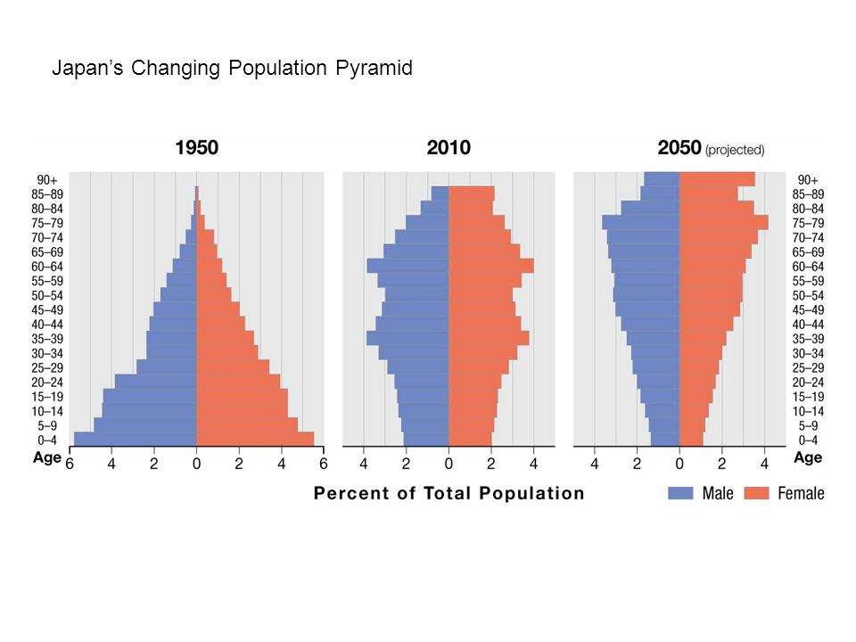
Demographic Change – Aging

Slide 8
The Human Rights-Based Approach
Rights-holders
Duty-bearers
CLAIMS
OBLIGATIONS
strengthening the
capacities of rights-holders to make their claims
strengthening
duty-bearers to
meet their obligations
HRBA

Slide 9
Duty-bearers
State/municipalities – “lack of sources” instead of human rights based approach;
Church – post Soviet…
CSOs – insignificant activities at micro level (reduced donor support, inability of out-of-pocket payment);
Family – splitting of traditional (multigenerational) families, out migration of youth, increased employment of woman.

Slide 10
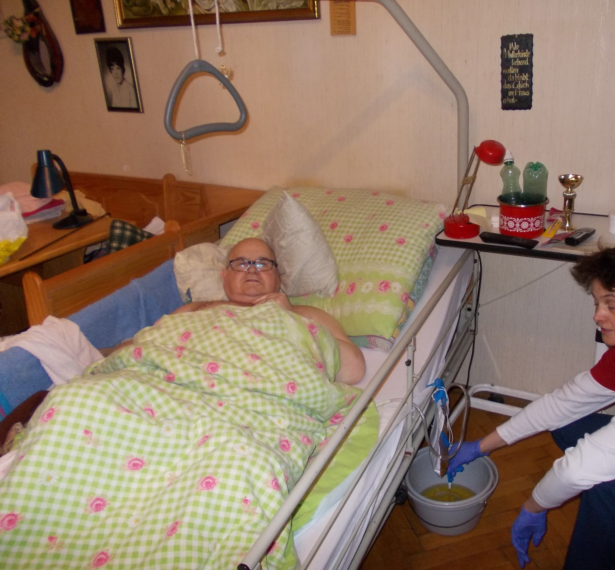
Care in Developed Countries

Slide 11
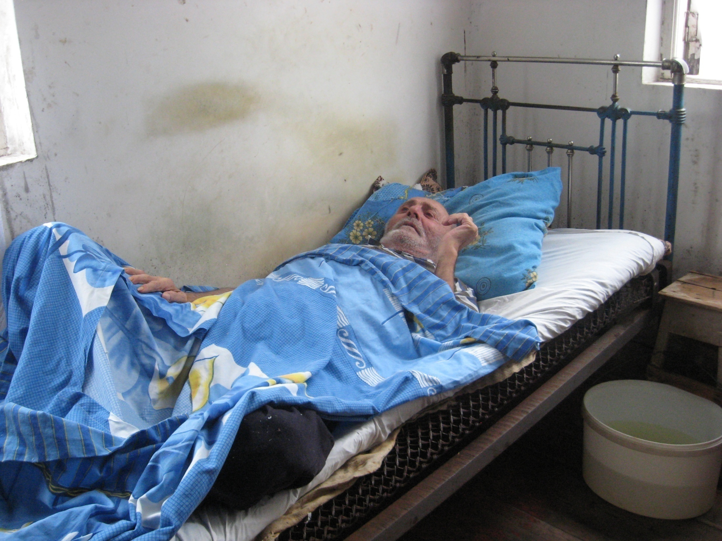
Living Without Proper Care

Slide 12
General Recommendation for Elderly Care in EaP Countries
Quality
Human Rights
Pilot Model
Lobby / Advocacy
Traditions / Reality
Best Practicies

Slide 13
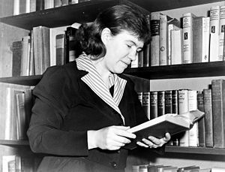
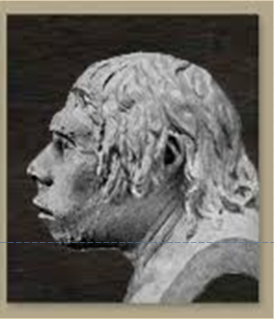
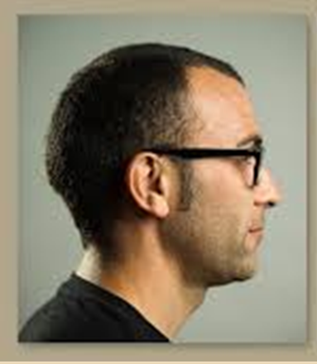
        As a civilized society, we are only as strong as our weakest, most vulnerable citizen.
        Margaret Mead

