Slide 1
Genetics, Genomics, and Human Rights
Conseil de l’Europe – October 26 2017
Professor Bartha Maria Knoppers
Director, Centre of Genomics and Policy
Canada Research Chair in Law and Medicine
McGill University

Slide 2
Outline
Whither “Genetic” Discrimination and Insurance?
“Big Data” to the Rescue?
A Human Rights Approach?

Slide 3
I. Whither “Genetic” Discrimination and Insurance?

Slide 4
European Union
Convention on Human Rights and Biomedicine (1997) ​
Chapter IV - Human Genome
Article 11 - Non-discrimination
Article 12 - Predictive genetic tests
Charter of Fundamental Rights of the European Union (2012)​
Title III - Equality
Art 21 – Non-discrimination (“genetic features”)

Slide 5
Recommendation CM/Rec(2016)8 of the Committee of Ministers to the member States on the processing of personal health-related data for insurance purposes, including data resulting from genetic tests
“Bearing in mind the significant expansion of private insurance contracts covering risks related to an individual’s health, physical integrity, age or death;
Considering the sensitive nature of the personal health-related data processed in these contracts;
Taking into account developments in the field of genetics, in particular the prospects of obtaining data more and more easily on the genetic characteristics of individuals, the analysis of which may be particularly complex;
Bearing in mind the risks of an incorrect or excessive interpretation of these data regarding the state of health of the persons concerned in the – sometimes very distant – future;
Convinced of the social importance in each country of appropriate coverage for certain risks related to health, physical integrity, age or death;
Recognising at the same time the insurer’s legitimate interest in assessing the level of risk presented by the insured person;”

Slide 6
Recommendation CM/Rec(2016)8 of the Committee of Ministers to the member States on the processing of personal health-related data for insurance purposes, including data resulting from genetic tests
Principle 4 – Insurers should not require genetic tests for insurance purposes.
15. In accordance with the principle laid down in Article 12 of the Convention on Human Rights and Biomedicine, predictive genetic tests must not
be carried out for insurance purposes.
16. Existing predictive data resulting from genetic tests should not be processed for insurance purposes unless specifically authorised by law. If so,
their processing should only be allowed after independent assessment of conformity with the criteria laid down in paragraph 5 by type of test used
and with regard to a particular risk to be insured.
17. Existing data from genetic tests from family members of the insured person should not be processed for insurance purposes.

Slide 7
Recommendation CM/Rec(2016)8 of the Committee of Ministers to the member States on the processing of personal health-related data for insurance purposes, including data resulting from genetic tests
IV. Provisions on risk assessment
Principle 5 – Insurers should take account of new scienti?c knowledge.
18. Insurers should regularly update their actuarial bases in line with relevant, new scientific knowledge.
19. At the request of the insured person, the insurer should provide relevant information and justification to that person regarding the calculation
of the premium, any additional premium or any total or partial exclusion from insurance.

Slide 8
Preventing Genetic Discrimination
8 Main Approaches​
Human Rights​
Genetic Exceptionalism
Sectoral Prohibition
Moratoria​
Ethical Guidance
Self-Regulatory​
Hybrid​
Status Quo​
Source: Joly, Yann, Ngueng Feze, Ida, and Knoppers, Bartha M. "Comparative Approaches to Genetic Discrimination: Chasing Shadows?" Trends in Genetics (2017).

Slide 9
Summary of International approaches to GD
Source: Joly, Yann, Ngueng Feze, Ida, and Knoppers, Bartha M. "Comparative Approaches to Genetic Discrimination: Chasing Shadows?" Trends in Genetics (2017).*
Notes:
*The map was modified to reflect Canada’s recent adoption of the Genetic Non-Discrimination Act (2017) (original map had Canada in white as a status-quo nation). ​

Slide 10
A systematic review of genetic discrimination and life insurance
“The available data clearly document the existence of individual cases of genetic discrimination. The significance of this initial finding is, however, greatly diminished by four observations. First, the methodology used in most of the studies is not sufficiently robust to clearly establish either the prevalence or the impact of discriminatory practices. Second, the current body of evidence was mostly developed around a small number of ‘classic’ genetic conditions. Third, the heterogeneity and small scope of most of the studies prevents formal statistical analysis of the aggregate results. Fourth, the small number of reported genetic discrimination cases in some studies could indicate that these incidents took place due to occasional errors, rather than the voluntary or planned choice, of the insurers.”
Source: Joly, Yann, Ngueng Feze, Ida and Jacques Simard. "Genetic discrimination and life insurance: a systematic review of the evidence." BMC medicine 11.1 (2013): 25.

Slide 11
Conclusion of the study
Outside of selected rare adult onset monogenic conditions such as Huntington, there is no conclusive data demonstrating a systemic discriminatory practice on the part of life insurers (33 studies: 1991-2012)
Source: Joly, Yann, Ngueng Feze, Ida and Jacques Simard. "Genetic discrimination and life insurance: a systematic review of the evidence." BMC medicine 11.1 (2013): 25.

Slide 12
"An implicit question raised by these observations is whether law is truly the best vehicle to address GD. By increasingly deciding to single out, regulate, and protect genetic information, are we not also fostering genetic exceptionalism and the stigmatization of certain types of genetic profiles considered ‘at risk’? While legislation may help prevent GD, there could be an even greater need to actively engage stakeholders on the potential and limits of genetic technologies, existing protections, and the need to express greater solidarity in integrating genetics in everyday life. We substantially share our genome with our relatives, our neighbors, and the entire human species, which provides an impetus for giving greater weight to the ethical principle of solidarity in addressing GD."
Source: Joly, Yann, Ngueng Feze, Ida, and Knoppers, Bartha M. "Comparative Approaches to Genetic Discrimination: Chasing Shadows?" Trends in Genetics (2017).

Slide 13
“[I]n the insurance contract, rational, scientifically sound and empirically supported discrimination is possible. Discrimination among risks is considered ethically problematic only where there is no sound actuarial basis for the manner in which the risks are classified, or individuals of the same risk class are treated differently. Hence, the more information available to the insurers the better, the more precise the discrimination, the greater the actuarial fairness of the system.”
Source: Joly, Yann, Bartha M. Knoppers, and Béatrice Godard. "Genetic information and life insurance: a 'real’ risk?." European journal of human genetics: EJHG 11.8 (2003): 561 citing Anderlik, Mary R., and Mark A. Rothstein. "Privacy and confidentiality of genetic information: what rules for the new science?" Annual review of genomics and human genetics 2.1 (2001): 401-433.

Slide 14
II. “Big Data” to the Rescue?

Slide 16
Data Needed to Make Progress in Human Health
Pathways
Data must describe
Data linkage
leverages the value of data to answer specific questions
Processes
Outcomes
Costs
Key prerequisites
Electronic health records (EHRs)
Longitudinal record of treatments and outcomes
Individual patients / person level
Follow patients through cycle of care
Link to outcomes

Slide 17
Recommendation IV
The OECD recommends “that governments support transborder cooperation in the processing of personal health data for health system management, research, statistics and other health-related purposes that serve the public interest subject to safeguards consistent with this Recommendation” and
“Identify and remove barriers to effective cross-border cooperation …”
“Facilitate the compatibility and interoperability of health data governance frameworks.”
Source: Recommendation of the OECD Council on Health Data Governance, 2017

Slide 18
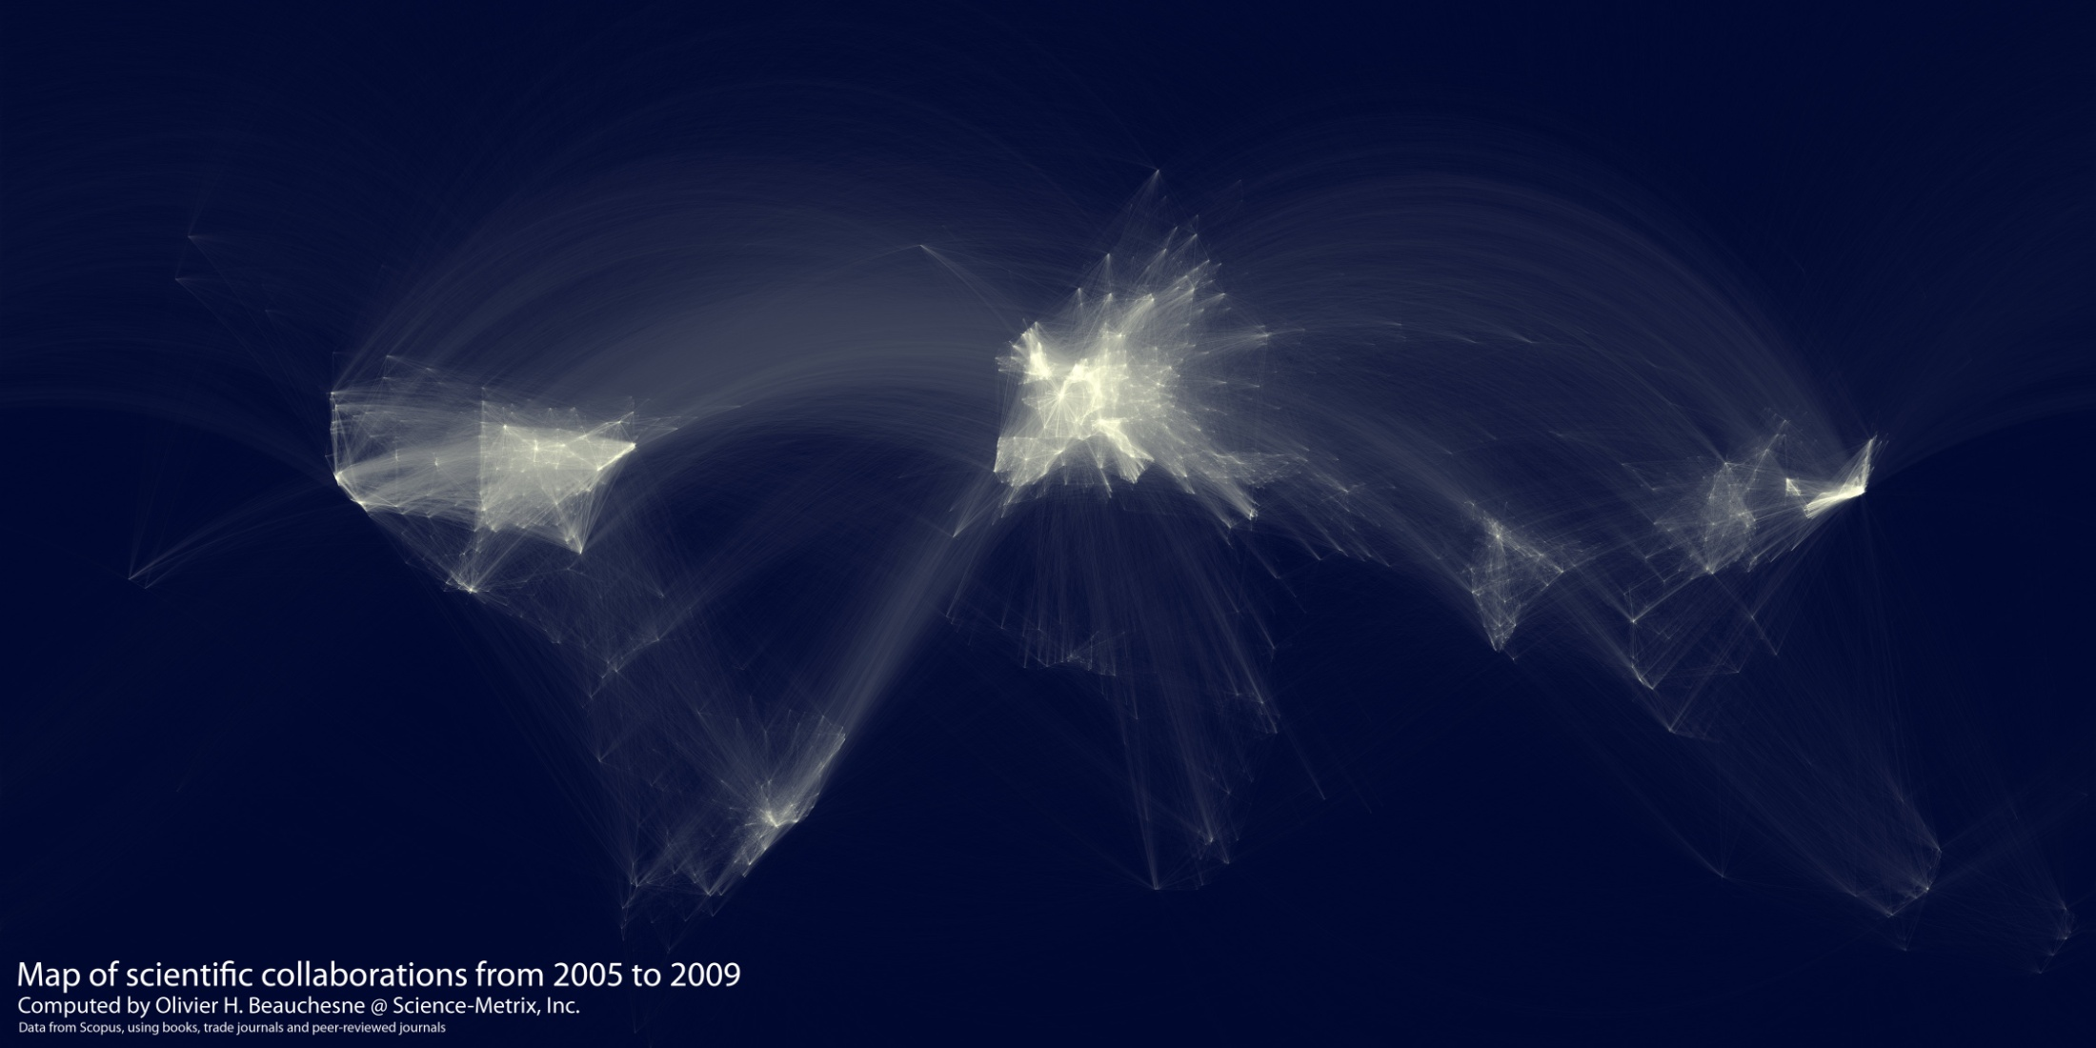

Slide 20
III. A Human Rights Approach to Data Sharing?

Slide 21
Human Rights Foundation
Universal Declaration of Human Rights (1948)
“The Right to Benefit from Science”
“The Right to Recognition”
27(1)
27(2)
“Everyone has the right freely to participate in the cultural life of the community, to enjoy the arts and to share in scientific advancement and its benefits.”
“Everyone has the right to the protection of the moral and material interests resulting from any scientific, literary or artistic production of which he is the author.”

Slide 22
Legal Force
Dual rights rendered legally binding by the International Covenant on Economic, Social and Cultural Rights (ICESCR) (1966) – Article 15
165 States have ratified the ICESCR
States are bound to implement the treaty in their national laws
The Right to Science → Actionable

Slide 23
Why Human Rights?
Universalizing force
Political and legal dimensions that reach beyond the moral appeals of bioethics
International legal force
Belong to groups as well as individuals (reciprocity)
Impose positive duties on governments and private actors

Slide 24
Content of the Right to Science
Access by everyone without discrimination to the benefits of science and its applications;
Opportunities for all to contribute to the scientific enterprise
The freedom indispensable for scientific research;
Participation of individuals and communities in decision-making;
Conservation, development and diffusion of science and technology.
Source: UNESCO, Venice Statement 2009

Slide 25
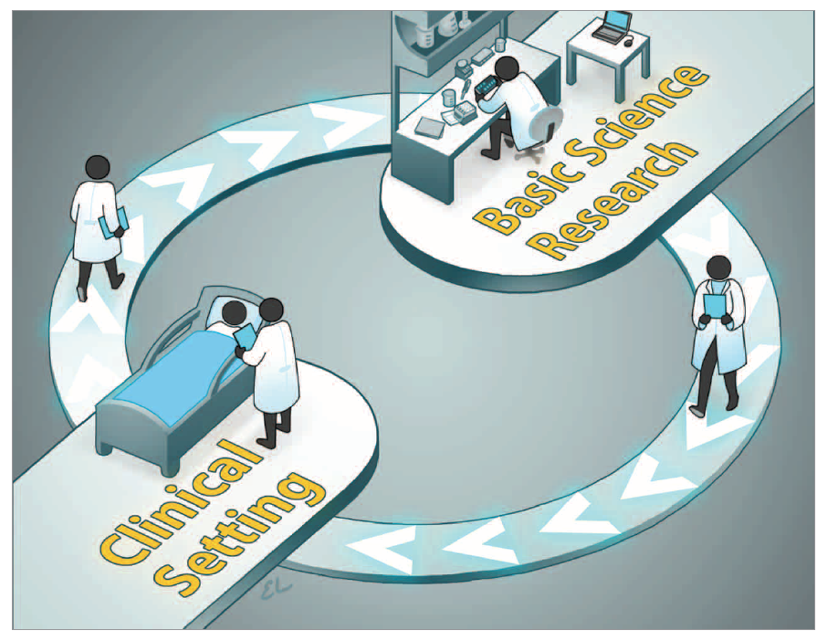
Bench to Bedside and Back Again May Be Key to Clinical Breakthroughs
Source: JAMA 318.1 (July 4, 2017).

Slide 26
Source: ”Annual Report of the Chief Medical Office: Genomic" (2016): Chapter 16, p 1.

Slide 27
Conclusion
“[L]egislation prohibiting genetic discrimination does not seem to (completely) alleviate fears of genetic discrimination.”
“Fears seem to arise from pre-existing experiences of living with the social consequences of disease in the family.”
“While most studies included in this systematic literature review focused on monogenic diseases, it is important for future research to study whether and how new genomic tools, such as genomic sequencing, will influence the abovementioned issues and the debate on genetic discrimination.”
Source: Wauters, Annet, and Ine Van Hoyweghen. "Global trends on fears and concerns of genetic discrimination: a systematic literature review." Journal of human genetics 61.4 (2016): 275.

