Slide 1
An Ethic of Integration: Novel Biotechnologies and Human Dignity
Sheila Jasanoff
Harvard University
20th Anniversary of Oviedo Convention
Strasbourg, October 25, 2017

Slide 2
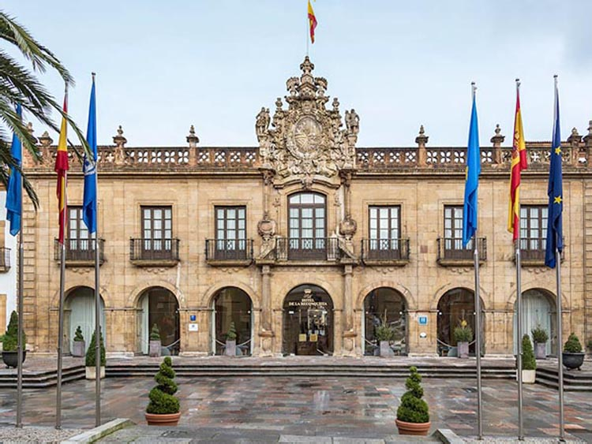
Oviedo @ 20

Slide 3
Oviedo Convention
Article 1 – Purpose and object
Parties to this Convention shall protect the dignity and identity of all human beings and guarantee everyone, without discrimination, respect for their integrity and other rights and fundamental freedoms with regard to the application of biology and medicine.
Article 2 – Primacy of the human being
The interests and welfare of the human being shall prevail over the sole interest of society or science.
Article 13 – Interventions on the human genome
An intervention seeking to modify the human genome may only be undertaken for preventive, diagnostic or therapeutic purposes and only if its aim is not to introduce any modification in the genome of any descendants.

Slide 4
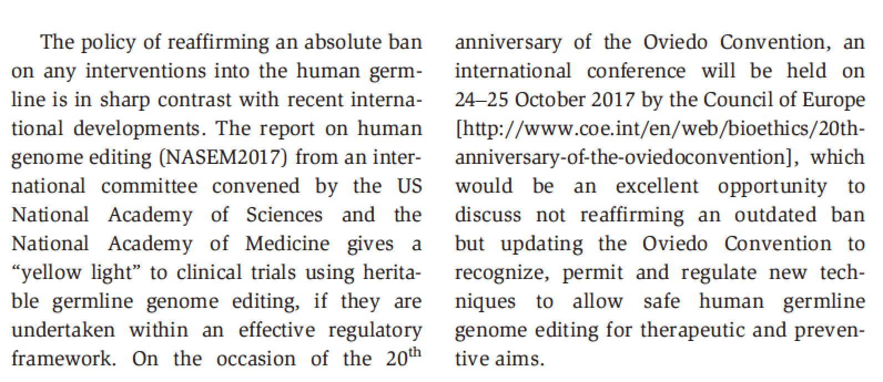
Sykora & Caplan, EMBO Reports 2017

Slide 5
(re)connecting technology with norms?
A framework for analysis
Narratives
Disentangling lines of discourse
Scientific
Legal
Ethical
Biopolitical orders
Coexistence
Cosmopolitanism
Constitutionalism
Conclusions

Slide 6
Moral Obligations: “Playing God”

Slide 7
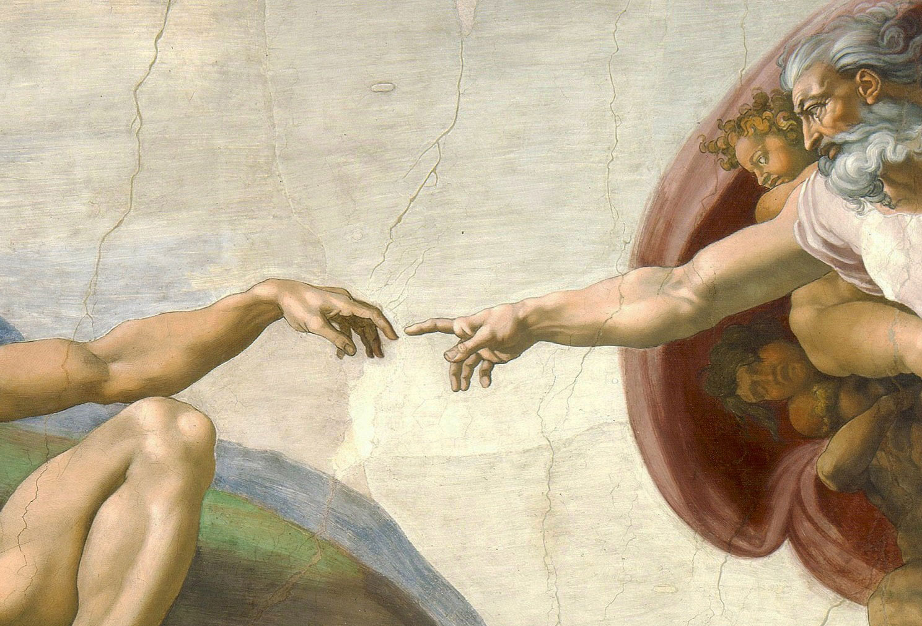

Slide 8
HUMAN HANDS: Editorial Precision

Slide 9
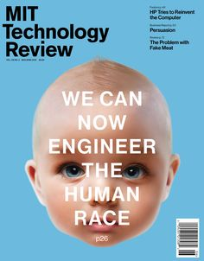
Engineering the Human

Slide 10
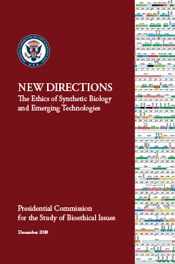
When discussing synthetic biology, individuals and deliberative forums
should strive to employ clear and accurate language. The use of sensationalist buzzwords and phrases such as “creating life” or “playing God” may initially increase attention to the underlying science and its implications for society, but ultimately such words impede ongoing understanding of both the scientific and ethical issues at the core of public debates on these topics. To further promote public education and discourse, a mechanism should be created, ideally overseen by a private organization, to fact-check the variety of claims relevant to advances in synthetic biology.

Slide 11
Promises: An Age of Miracles

Slide 12
A New “Natural” Resource

Slide 13
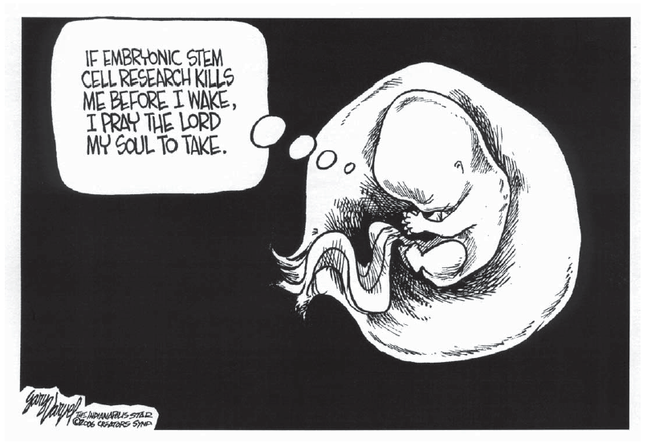
Questions of Faith…

Slide 14
Narratives
Thin Description
Only cells
Mere matter
Pre-conscious
Limited future (only therapeutic)
Subject to scientific governance
Thick Description
Cells encoding life
Precursor of life
Capable of consciousness
Unlimited future (pre-human being)
Subject to political governance

Slide 15
Owning Life:
from Science to
Technoscience

Slide 16
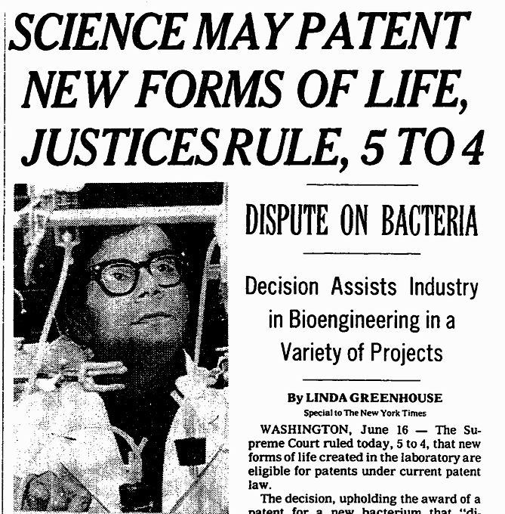
“anything under the sun that is made by man”

Slide 17
Diamond v. Chakrabarty (1980)
Question presented:
Whether a living organism is patentable subject matter under 35 U.S.C. 101.
Background
GE bioengineer Ananda Chakrabarty created an oil-eating bacterium (Pseudomonas), fusing multiple incompatible bacterial plasmids
GE patent lawyer recommended patenting
First patent claim covering non-plant living organism

Slide 18
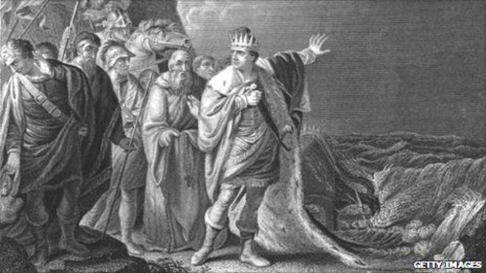
King Canute and the Advancing Tide

Slide 19
The Court and its “Friends”
Genentech: “...it is not for this Court…to attempt like King Canute to command the tide of technological development”
Supreme Court: “... legislative or judicial fiat as to patentability will not deter the scientific mind from probing into the unknown any more than Canute could command the tides”
Genentech: “...it is not for this Court…to attempt like King Canute to command the tide of technological development”
Supreme Court: “... legislative or judicial fiat as to patentability will not deter the scientific mind from probing into the unknown any more than Canute could command the tides”

Slide 20
Unwritten Constitutions of Life
US
Science and politics strictly separated, with facts preceding concerns; individual-centered
UK
Coproduced common sense knowledge and norms as basis for both facts and concerns; family in society
Germany
Law as baseline for defining human integrity, with science underwriting narratives of life under law; individual in society, relational values

Slide 21
Comparisons
 | US | UK | Germany
Embryo protection | Indeterminate/contested | 14 day rule | Fertilization/nuclear fusion
Ontological claim | “Life” | Not yet life | Potential for life
Risks | Destroying life | Crossing lines of reasonableness | Instrumentalizing life
Other interests | Preserving life | Health research/national leadership | Scientific freedom; abortion settlement
Supervisory authority | Distributed/state and federal courts | Centralized/HFEA | Centralized/Bundestag
Abuse | Life vs. progress | Overregulation | Technology as end in itself

Slide 22
Responsibilities

Slide 23
Three Models of Subsidiarity
Coexistence
Interstate contradictions need not be resolved
Challenge is border management
Cosmopolitanism
A degree of mutual recognition must be assured
Challenge is harmonization
Constitutionalism
Norms to guide duties and obligations
Challenge is producing binding norms

Slide 24
Coexistence (with Containment)
Goal: Freedom to choose modes of production
Coexistence demands foolproof borders (containment)
“Contained” regimes typically cannot protect their boundaries against flows and transfers (of genes, organisms, actors, politics)

Slide 25
Cosmopolitanism
Goal: Regime of mutual recognition
How good is our record?
Not good at recognizing cross-cultural divergences in risk creation and management
Product vs. process regulation for example
Not good at recognizing sociality of material products
Stem cell narratives for example
Not good at recognizing alternative procedural approaches to balancing uncertainties
Precaution in EU and US for example

Slide 26
Constitutionalism
Goal: Regime of ordered responsibilities (including responsibilities for knowledge)
What should be negotiated in a constitutional convention on emerging biotechnologies?
Theories of science and proof (civic epistemologies)
E.g., nature of public demnstrations
Principles of delegation to experts
Scientific advice and “the fifth branch”
Principles of accountability for public reason
Procedures for public participation
Challenges and controversies

Slide 27
Hans Jonas (1976):
“Scientific inquiry claims untrammeled
freedom for itself.”

Slide 28
Science
is not a
spectator sport!

Slide 29
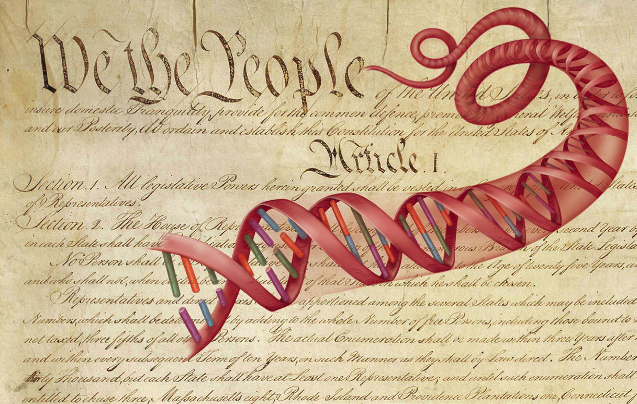

Slide 30
Thank you!

