Slide 1
Action(s) to be undertaken at intergovernmental level to address the identified challenges
20TH ANNIVERSARY OF THE OVIEDO CONVENTION: RELEVANCE AND CHALLENGES
Antonio Cherubini
Geriatria, Accettazione geriatrica
Centro di ricerca per l’invecchiamento
IRCCS-INRCA, Italia
Notes:
It is a honour and a pleasure to have the opportunity to participate in the celebretion of the 20th anniversary of the Oviedo convention in the Council of Europe, an institution that has in recent years promoted the rights of older persons, by means os important statements, such as Recommendation CM/Rec(2014)2 of the Committee of Ministers to member States on the promotion of human rights of older persons and the recente Report on Human rights of older persons and their comprehensive care
(

Slide 2
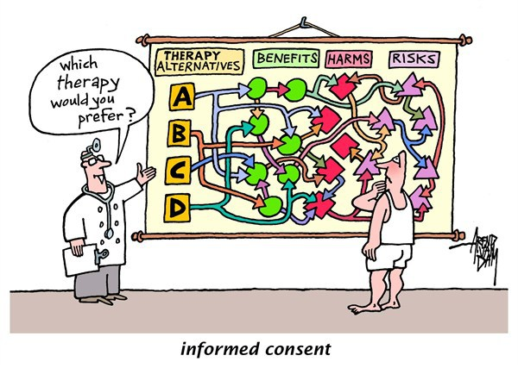
Informed consent and Assessment of capacity

Slide 3
The Changing Face of Informed Consent
A contemporary challenge to informed consent emerges from expected sociodemographic trends. The U.S. population will become considerably older and more racially and ethnically diverse over the next few decades, with an expected doubling of the number of persons 65 years of age or older and an even more dramatic increase in the number of the “oldest old” (85 years+). Persons older than 65 years use more health care services, have a higher prevalence of chronic diseases, and more often have declining physical and cognitive function... The number of people with Alzheimer’s dementia is also expected to more than double by 2050 and to increase more dramatically among the oldest old. Preparing for these realities and their effect on health care is critical. For informed consent, they suggest the need for respectful, effective, and efficient methods of both ascertaining whether persons have the capacity to consent for themselves and facilitating decision-making processes for those who do not. Although many elderly persons, including some with dementia, retain the capacity to give informed consent for certain treatment decisions, others do not.
Grady, N Engl J Med. 2017

Slide 4
The Changing Face of Informed Consent
Over the past 50 years, the informed consent process has become increasingly regulated and standardized, while the challenges remain persistent and hard to overcome.
Consent forms are increasingly long and complicated, obscuring important details, and are often designed to serve the interests of institutions and sponsors.
Data show that participants often have a limited understanding of study information even when they have signed a consent form.
Grady, N Engl J Med. 2017

Slide 5
What Methods Have Been Used To Improve Informed Consent?
Simplifying Informed Consent forms may improve satisfaction, if not comprehension
Providing supplemental written materials improves recall and comprehension
Decision Aids improve knowledge and participation in shared decision-making
Video educational tools also improve knowledge
Interactive Computer-Based Educational Tools show mixed results
Structured Informed Consent discussions need further testing
“Repeat Back” Methods may be effective but time consuming

Slide 6
Enduring and Emerging Challenges
of Informed Consent
Clinicians, who often lack training in assessing capacity, do not always recognize incapacity and may question a patient’s capacity only when they face a risky decision or when the patient disagrees with their recommendations.
Assessing capacity and identifying appropriate and legally acceptable alternative decision makers or processes take time and resources and often receive short shrift in a busy clinical or research setting. Assessing the reasoning capacities of persons from cultural backgrounds that are not well understood by clinicians can also pose considerable challenges. Clinicians and investigators should be taught to assess capacity and should be provided with validated and useful tools and the resources to help resolve difficult or borderline cases.
Grady, N engl j med. 2015

Slide 7
REGULATION (EU) No 536/2014 OF THE EUROPEAN PARLIAMENT AND OF THE COUNCIL of 16 April 2014 on clinical trials on medicinal products for human use, and repealing Directive 2001/20/EC
(27) Human dignity and the right to the integrity of the person are recognised in the Charter of Fundamental Rights of the European Union (the ‘Charter’). In particular, the Charter requires that any intervention in the field of biology and medicine cannot be performed without free and informed consent of the person concerned. Directive
2001/20/EC contains an extensive set of rules for the protection of subjects. These rules should be upheld.
Regarding the rules concerning the determination of the legally designated representatives of incapacitated persons and minors, those rules diverge in Member States. It should therefore be left to Member States to determine the legally designated representatives of incapacitated persons and minors. Incapacitated subjects, minors, pregnant women and breastfeeding women require specific protection measures.

Slide 8
How Legislation on Decisional Capacity Can Negatively Affect the Feasibility of Clinical Trials in Patients with Dementia
The AdCare study, a non-profit, randomized, placebo-controlled, double-blind, multicentre, pragmatic trial coordinated by the Italian National Institute of Health, aimed to evaluate the long-term safety and efficacy profiles of 3 atypical antipsychotic drugs (risperidone, olanzapine and quetiapine) and 1 conventional antipsychotic drug (haloperidol) in treating psychosis, aggression and agitation in outpatients with AD. The study was planned to be carried out in 19 clinical centres and to enrol 1000 outpatients. According to Italian law, in the case where a patient is considered unable to give informed consent, a legal representative designated by the court has to provide it.
Because of difficulties in the informed consent procedure, the study had to be prematurely interrupted. From February 2009 to April 2010, 83 patients gave informed consent to participate in the trial.
Galeotti, Drugs Aging, 2012

Slide 9
Action(s) to be undertaken
Actions to promote uniform cross national standards for the production and acquisition of the informed consent
Actions to promote uniform cross national criteria for the assessment of capacity to provide informed consent

Slide 10
Ageism

Slide 11
Ageism
Ageism can be seen as a process of systematic stereotyping of and discrimination against people because they are old, just as racism and sexism accomplish this for skin colour and gender. Old people are categorized as senile, rigid in thought and manner, old-fashioned in morality and skills
Butler, Gerontologist.1969

Slide 12
CHARTER OF FUNDAMENTAL RIGHTS OF THE EUROPEAN UNION (2016/C 202/02)
Article 21
Non-discrimination
Any discrimination based on any ground such as sex, race, colour, ethnic or social origin, genetic features, language, religion or belief, political or any other opinion, membership of a national minority, property, birth, disability, age or sexual orientation shall be prohibited.

Slide 13
Valuing older people: time for a global campaign to combat ageism
Negative attitudes and stereotypes about older adults as frail, out of touch, burdensome or dependent are ubiquitous. A recent analysis carried out by the WHO using world values survey data of 83 034 adults from 57 countries found low respect for older adults. 60% of participants reported that older adults are not well respected, with respondents from higher income countries being more likely to report so
Unlike other forms of discrimination, including sexism and racism, ageism is socially acceptable, strongly institutionalised, largely undetected and unchallenged
Pervasive misconceptions, negative attitudes and assumptions about older people are serious barriers to developing good public policy on ageing and health.
.
Officer, Bull World Health Organ. 2016

Slide 14
Valuing older people: time for a global campaign to combat ageism
Ageism influences the development of global health policy and targets. Age limits placed on global goals to prevent and control non communicable diseases and the use of premature mortality thresholds may be used to discriminate against older adults in the allocation of health resources and data collection.
Older people who hold negative self-stereotypes make poorer recovery from disability and live on average 7.5 years less than people with positive attitudes to ageing.
Health care providers have been shown to hold more negative implicit attitudes towards older adults than the general population. This may help explain research findings showing that older people receive less screening, less preventive care and poorer management and treatment.
Officer, Bull World Health Organ. 2016

Slide 15
AGE Platform Europe Position on Structural Ageism (Brussels, 26th April 2016)
Structural ageism is a form of systematic stereotyping and can be defined as the way in which society and its institutions sustain ageist attitudes, actions or language in laws, policies, practices or culture. It can be encountered in the legal system, the media, health care provision and the economy, among many other areas.
It takes the form of upper age limits, the inadequate provision of services for the needs of older people, the failure to take situations, experiences or aspirations of individuals into account when making decisions or allocating resources, or the segregation of people in later life due to a lack of real choice to remain active in their communities.
It is also common for older persons not to be appropriately represented in surveys or studies, which very often group everybody together into one homogeneous ‘older’ age range (i.e. 60+), or exclude older people beyond a certain age, allowing for little nuance in information presented publicly about older generations.

Slide 16
AGE Platform Europe Position on Structural Ageism (Brussels, 26th April 2016)
Health and long term care
AGE members have highlighted a particular prevalence of unequal access to healthcare services, such as surgical treatments and medical rehabilitation, despite older age groups requiring these services more frequently and being much fitter than in previous generations.
Examples
- In Cyprus innovative surgical treatment did not cover older people even though it could have had beneficial results for the patients
- In Finland, the scheme for medical rehabilitation was reformed in 2016 and is no longer available to people over the age of 65.
Notes:
Lack of access to geriaric services that in many countries are too few and sparse

Slide 17
AGE Platform Europe Position on Structural Ageism (Brussels, 26th April 2016)
Crucially, the lack of harmonising anti-discrimination legislation and monitoring among EU Member States leaves a very noticeable gap and as a result older people living in some countries are better protected than others. For instance, there is legislation in Bulgaria, Croatia, France, Hungary, Italy, Slovenia, Sweden, the UK and to some extent Slovakia which prohibits age discrimination in access to goods and services (albeit often with exceptions related to financial services), although in the rest of the EU older people are not explicitly (or only minimally) protected from being discriminated against outside of employment.

Slide 18
Equality Act – 2010 –UK Protected characteristics
‘The Equality Act is a law which protects you from discrimination. It means that discrimination or unfair treatment on the basis of certain personal characteristics, such as age, is now against the law in almost all cases.
The Equality Act applies to discrimination based on:
Age
Race
Sex
Gender reassignment
Disability
Religion or belief
Sexual orientation
Marriage or civil partnership
Pregnancy and maternity

Slide 19
Equality Act – 2010 –UK How does the law protect me from age discrimination?
Direct discrimination
Indirect discrimination
Harassment
Victimisation

Slide 20
Equality Act – 2010 –UK In what situations does the Equality Act apply?
Consumer services
Health services
Employers
Public services

Slide 21
Action(s) to be undertaken
Actions to promote a common European legislation to combat ageism as well as a greater awareness of ageism at all society levels

Slide 22
Ageism in health research

Slide 24
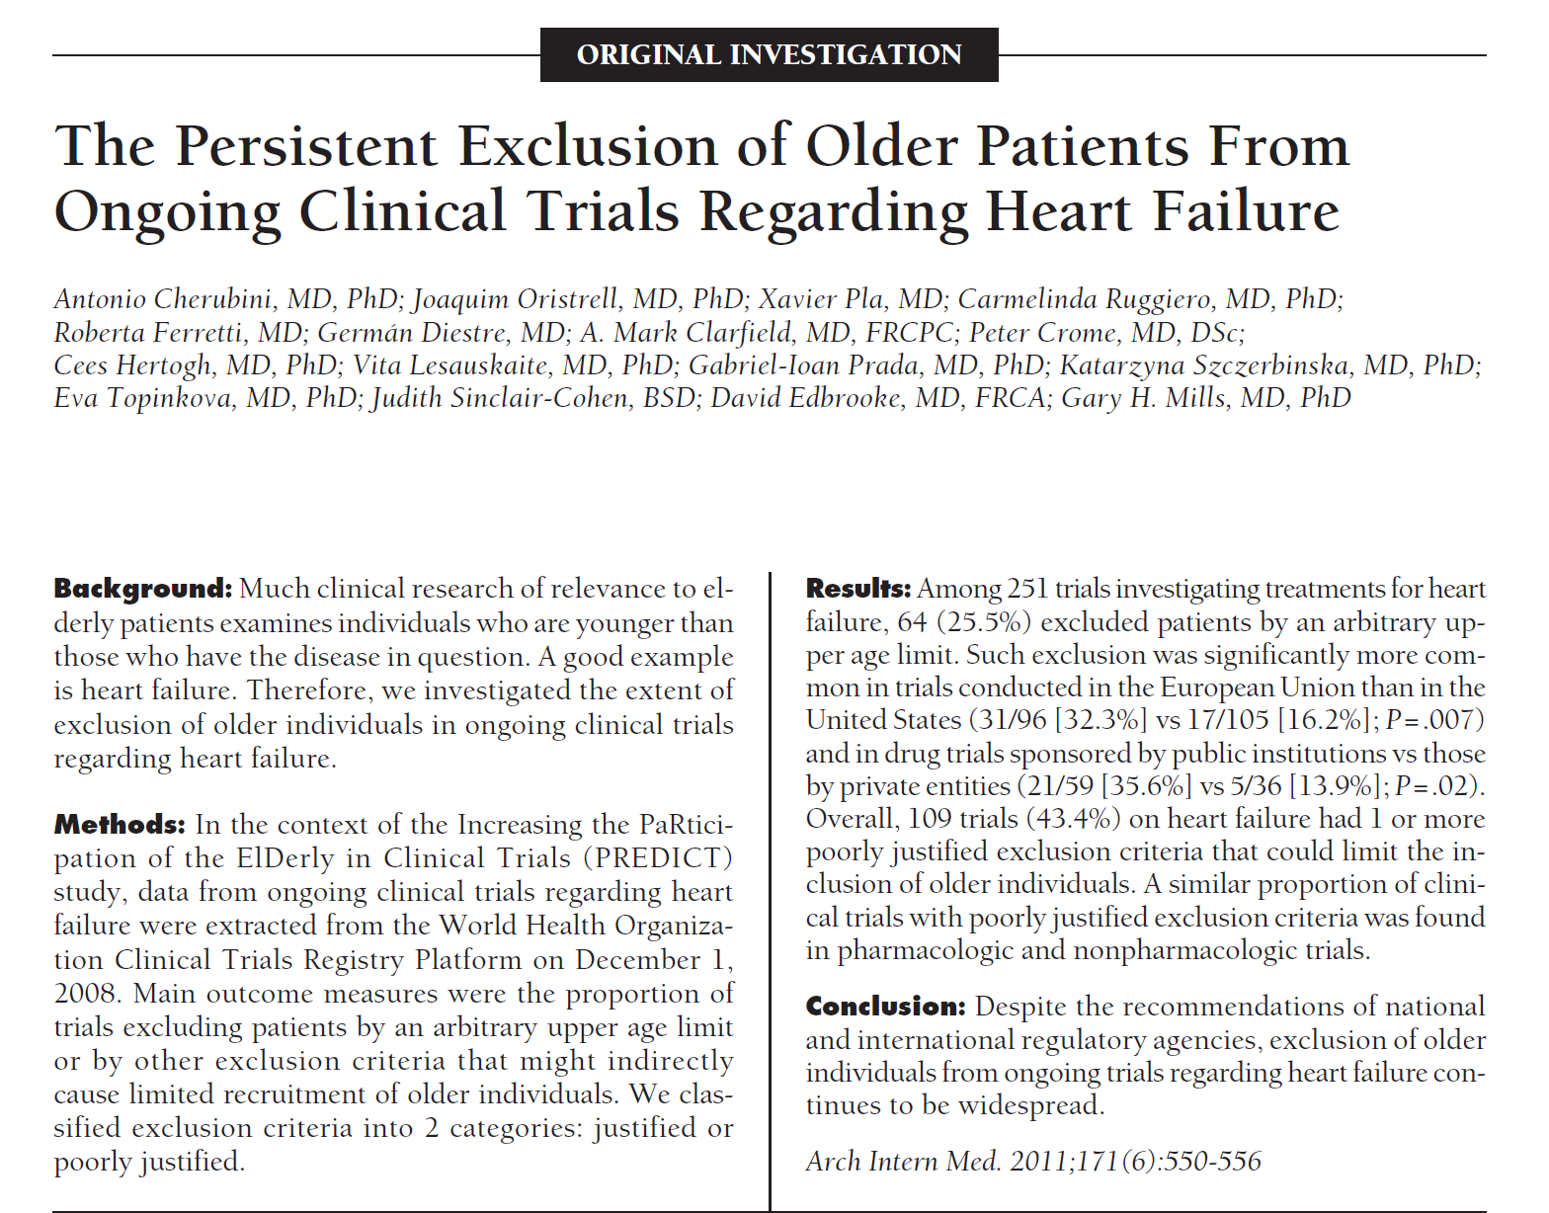

Slide 25
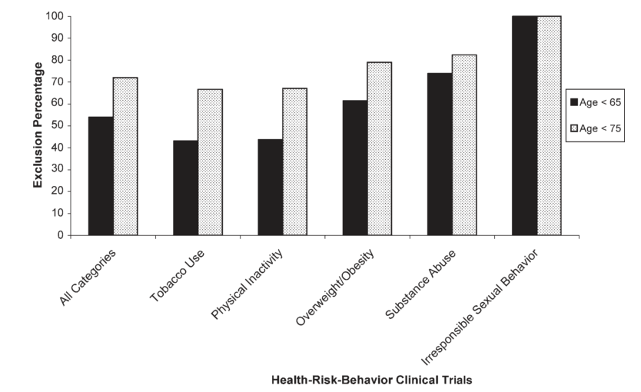
Exclusion of elderly persons from health-risk behavior clinical trials
Percentage of health-risk-behavior clinical trials that exclude persons over age 65.
Levy B,Preventive Medicine, 2006

Slide 26
The exclusion of older subjects from clinical trials: which are the reasons?
High heterogeneity of the older population;
Higher risk of drop out or reduced adherence;
Higher probability of drug interactions, ADE, adverse events;
Ethical challanges to include older subjects with cognitive impairment or frailty;
Cost containment (higher complexity of trials);
Belief that results obtained in young adult subjects can be easily transferred to older subjects;
Ageism
Notes:
Higher internal validity, lower costs and work with cleaner results! …but limited generalizability and likely higher risk for real world patients who wll be treated with drugs that have not been evaluated in similar patients,

Slide 27
Evidence B(i)ased Medicine
high
Real World
Comorbidity
RCT
low
60
80
Age

Slide 28
Consequences of the exclusion of older subjects from clinical trials
The efficacy and safety of pharmacological and non pharmacological treatments is not well known;
High risk of inappropriate prescription, including overtreatment and undertreatment;
3) High risk of negative health outcomes, i.e. adverse
drug reactions, inappropriate use of health care
services and high socio-economic costs

Slide 29
The PREDICT (increasing the participation of the elderly in clinical trials) study:
the charter and beyond
Crome, Expert Rev. Clin. Pharmacol. 2014

Slide 30
Charter for the Rights of Older People in Clinical Trials
Older people have the right to access evidence-based treatments
Promoting the inclusion of older people in clinical trials and preventing discrimination
Clinical trials should be made as practicable as possible for older people
The safety of clinical trials in older people
Outcome measures should be relevant for older people
The values of older people participating in clinical trials should be respected.
Crome, Expert Rev. Clin. Pharmacol. 2014

Slide 32
REGULATION (EU) No 536/2014 OF THE EUROPEAN PARLIAMENT AND OF THE COUNCIL of 16 April 2014 on clinical trials on medicinal products for human use, and repealing Directive 2001/20/EC
(y) a justification for the gender and age allocation of subjects and, if a specific gender or age group is excluded from or underrepresented in the clinical trials, an explanation of the reasons and justification for these exclusion criteria

Slide 33
In September 2004, based on the success of
pediatric drug laws in the US, the EC adopted
a proposal to develop regulations for pediatric
investigations for the EU.
The EC passed Pediatric Regulation (EC) No 1901/2006 in 2006, later amended by Regulation (EC) No. 1902/2006, to require clinical studies for pediatric drug development in the EU. The regulation took effect on 26 January 2007.
Kishore, Regulatory Focus. 2010

Slide 34
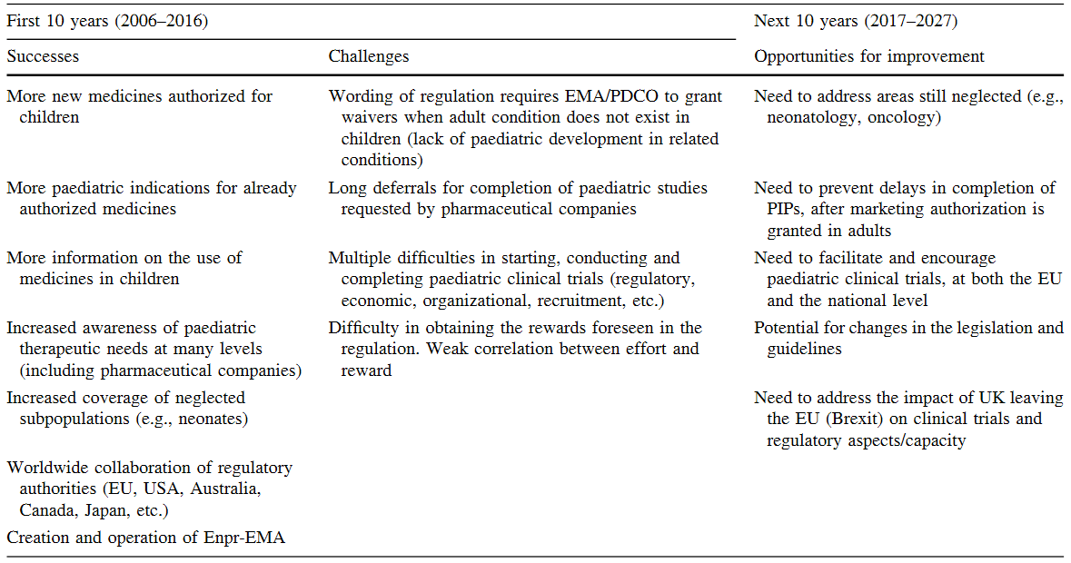
10 years of paediatric regulation in the European Union
Tomasi, Pediatr Drugs. 2017

Slide 35
Action(s) to be undertaken
Actions to promote initiatives that guarantee inclusion of older subjects in health research, e.g. a specific legislation for inclusion of older subjects in clinical research

Slide 36
Digital literacy in older adults

Slide 37
Older people and digital skills for improving health literacy
In an era of technological innovations, a false perception dominates that all people are familiar with computers, smart phones and tablets. But this is not always true, especially when referring to the older generation.
Socio-economic status plays an important role in determining understanding of new technologies and the messages it delivers to support the technological literacy of the older users can be fundamental for increasing the health literacy of this population.
Notes:
From the IROHLA project findings in which INRCA participated: http://www.irohla.eu/home/ and http://healthliteracycentre.eu/wp-content/uploads/2015/11/Brochure_Policy.pdf
Definition of Health Literacy: Health literacy is linked to literacy and entails people’s knowledge, motivation, and competence to access, understand, appraise and apply health information in order to make judgments and take decisions in everyday life concerning healthcare, disease prevention, and health promotion to maintain or improve quality of life during the life course (Sørensen et al., 2012, p. 3).

Slide 38
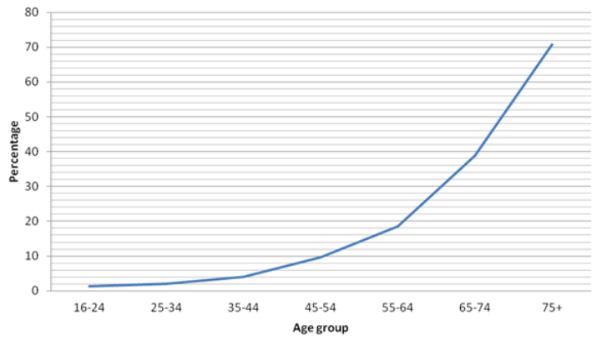
Not using the internet, by age, UK 2012
M. Green and P. Rossall, Age UK Digital Inclusion Evidence Report . 2013

Slide 39
Barriers to digital inclusion
Lack of interest
Lack of knowledge/education
Cost
Usability and Accessibility
The European Older People’s Platform. 2008

Slide 40
Advantages of Digital inclusion in Older People
Alleviating social isolation and loneliness
Positive effect on depression
Benefits for the health and well-being, better access to health care and in particular e-health
M. Green and P. Rossall, Age UK Digital Inclusion Evidence Report . 2013

Slide 41
Promote eHealth through technological literacy
On the one hand, patient empowerment and digital health literacy are essential for successful eHealth deployment. On the other hand, eHealth facilitates patients managing their own conditions or healthy citizens benefiting from prevention measures.
However, a significant barrier lies in the lack of awareness of eHealth opportunities and challenges for users (citizens, patients, health and social care professionals).
Notes:
See evidence overview in Staff Working Document Accompanying the eHealth Action Plan and responses to the eHealth Action Plan consultation. ://ec.europa.eu/information_society/activities/health/docs/policy/ehap2012public-consult-report.pdf
The last three points are extrapoleted from the survey conducted among researchers and summarized in the Report on the public consultation on eHealth Action Plan 2012-2020 (https://ec.europa.eu/digital-single-market/news/report-public-consultation-ehealth-action-plan-2012-2020)

Slide 42
Action(s) to be undertaken
Actions to increase digital inclusion in older adults

