Slide 1

CHALLENGES RAISED BY THE EVOLUTION OF PRACTICES FOR ELDERLY PERSONS
Ana Sofia Carvalho

Slide 2
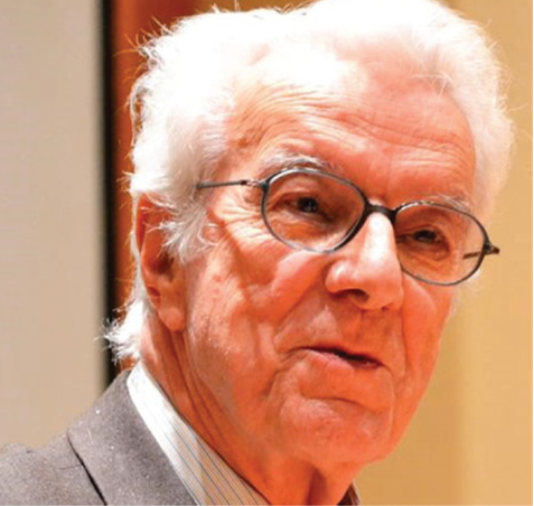


Slide 3
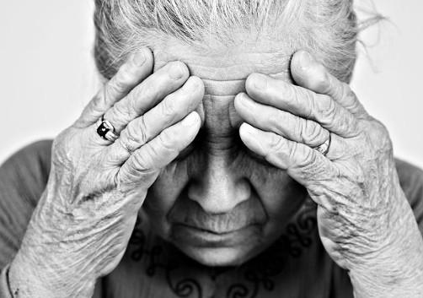

Slide 4

DECISION MAKING CAPACITY ASSESSMENT AND INFORMED CONSENT TAKING INTO CONSIDERATION DIFFERENT CATEGORIES OF VULNERABILITIES THAT CAN BE FOUND IN DIFFERENT OLDER PERSONS

Slide 5
Decision-making capacity (DMC) is an indispensable prerequisite, including consent, refusal to participate, and thus, the basis of the principle of autonomy
Two moral requirements are entailed in DMC evaluations:
RESPECT FOR THE AUTONOMY OF THOSE WHO ARE ABLE TO MAKE THEIR OWN DECISIONS and
PROVISION OF PROTECTION FOR THOSE WITH DIMINISHED DECISIONAL CAPACITY
DECISION MAKING AND THE CHALLENGES OF THE TO THE VULNERABLE
ASSESSMENT OF DMC
IS ESSENTIAL

Slide 6
THE CRITERIA FOR VALID CONSENT ARE, NORMALLY, BASED ON THREE ELEMENTS:
(2) BE FREE FROM COERCION;
(3) HAVE DECISION-MAKING CAPACITY.
(1) BE GIVEN ADEQUATE INFORMATION REGARDING THE NATURE, METHODS AND PURPOSE OF THE SOLUTION, AS WELL AS THE RISKS, BENEFITS...;

Slide 7
THE FOLLOWING COGNITIVE CRITERIA FOR MEDICAL DMC HAVE BEEN PROPOSED AND ARE WIDELY USED IN RESEARCH AND PRACTICE (APPELBAUM, 2007):
(1) ABILITY TO UNDERSTAND RELEVANT INFORMATION
(2) ABILITY TO APPRECIATE THE NATURE OF THE TREATMENT/RESEARCH
(3) ABILITY TO REASON ABOUT THE CHOICES
(4) ABILITY TO COMMUNICATE A CHOICE.

Slide 8


Slide 9
CATEGORIES OF VULNERABILITIES THAT CAN BE FOUND IN DIFFERENT OLDER PERSONS
ALLOCATIONAL
COGNITIVE
MEDICAL
SITUATIONAL
DEFERENTIAL
SOCIAL

Slide 10

COGNITIVE VULNERABILITY DOES THE PERSON HAVE THE CAPACITY TO UNDERSTAND AND DECIDE TO BE TREATED OR NOT?
This category includes, for instance, persons with early-stage dementia, with certain types of mental illness, intellectual disability, older adults who are institutionalised in nursing homes, educational deficits and unfamiliarity with the medical language.

Slide 11


SITUATIONAL VULNERABILITY IS THE PATIENT IN A SITUATION IN WHICH MEDICAL EXIGENCY PREVENTS THE EDUCATION AND DELIBERATION NEEDED TO DECIDE?
This category includes patients who cannot be sufficiently informed and/or who cannot complete effective deliberation within the available timeframe (patients receiving a very serious diagnostic or closed prognostic; patients who are being submitted to a surgery or who need to be sedated for a certain reversible reason).

Slide 12

MEDICAL VULNERABILITY
HAS THE PERSON A SERIOUS HEALTH-RELATED CONDITION FOR WHISH THERE ARE NO SATISFACTORY SOLUTION?
This category includes: patients with a serious health-related condition for which there are no satisfactory treatments; for instance, patients with palliative care needs, with metastatic cancers, Parkinson’s disease, multiple sclerosis, Alzheimer’s disease, end-stage AIDS ….

Slide 13


ALLOCATIONAL VULNERABILITY
IS THE PATIENT SERIOUSLY LACKING IN IMPORTANT SOCIAL GOODS THAT WILL INFLUENCE HIS/HER DECISION
Very poor patients, and all the older patients who belong to a socially devaluated or disadvantaged group.

Slide 14
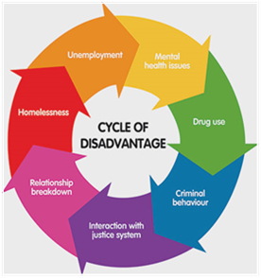
SOCIAL VULNERABILITY
Does the PATIENT belong to a group whose rights and interests have been socially disvalued?
Addicted older patients, older migrants, homeless, prisoners and all the patients belong to a socially disvalued or disadvantaged group.

Slide 15
DEFERENTIAL VULNERABILITY
The deferential vulnerability of these subjects consists in their readiness to accede to the perceived desires of certain others notwithstanding an inner reticence to do so.
The powerful social and cultural pressures: the white coat and women or men who may find it hard to turn down requests from their spouses.

Slide 16


FUTURE RESEARCH EFFORTS SHOULD ALLOW US TO DEVELOP A MORE ACCURATE UNDERSTANDING AND IDENTIFICATION OF RISK FACTORS FOR IMPAIRMENT IN DECISION-MAKING CAPACITY.
…BE BETTER AT PROTECTING THEM FROM IMPROPER CONSENT AND,
…AVOIDING CASES WHERE TOO MUCH PROTECTION RESULTS IN LACK OF ACCESS TO RESEARCH OPPORTUNITIES.

Slide 17

EQUITY AND JUSTICE IN USING SCARCE RESOURCES AND ACCESS TO HEALTH CARE
RESEARCH AND CLINICAL TRIALS INCLUSION CRITERIA
COMPUTERISATION AND DIGITAL SKILL

Slide 18

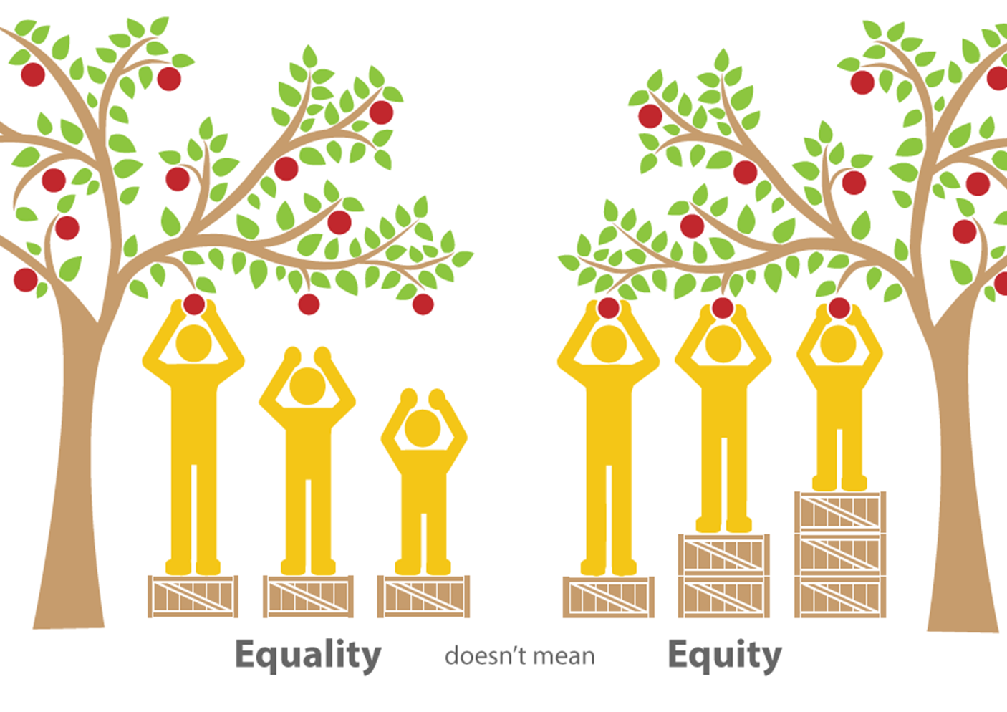

Slide 19



Slide 20


Slide 21


Slide 22

CLINICAL TRIALS RECRUITMENT CRITERIA

Slide 23

COMPUTERISATION
AND
DIGITAL SKILLS

