Slide 1





20TH ANNIVERSARY OF THE OVIEDO CONVENTION: RELEVANCE AND CHALLENGES
Strasbourg, 24-25/10/2017
SESSION III - NEW SCIENTIFIC AND TECHNOLOGICAL DEVELOPMENTS .
Genomics:
Sequencing and analysis: Human rights challenges raised by scientific and technological developments -
Anne Cambon-Thomsen

Slide 2
Genomics in The Oviedo Convention
Article 11 – Non-discrimination
Any form of discrimination against a person on grounds of his or her genetic heritage is prohibited.
Article 12 – Predictive genetic tests
Tests which are predictive of genetic diseases or which serve either to identify the subject as a carrier of a gene responsible for a disease or to detect a genetic predisposition or susceptibility to a disease may be performed only for health purposes or for scientific research linked to health purposes, and subject to appropriate genetic counselling.
Chapter V – Scientific research :
Article 15 – General rule; Article 16 – Protection of persons undergoing research
Article 28 – Public debate

Slide 3
Outline
The challenge of the changing of scale
The issues identified
  Various empirical data
  Views of patients/lay people
  (Views of clinicians and researchers in oncology)
  (Views of professionals in genetics in Europe)
Conclusion

Slide 4
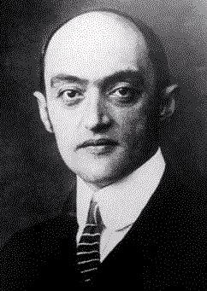
Innovation & Values
Schumpeter (1930): “Innovation changes the values onto which the system is based“
Slide from A. Soulier
Notes:
. For this renewal to take place it is necessary for people to change the way they make decisions, they must choose to do things differently, make choices outside of their norm. Schumpeter c.s. (~1930) seems to have stated that innovation changes the values onto which the system is based.
Our main ethical concern would thus be to examine conditions of the process in order to preserve specificities of clinics (in terms of legacy, “values”, “principles” and “traditions”) in tis restructuring phase which aims to propose better care.

Slide 5

Plan France Médecine Génomique 2025
"La médecine génomique est une révolution dans le domaine du soin et de la prévention, a affirmé Yves Lévy lors de la remise du Plan France Médecine Génomique 2025. ".

Slide 6
Blurring several limits
Specific clinical question/ genome exploration
Clinical care/ research
Protocol of research/ database driven discovery
Health information/ non health information
Body elements / information
Clinical utility /personal utility (curiosity)

Slide 7
Creating continuum instead of discrete categories
Evolving capacity of data interpretation
Evolving level of identifiability
Right to know/not to know generally do not apply the same way to all kinds of information

Slide 8
Transforming established concepts
Generating a world of documented uncertainty
  Autonomy in the context of an evolving uncertainty?
  Meaning of « best interest »?
Responsibility towards own health/family

Slide 9
Issues in large scale sequencing (1)
Can the same type of regulation apply to targeted tests and to genome-wide sequencing?
Does sequencing require a different level or kind of consent than other genetic tests or medical assessments?
Should whole-genome sequencing be performed for children or vulnerable adults?
How to communicate results when interpretation is uncertain?
Should patients be informed of incidental findings that unequivocally predict serious disease that can be prevented or ameliorated by early detection? What if the disease cannot be prevented or ameliorated?

Slide 10
Issues in large scale sequencing (2)
How will healthcare providers manage cases in the face of such a rapidly changing knowledge base?
How to regulate sequencing services offered directly to consumers?
To ensure fair and reasonable translation of sequencing technologies, the issue of prioritization needs to be addressed explicitly
  by collaborative efforts of geneticists, ethicists, health economists, patient representatives and decision makers.

Slide 11
Issues identified through literature search and study of related technologies
Testing children
Prenatal testing
Incidental findings
Informed consent
Storage of data and recontact
Database participation and access

Slide 12
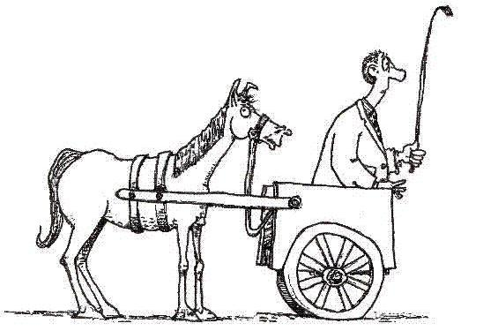
Recommendations for whole genome sequencing are not stabilised (yet)
As we are technology driven are we…
– putting the cart before the horse?

Slide 13

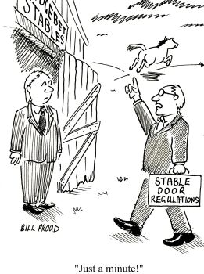

The Cassandra Complex
Ethicists considered as being too negative or too late
or
Slide from S. Leonard

Slide 14
The evidentiary time-lag (shutting the stable door)
Technology introduced
? Guidelines introduced
Problems encountered
Evidence gathered
Slide from S. Leonard

Slide 15
Outline
The challenge of the changing of scale
The issues identified
  Various empirical data
  Views of patients/lay people
  (Views of clinicians and researchers in oncology)
  (Views of professionals in genetics in Europe)
Conclusion

Slide 16



The TECHGENE study
Use of focus groups to add empirical element to ethical considerations
Focus groups = form of group interview Allows examination of not only what people think but how and why
SOULIER A., LEONARD S., CAMBON-THOMSEN A.
From the arcane to the mundane: Engaging the public in
discussing clinical applications of genetic technology
New Genetics and Society, 2016, Vol: 35;1 1-28
Notes:
Participants encouraged to talk to one another, asking questions, commenting on each others experiences and points of view. This form of research focusses on dynamics of interaction between participants, strategies of individuals and groups when confronting their arguments, values defended within argumentation.

Slide 17
Perception of technological developments
Progress seen as inexorable and inevitable
General positivity to developments
Concern regarding how healthcare system will manage the technologies
"Are we sure we are ready? I mean not the scientific community but the whole community. Are we sure we are ready for this? Do we have the moral or the political ability to face upcoming complexities?" (C7)

Slide 18
Disclosure of problematic results
Uniform expectation that meaningful results will be disclosed to patients. Disagreement about what ‘meaningful’ means
  When result has impact on patient care
  When result illuminated etiology of any symptom

Slide 19
Incidental findings are not incidental in context of a holistic approach to patient care
“I am a patient. I am a patient as a whole. I am suffering from a rare genetic disease but not only. I have other troubles… At some point of an investigation, how can the doctors strictly isolate a finding from another? How do they know some finding will not be useful in managing my whole care?” (P2)

Slide 20
Acceptance of incidental findings
“I don’t really see why genetics is particular here. It happens all the time, no? (…) You’re going to the doctor because your throat hurts and he discovers that you have a brain tumor. Well, this is part of accepting a clinical investigation. Sometimes, you are really happy that your doctor finds something he was not looking for. This kind of “incident” can actually save your life” (L5)

Slide 21
Significance of clinic vs research
Prevailing view that activities of research and of clinic were continuous; that research was the natural pursuit of clinic when physicians had no answers any more.
"When we speak about these "problems", I am thinking in terms of complexities, of research questions. I think this new realm creates great opportunities for research. And in turn, this will lead to improvements in clinical care.
This is the situation of a virtuous circle." C7

Slide 22
Conclusion
Implementation is happening now
Concerns about implementation and regulation
Necessity of studies embedded in pilot projects to be able to know/ take into account stakeholders views
The ethical and legal frame to be (re) considered for certain aspects
Change of scale revive classical questions
Databases importance and circle between research and clinics

Slide 23
Publications used
CAMBON-THOMSEN A. Acteurs et outils de la prédiction génétique : l’éthique au cœur de la gouvernance [Actors and tools of predictive genetics: ethics at the heart of governance]. Journal international de bioéthique et d’éthique des sciences, 2014, Jun;25(2):159-68
JULIA S., BERTIER G., CAMBON-THOMSEN A. Quand l’anticipation devient plurielle : la complexité des données génomiques à l’épreuve des pratiques professionnelles. Revue Française d’Éthique Appliquée (RFEA) 2016, N°2, 19-28
ANASTASOVA V., BLASIMME A., JULIA S., CAMBON-THOMSEN A. Genomic incidental findings: reducing the burden to be fair. Am J Bioethics, 2013 Feb;13(2):52-4
ANASTASOVA V., MAHALATCHIMY A., RIAL-SEBBAG E., ANTÓ BOQUE J.M., KEIL T., SUNYER J., BOUSQUET J., CAMBON-THOMSEN A. Communication of results and disclosure of incidental findings in longitudinal paediatric research. Pediatr Allergy Immunol 2013, 24 389–394
BLASIMME A, SOULIER A JULIA S, LEONARD S, CAMBON-THOMSEN A. Disclosing results to genomic research participants: differences that matter. Am J Bioethics, 2012, 12:10, 20-22
SOULIER A., LEONARD S., CAMBON-THOMSEN A. From the arcane to the mundane: Engaging the public in discussing clinical applications of genetic technology New Genetics and Society, 2016, Vol: 35;1 1-28
Deliverables of EU projects : CAGEKID, TECHGENE, 3Gb-TEST

