Slide 1
Brain technologies – Ethical and human rights challenges raised by scientific and technical developments
20TH ANNIVERSARY OF THE OVIEDO CONVENTION –
International Conference
Strasbourg, 25 October 2017
Prof. Dr. med. Dr. phil. Nikola Biller-Andorno Institute of Biomedical Ethics and History of Medicine
University of Zurich, Switzerland

Slide 3
Developmental Neurobiology
- Brain Plasticity
Molecular Genetics
- Alzheimer‘s
Neurotransmitters, Receptors and
Cytokines in Brain Disorders
Imaging the Brain
Computational Neuroscience
Therapy
Restorative Neurology
- Neural Transplantation
Tandon P N. The decade of the brain : a brief review. Neurol India 2000;48:199-207

Slide 4
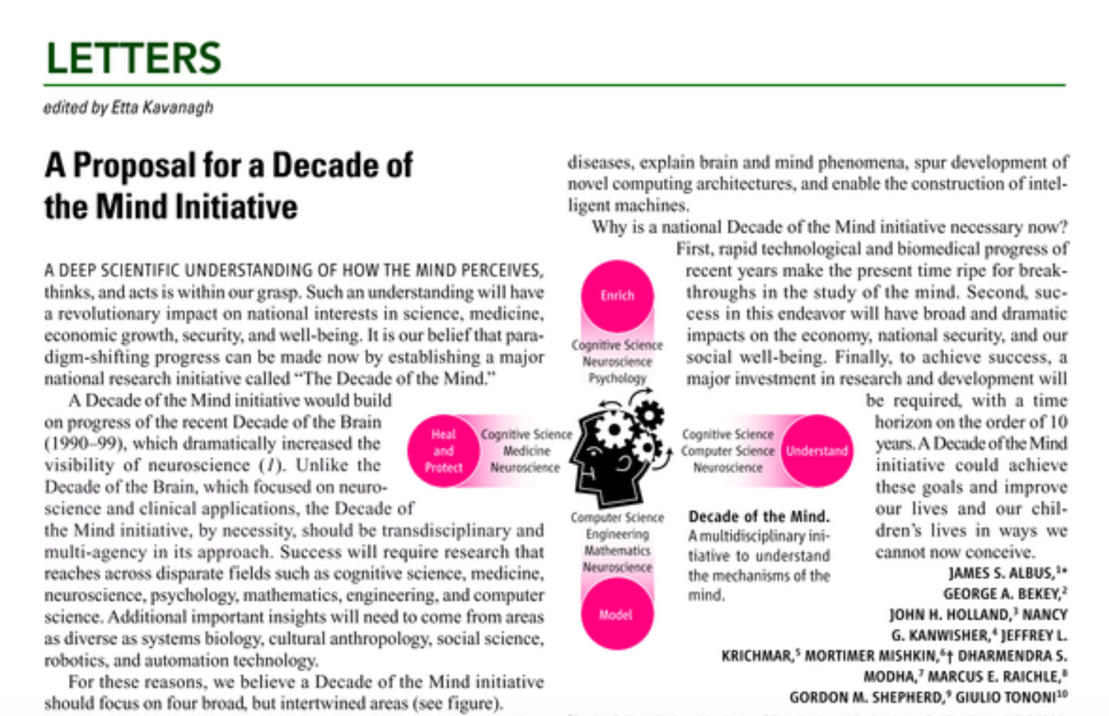

Slide 5
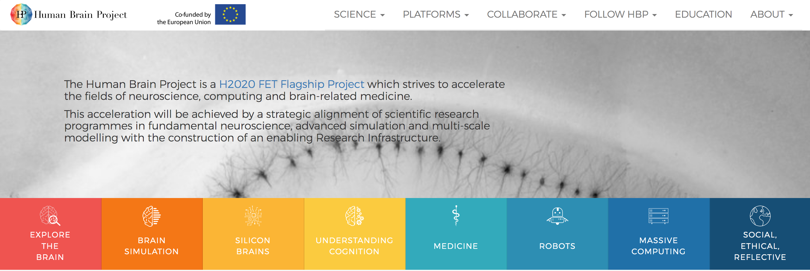

Slide 7
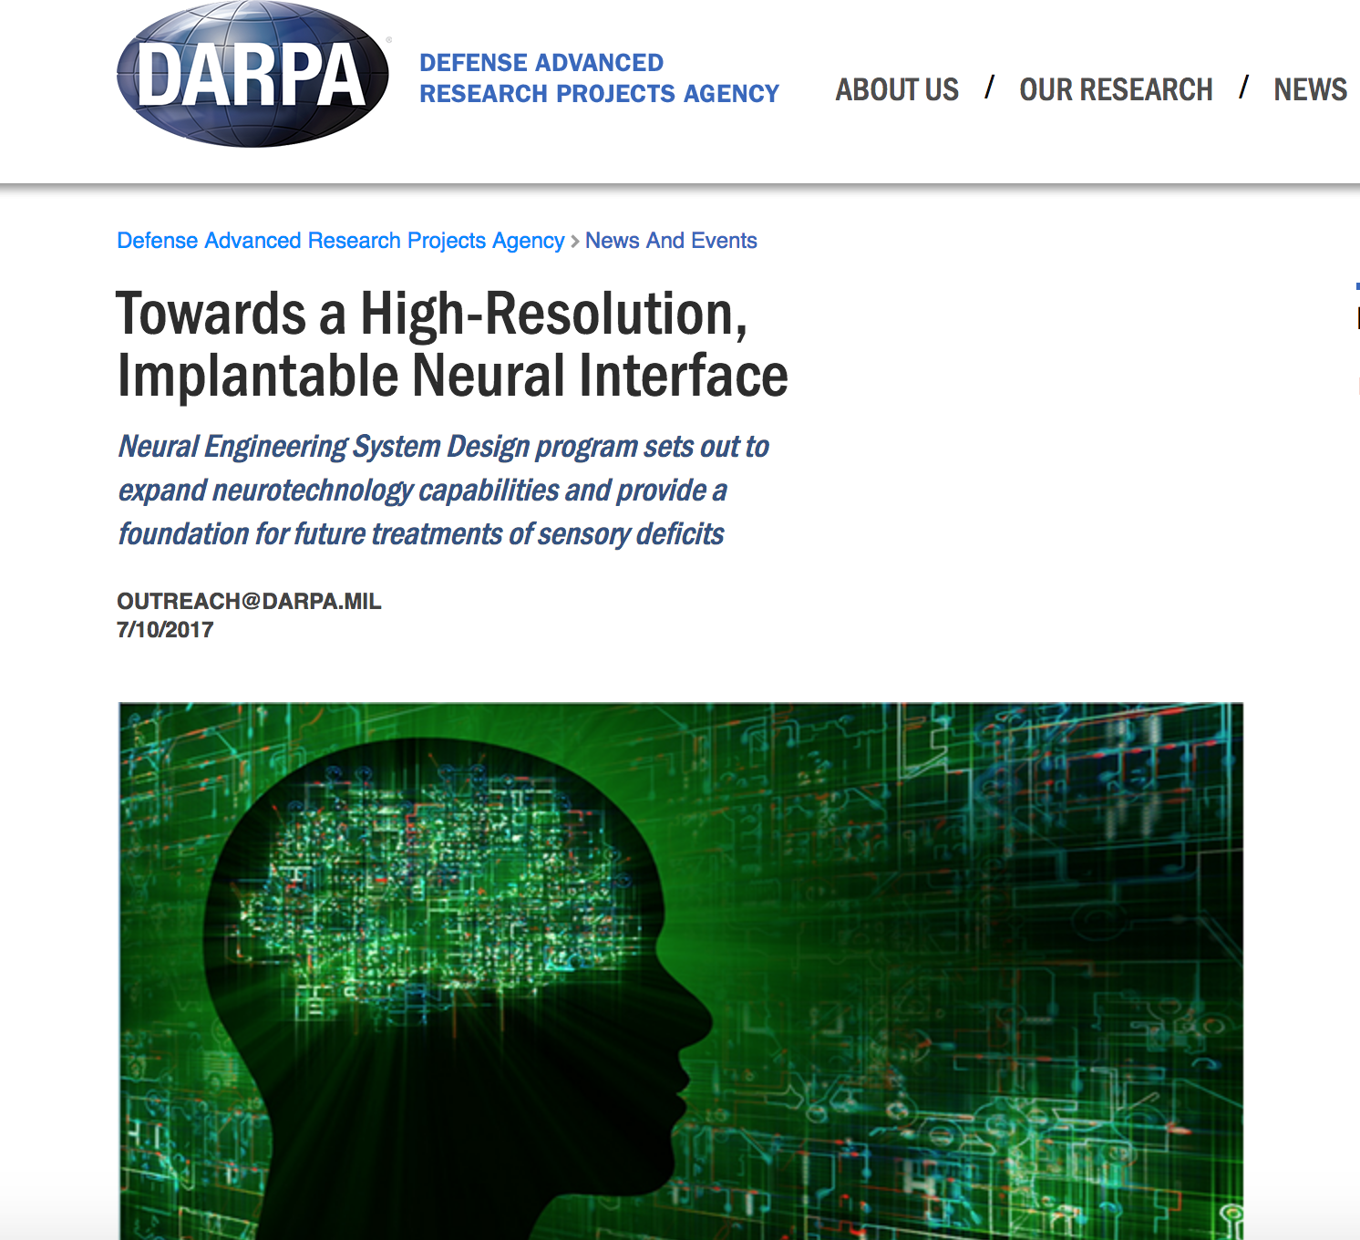
„The Neural Engineering System Design (NESD) program aims to develop an implantable neural interface able to provide advanced signal resolution and data-transfer bandwidth between the brain and electronics.
This interface would serve as a translator, converting between the electrochemical language used by neurons in the brain and the ones and zeros that constitute the language of information technology. The goal is to achieve this communications link in a biocompatible device no larger than one cubic centimeter in size, roughly the volume of two nickels stacked back to back.“
Dr. Al Edmondi, https://www.darpa.mil/program/neural-engineering-system-design

Slide 8
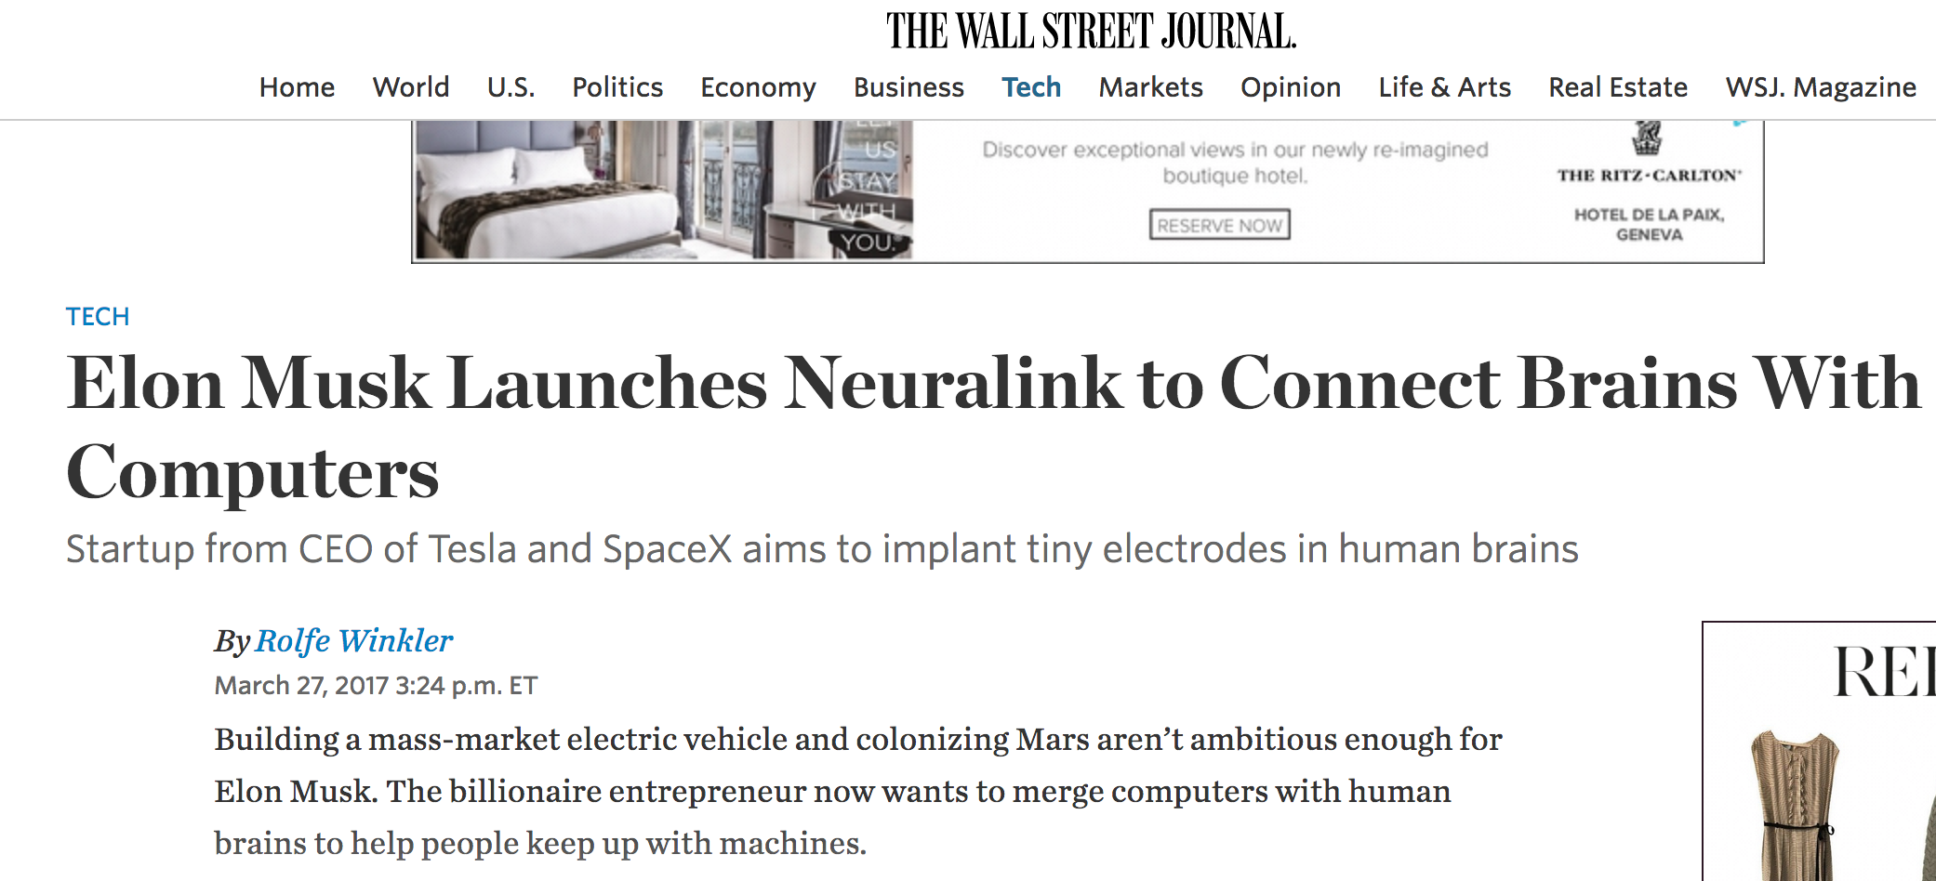
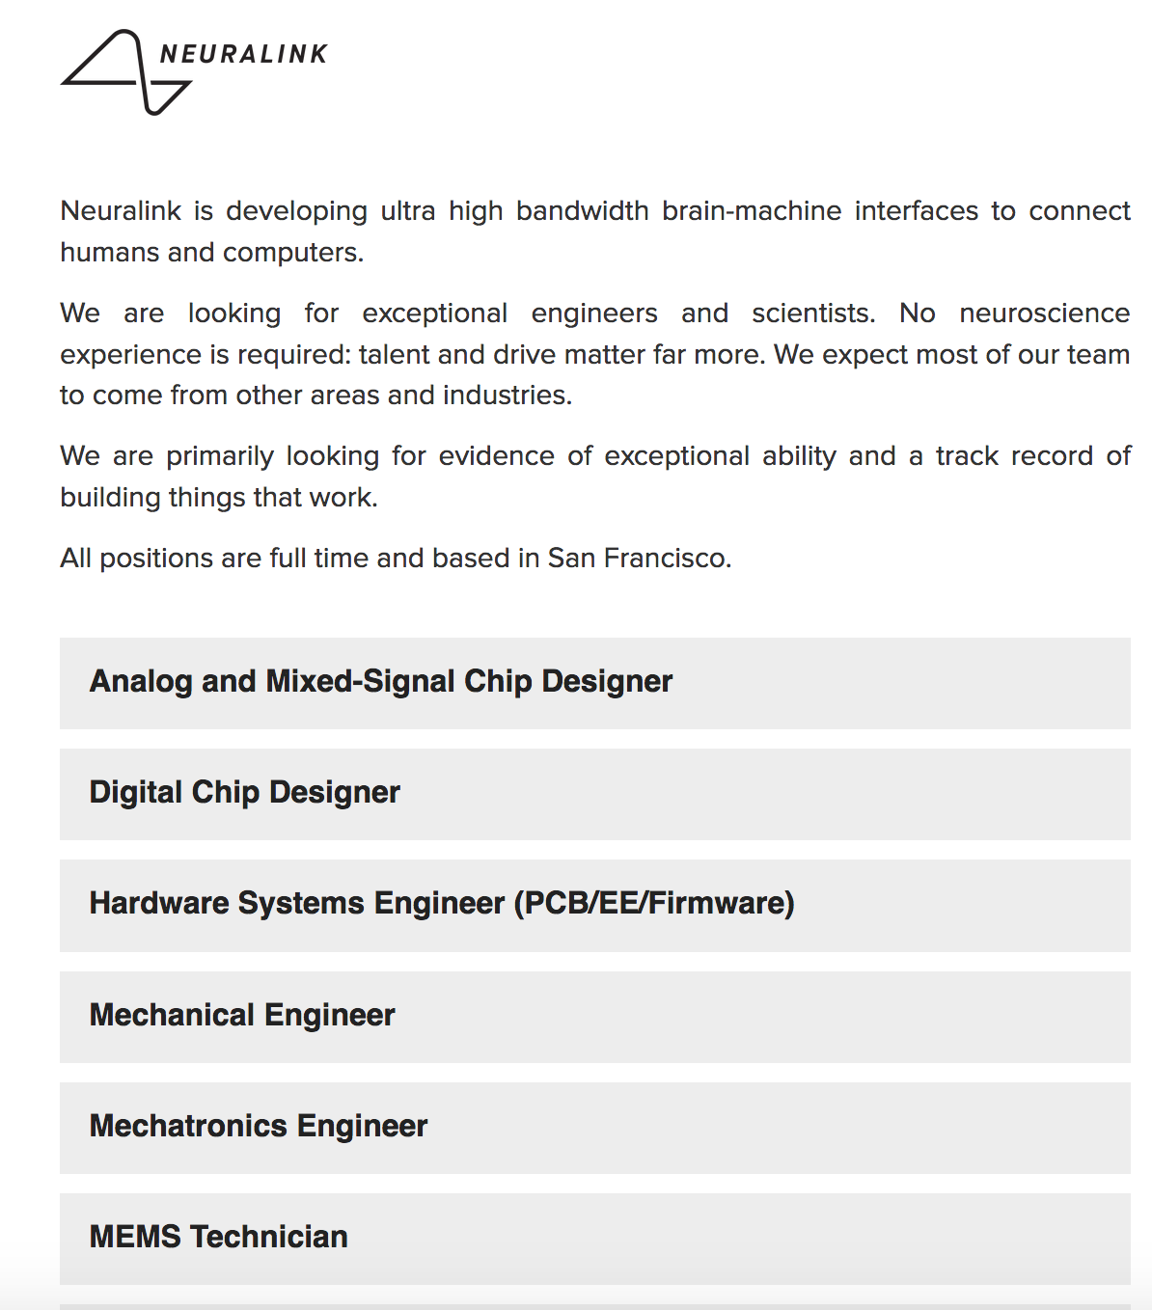
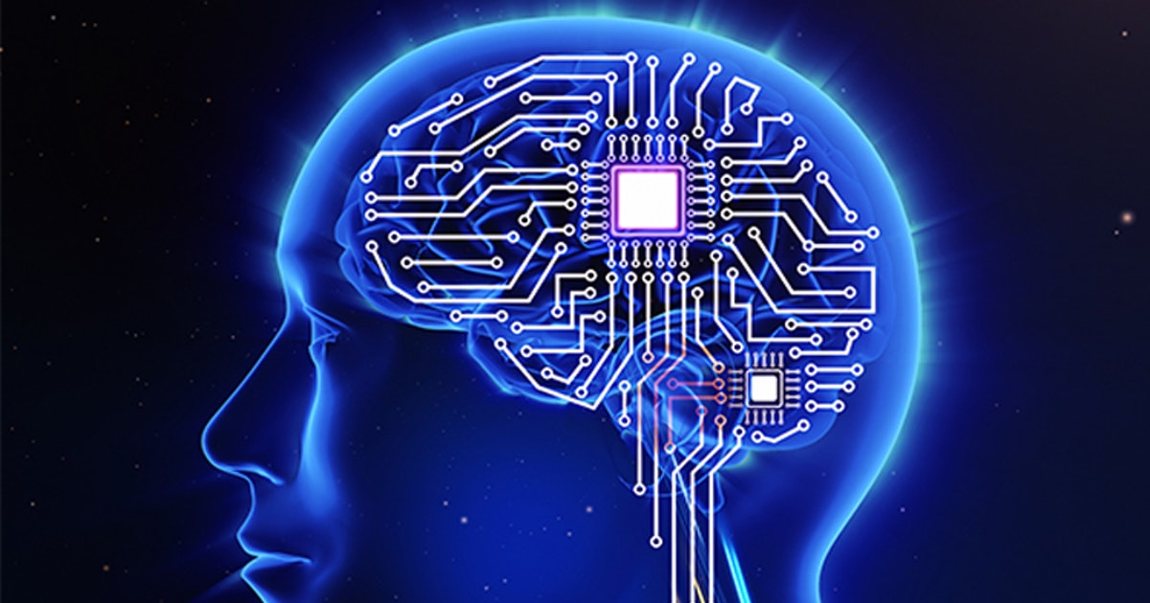

Slide 9
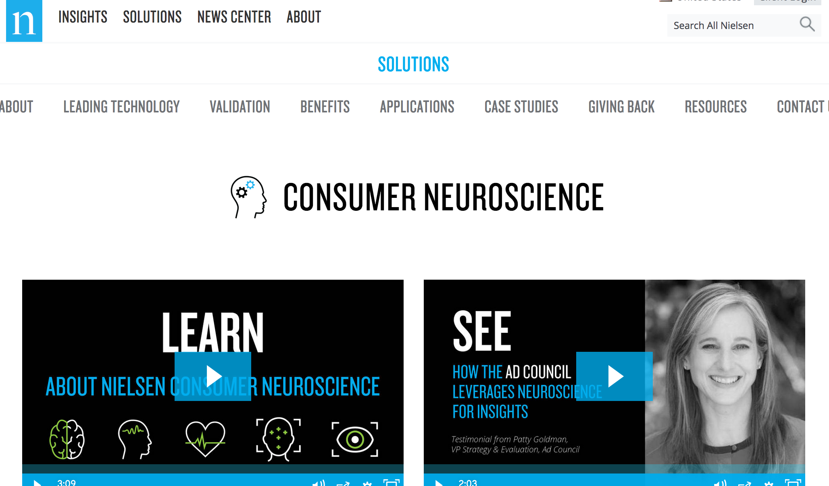

Slide 10
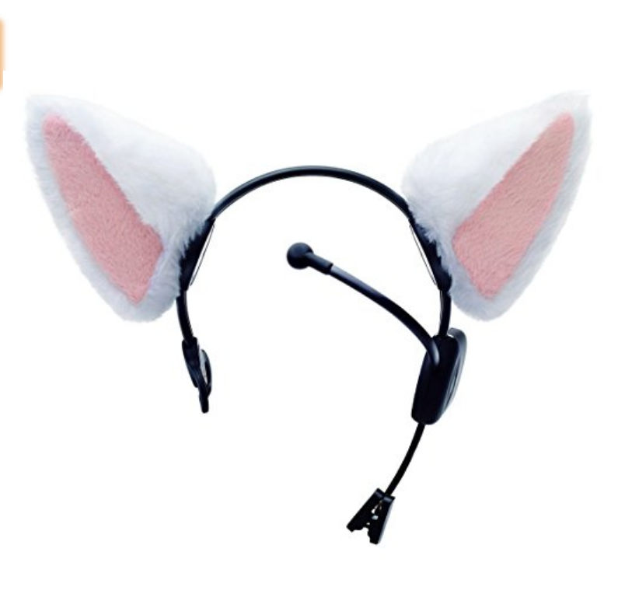
„a cat-eared headband that's powered by brain waves. The ears rise when you're excited or concentrating and drop during relaxed states. And if you're concentrating and relaxing at the same time, the ears perk up and wiggle.“

Slide 11
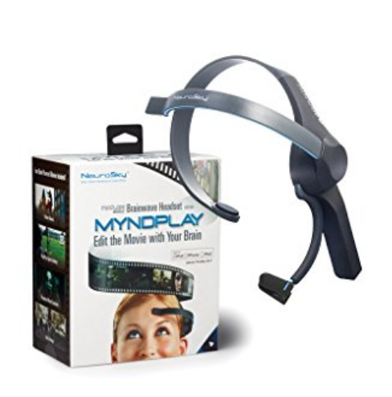

Slide 12
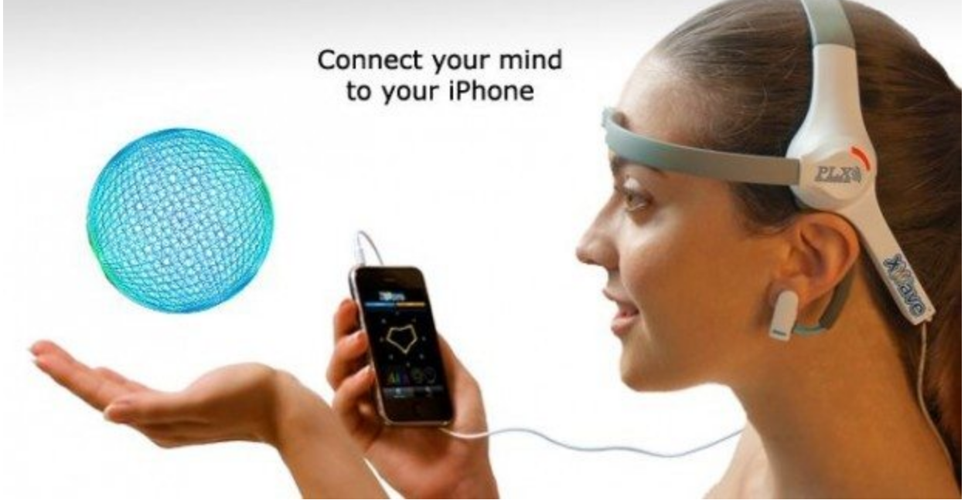
„The XWave is nothing less than the first brain-computer interface for iPhone, iPod Touch and iPad. The XWave is the first consumer product priced under $100 which can sense and detect human brainwaves, interpret them and connect it to your Apple devices. The headset senses even the weaker electrical impulses transmitted through your skull to the surface of your forehead and converts these analog signals into digital.“
http://neurogadget.net/2011/07/20/just-got-an-xwave-headset-from-plx-company/2345

Slide 13
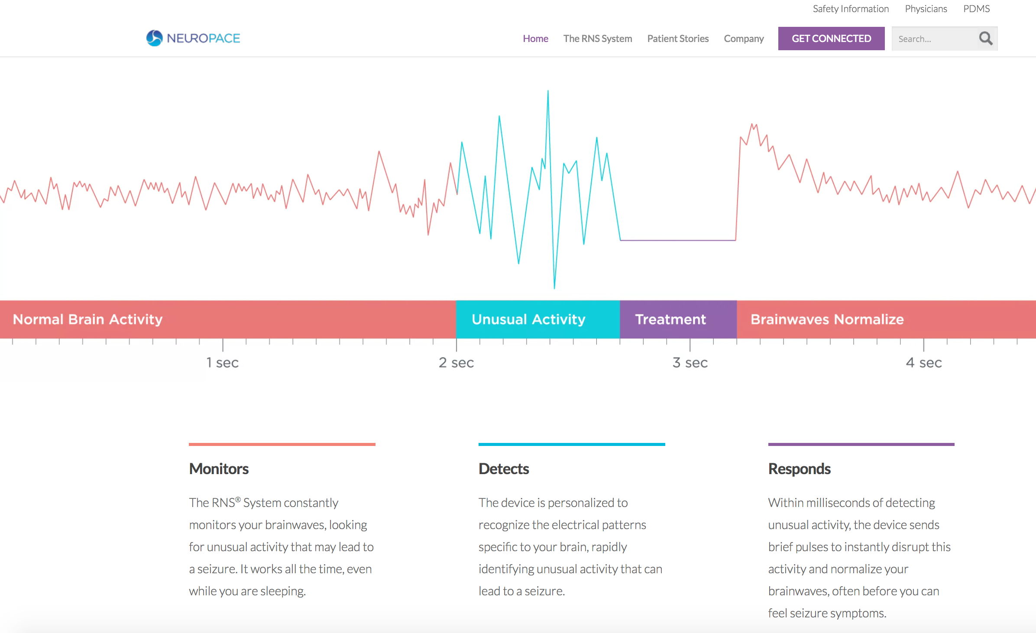
Closed loop!

Slide 14
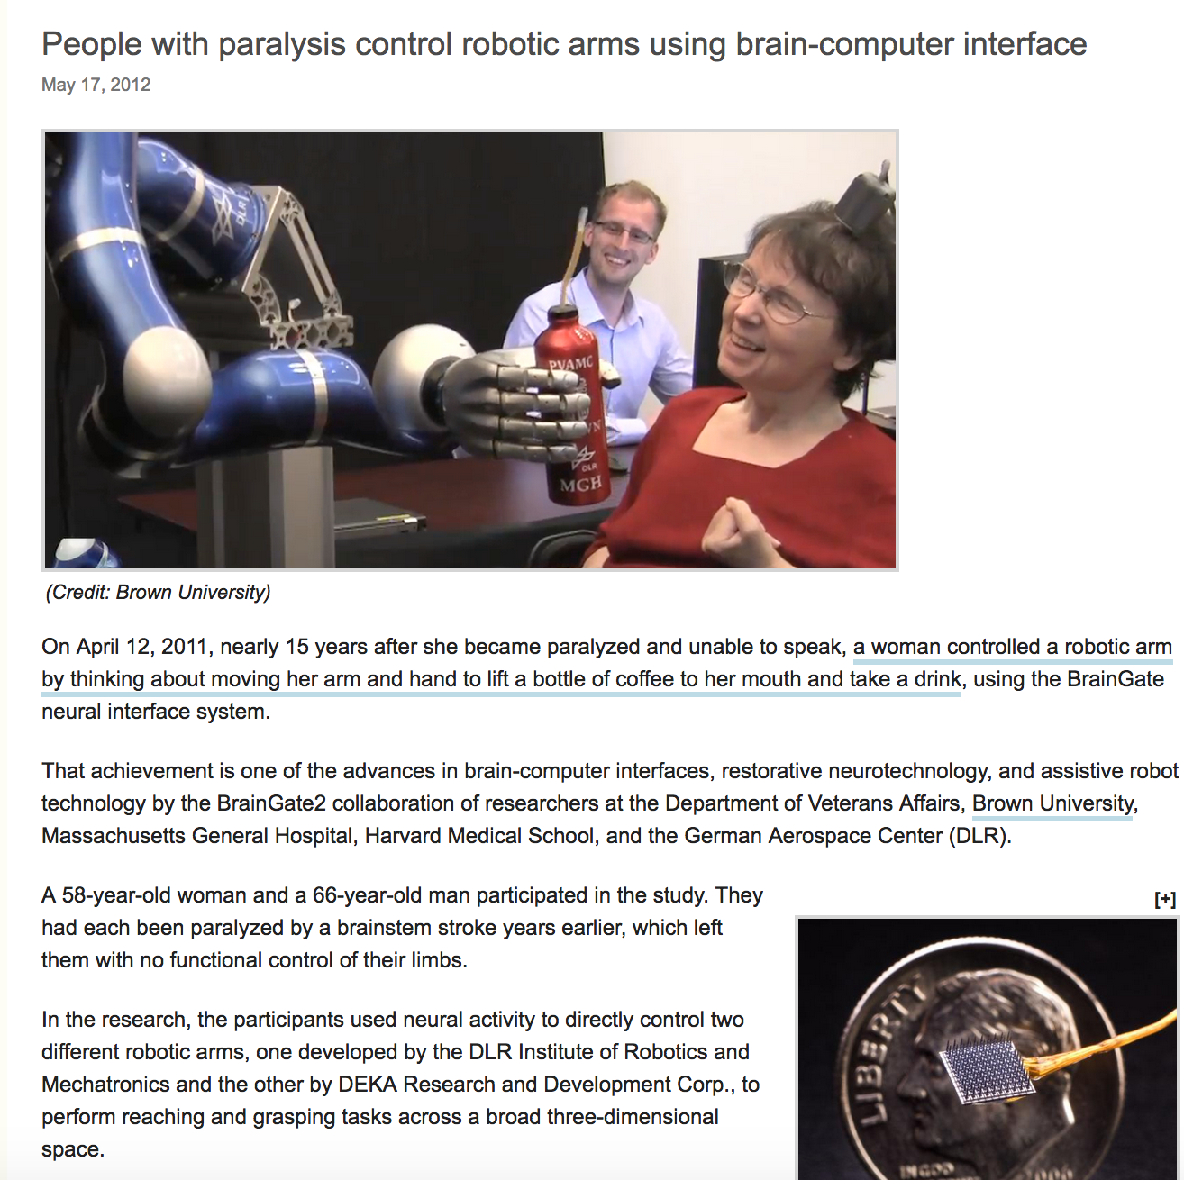
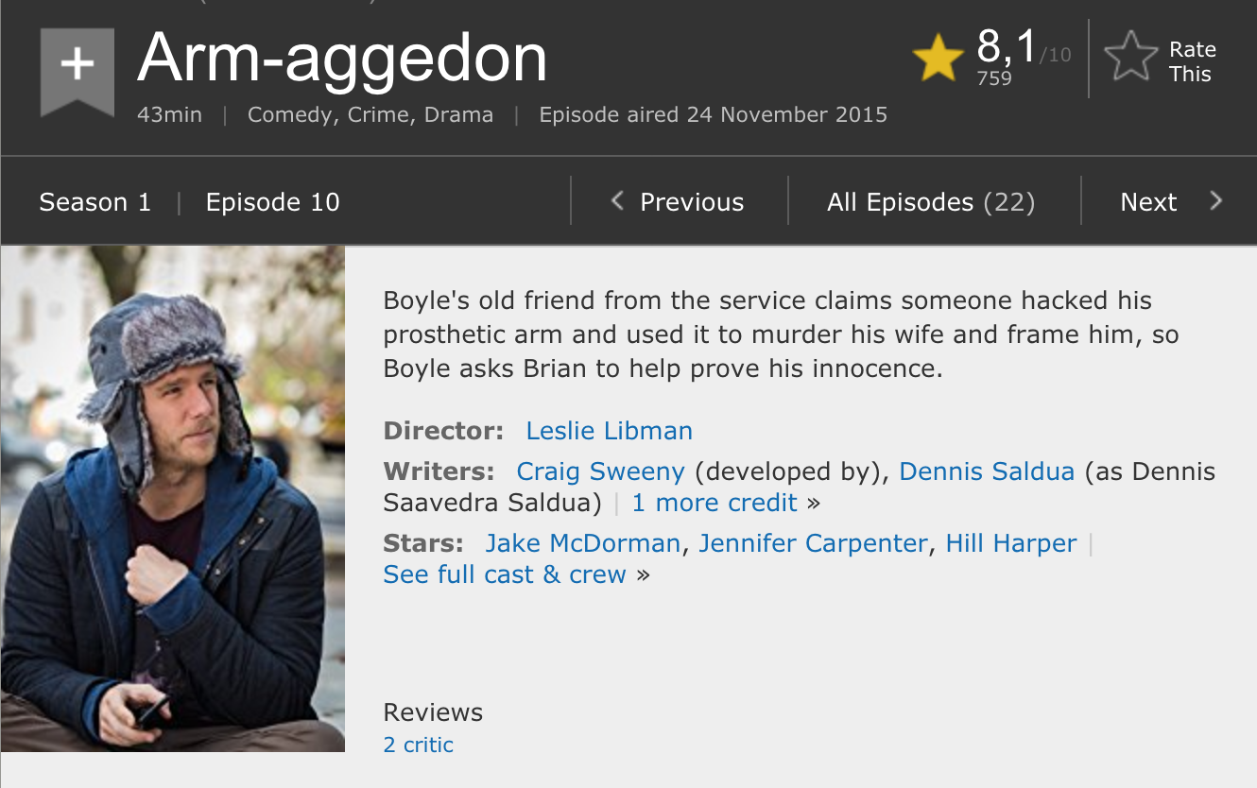
http://www.kurzweilai.net/people-with-paralysis-control-robotic-arms-using-brain-computer-interface

Slide 15
Control
Neuroprostheses
...
BCI games etc.
EEG
Electrocorticography
fMRI etc.
e.g. Paralysis
Quadriplegia
Consumer insights
Wearables etc.
Device
Robotic arm, exoskeleton etc.
Implants (retinal, cochlear)
open loop
closed loop
patient-controllable
Read
Monitor
De-code
Save („mind upload“)
Brain print
De-anonymize
...
Alter
Neurostimulation
e.g. Locked-in
Syndrome
Aphasia
Minimally
conscious state
Deep brain stimulation
Transcranial magnetic stimulation
e.g. Parkinson
Epilepsy
Compulsive-obsessive disorder
Depression
...
Modulate
Neurofeedback
Simulate
In silico brain
Neural networks
Deep learning
Machine learning
Artificial intelligence

Slide 16
Control
Neuroprostheses
...
BCI games etc.
EEG
Electrocorticography
fMRI etc.
e.g. Paralysis
Quadriplegia
Consumer insights
Wearables etc.
Device
Robotic arm, exoskeleton etc.
Implants (retinal, cochlear)
open loop
closed loop
patient-controllable
Read
Monitor
De-code
Save („mind upload“)
Brain print
De-anonymize
...
Alter
Neurostimulation
e.g. Locked-in
Syndrome
Aphasia
Minimally
conscious state
Deep brain stimulation
Transcranial magnetic stimulation
e.g. Parkinson
Epilepsy
Compulsive-obsessive disorder
Depression
...
Modulate
Neurofeedback
Simulate
In silico brain
Neural networks
Deep learning
Machine learning
Artificial intelligence

Slide 17
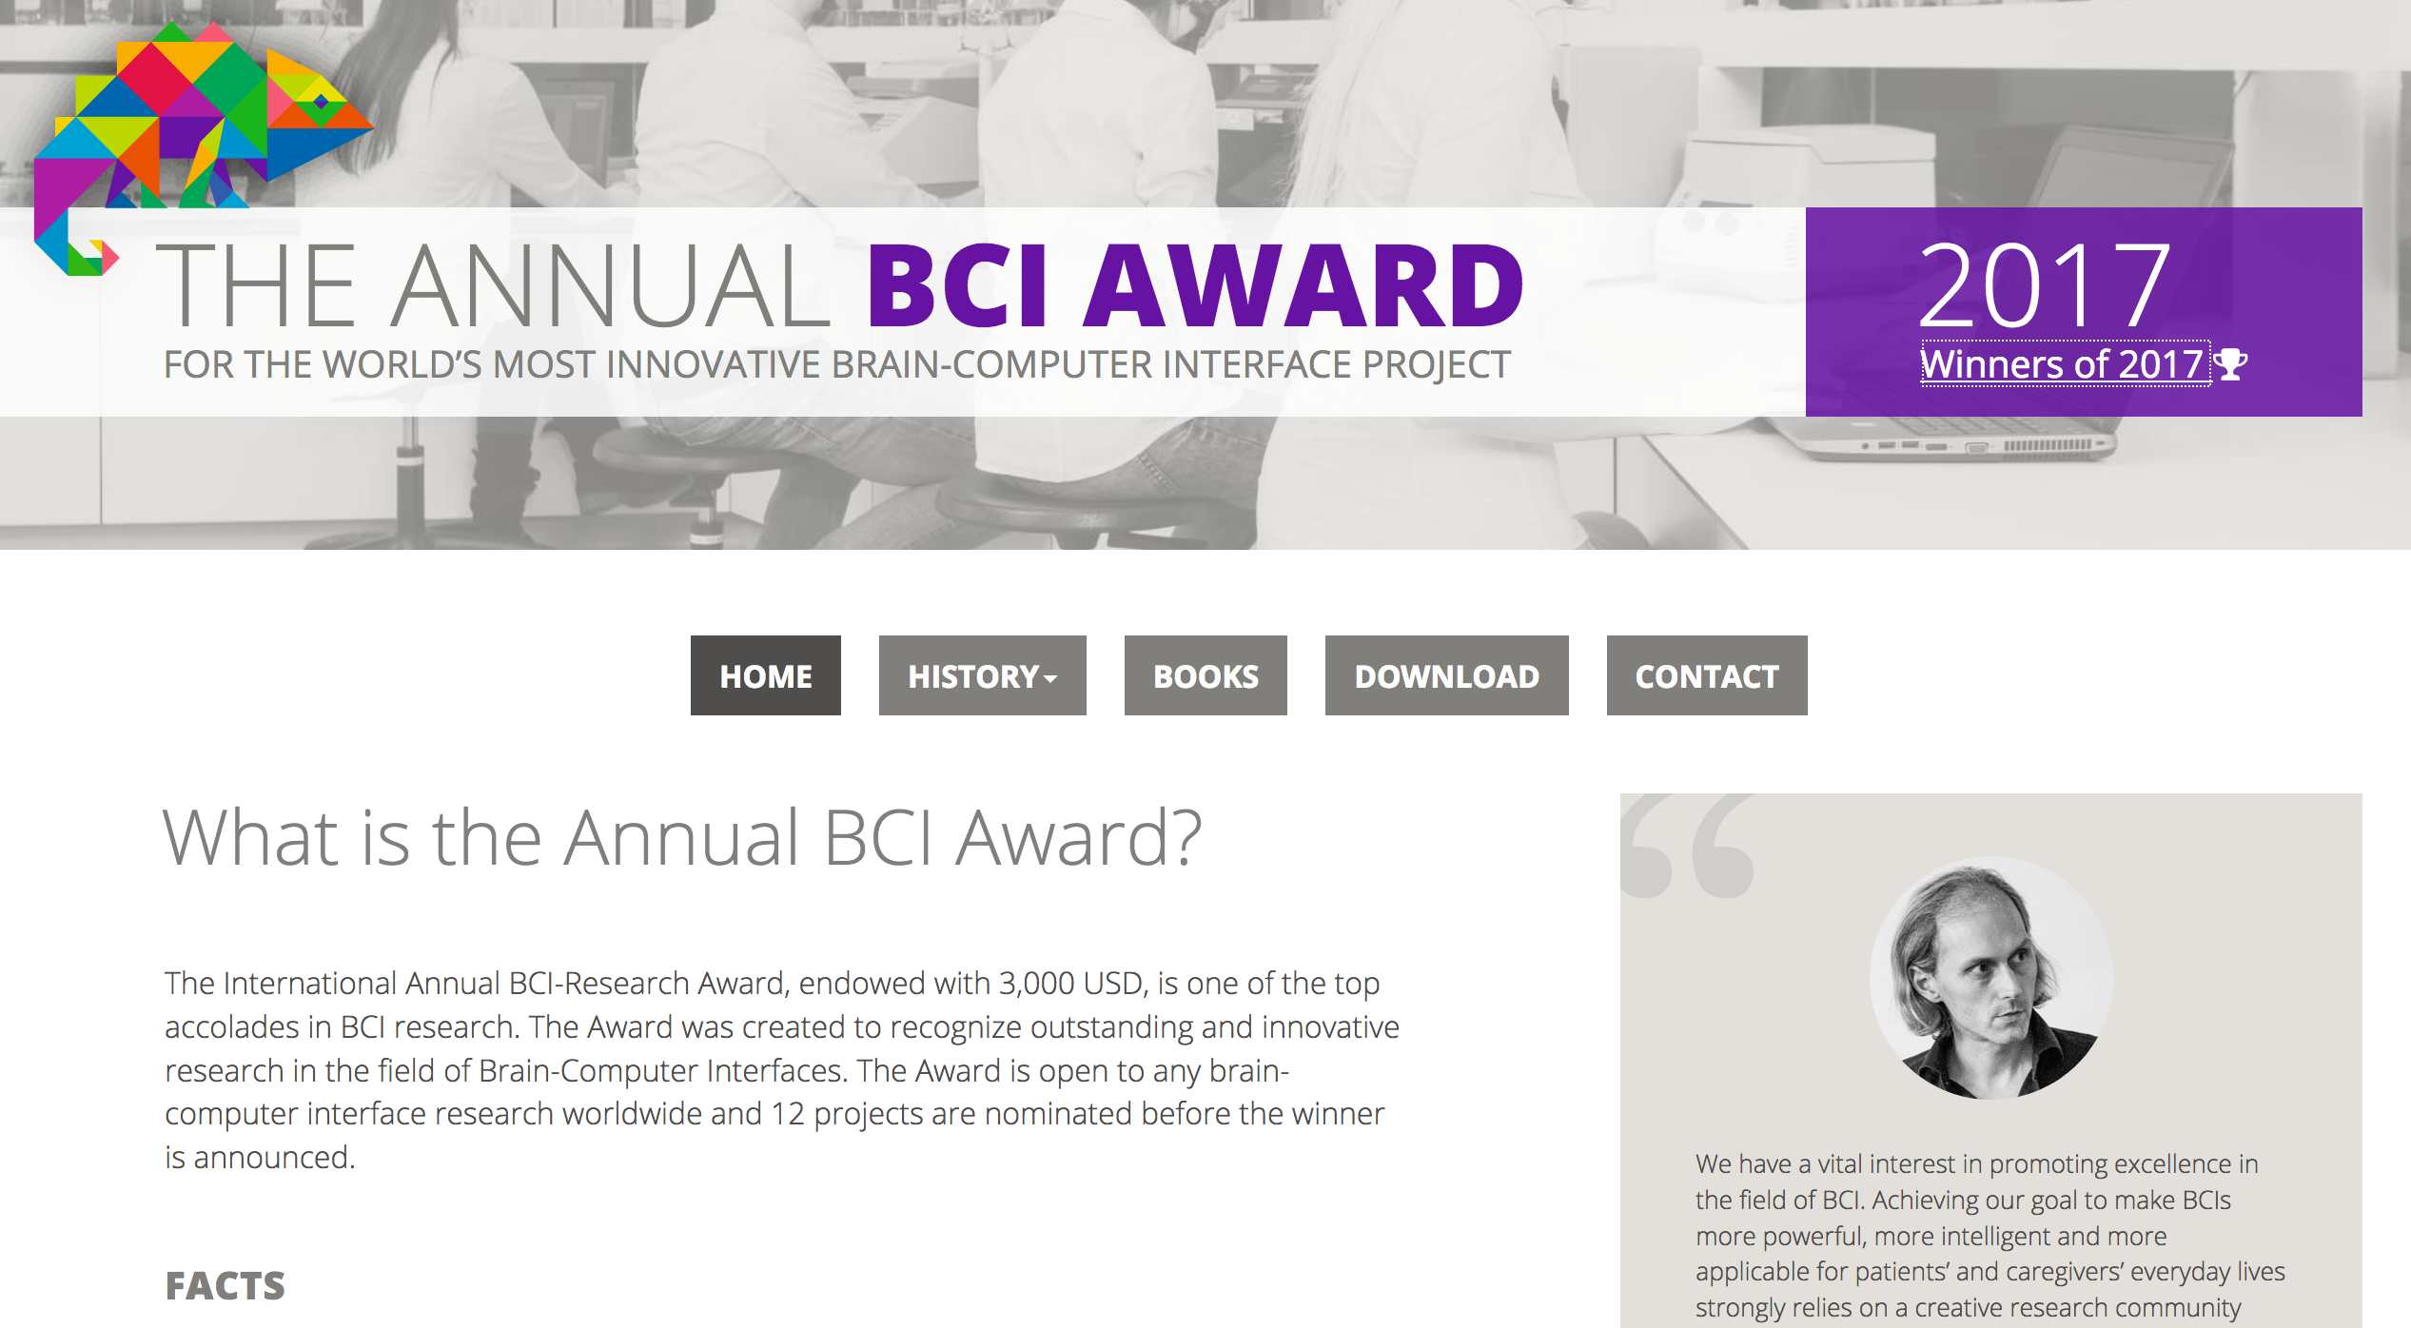
Key element: Brain computer interface
= direct communication pathway between brain and
an external device
Burgeoning field
Great variety: from EEG based wearables to invasive BCIs
“Dual use”: civil and military; medical and enhancement
Move towards consumer market (entertainment/wellness)
Informed consumers?
Accumulating data pool (not only health-related)
Dangers of abuse (hacking!)
Automatic decisions in closed loop systems
Broad applicability, e.g. remote device control (i-phone, wheelchair, car, drone etc.)
A future scenario: Brain “editing” (collect, store, delete thoughts)
Potential convergence with AI systems

Slide 18
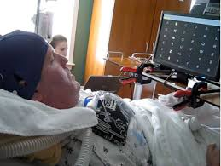
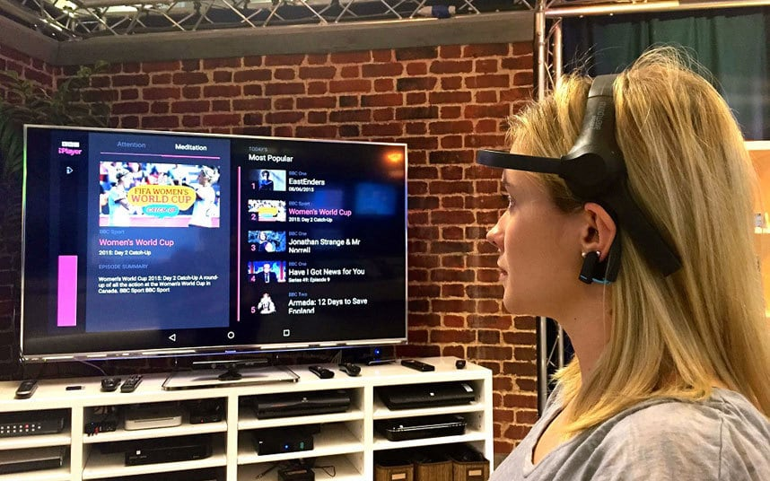
Brain technologies - ethically relevant distinctions
Purpose
Diagnostic
Therapeutic/restorative
Predictive/preventive
Enhancement/Transhumanism
Area
Clinical
Military
Legal (e.g. lie detection; prediction of criminal behavior)
Market research
Entertainment
Transport (alarm for fatigue or distraction)
Personal identification (brain print)
…
Method/Set-up
Invasive – non-invasive
Closed loop – open loop

Slide 19
Respect for persons
Dignity
Identity
Autonomy
Authenticity
Integrity
Fundamental freedoms
Privacy
Risk for harm
Safety
Security
Dual use
Justice
Equitable access
Non-discrimination
Social values
Solidarity
Liberalism
Benefits
Area specific benefits
Virtual immortality
Superintelligence
„Hyper-communication“
Purpose – area – methods

Slide 20
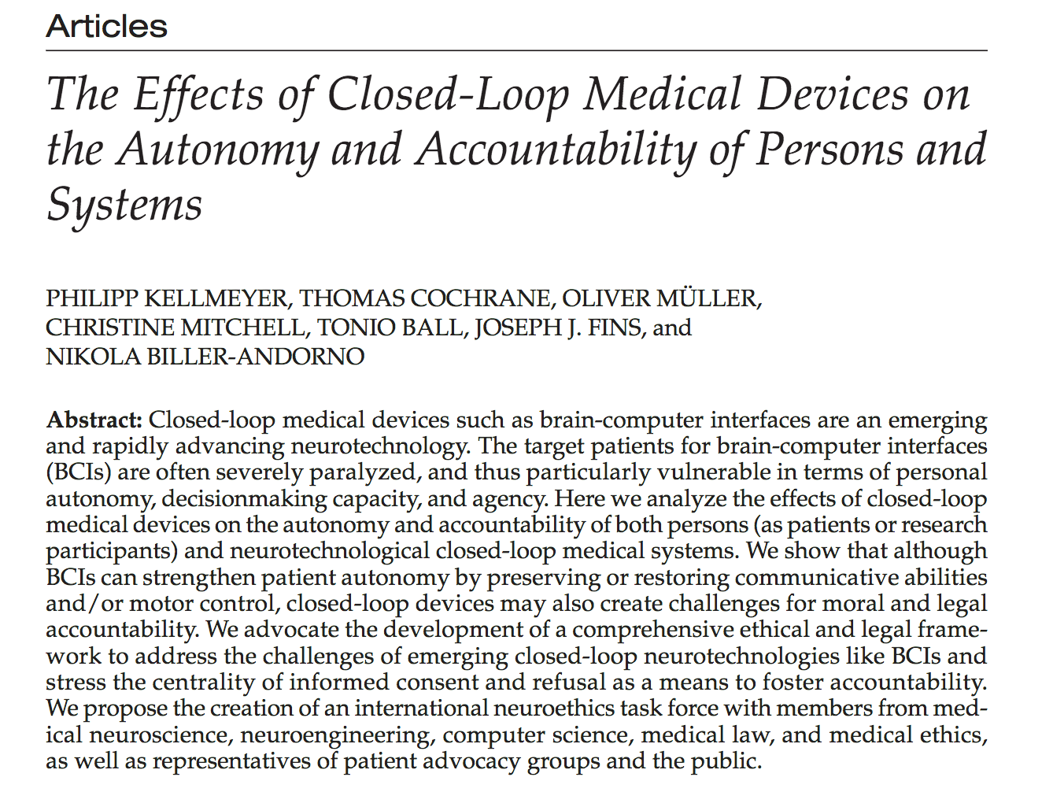

Slide 21
Human rights challenge: Do human rights need to be complemented (or rather to be specified)?
Right to cognitive liberty (e.g. no pressure to reveal neurodata)
Right to mental privacy (e.g. deleting data that is not needed for neuromarketing study)
Right to mental integrity (e.g. hacking of neuroimplants)
Right to psychological continuity (e.g. no unwanted personality changes)
European Convention of Human Rights:
Right to liberty - right to respect for private life – freedom of thought...
Ienca and Andorno: Towards new human rights in the age of neuroscience and neurotechnology. Life Sciences, Society and Policy (2017) 13:5. DOI 10.1186/s40504-017-0050-1

Slide 22
Thoughts are free
Thoughts are free, who can guess them,
they fly past like nighttime shadows.
No one can know them, no hunter can shoot them.
It remains: The thoughts are free!
A fundamental tenet of our society is at risk
Time for an Additional Protocol on Brain Technologies?

Slide 23
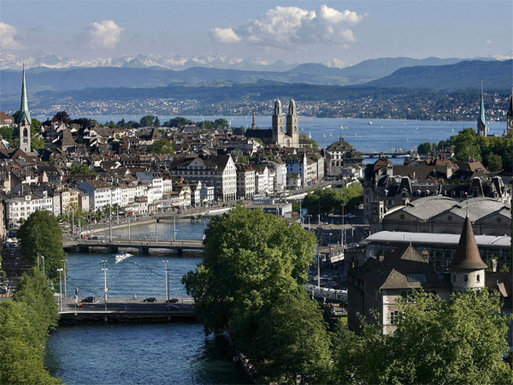
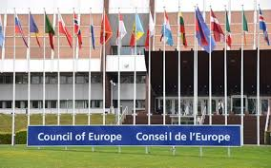
Congratulations on 20 years Oviedo Convention!
Prof. Dr. med. Dr. phil. Nikola Biller-Andorno
Institute of Biomedical Ethics und History of Medicine
University of Zurich, Switzerland
http://www.ibme.uzh.ch
biller-andorno@ibme.uzh.ch

