Slide 1
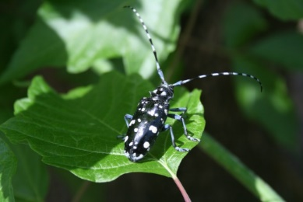
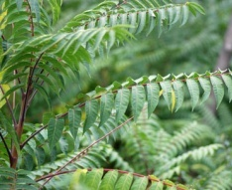
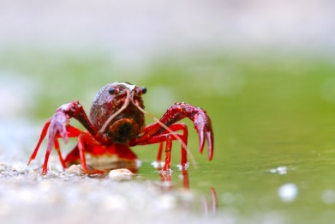
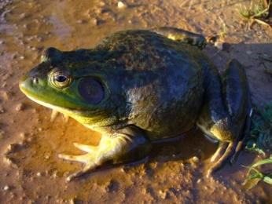
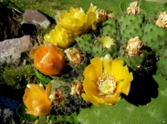
Bern Convention Group of Experts on IAS
Virtual meeting July 6, 2021
Toward a guidance document
on e-commerce and IAS
Andrea Monaco – ISPRA/Lazio Region (Italy)
IUCN SSC Invasive Species Specialist Group

Slide 2
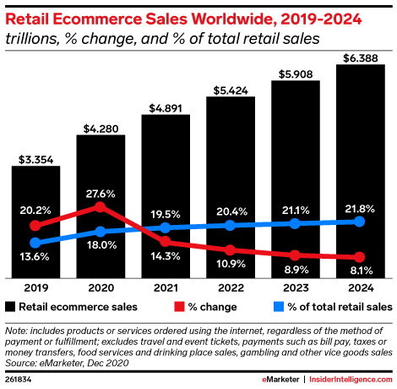
E-commerce and IAS
In the last decades internet has become an invaluable tool for facilitating commerce and communication worldwide, therefore the opportunities to trade in live animals and plants have hugely increased.
Internet sellers can directly approach a global clientele and commodities are often marketed by means of small and uneasily recognizable consignments, entailing the risk of bypassing border controls and biosecurity regulations
The rise of internet-based commerce in living organisms can be considered among the main driver of IAS introduction and a major biosecurity concern (Ricciardi et al., 2017).

Slide 3
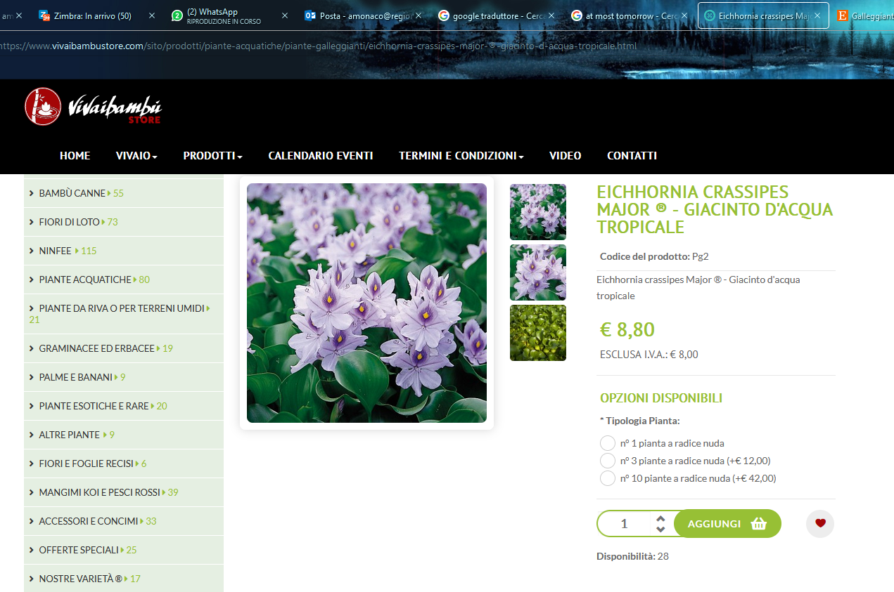
E-commerce and IAS
The online trade is poorly regulated and, being accessible to all, has increased considerably in recent years, making the purchase of invasive species just a mouse click away from any home.
E-commerce is not a physical pathway, but rather simply serves as a mechanism for processing commercial and non-commercial transactions
Growing diversity and complexity of the trade market, more and more difficult to approach with prevention and control strategies
Increase in non-experts in the plant and animal trade who may be ignorant or misinformed on risks and regulations or incorrectly identify their products

Slide 4
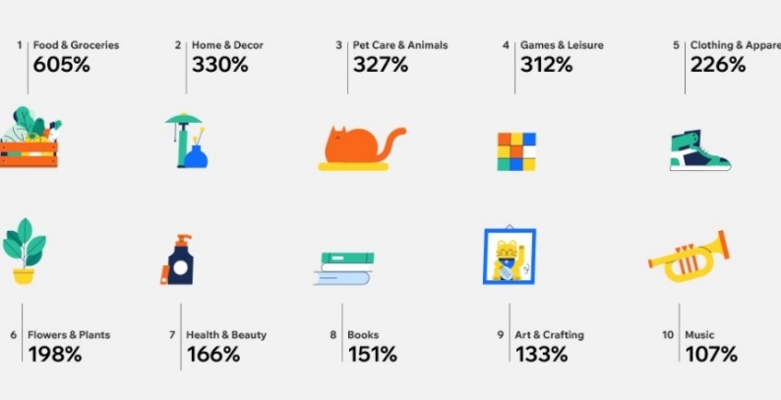
E-commerce, IAS and COVID 19
The recent COVID-19 pandemic has had a marked impact on consumer’s purchasing behaviour, encouraging people to online shopping and causing an increase from 16% (2019) to 19% (2020) in its share of all retail sales.
The increase in online sales during the pandemic affected many product categories, including pets and ornamental plants (and related products)
It is likely that this shift towards online shopping will consolidate in the future, increasing the risk of introduction and spread of pest and IAS worldwide by this pathway.

Slide 5
E-commerce and IAS
The major ways of addressing the risk associated with e-commerce are:
development of national regulations, to assist national customs agencies to enforce halting entries of invasive alien species.
data sharing and information flow
the need to engage with national Customs authorities to raise the issue of invasive alien species, in collaboration, among the users and operators of e- commerce

Slide 6
What happened after Batumi 2019
Integrated the first draft after reciving comments, suggestions and inputs from the GoE on IAS and the EC-DG ENV
Integrated the Chapter 2 with the issue of COVID and E-commerce (following the decision of the Standing Committee of Bern Convention in December 2020)
Reviewed and updated scientific and technical literature as well as the new available guidance documents
Prepared the third draft of the Guidance document on e-commerce and IAS

Slide 7
Major comments or point of criticism at the first draft
Some criticism on the real effectiveness of non-binding, voluntary tools (addressed)
A number of revisions are requested to improve the chapter on the on-line survey results (addressed)
Request to clarify how the guidance could support the implementation of the EU IAS policy (addressed)
Request to underline that people involved in the e-commerce of IAS are often specialist and therefore nor ignorant or misinformed about species features and regulations (GP1) (addressed)
Request to be a bit more accurate in talking about differences among white and black list of IAS (GP2) (addressed)
Invite to evaluate as a best practice the approach used by the Walloon Region to limit the sale of animals only to specialised websites (GP4) (addressed)

Slide 8
Aim and target of the Guidance document
to draw a set of key recommendations to be adopted in order to limit the role of e-commerce as pathway of introduction of invasive alien species at all scale
to raise awareness on this threat, and at improving the information on this issue
The Guidance document is addressed to all the fifty countries which are signatories of the Bern Convention
The Guidance document is specifically addressed at national authorities and institutions, and at different subjects that can contribute to the enforcement of an effective management and regulation of this pathway

Slide 9
The 5 Guiding principles
GP 1: Raise awareness on biological invasion risks associated with e-commerce, among all relevant subjects and institutions
GP 2: Adopt and enforce national legislations regulating invasive alien species, including the further development and implementation of the list of invasive alien species of Union concern, and make the lists of regulated species easily accessible to all subjects (sellers, buyers, platforms, custom organizations, environmental protection agencies, etc.)
GP 3: Collaborate with the main platforms and actors of e-trade of plants and animals to prevent the e-commerce of invasive alien species
GP 4: Ensure that sellers and buyers are provided with the key information and warnings on the species they sell or buy, including on their potential invasiveness
GP 5: Monitor e-commerce of invasive alien species at all scale

Slide 10
Possible next steps
Collect comments and suggestions at this Meeting
Integrate the third draft taking into account comments, suggestions and inputs received so far and prepare the final version of the Guidance
Circulate the final draft among members of the Group of experts on IAS of the Bern Convention
Submit the final version of the Guidelines for the adoption to the next Standing Commitee of the Bern Convention

Slide 11
Acknowledgments
I sincerely thank the experts that contributed to the present document with suggestions and information, since the first presentation at the Meeting of the Select Group of Experts on Invasive Alien Species (Rome, April 2018)
Among them, a special thank to Spyridon Flevaris and Myriam Dumortier (European Commission), Piero Genovesi, Riccardo Scalera and Kevin Smith (IUCN), Ilaria di Silvestre (Eurogroup for Animals), Wojciech Solarz, Juan Luis Rodriguez Luengo and Stephanie Morelle (GoE IAS Bern Convention), who provided very helpful comments and materials.
Thanks to Nadia Saporito (Bern Convention) for revising and integrating the draft as well as improving the English language.

