Slide 1
Centre Euro-Mediterranéen pour la Prévention du Risque Sismique CEPRIS ACTIVITY REPORT by: Nacer Jabour National Scientific and Technical Research Centre CNRST- Rabat – Morocco
EUR-OPA Joint meeting 6-7 November 2017, Paris

Slide 2
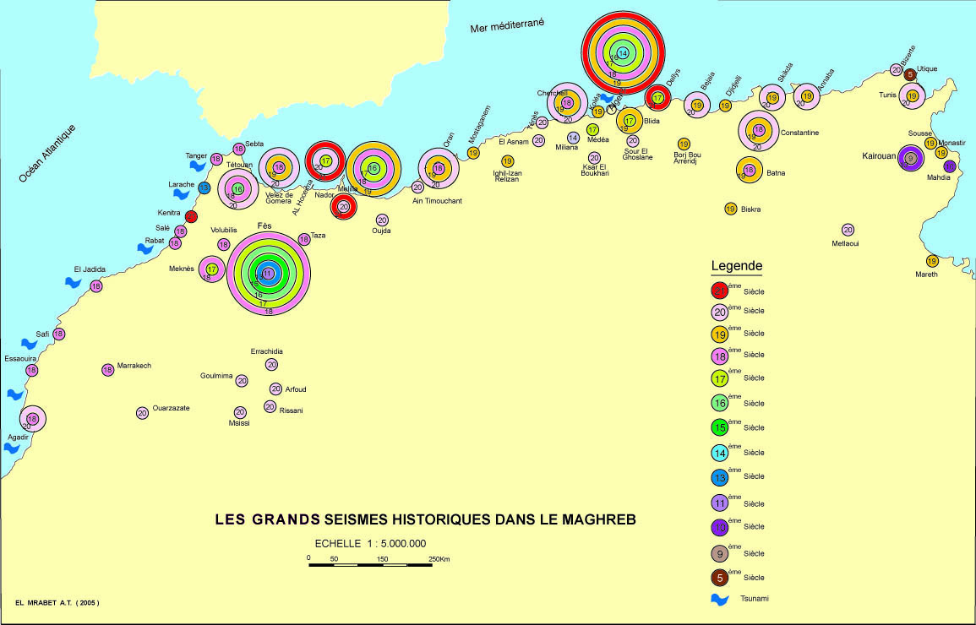
Historical seismicity of the Maghreb

Slide 3
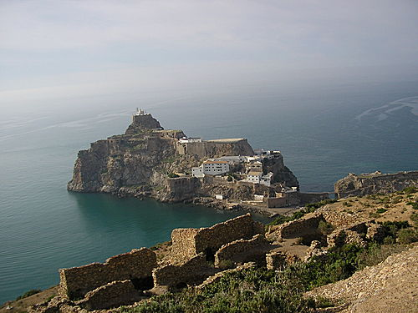
LAReHBA Project: Local Appropriate Retrofitting of Historical Built-up Areas
View of the island of Badis with the ruins of the ancient city

Slide 4
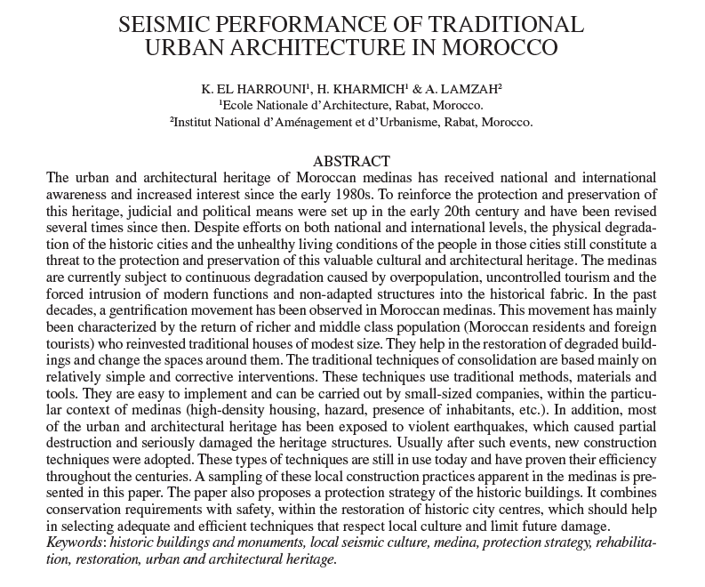

Slide 5
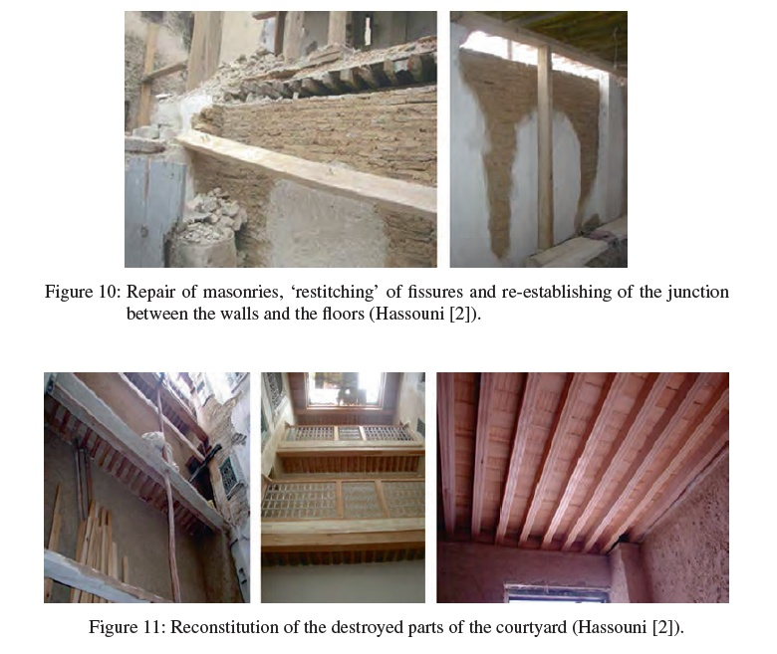

Slide 6
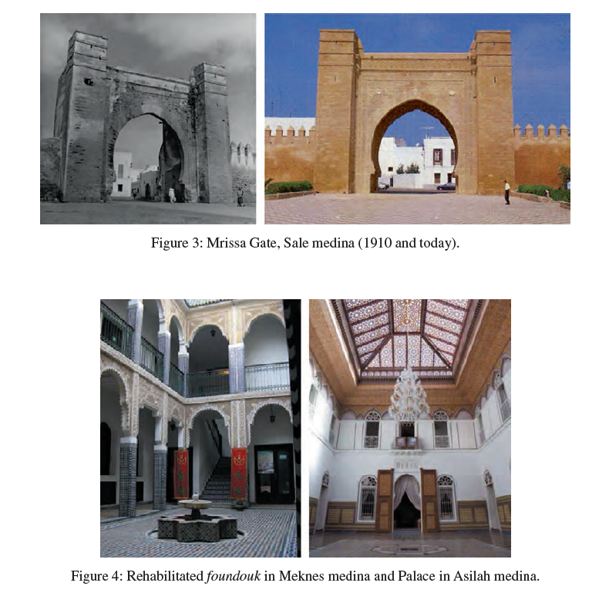

Slide 7
Aquestionnaire on the tsunami hazard and risk was diffused in Tangier, Northern Morocco within the BAYWATCH project to assess the hôteliers level of awarness and the preparation measures as these structures are hosting tourists from different countries.
Action plans of associated centers as well as common plans were discussed during the Lagos, Portugal workshop with of the Caraebean Tsunami warning Center representative.

Slide 8
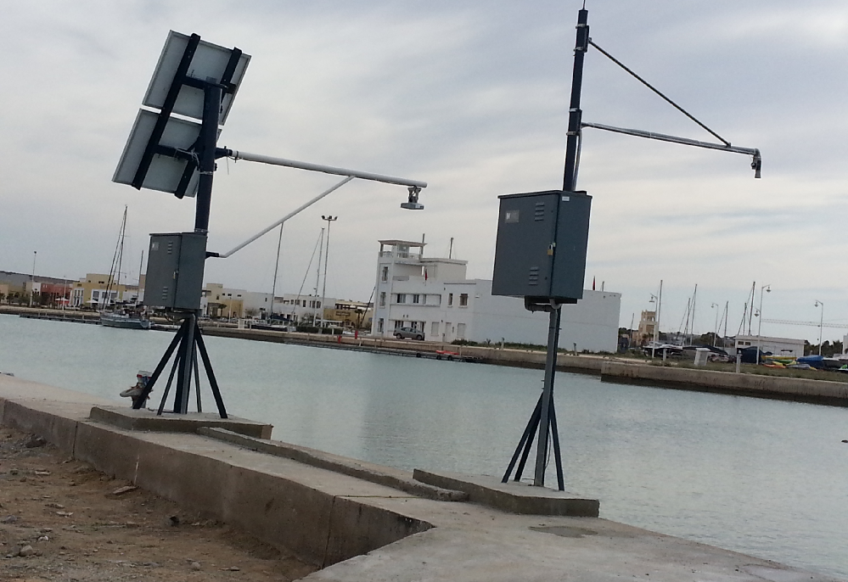
Deux Maregraphes à Saidia
MAREGRAPHES DE SAIDIA, CNRST et JRC

Slide 9
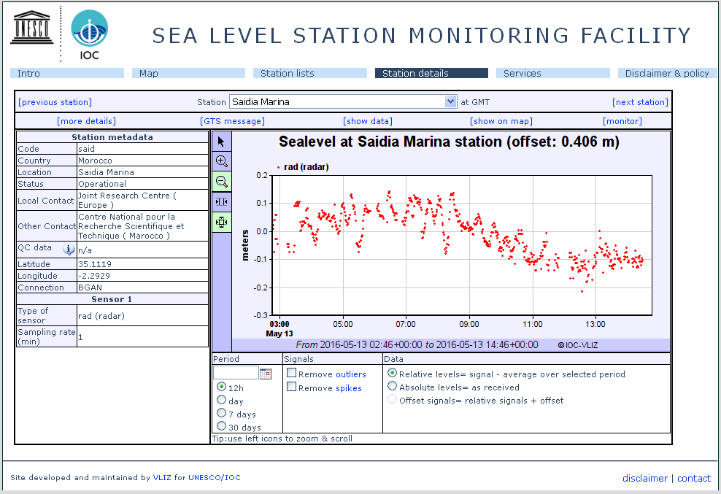
Enregistrement du niveau de la mer en temps réel à Saadia, CNRST

Slide 10
Affiches et signalisations

Slide 11
Project proposal 2018-2019
PRIORITY FOR ACTION OF THE MEDIUM TERM PLAN:
National actions aim to spread local seismic culture.
Defining actions to reach the population in order to present all availlable measures for the seismic and tsunami prevention and protection.
Preparation of evacuation exercises in coordination with the civil protection authority, starting with schools in priority

Slide 12
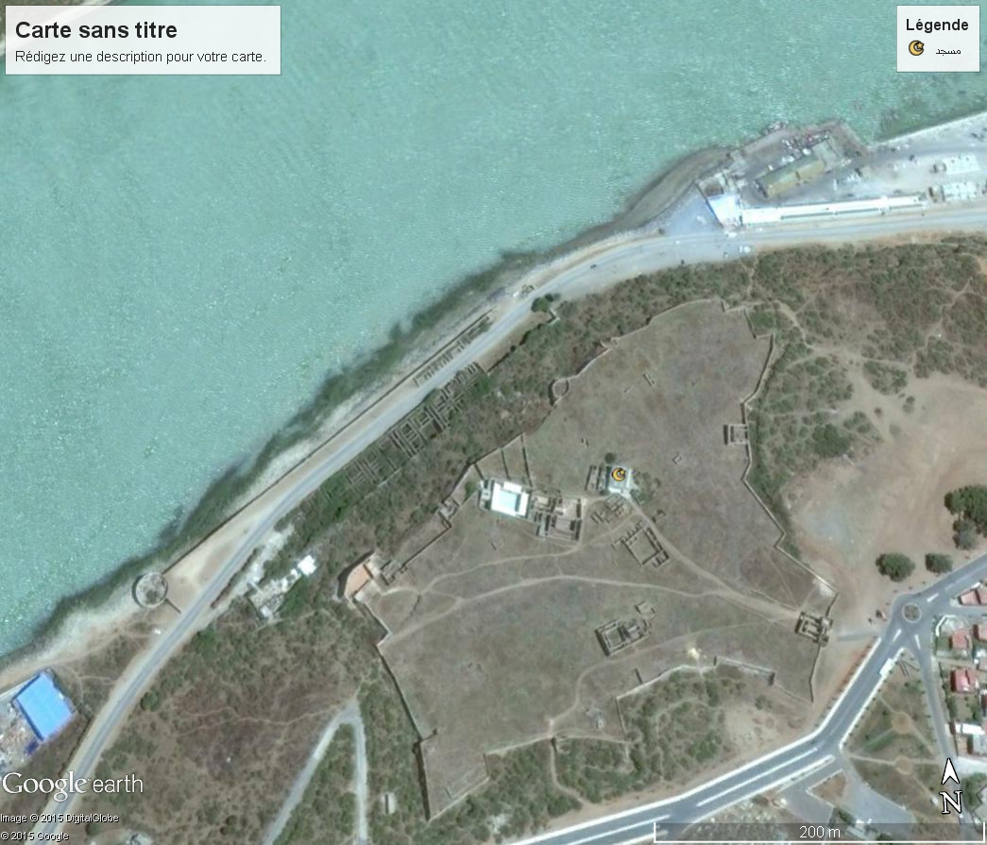
THANK YOU FOR YOUR ATTENTION
Mahdia harbour

