Slide 1
A reference framework for the development of
Competences for Democratic Culture and National Qualification Frameworks Hilligje van’t land
Secretary General
International Association of Universities (IAU)
Expert member of the CDC Working Group

Slide 2
WHY EDUCATION?
The Council of Europe position:
Preparation for employment
Preparation for democratic citizenship
Personal development
Broad, advanced knowledge base

Slide 3
What kind of education ?
The answer to the question: “what kind of education do we need?” lies in the answer to another question: “What kind of society do we want”?
Eugenio Tironi: El sueño chileno (2005)

Slide 4
« European Societies are faced with challenges that (higher) education needs to play a key role in meeting, and it is part of [education and] higher education’s democratic mission to respond to these societies’ expectations in the respect »
Snezana Samardzic-Markovic, Director General for Democracy, CoE, in
Higher Education for Diversity, social inclusion and community – a democratic imperative,
CoE August 2018

Slide 5
COMPETENCES FOR DEMOCRATIC CULTURE - BACKGROUND
24th session of the Council of Europe Standing Conference of Ministers of Education, Helsinki, 26-27 April 2013 :
“… competences for a culture of democracy and intercultural dialogue were fundamental to our societies today and that they should be described and put into practice in our formal education systems.”
7-8 February 2013, Andorra la Vella, High-Level Conference organised by the Andorran Chairmanship on
“Competences for a culture of democracy and intercultural dialogue: a political challenge and values”
Adoption of the theme by the Council of Europe flagship project in Education
Appointment Expert Working Group; Meetings : December 2013 – 2018.
Council of Europe Standing Conference of Ministers of Education “SECURING DEMOCRACY THROUGH EDUCATION” The development of a Reference Framework of Competences for Democratic Culture”25th session Brussels, 11-12 April 2016
Publication : April 2018

Slide 6
COMPETENCES FOR DEMOCRATIC CULTURE - BACKGROUND
Main sources of inspiration:
The Common European Framework of Reference for Languages (2001)
The White Paper on Intercultural Dialogue: “Living together as equals in dignity” (2008)
The Charter on Education for Democratic Citizenship (2010)
Recommendation CM/Rec (2012)13 of the Committee of Ministers to member States on ensuring quality education

Slide 7
What do we understand by COMPETENCES FOR DEMOCRATIC CULTURE
The set of attitudes and behaviours that enable democratic institutions and democratic laws to function in practice
The will and ability to conduct intercultural dialogue is part of democratic culture
Understanding of and respect for human rights is also part of democratic culture

Slide 8
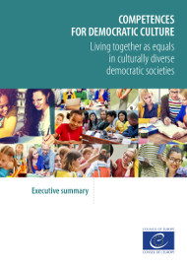
Competences for Democratic Culture Reference Framework Published April 2018
:
Model (adopted by European Ministers April 2016)
Descriptors (piloted June 2016 – March 2017)
858 teachers in 16 countries piloted descriptors for learners aged 9 years upwards
Guidance for implementation:
Curriculum
Pedagogy
Assessment
Teacher education
Whole-school approach
Building resilience to radicalisation leading to violent extremism and terrorism

Slide 9
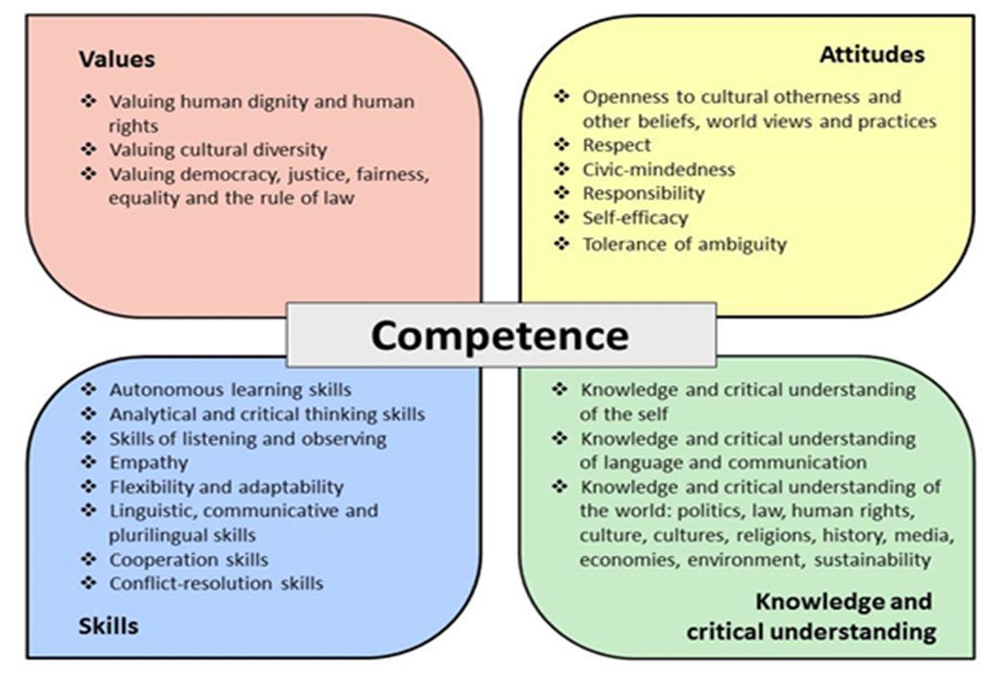
THE CDC MODEL

Slide 10
COMPETENCES
Is about what you:
Know
Understand
Are able to do
Are willing to do – or refrain from doing
They should be
Teachable
Learnable
Assessable
For all learners at all ages and all levels of education

Slide 11
Competences DESCRIPTORS
Descriptors have been developed for all competences in the model
Descriptors show how a person can demonstrate knowledge and understanding of a given competence and their ability and willingness to act or abstain from acting
Formulated using the language of learning outcomes:
- Start with an action verb followed by the object of that verb
- The outcome must be observable and assessable

Slide 12
DESCRIPTORS - Examples
Values - Valuing cultural diversity: Promotes the view that we should be tolerant of the different beliefs that are held by others in society
Attitudes - Openness to cultural otherness and to other beliefs, world views and practices: Expresses a willingness to relate to others who are perceived to be different from oneself
Analytical and critical thinking skills: Can make connections between arguments and information
Knowledge and critical understanding of language and communication: Can describe some effects that different styles of language use can have in social and working situations

Slide 13
DESCRIPTORS: example of levels
VALUING CULTURAL DIVERSITY
BASIC
Promotes the view that we should be tolerant of the different beliefs that are held by others in society
Promotes the view that one should always strive for mutual understanding and meaningful dialogue between people and groups who are perceived to be “different” from one another
INTERMEDIATE
Expresses the view that the cultural diversity within a society should be positively valued and appreciated
ADVANCED
Argues that intercultural dialogue should be used to help us recognise our different identities and cultural affiliations
Argues that intercultural dialogue should be used to develop respect and a culture of “living together”

Slide 14
SUPPORTING DOCUMENTS now available
Assessment
Pedagogy
Teacher education
Curriculum design
Radicalisation
Whole-school approach

Slide 15
Timetable
Spring 2018 Publication and official launch
2018-19 Implementation in co-operation with member states and further development: - Descriptors for younger leaners - Portfolio - Language and communication
- Vocational education
Spring/Fall 2018 Development of Higher Education dimension

Slide 16
Strasbourg Meeting – National Correspondents for Qualifications Frameworks (QF-EHEA), 4 September 2018 Questions to participants
What do you know about the Reference Framework of Competences for Democratic Culture (RF-CDC)?
Do you already look at how to introduce the RF-CDC in Qualification Frameworks?
What are the opportunities for introducing CDC in your context (current or planned reform, new qualifications, etc.)?
What added value do you think CDC can bring to your education context and QF system?
What are the challenges of incorporating CDC?
What specific issues need to be addressed in your country? In what way do you think CDC can help?
Do you have any suggestions for future action or further development of the CDC Framework especially as far as higher education is concerned?

Slide 17
www.coe.int/competences

