Slide 1
Framework Convention on the Value of Cultural Heritage for Society Fontecchio, Italy – 9-12 October 2017 Hakan Shearer Demir

Slide 2
Parameters (concept of heritage at the CoE)
Heritage is a social and political construct
Exercise in democracy and human rights
Heritage as means and not as an end in itself
Relations between peoples, places and stories

a. Heritage governance –communities’ central role
b. The role of heritage in addressing societal challenges

Slide 3
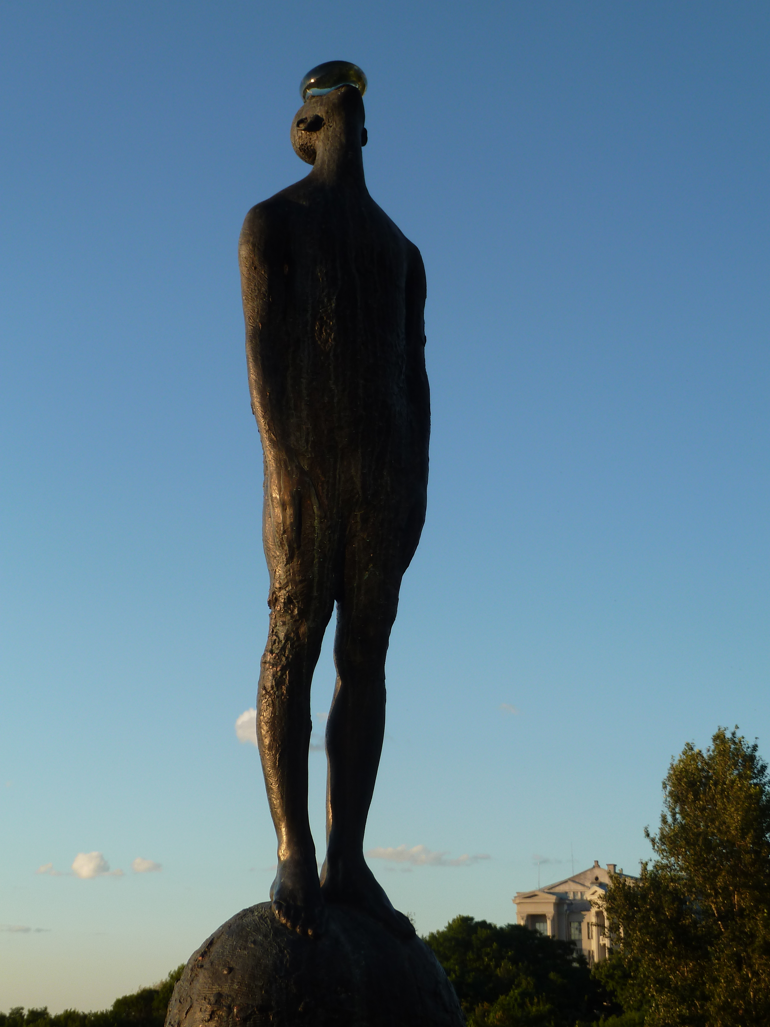
MULTIPLE IDENTITIES
DIVERSITY
DIGNITY
QUALITY OF LIFE
Notes:
From a window of

Slide 4
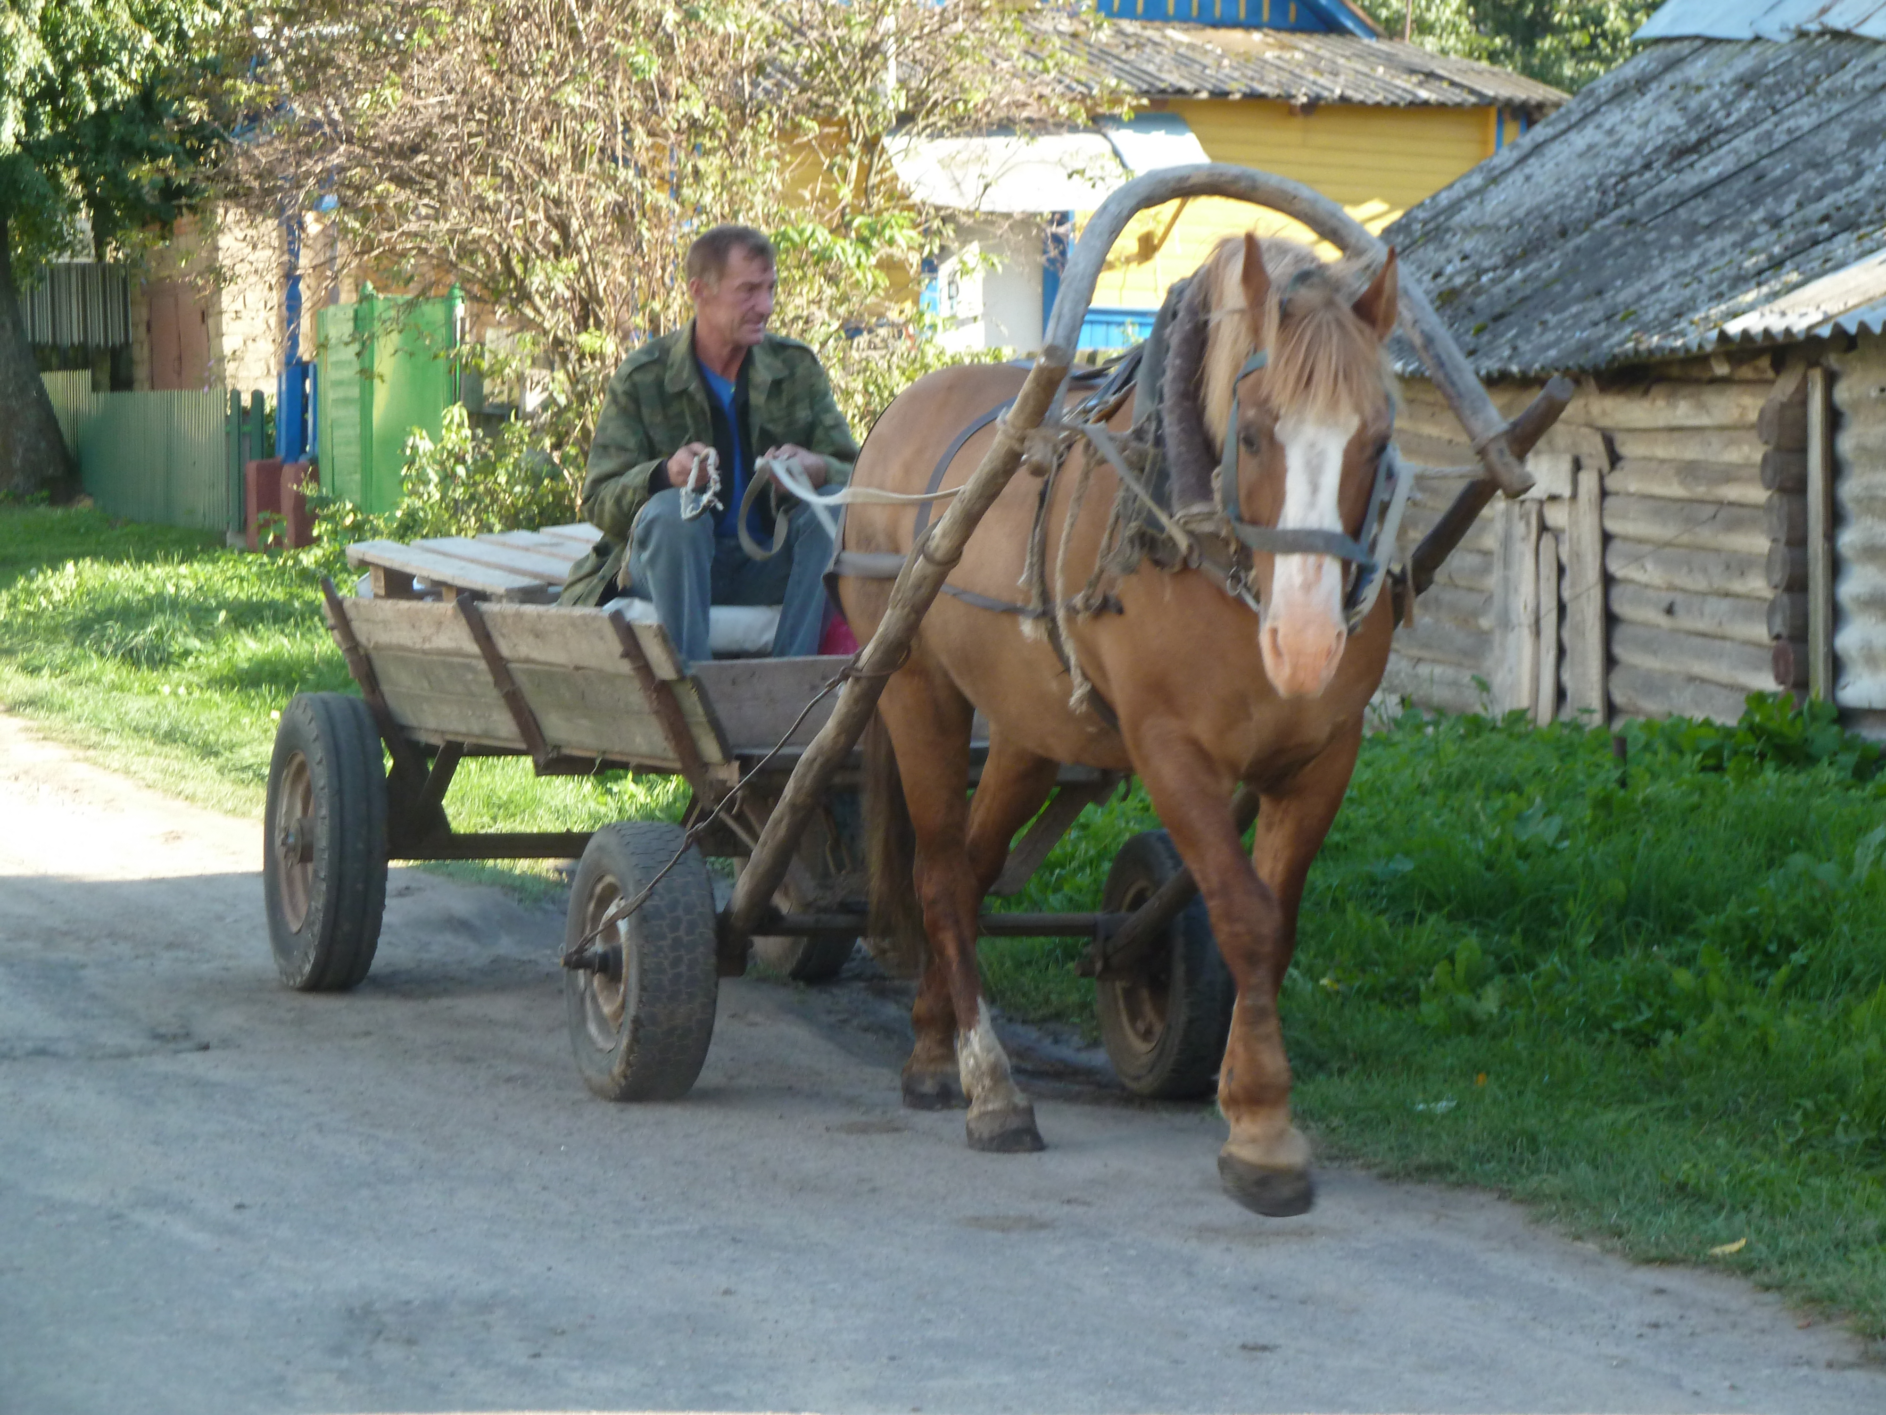
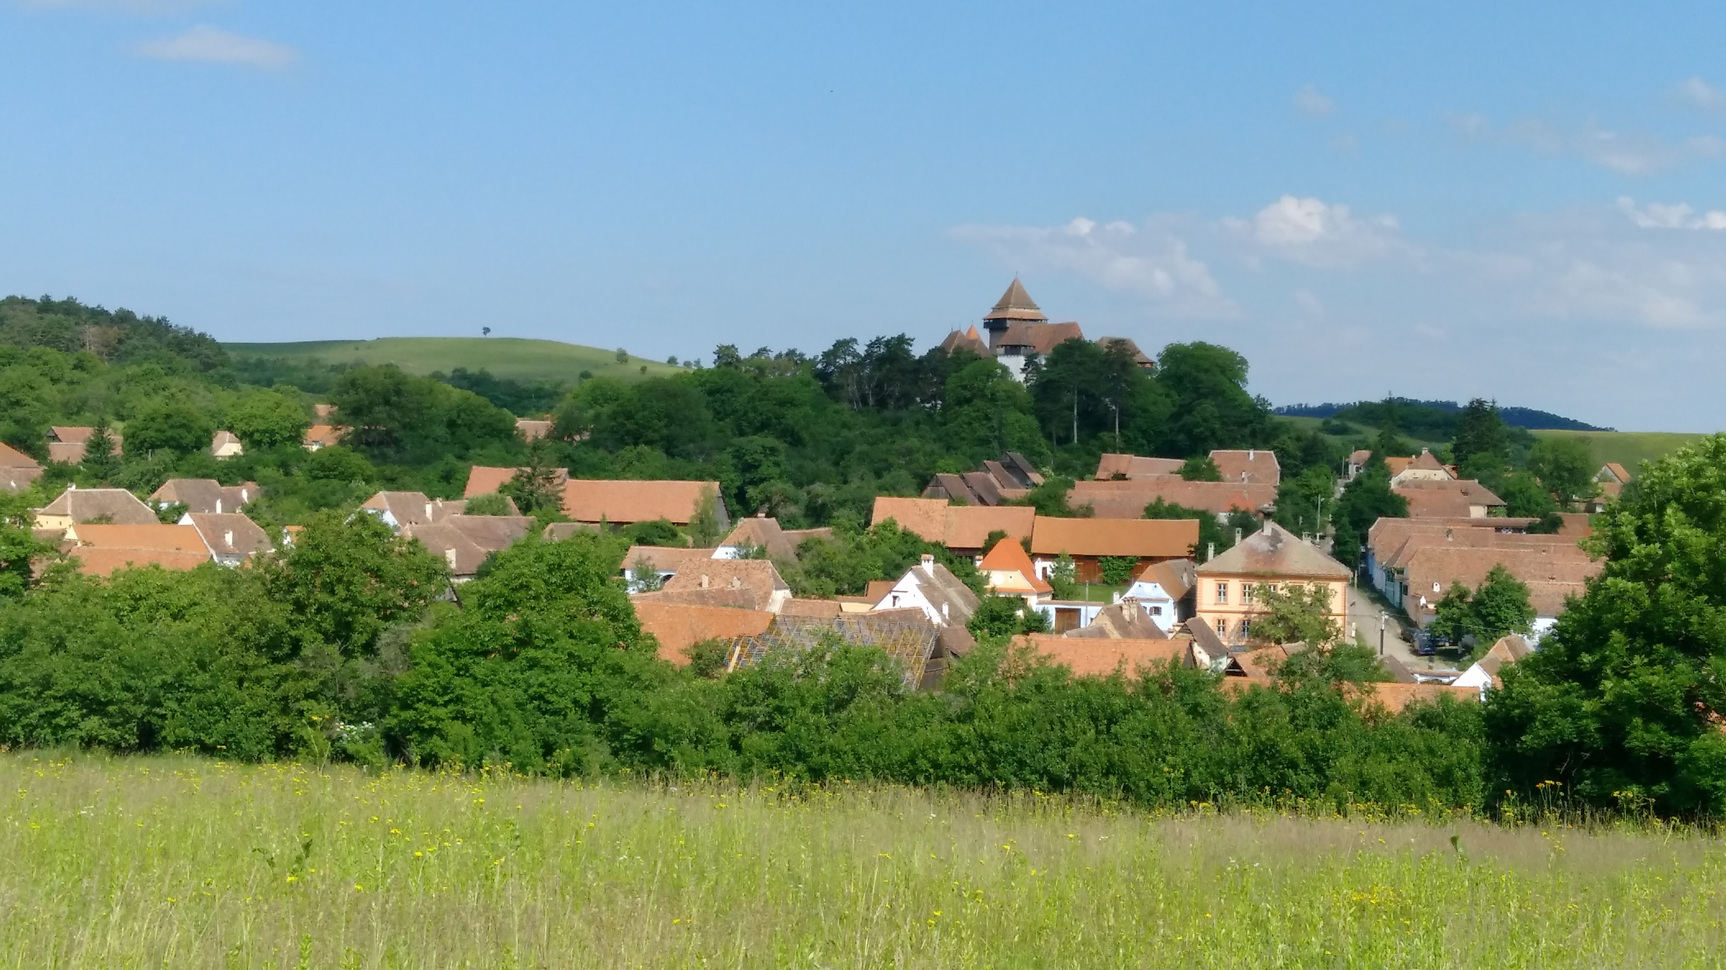
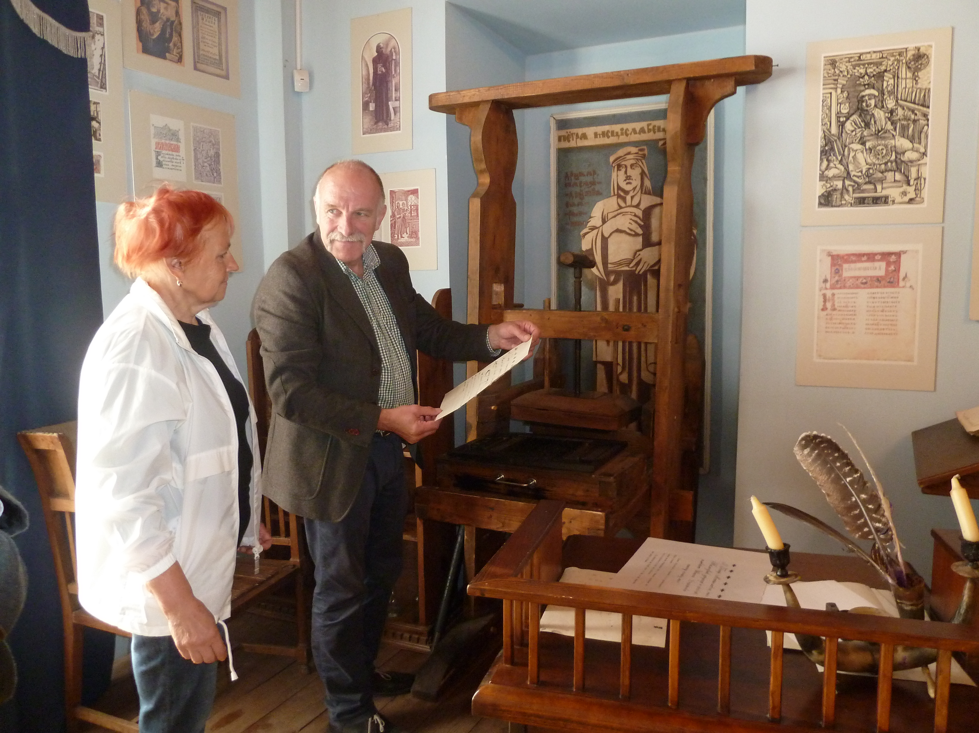
Faro Convention
PEOPLE
PLACES
STORIES
Notes:
Faro Convention is about peoples, places and stories where unique practices and traditions acknowledged, valued and promoted by heritage communities and turned into social and economic opportunities for a better quality of life. It is a process of democratisation of the heritage field together with the civil society local and national institutions and authorities.

Slide 5
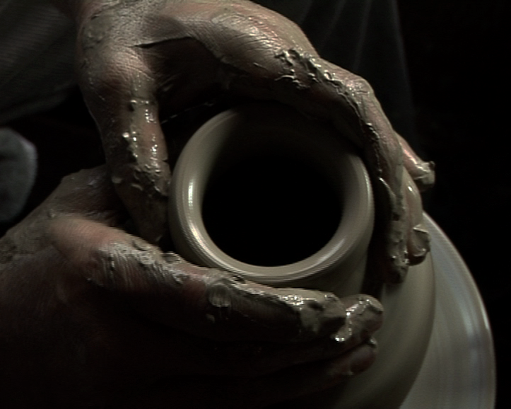
47 MEMBER STATES 820 MILLION EUROPEANS
The Convention
-A vision and a new way of looking
at heritage
-A distinctive approach
-Exercise in participatory democracy
The Action Plan
-Heritage-led, people centered actions
-Societal challenges
-A pan-European Network
-Making Invisible - Visible

Slide 6
Faro Convention Process
Faro Action Plan
Promotion
Faro Convention Network
Faro Convention in Action
Faro Convention Research
Faro Convention Spotlights

Slide 8
The principles:
Connection to a community and territory determines a sense of belonging;
Social cohesion is founded on various levels of cooperation and commitment;
Democracy is practised by engagement of civil society in dialogue and action, through shared responsibilities based on capacities.

Slide 9
The criteria:
Who?
Presence of an active civil society (heritage community) that has a common interest in a specific heritage;
Presence of people who can convey the message (facilitators);
Engaged and supportive political players in the public sector (local, regional, national institutes and authorities);
Engaged and supportive stakeholders in the private sector (businesses, non-profit entities, academia, CSOs, NGOs, etc.).

Slide 10
How?
Consensus on an expanded common vision of heritage;
Willingness of all stakeholders to cooperate (local authorities and civil society);
A defined common interest of a heritage-led action;
Commitment and capacity for resource mobilisation.

Slide 11
What?
Readiness of the group to engage in the process of developing diverse narratives based on the people and places;
Aspirations towards a more democratic socio-economic model;
Commitment to human rights principles in local development processes (respect for dignity and multiple identities);
Improved democratic participation and social inclusion of all inhabitants.

Slide 12
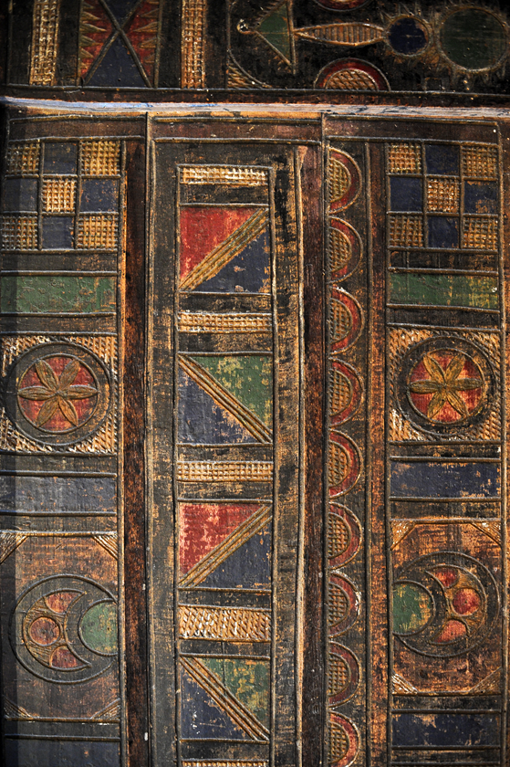
Self Management Process
Self Assessment
Self Monitoring
Self Evaluation

Slide 13
Faro Convention Methodology
Commons – Cooperation – Narratives
Places – People - Stories

Slide 14
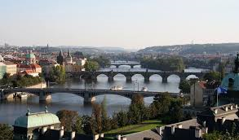
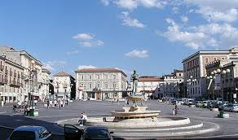
Standards:
Also active with the Architectural (Granada), Archaeological (Valletta), Landscape (Florence) conventions
Strategy 21: European Cultural Heritage Strategy for the 21st century
Council of Europe Convention on Offences relating to Cultural Property opened for signature earlier 2017

Slide 15
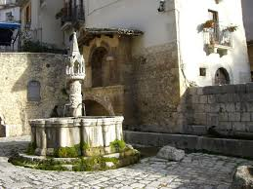
Italy and the Faro Convention
Signed - February 2013
Faro Convention principles and criteria are observed in a number of initiatives as a natural fabric of the society

Slide 16
Co-operation & Synergies
Faro Convention Action Plan is a good platform to bring theory and practice together
Synergies with other sectors is fundamental
The Faro Research in Fontecchio is a constructive step toward this goal with the focus on post disaster revitalisation and the role of communities

Slide 17
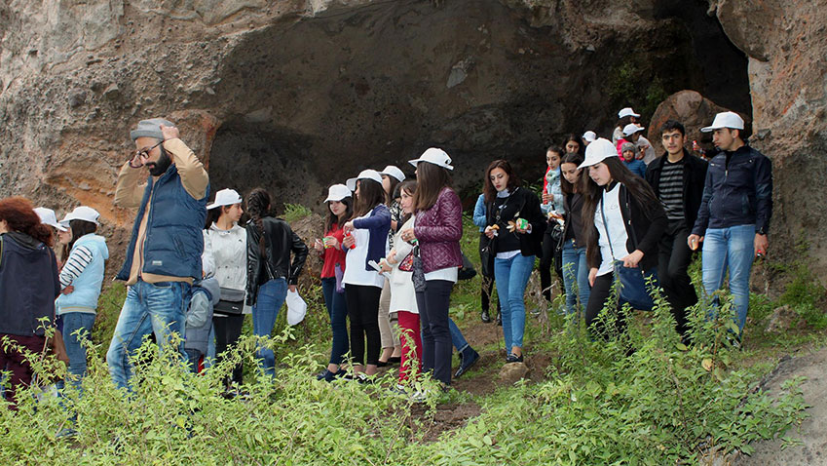
Implementation:
Engagement at all levels
Ministry and institutional support (working with all levels)
Raising awareness
Mapping initiatives in line with the Faro Convention
Incentives
Sharing among Faro Convention Network / CDCPP

Slide 18
SYNERGIES WITH OTHER COE PROGRAMS
European Heritage Days
STRATEGY 21
Intercultural Cities
Cultural Routes
EUR-OPA
CoE Conventions

Slide 19
www.coe.int/faro-action-plan
faro.convention@coe.int
Faro Convention Network

Slide 20
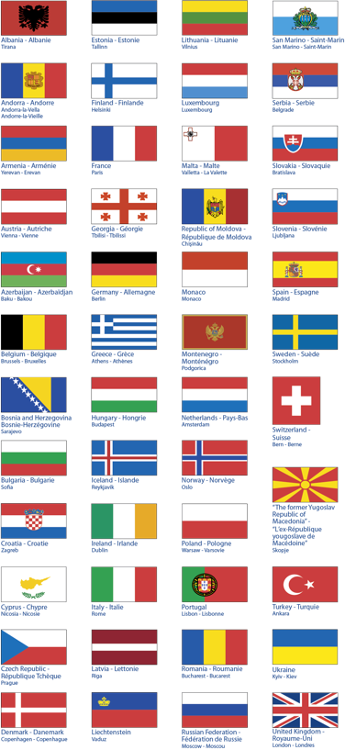
Thank you
BACK

