Slide 1
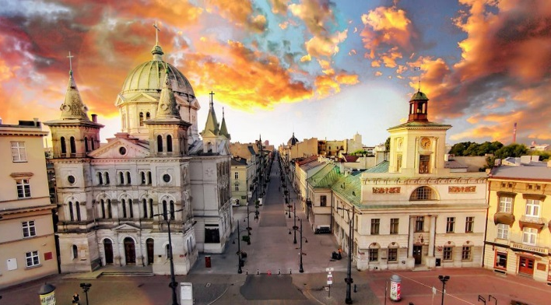
European Year of Cultural Heritage
2018
#EuropeForCulture
© European Heritage Label
Notes:
City of Lodz, Poland
European Heritage Label Candidate site

Slide 2
What is cultural heritage?
Resources inherited from the past in all forms and aspects: tangible, intangible and digital. Including:
Monuments and sites
Landscapes and natural sites
Skills, knowledge and expressions of human creativity (oral traditions, festivals, songs, etc.)
Collections in museums, libraries and archives (paintings, books, artefacts, etc.)
Film heritage

Slide 3
Why a Year for
Cultural Heritage?
To encourage the sharing and appreciation of Europe's cultural heritage as a shared resource;
To raise awareness of common history and values;
To reinforce a sense of belonging to Europe; and
To better protect, safeguard, reuse, enhance, valorise and promote Europe's cultural heritage.
© European Heritage Label
Notes:
© Pol Englebert Joutes

Slide 4
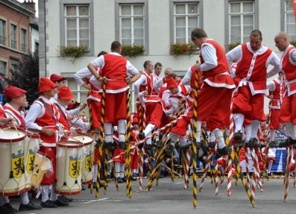
The European Year
will promote:
Cultural heritage as a pivotal component of cultural diversity and inter-cultural dialogue;
Cultural heritage's contribution to the economy; and
Cultural heritage as an important element of the relations between the EU and third countries.
© Shutterstock
© Shutterstock
© Photo Franc Ferjan
© Pol Englebert Joutes

Slide 5
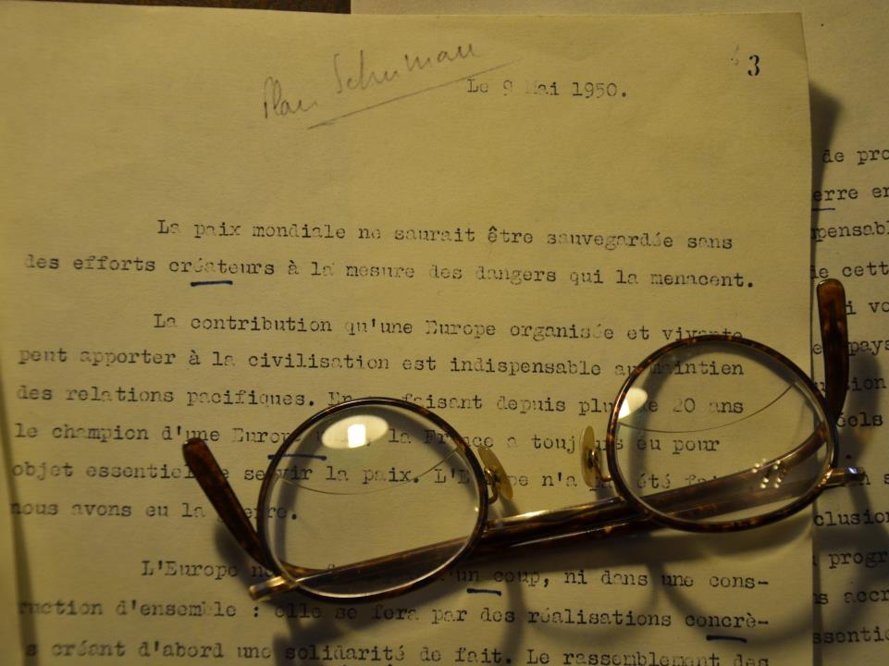
© European Heritage Label
Cultural heritage is not only a legacy from the past, it is also a resource for our future

Slide 6
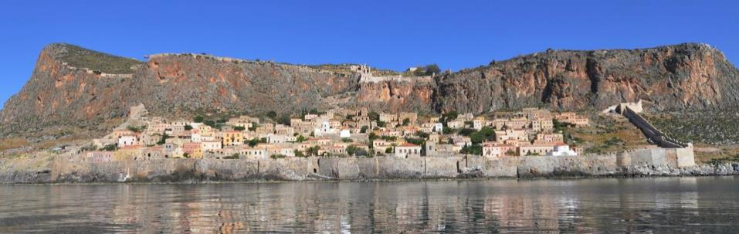
Where?
Projects and events will take place all across Europe
EU delegations will also help promote the Year outside the EU
© European Heritage Label

Slide 7
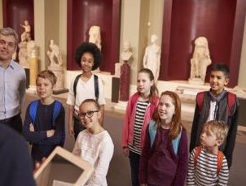
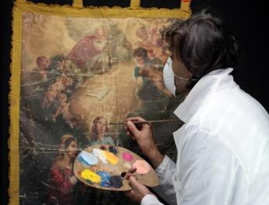
For whom?
Children (10-15)
Young people (15-25)
The wider public
Cultural heritage professionals
And all curious people!
© European Heritage Label
© Shutterstock
© Javier Rodríguez
© Shutterstock

Slide 8
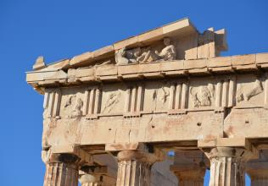
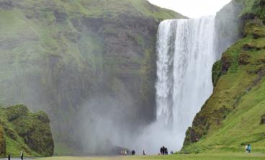
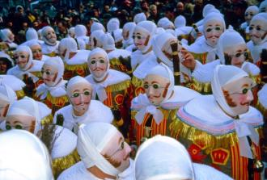
With whom?
Cultural heritage professionals
International organisations
Member States, regional and local authorities
Civil society
The European Year belongs to all!
© European Heritage Label
© Shutterstock
© European Heritage Label
© European Commission
© European Commission
© Shutterstock

Slide 9
How?
Management of the Year at national level
National Coordinators manage the Year in Member States.
Supported by Multipliers: Creative Europe desks, Commission and European Parliament representations, cultural heritage stakeholders, the cultural sector, etc.

Slide 10
How?
Management of the Year at European level
Joint effort of European Institutions: Commission, Parliament, Council of the EU, European External Action Service, Committee of the Regions and European Economic and Social Committee.
With DG Education and Culture in the lead, it will be a Joint effort of different departments of the Commission, focusing on: education, regional development, social cohesion, environment, tourism, research, audio-visual policy, etc.

Slide 11
How?
Management of the Year at European level
The Commission is assisted by a Committee of stakeholders, composed of 35 representative organisations.
http://www.voicesofculture.eu/
International organisations including UNESCO and the Council of Europe are also closely associated.

Slide 12
How?
Initiatives at European level
Transnational projects and European initiatives
Numerous events, starting with the launch of the Year at the European Culture Forum on 7-8 December 2017
Communication campaign and Eurobarometer survey

Slide 13
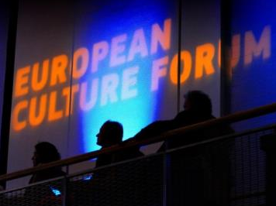
Key events in 2018
European Culture Forum
Biannual highly-visible event
The December 2017 edition will be the occasion of the launch of the Year
http://ec.europa.eu/culture/forum/
European Heritage Days
Celebrated yearly in September
Thousands of events and access to rarely opened sites
Over 30 million participants every year
http://www.europeanheritagedays.com/

Slide 14
Key events in 2018
European Heritage Label
For European sites with symbolic value and historic importance
29 sites designated since 2013
European Capitals of Culture 2018
https://ec.europa.eu/programmes/creative-europe/actions/heritage-label_en
2 designated cities each year since 1985
Highlighting the richness of Europe’s cultural diversity
2018 Capitals of Culture: Valletta (Malta) and Leeuwarden (the Netherlands)
https://ec.europa.eu/programmes/creative-europe/actions/capitals-culture_en

Slide 15
How?
Budget
Total budget of EUR 8 million for 2017 and 2018:
To finance transnational projects through the dedicated Creative Europe call;
To support the implementation of the 10 European initiatives;
For the Year's communication strategy (Euro-barometer survey, production of toolkits to reach target audiences, etc.).

Slide 16
How?
IN ADDITION
Funding for cultural heritage will be available through different EU programmes:
Erasmus+,
Horizon 2020,
COSME,
Europe for Citizens,
EU structural and cohesion funds, etc.
http://ec.europa.eu/assets/eac/culture/library/reports/2014-heritage-mapping_en.pdf
Notes:
A dedicated Creative Europe call of 5-7 MIO EU

Slide 17
Ten European initiatives
Each initiative will cluster a number of projects and actions
They will be implemented by the European Commission in collaboration with key partners (Council of Europe, UNESCO, ICOMOS, etc.)
These ten highly-visible initiatives will ensure the legacy of the Year after 2018
They answer four main objectives, defining what European cultural heritage stands for…

Slide 18
Ten European initiatives responding to
four objectives
Shared heritage: cultural heritage belongs to us all
Heritage at school: children discovering Europe's most precious treasures and traditions
Youth for heritage: young people bringing new life to heritage
Engagement
Heritage in transition: re-imagining industrial, religious, military sites and landscapes
Tourism and heritage: responsible and sustainable tourism around cultural heritage
Sustainability
Protection
Cherishing heritage: developing quality standards for interventions on cultural heritage
Heritage at risk: fighting against illicit trade in cultural goods and managing risks for cultural heritage
Heritage-related skills: better education and training for traditional and new professions
All for heritage: fostering social innovation and people's and communities participation
Science for heritage: research, innovation, science and technology for the benefit of heritage
Innovation

Slide 19
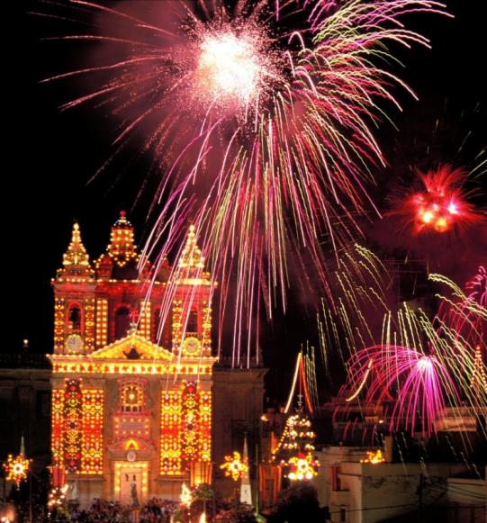
For more information:
https://ec.europa.eu/culture/european-year-cultural-heritage-2018_en
#EuropeForCulture
EAC-EYCH2018@ec.europa.eu
Legal basis

