Slide 1
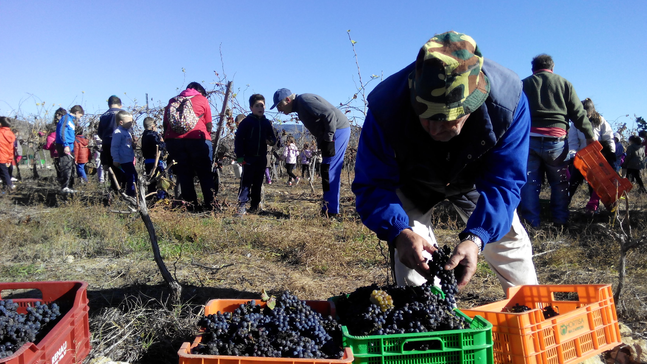
Faro Convention Research Study. Fontecchio, Italy
An example of a heritage community network: the Jaume I University Patrimoni project
Ángel Portolés Górriz. Patrimoni project coordinator

Slide 2
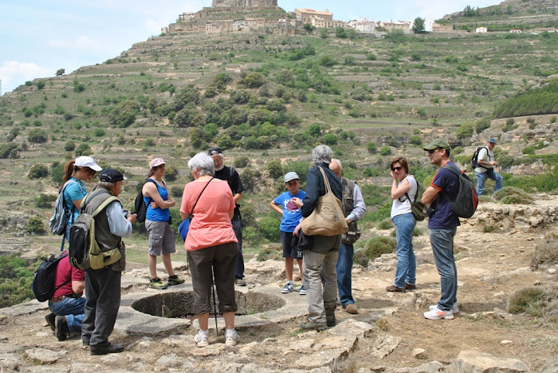
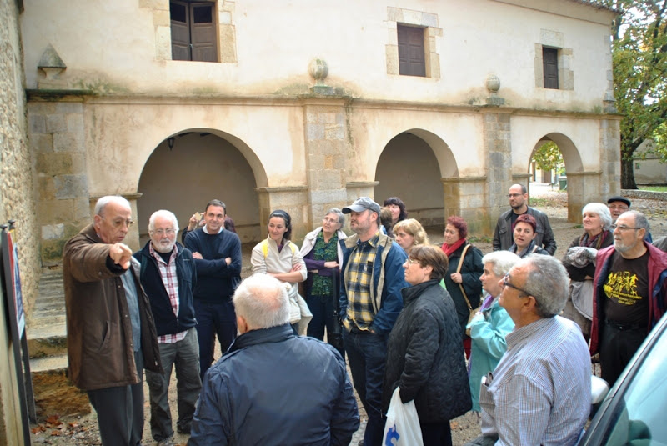
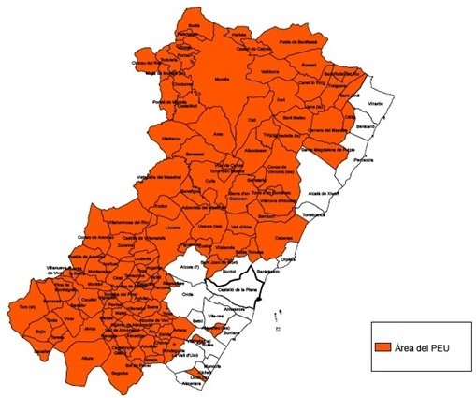
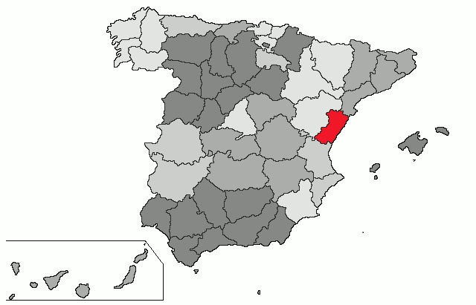
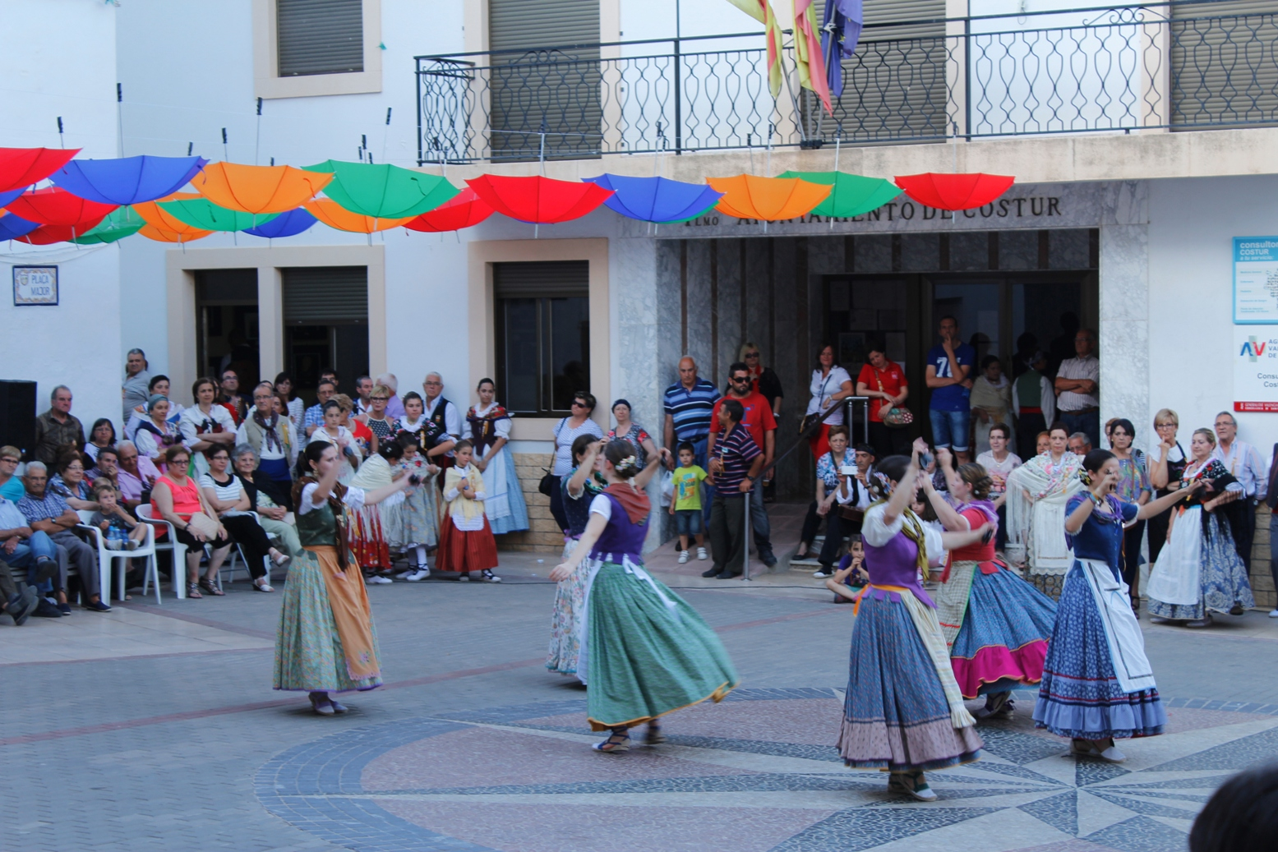
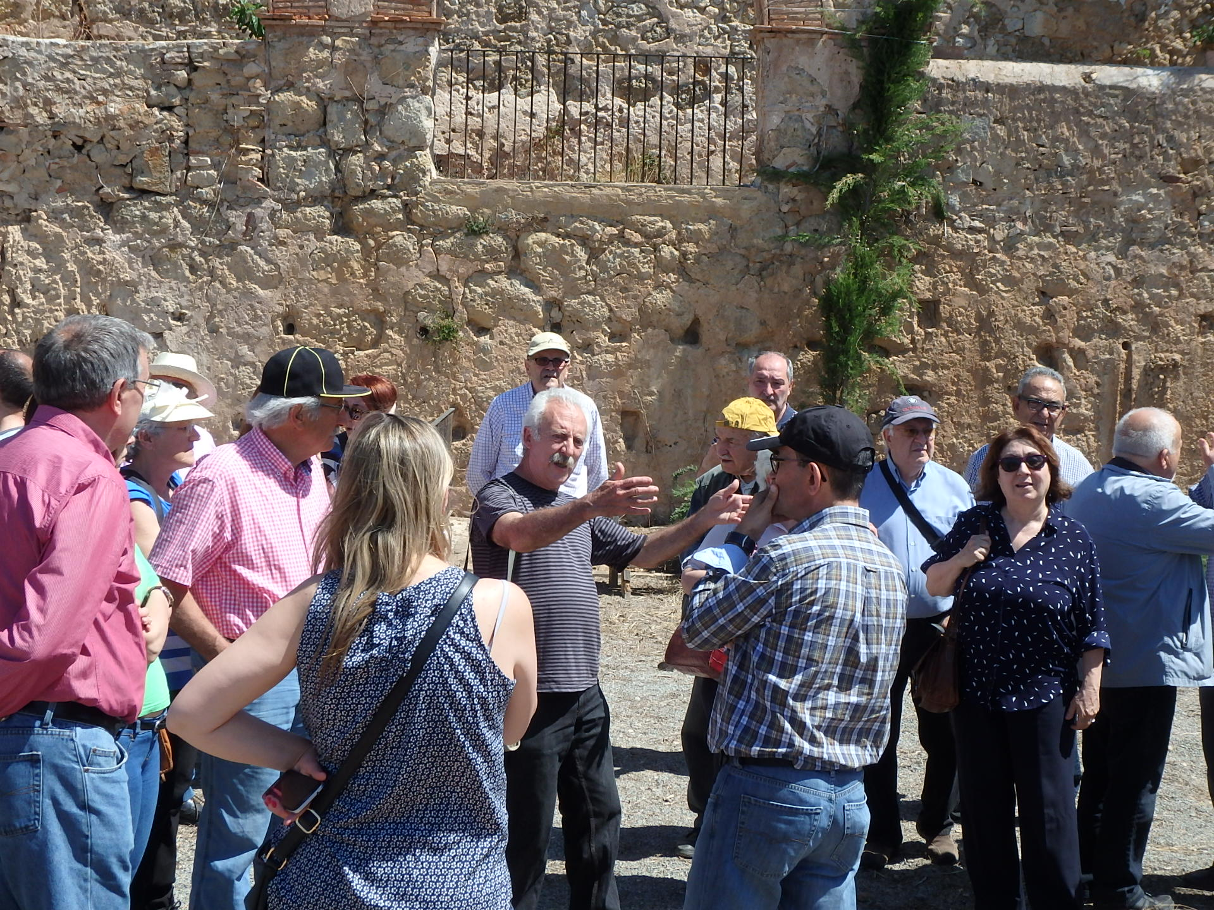
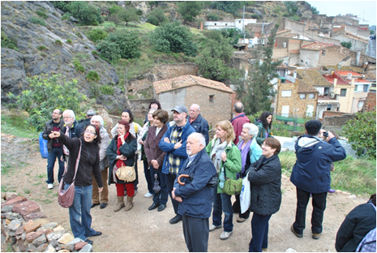
Faro Convention Research Study. Fontecchio, Italy
The Patrimoni project is an initiative of the University Extension Programme (PEU) of the Jaume I University of Castellón (Spain)

Slide 3
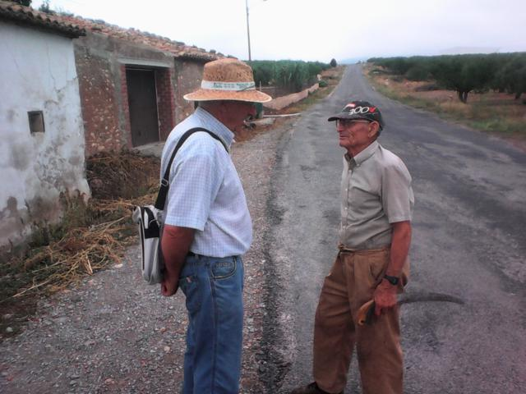
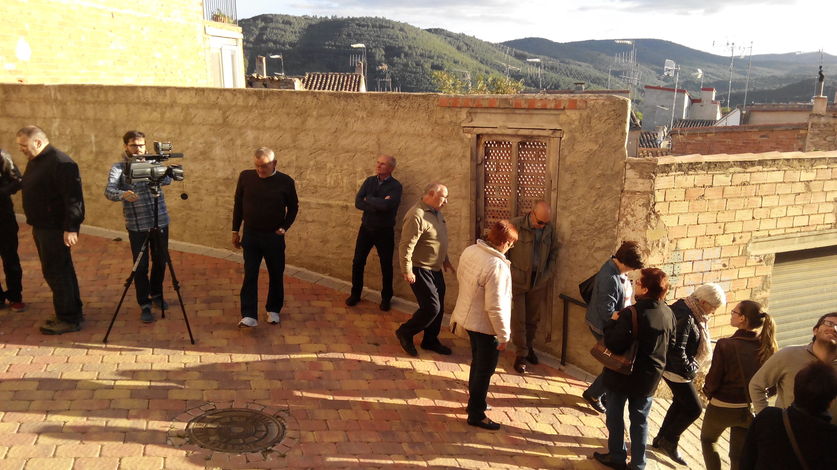
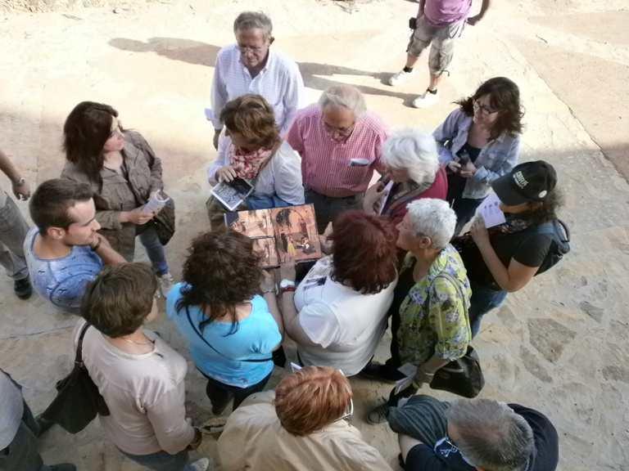
Faro Convention Research Study. Fontecchio, Italy
The Patrimoni project:
Is a collective process that aims to revitalise cultural heritage and citizen activity in rural areas.
It offers a space for consultation and guidance on matters related to cultural heritage, and the awareness, interpretation and dissemination of this asset.

Slide 4
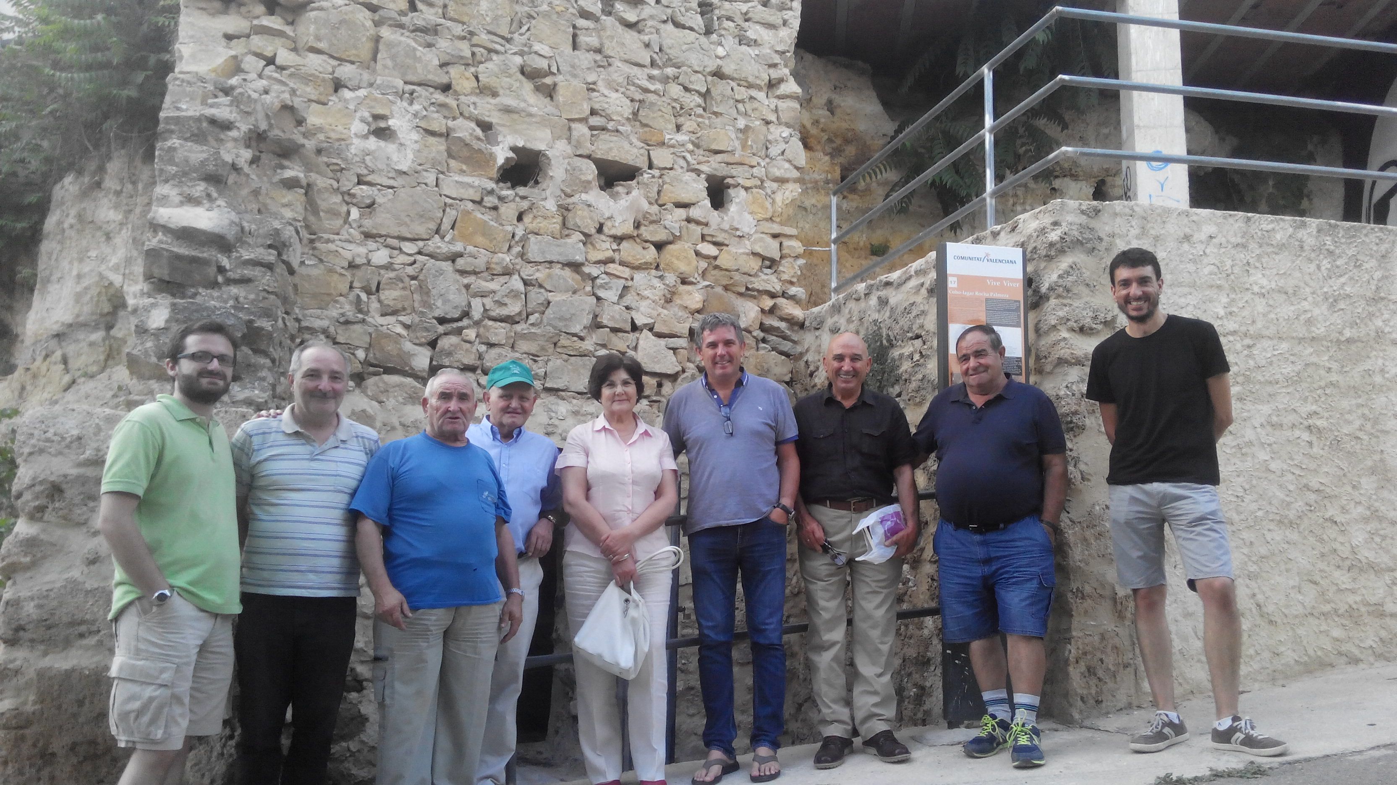
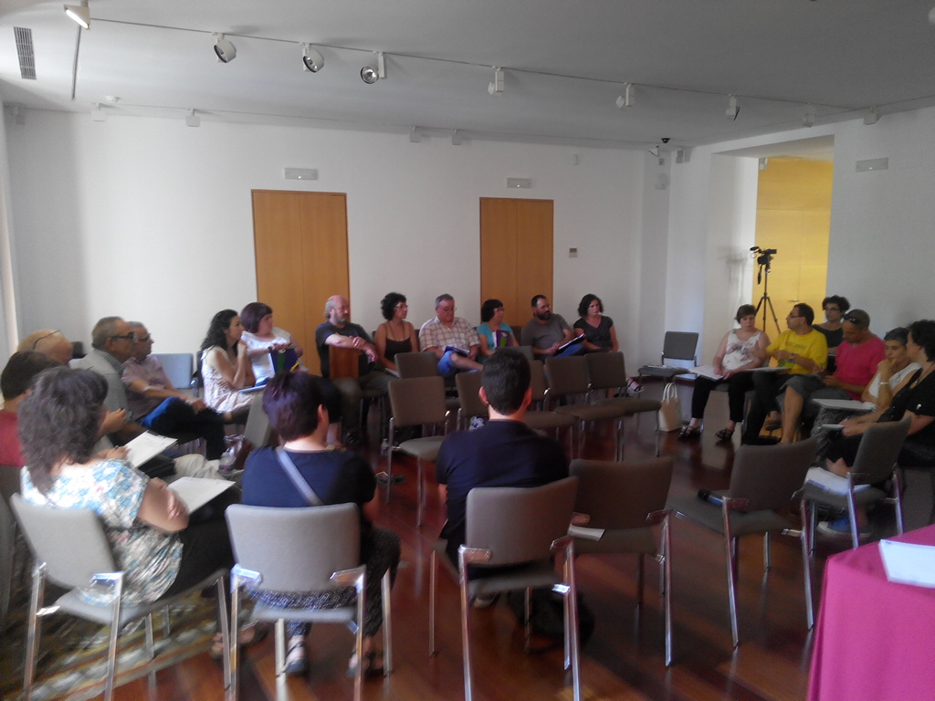
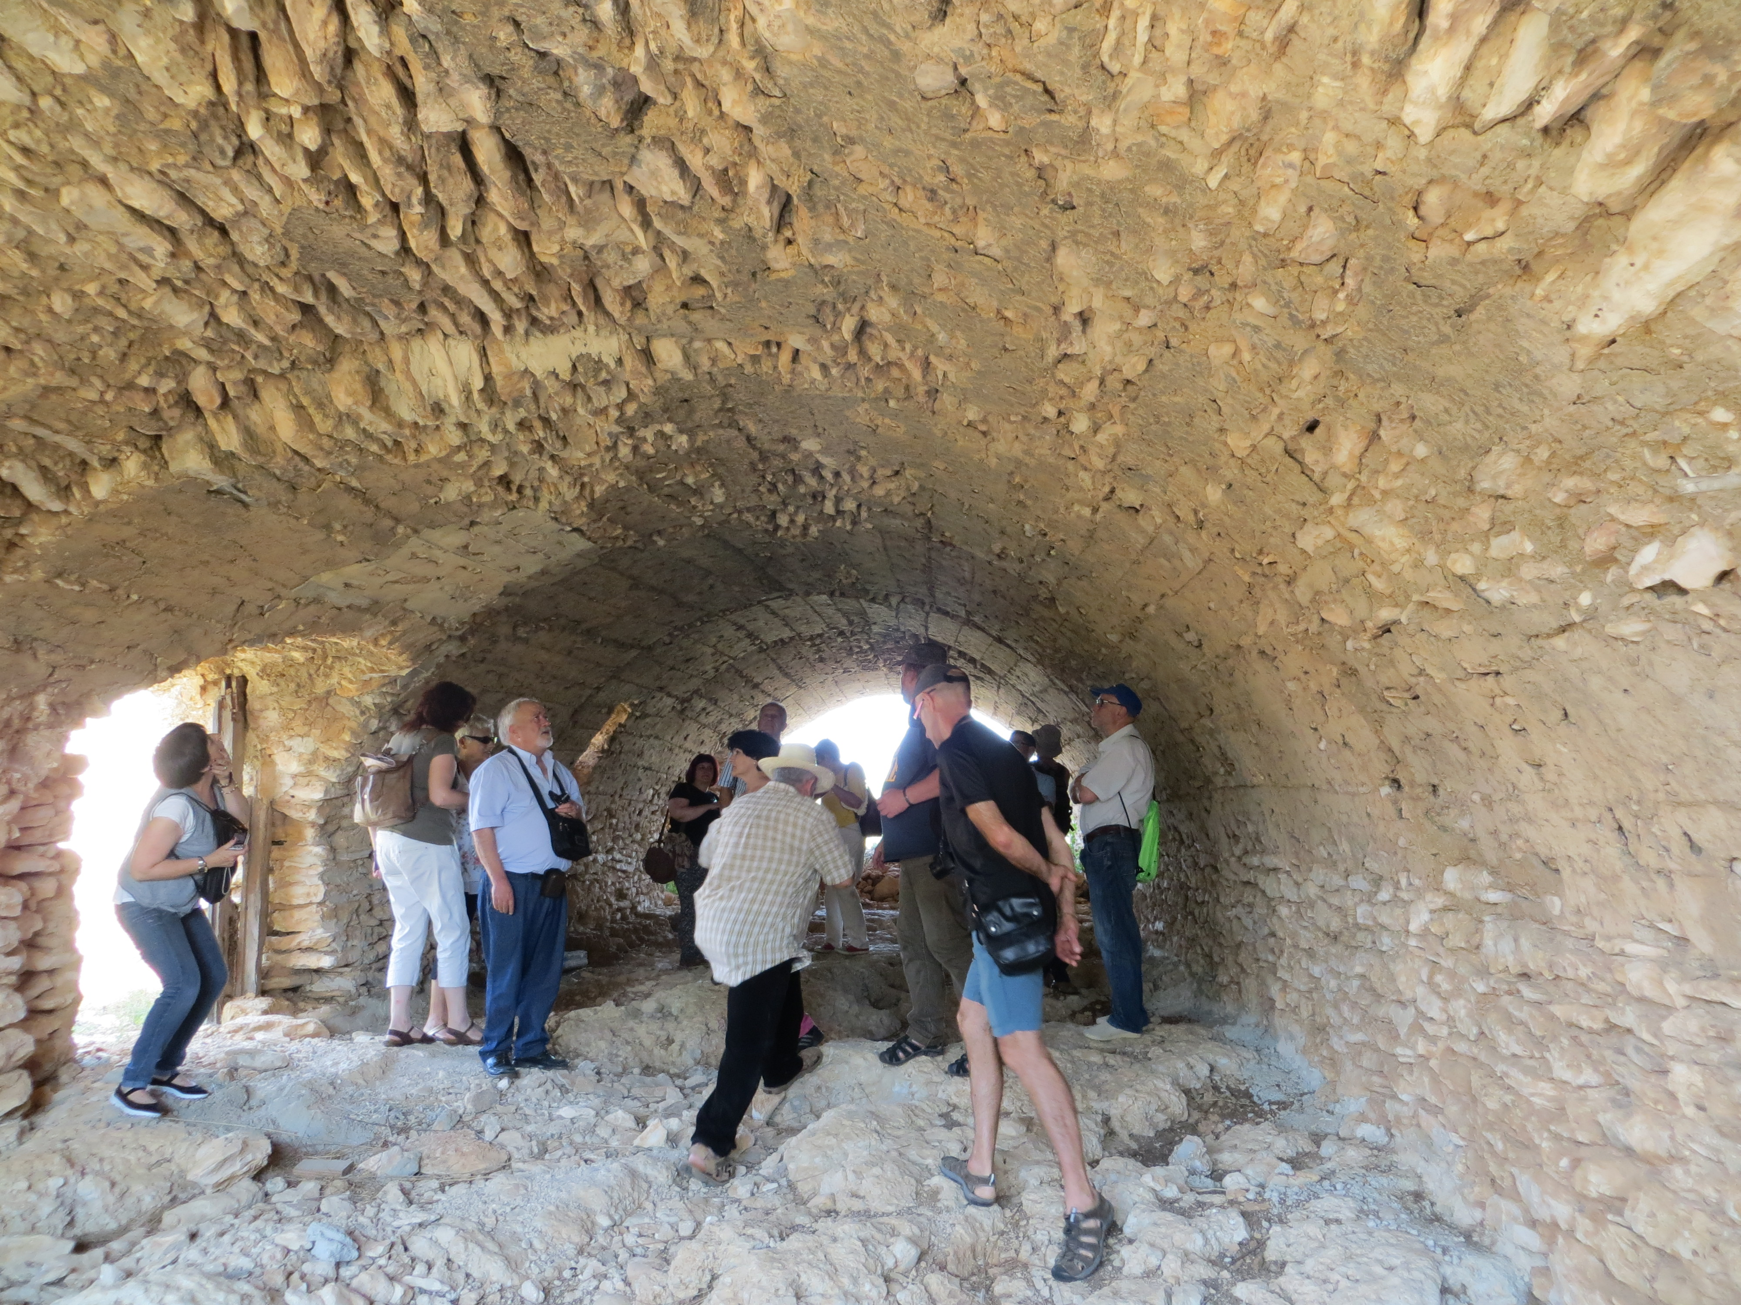
Faro Convention Research Study. Fontecchio, Italy
The three pillars of the Patrimoni project are:
Training (courses and workshops about heritage and needs of the groups)
Continous specialized support (called “Acompañamiento”)
A wide range of network structures that enable training, exchange, debate and planning to be shared among the Patrimoni groups

Slide 5
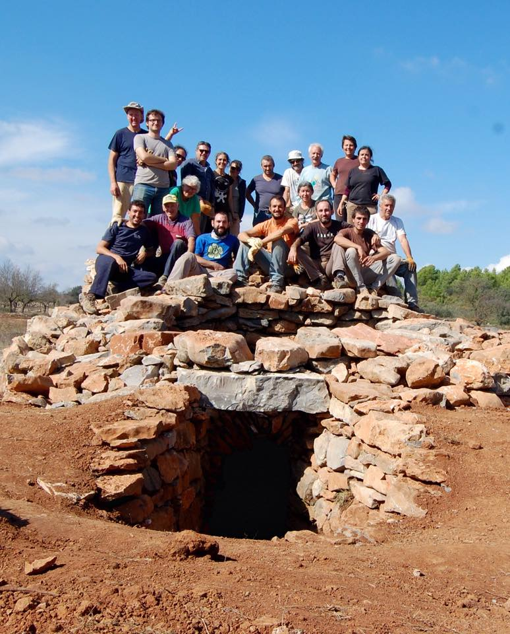
Faro Convention Research Study. Fontecchio, Italy
Main points of the Patrimoni project groups
- THEIR cultural heritage projects
each project (and support) is unique
the voluntary involvement of the local group members
from viewers to participants (from the beginning)
the horizontal and participatory structure (bottom up)
the continuous remodelling and updating of the training and methods
the search to share and export knowlegde

Slide 6
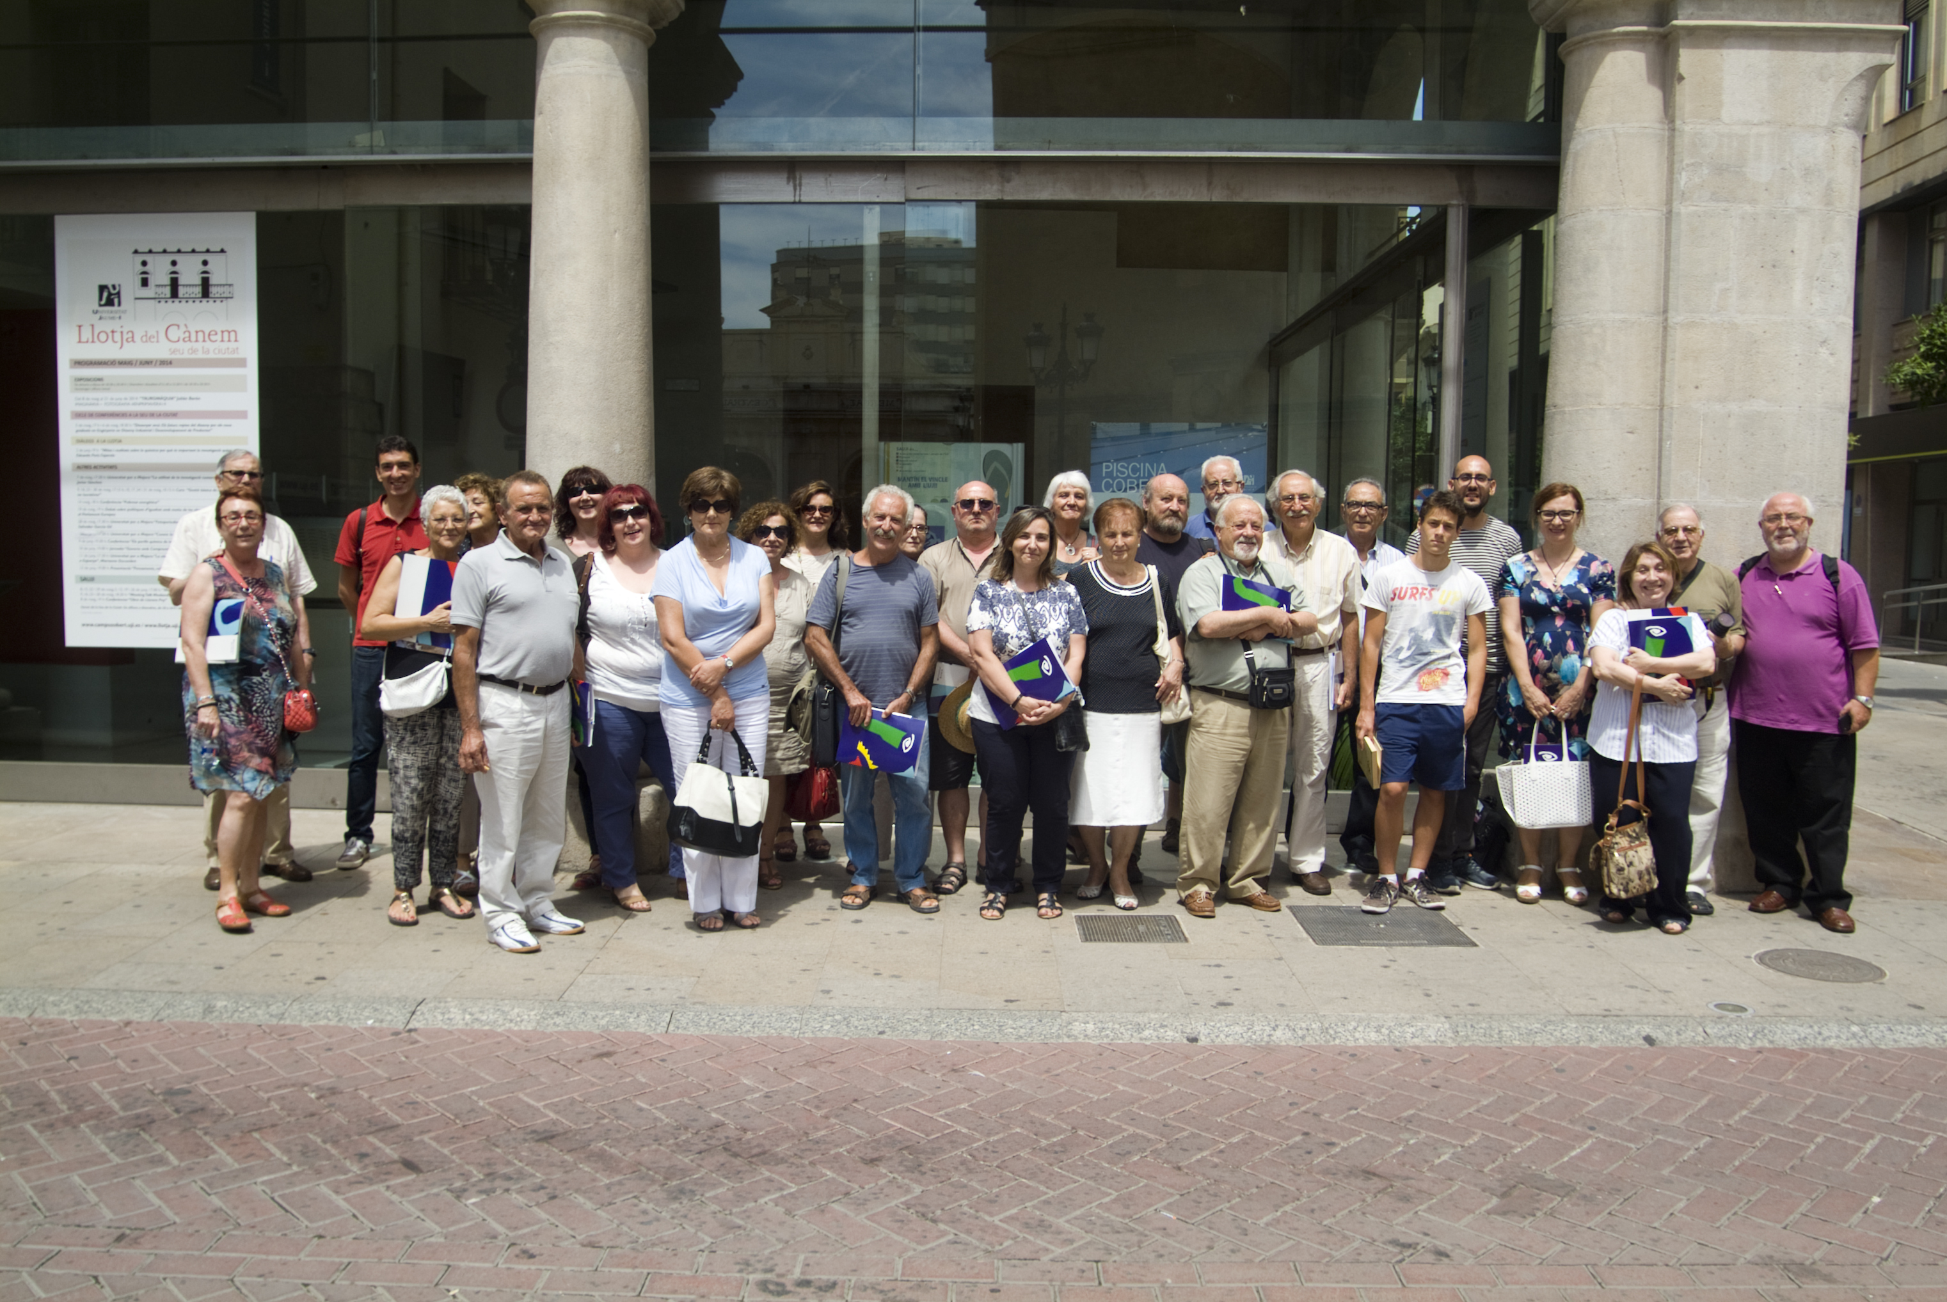
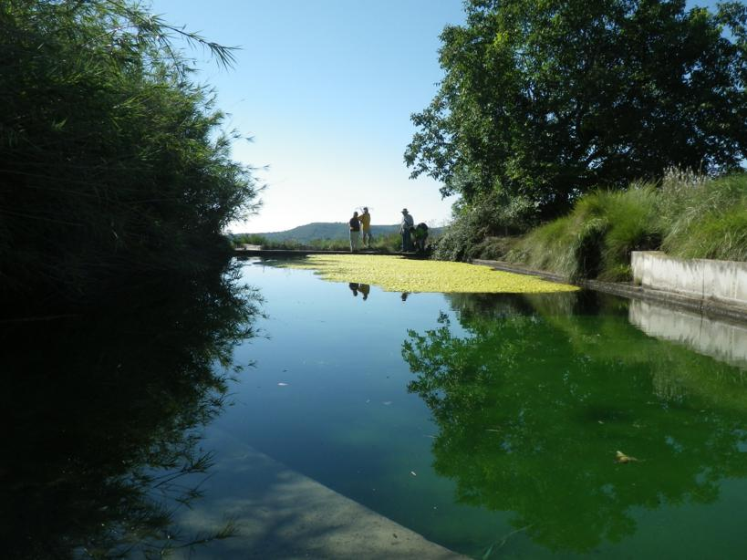
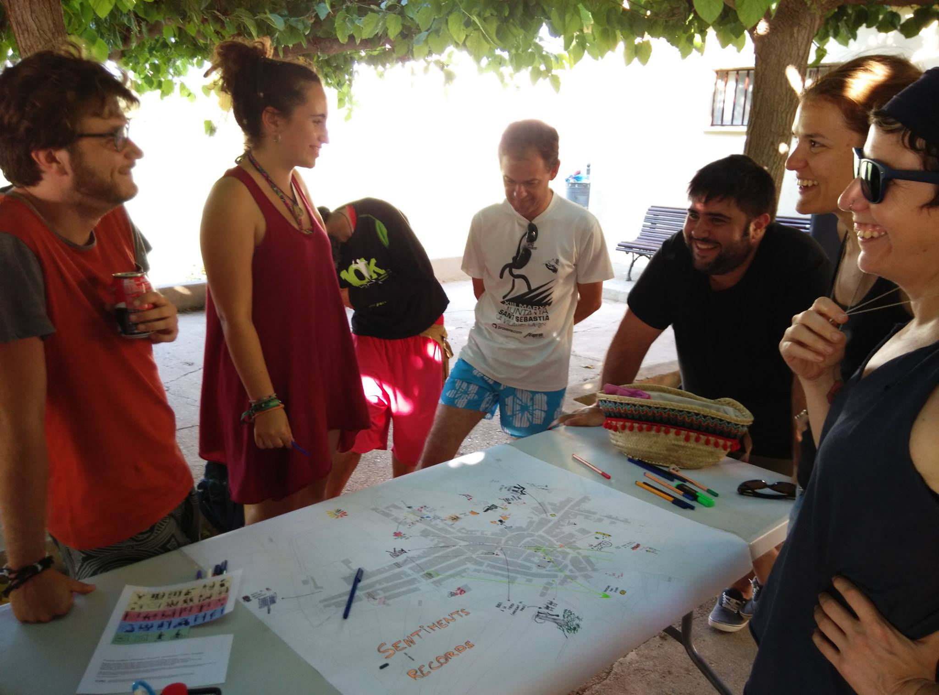
Faro Convention Research Study. Fontecchio, Italy
Patrimoni as a network of heritage communities
Patrimoni is structured around a network of local groups with real projects that have emerged in recent years in the territory.
These groups are developing local projects about their cultural heritage, but also, within the framework of the project, they are interacting with each other in search of common ground for reflection, analysis and permanent dialogue.
Some examples of heritage communities...

Slide 7
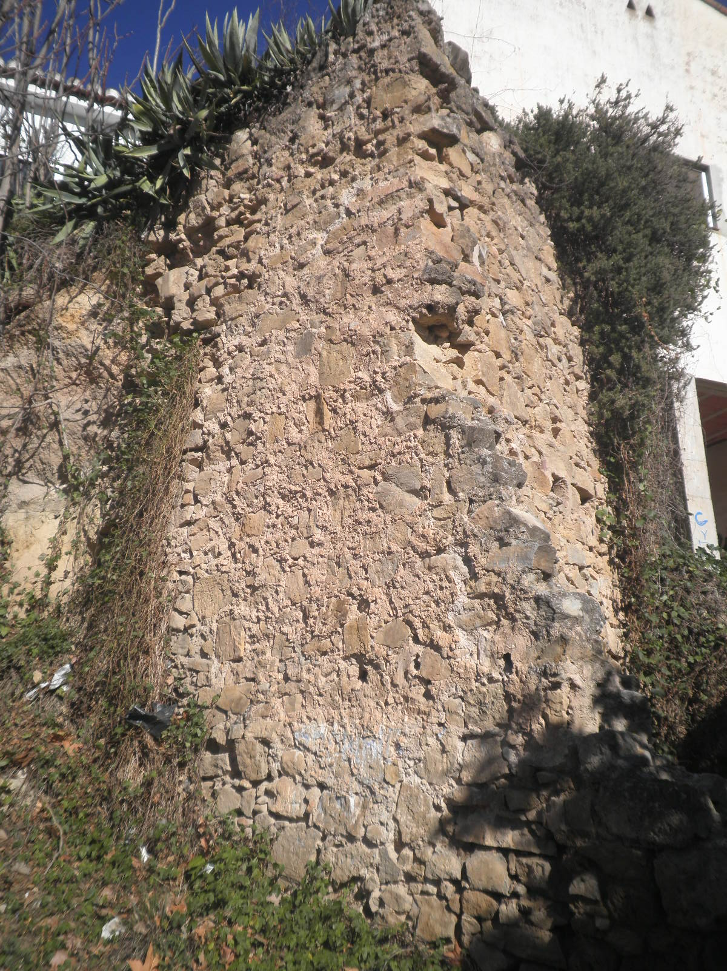
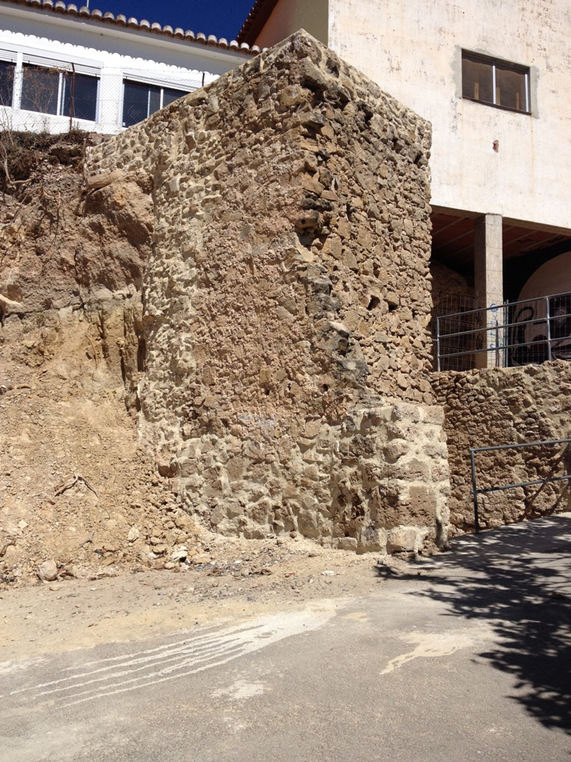
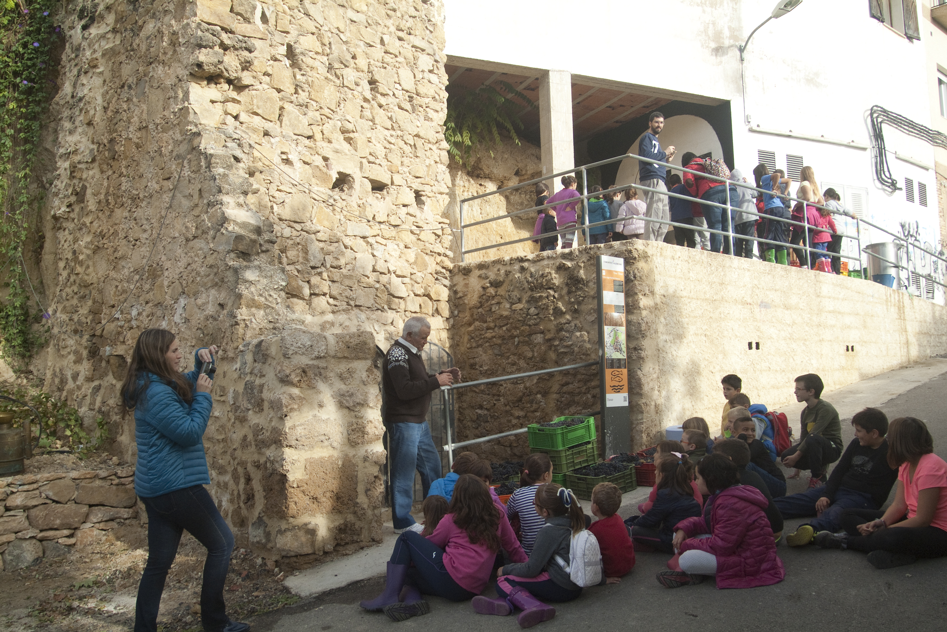
Faro Convention Research Study. Fontecchio, Italy
The local group of Viver: The importance of Heritage Education
In 2013, a group of neighbours in Viver (population 1.536) contacted the Patrimoni project of the Jaume I University to begin a project that would raise the profile of the town’s viticulture heritage.
In two years, the local group of Viver studied and inventoried wine heritage and made some routes and activities to share their value to the village’s residents.

Slide 8
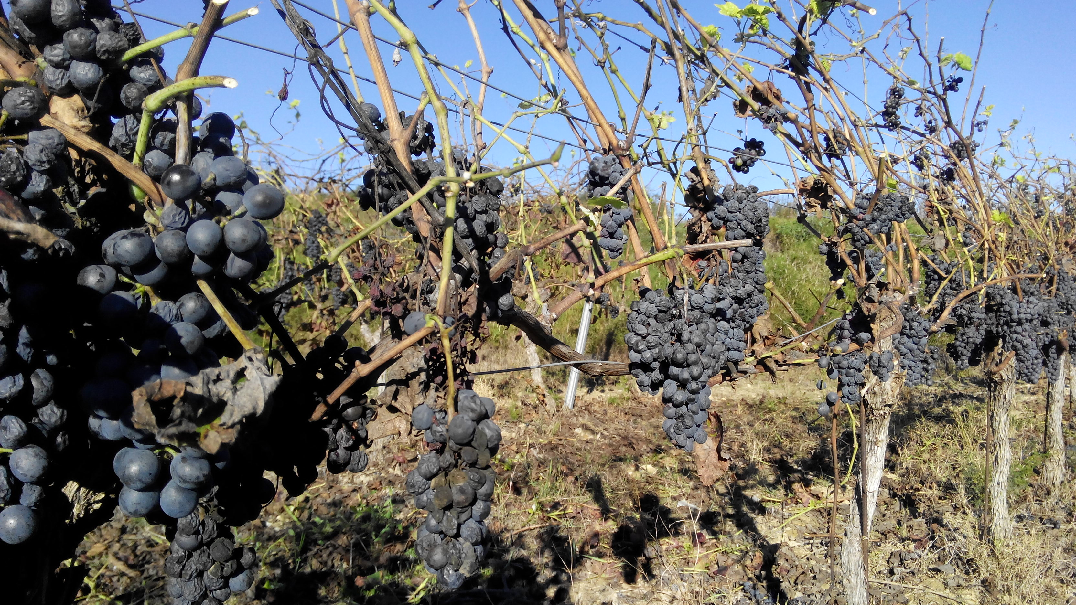
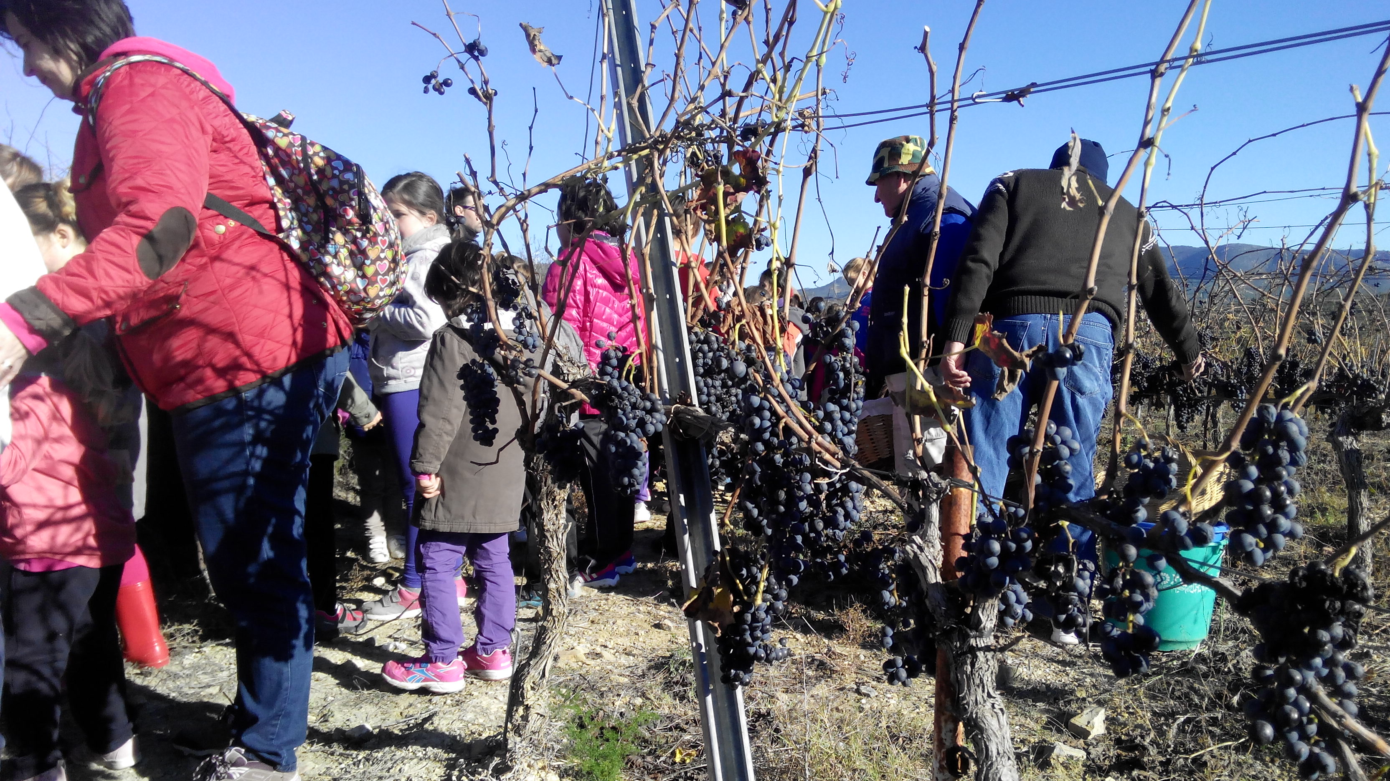
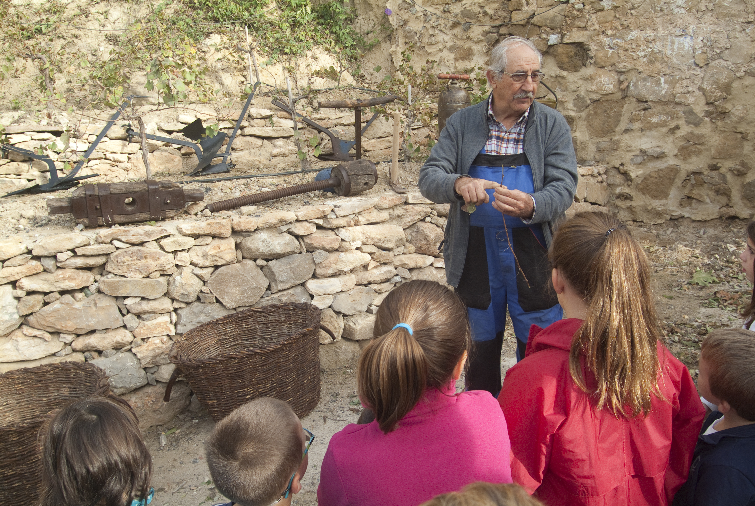
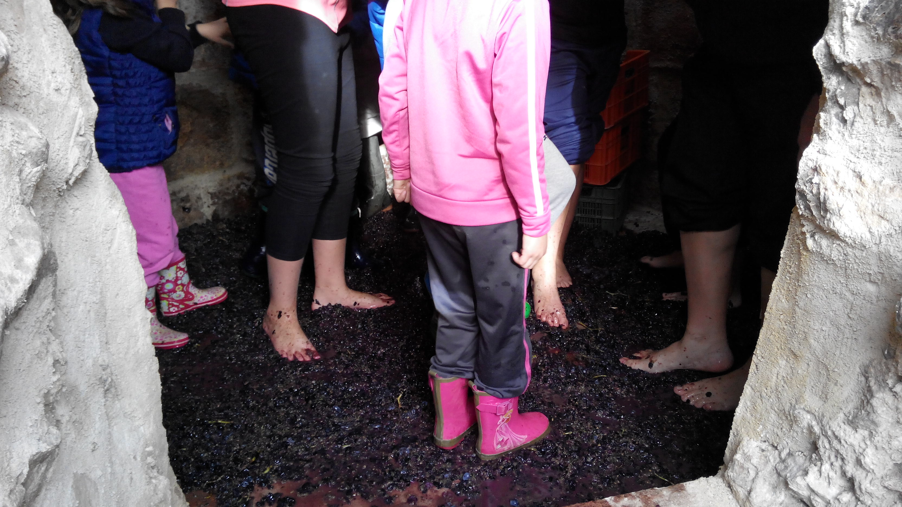
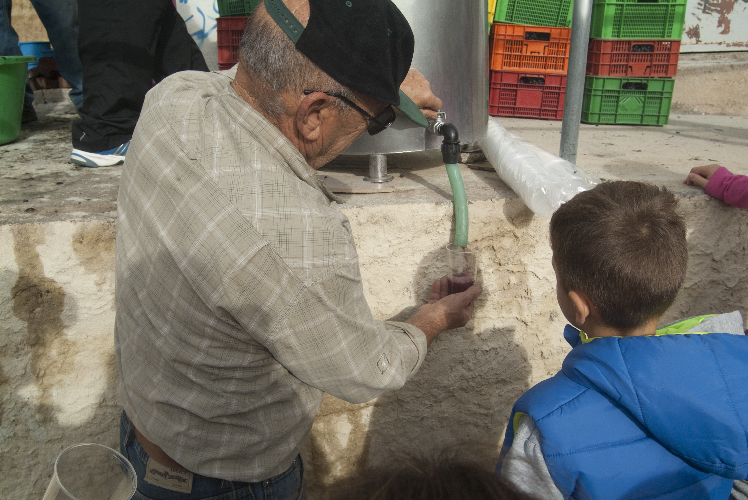
Faro Convention Research Study. Fontecchio, Italy
The local group of Viver: The Wine Festival
In 2015, the local group met with staff at the primary school with a proposal to organise an educational activity around this local heritage.

Slide 9
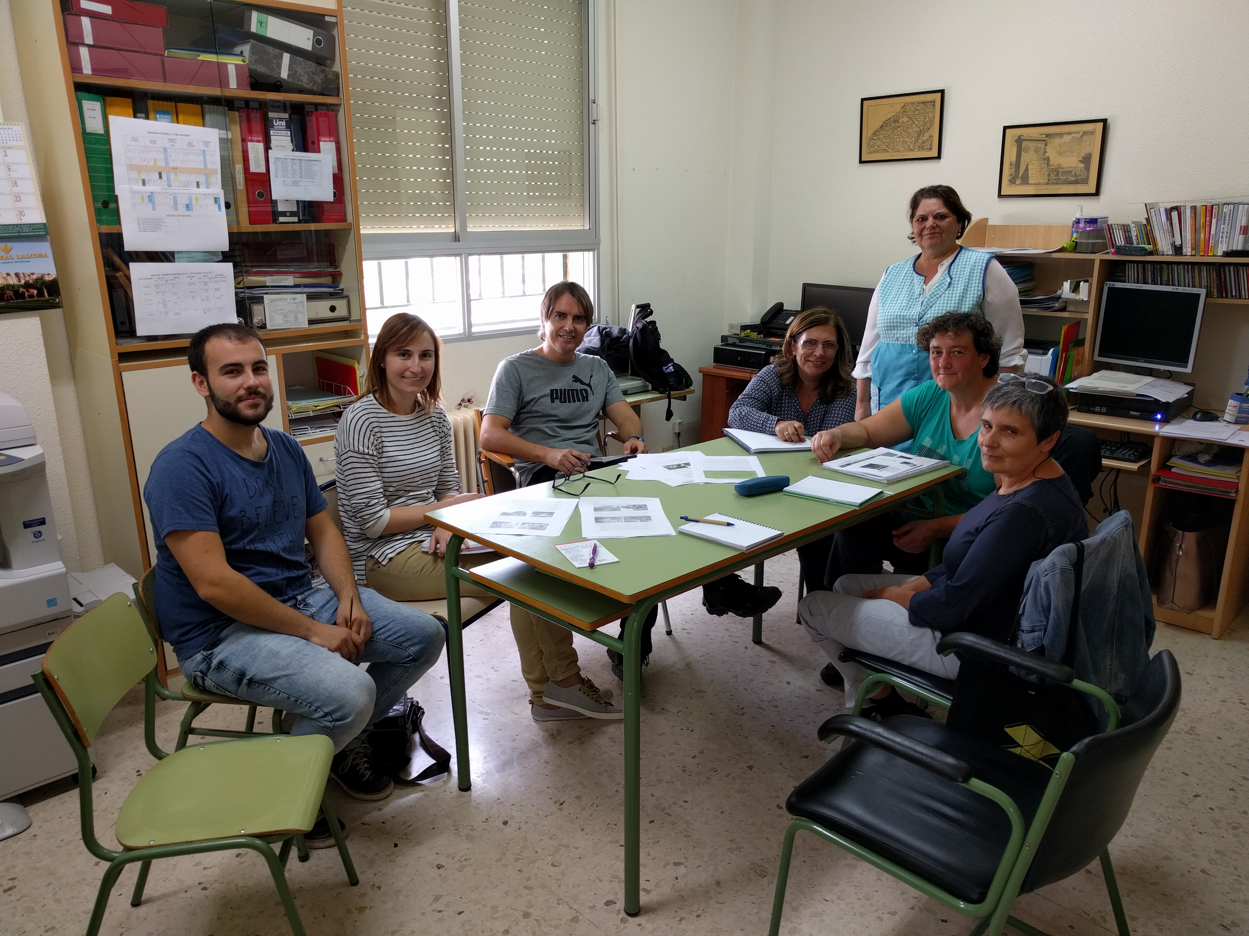
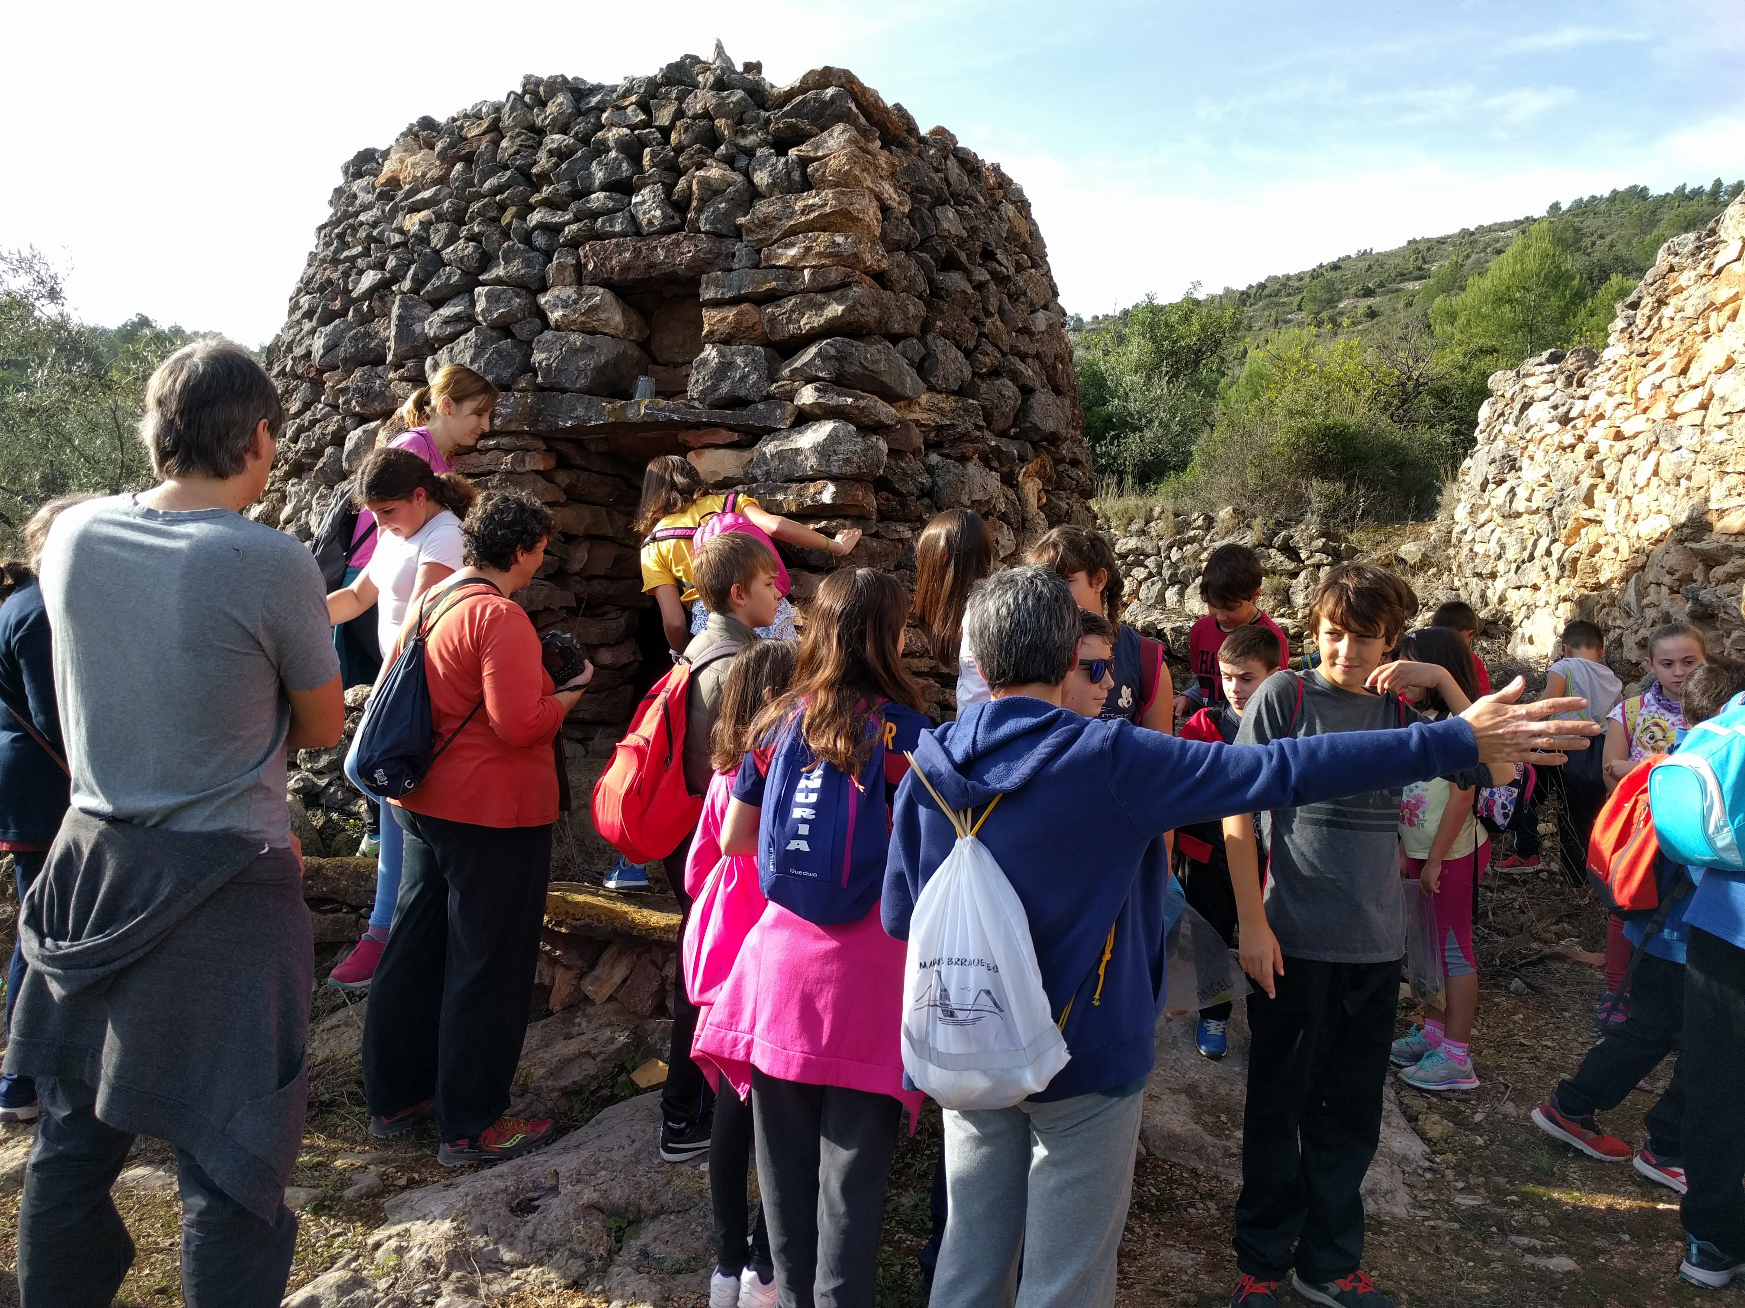
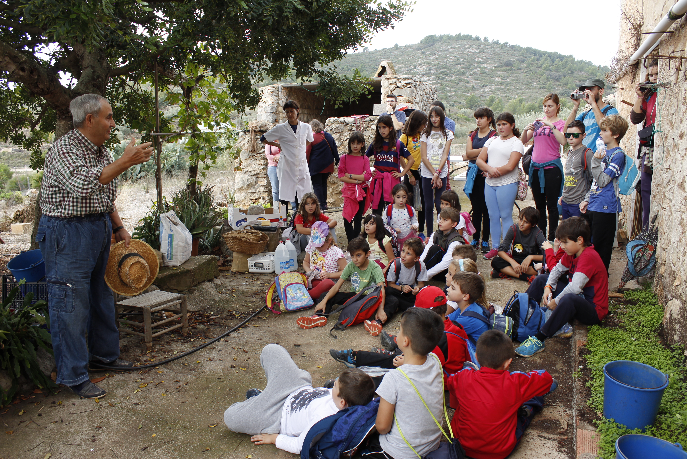
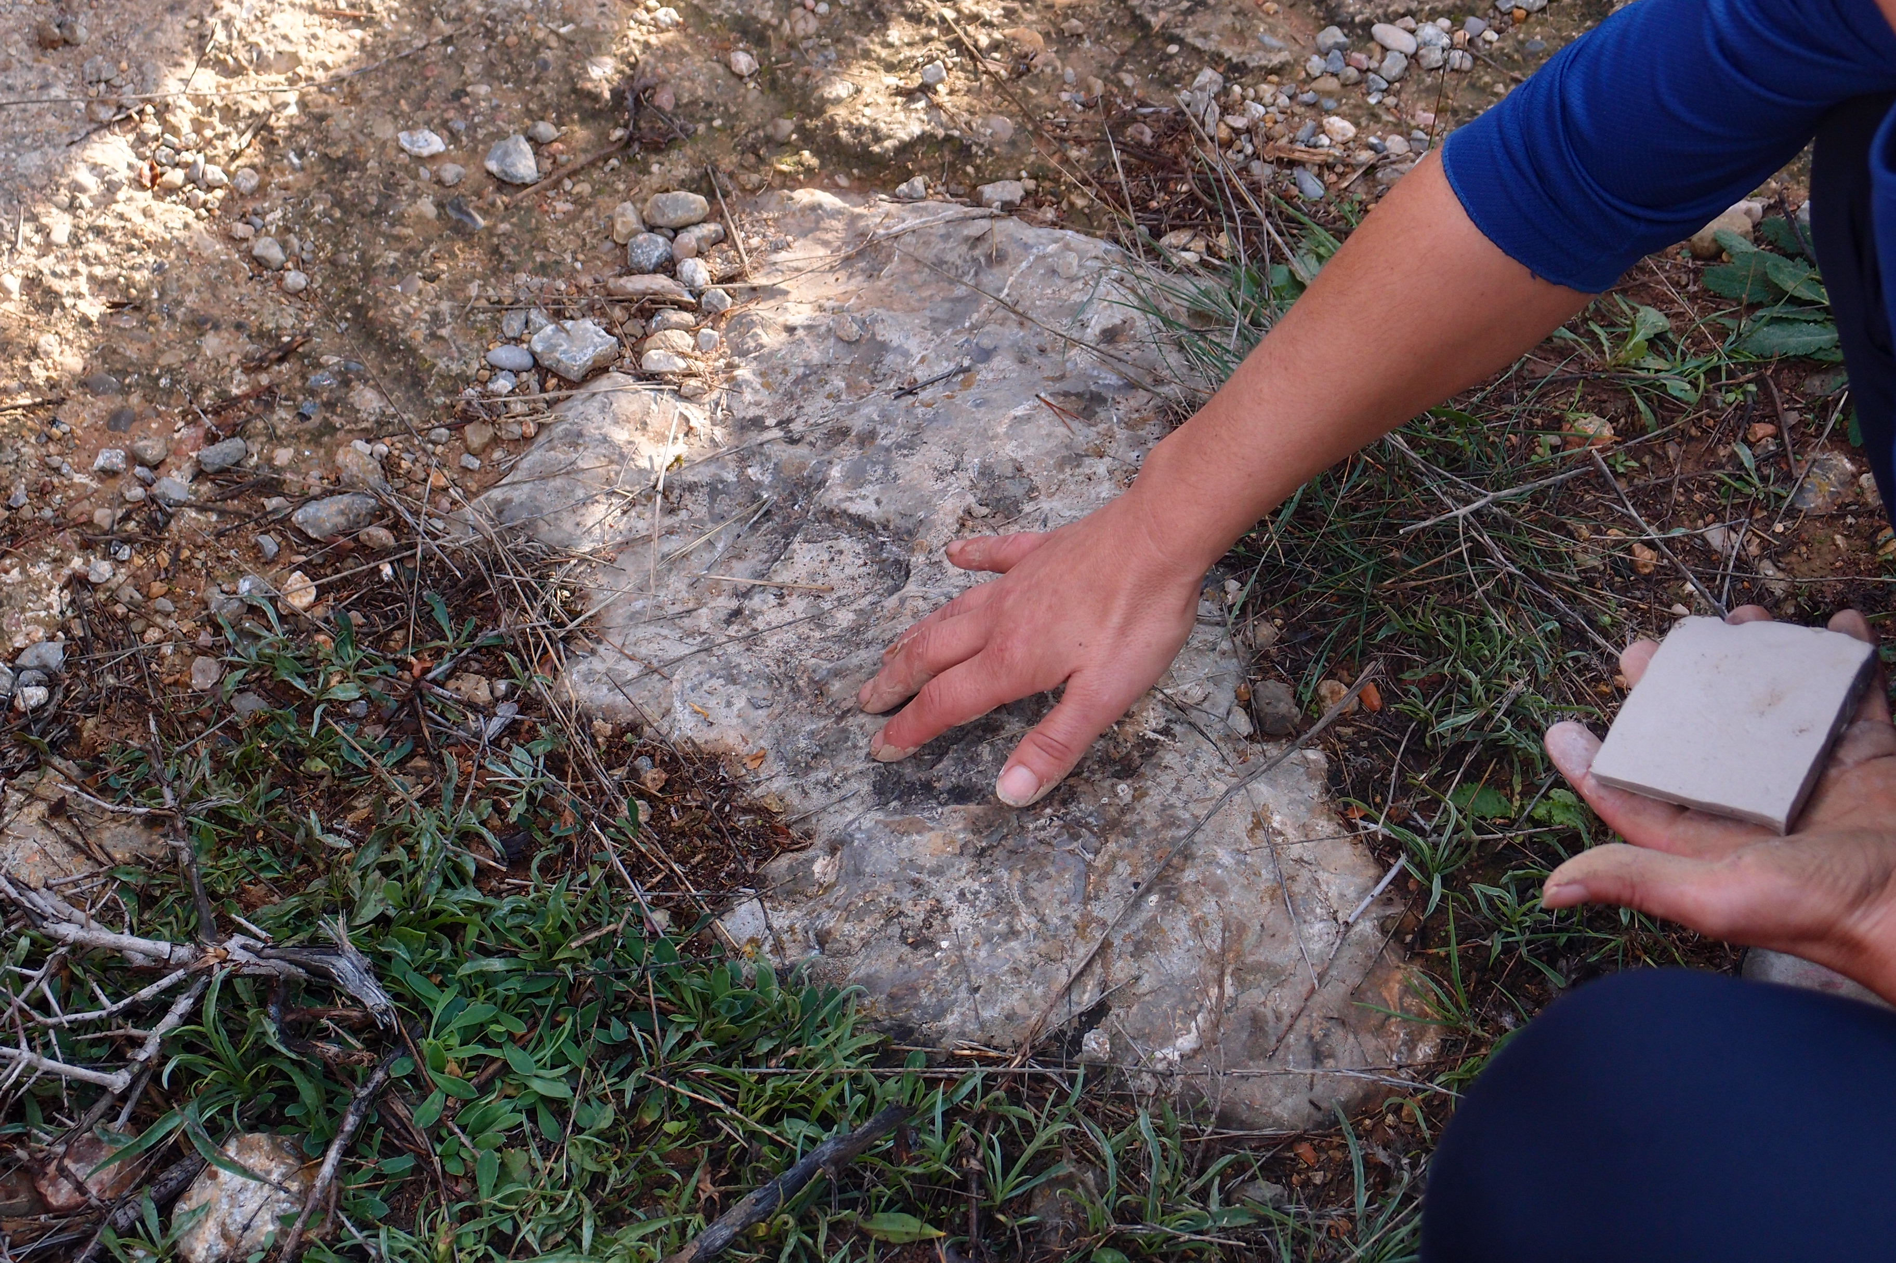
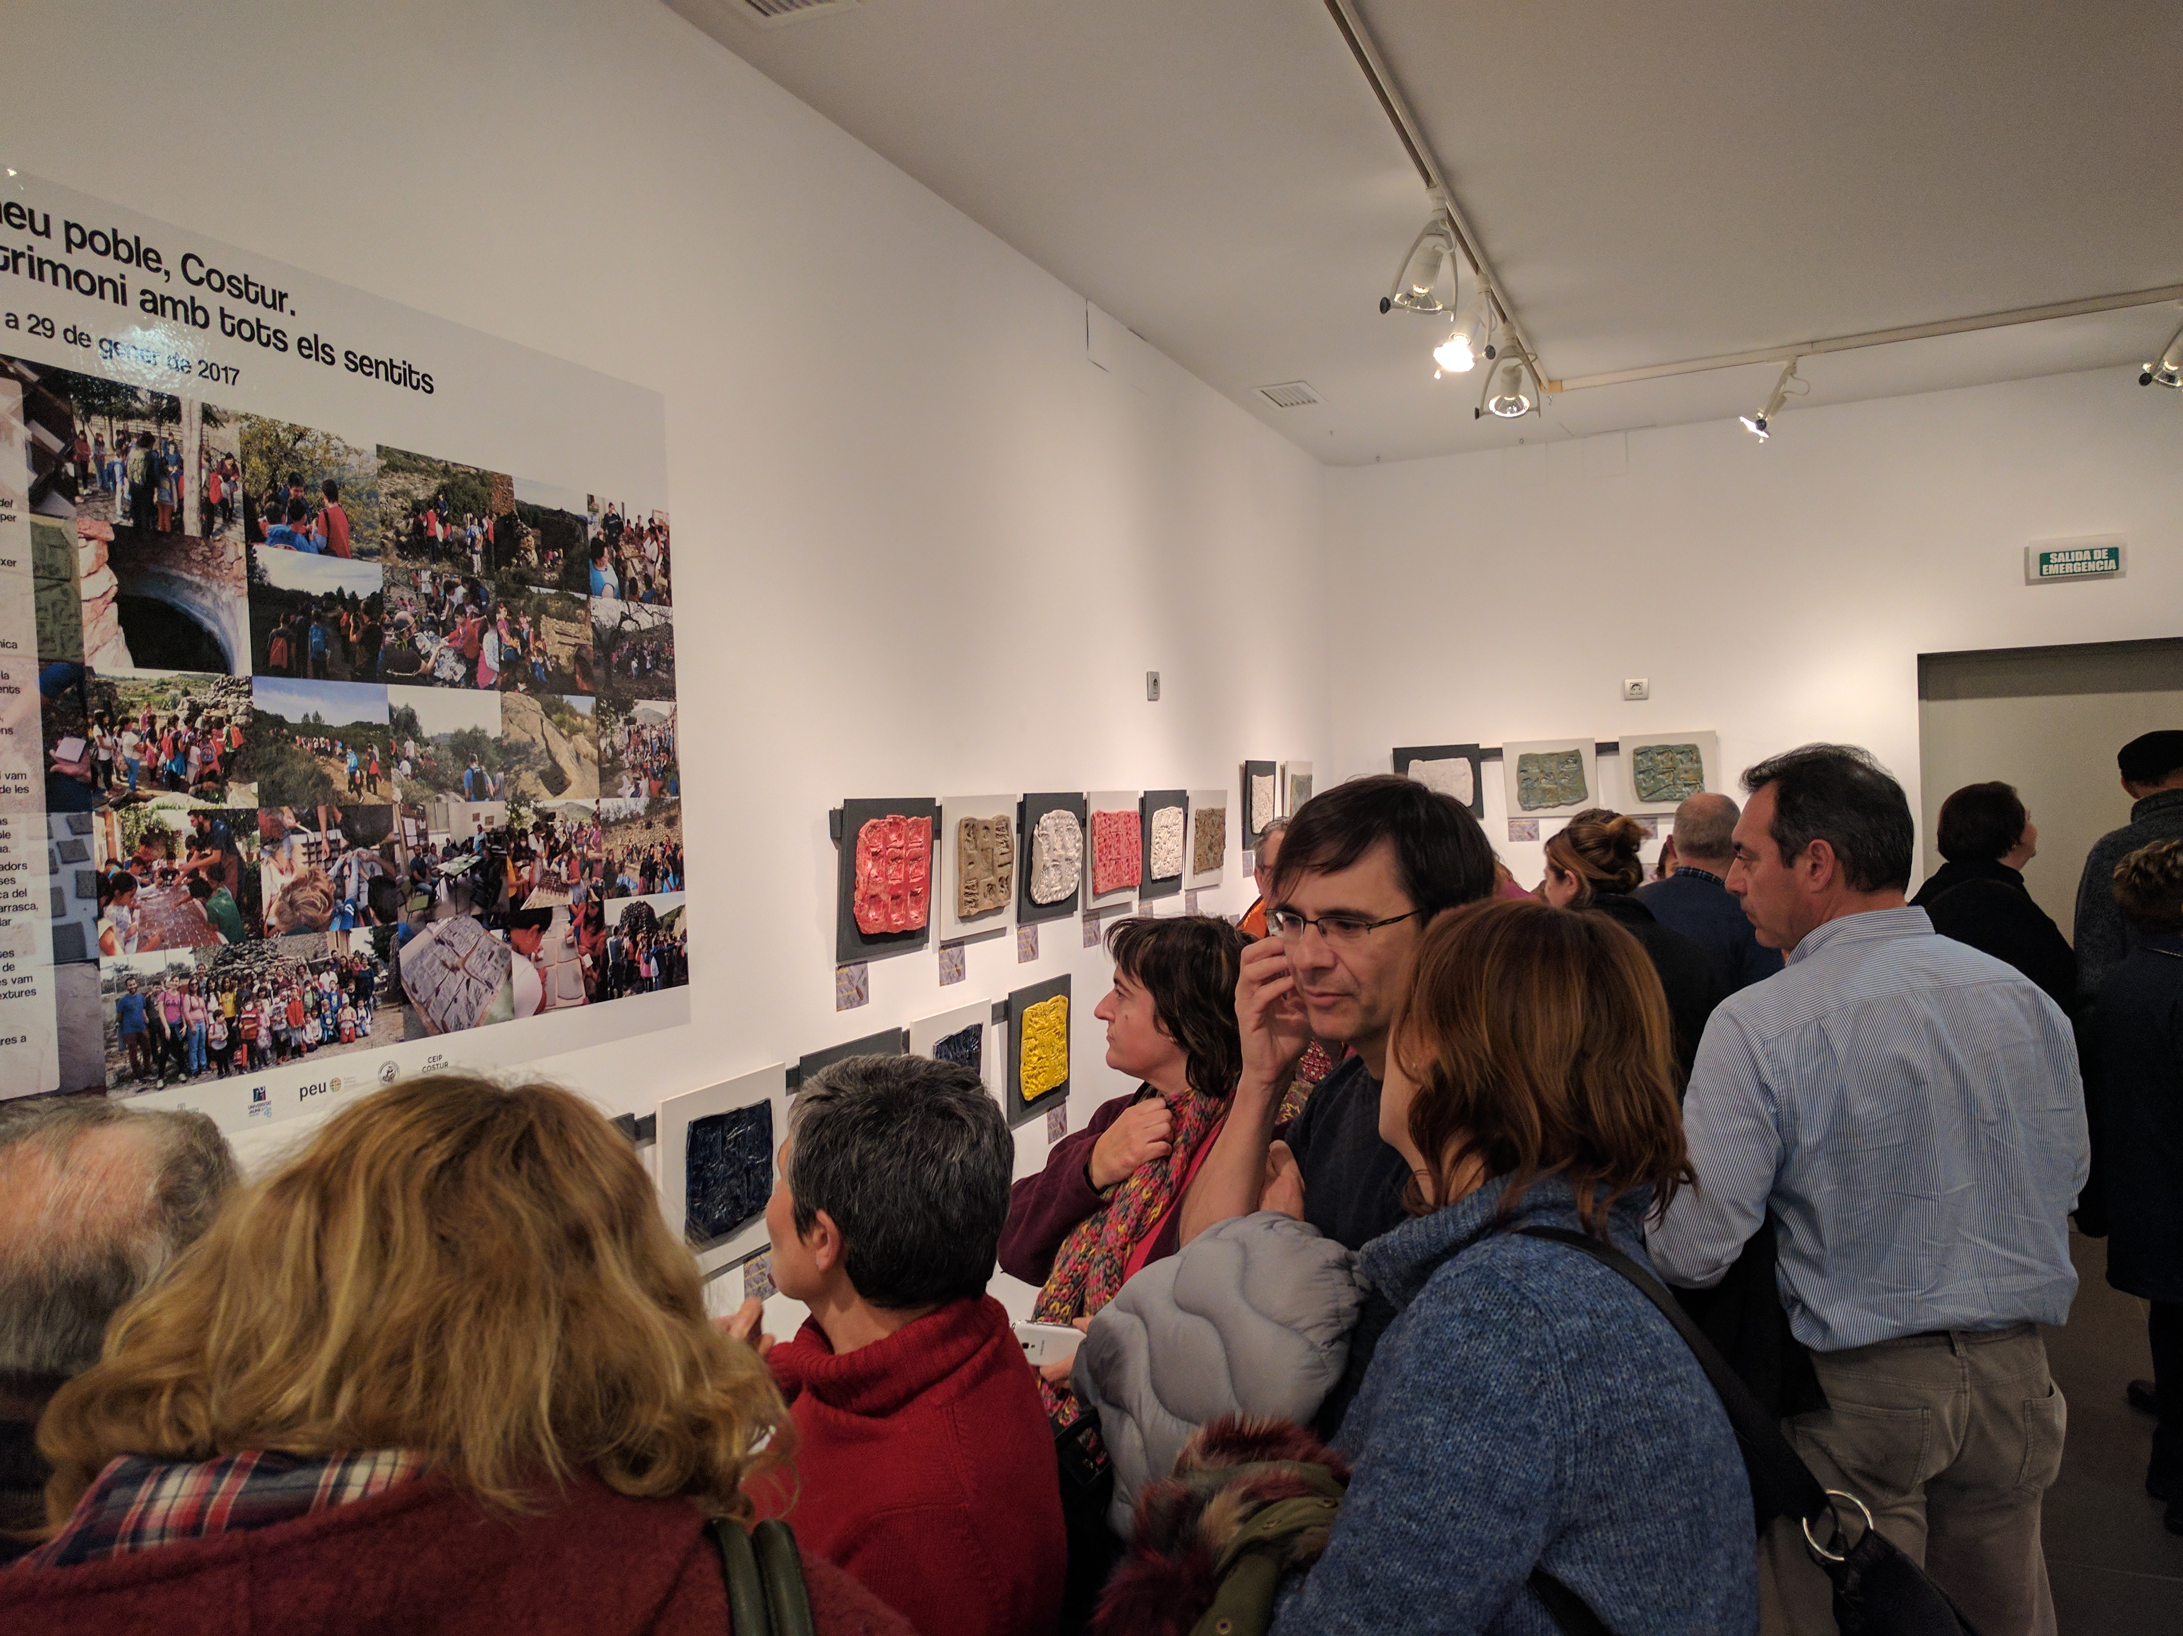
Faro Convention Research Study. Fontecchio, Italy
The local group of Costur: The importance of Heritage Education
In 2016, La Fontanella Cultural Association of Costur (population 543) organised an educational heritage activity, “Texturas de mi pueblo” (Textures of my village), with the local school and the collaboration of the Ceramics Museum in L’Alcora.

Slide 10
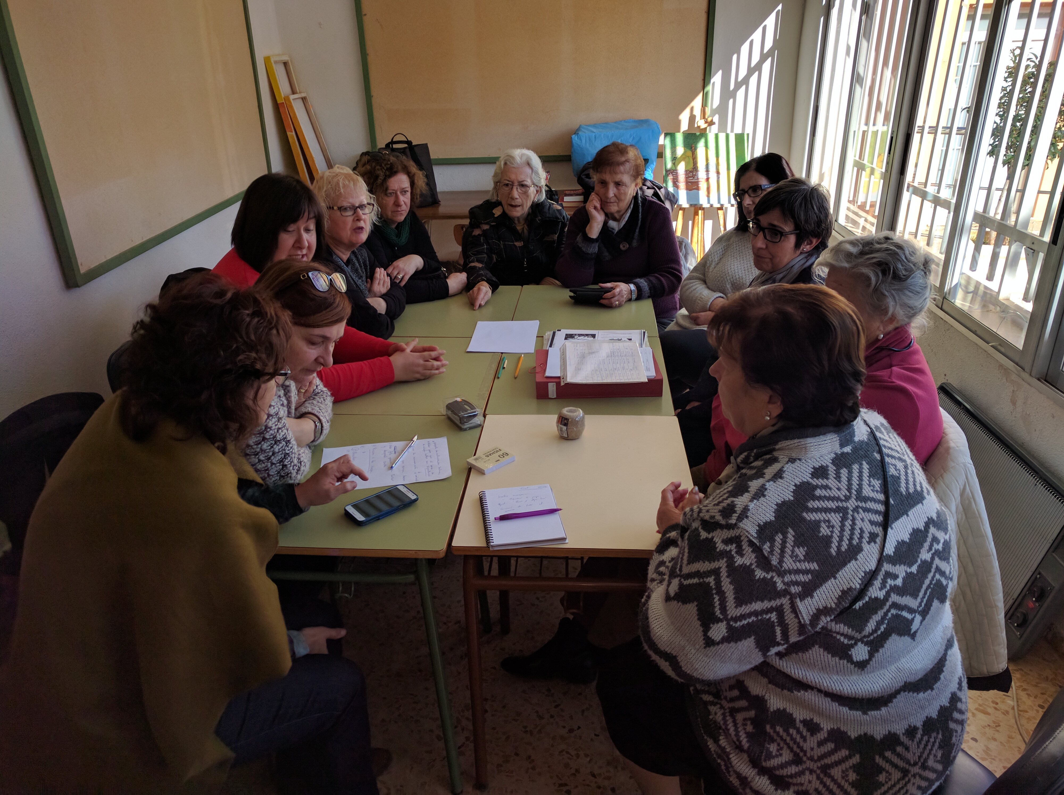
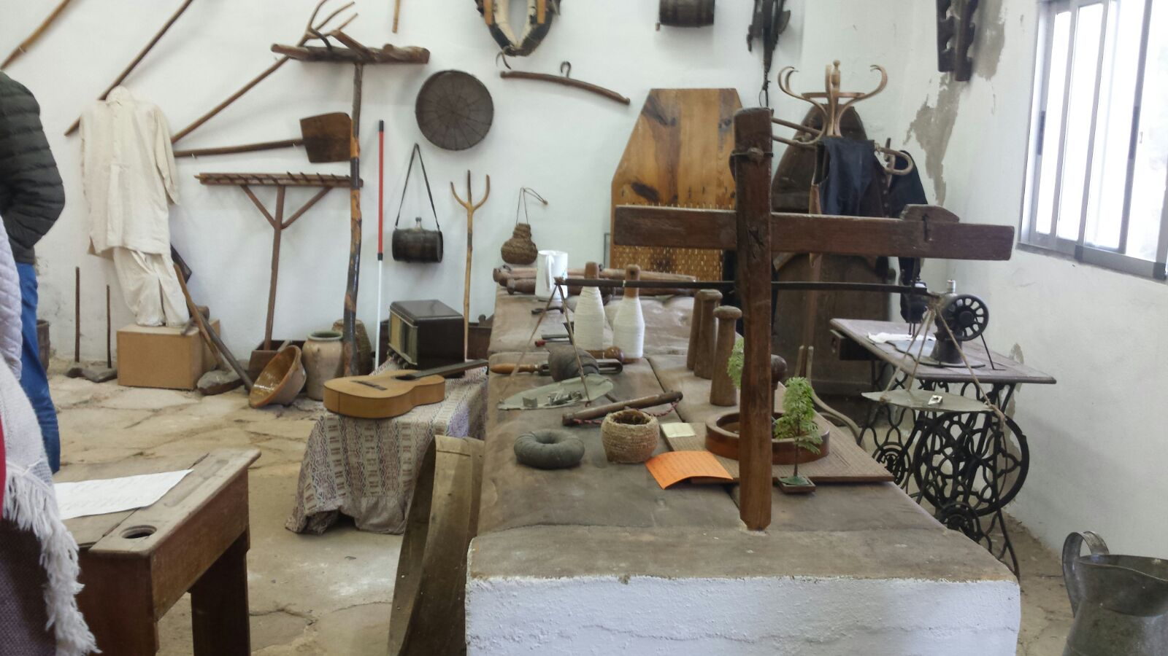
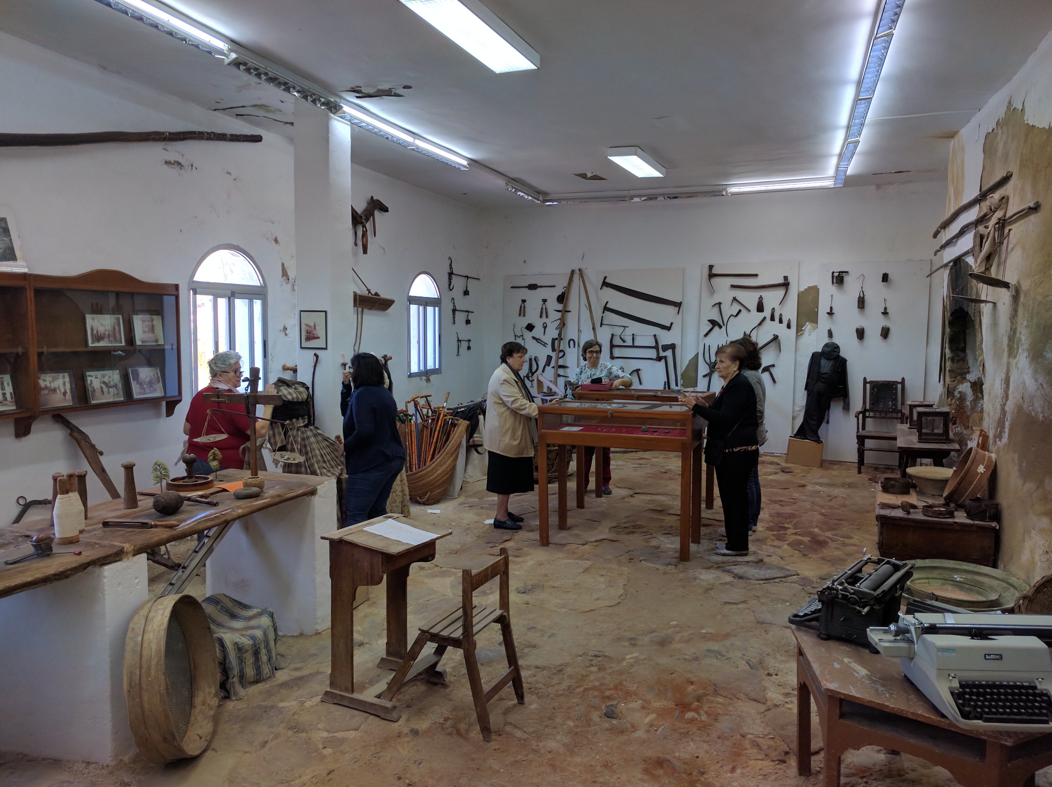
Faro Convention Research Study. Fontecchio, Italy
The Museum of Cirat : The importance of an ongoing process
In 2016, Las Salinas Cultural Association of Cirat (population 220), began work on a plan to promote the village’s ethnography museum.
The first action was to organise a cultural heritage workshop during which participants could consider the museum and make suggestions for its improvement.

Slide 11
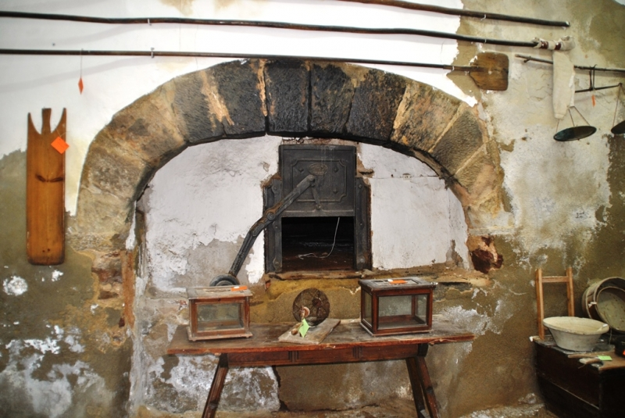
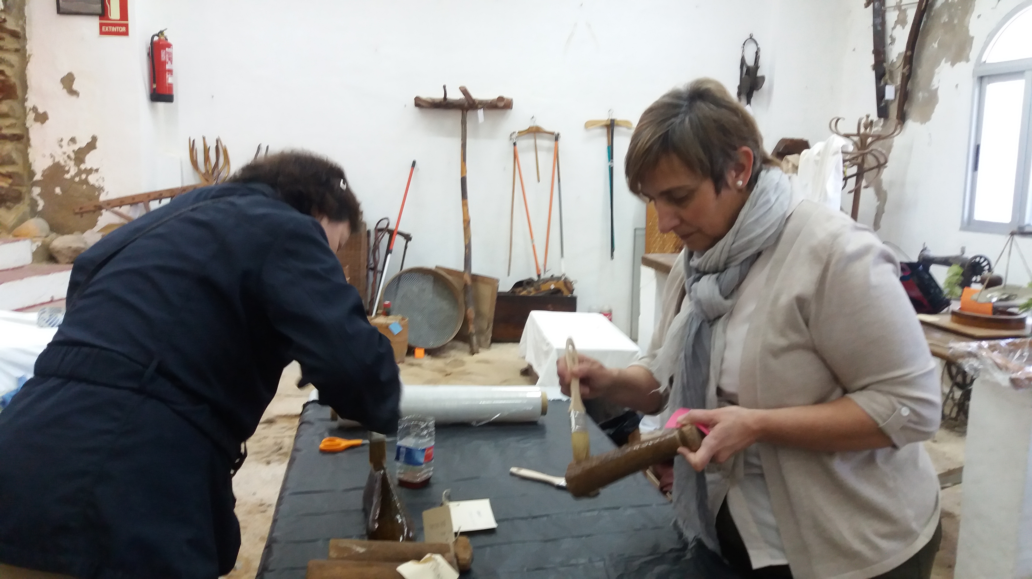
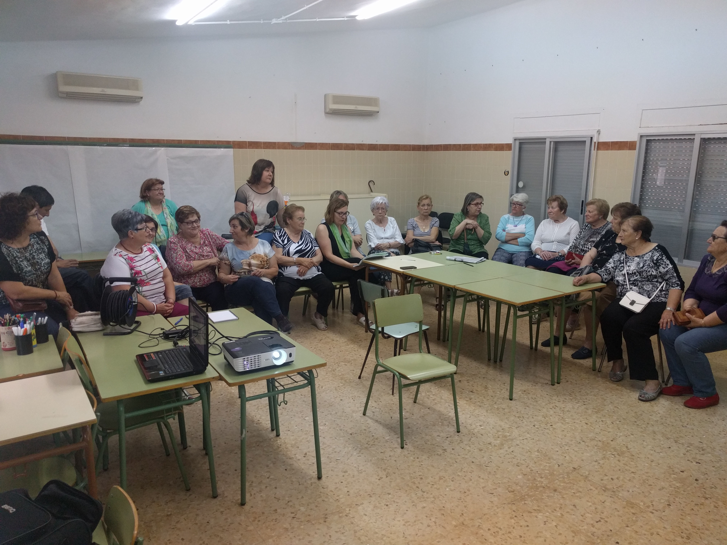
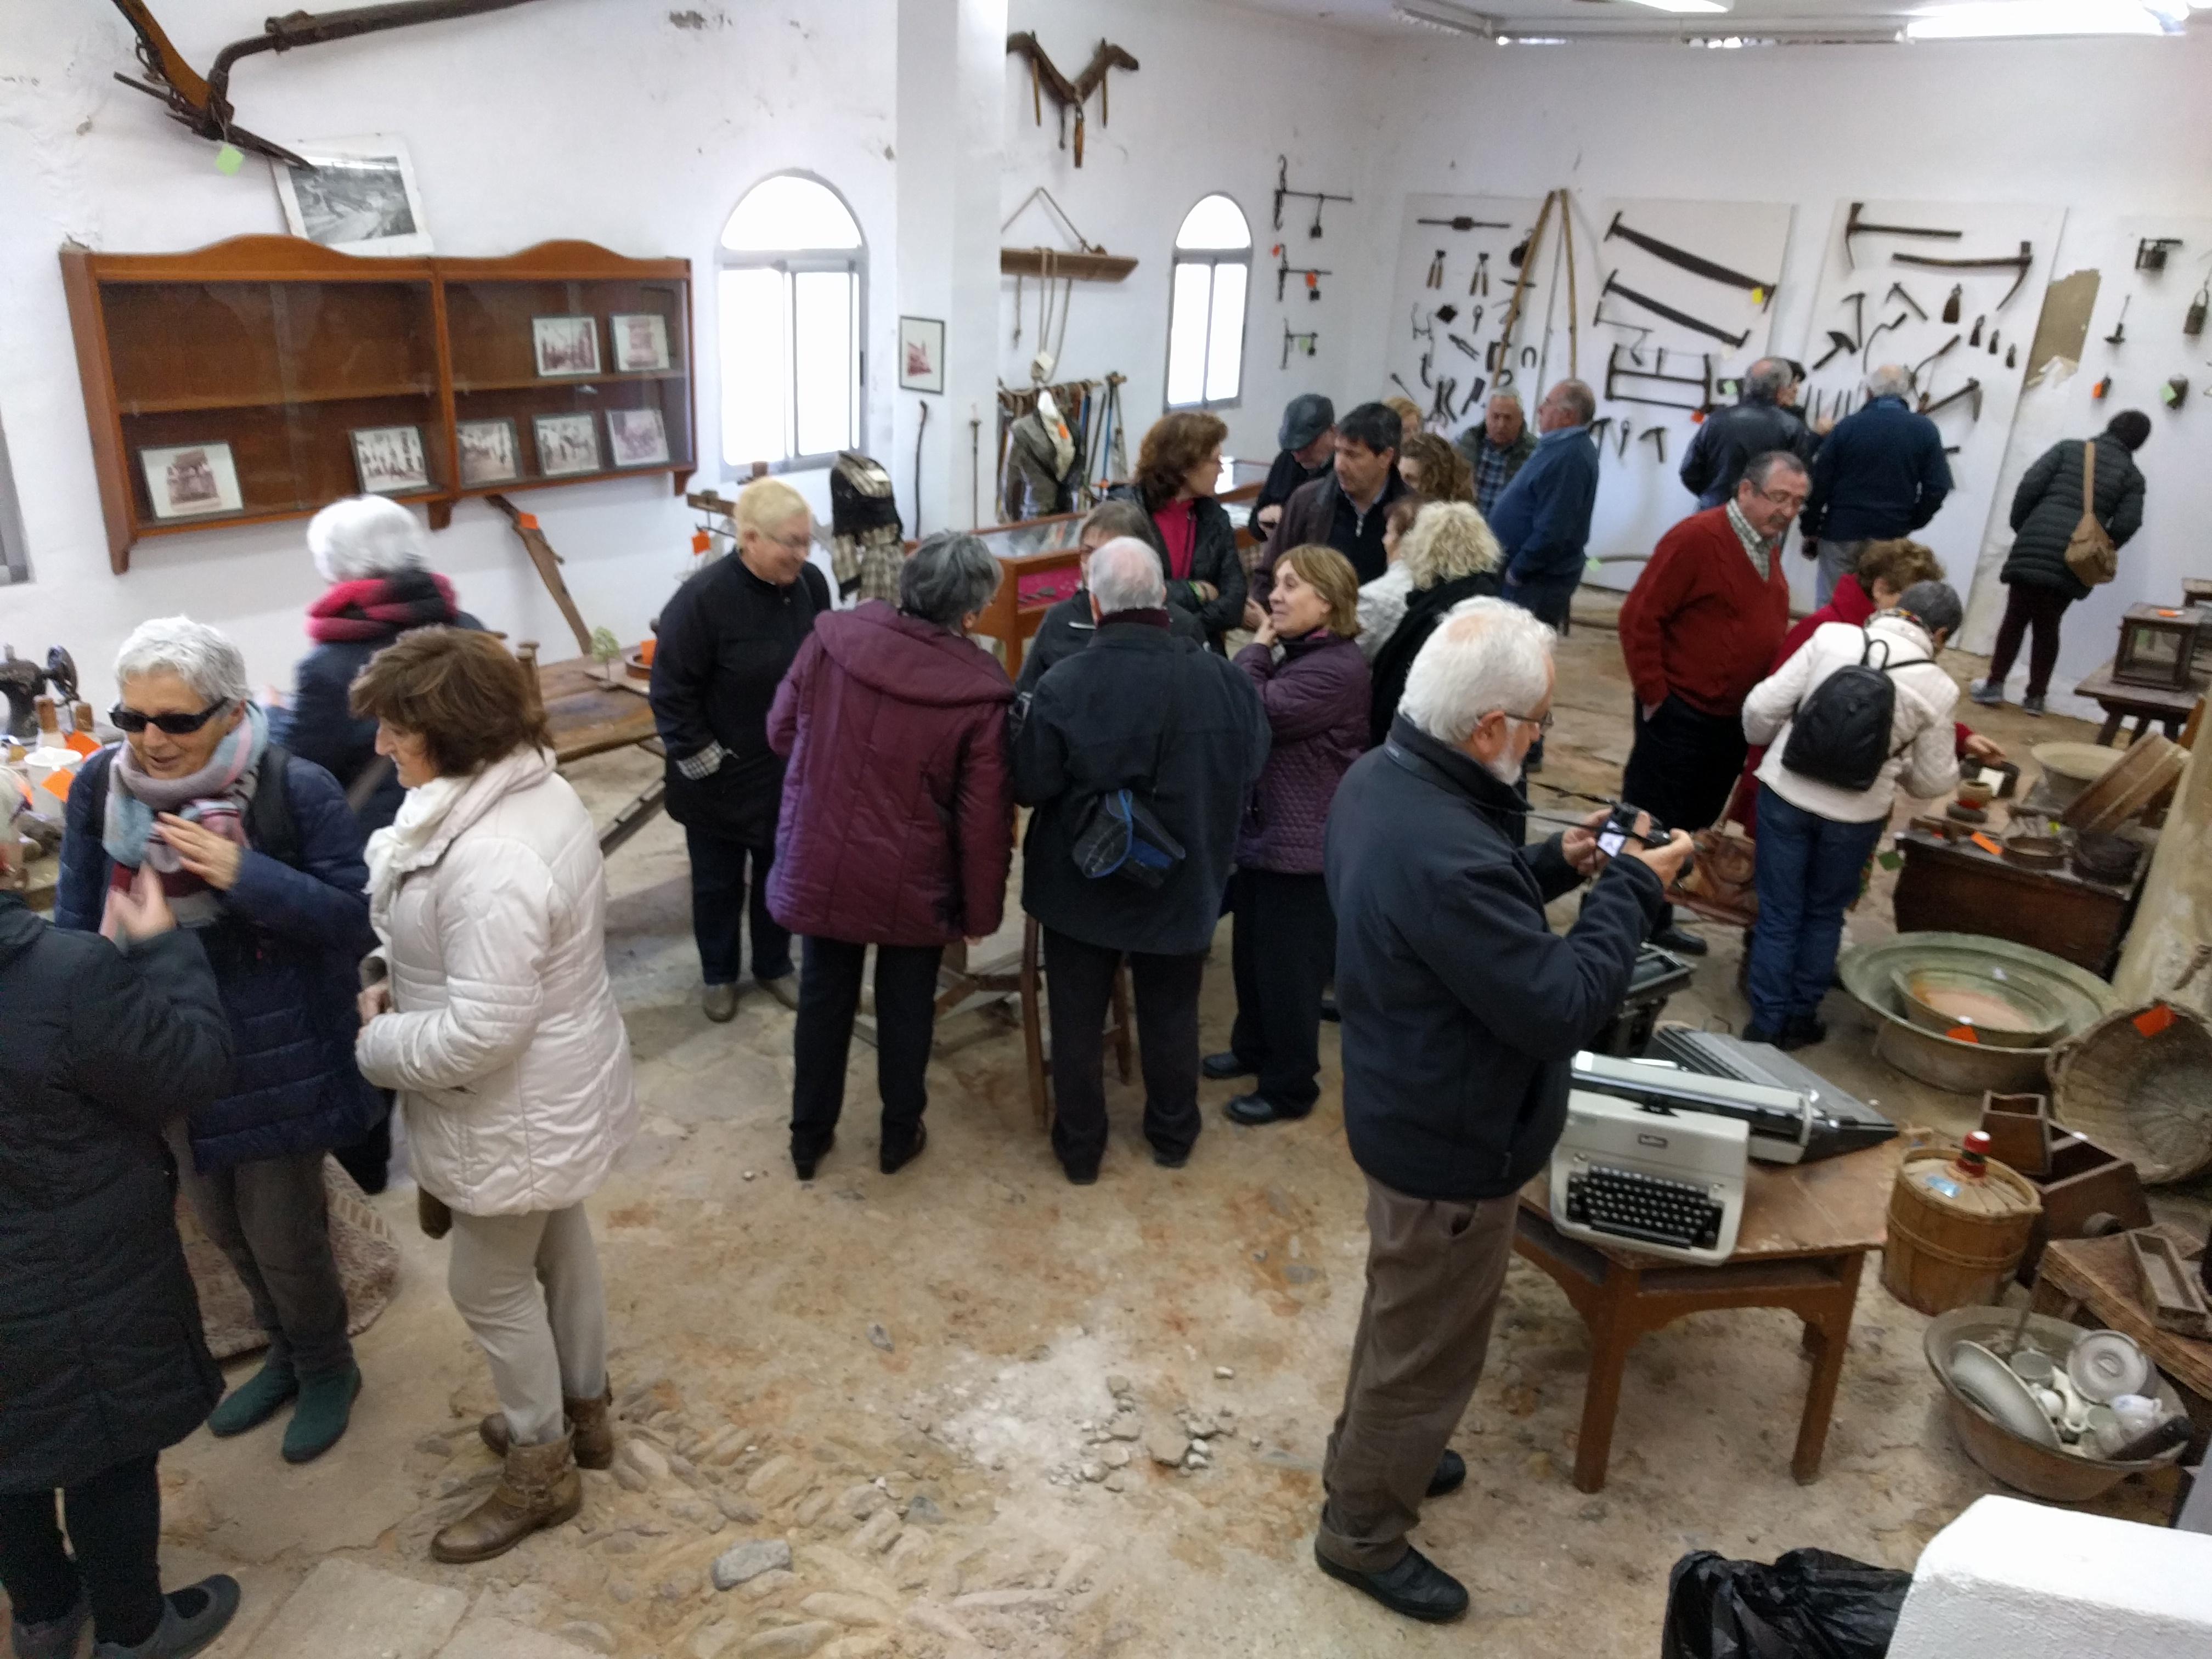
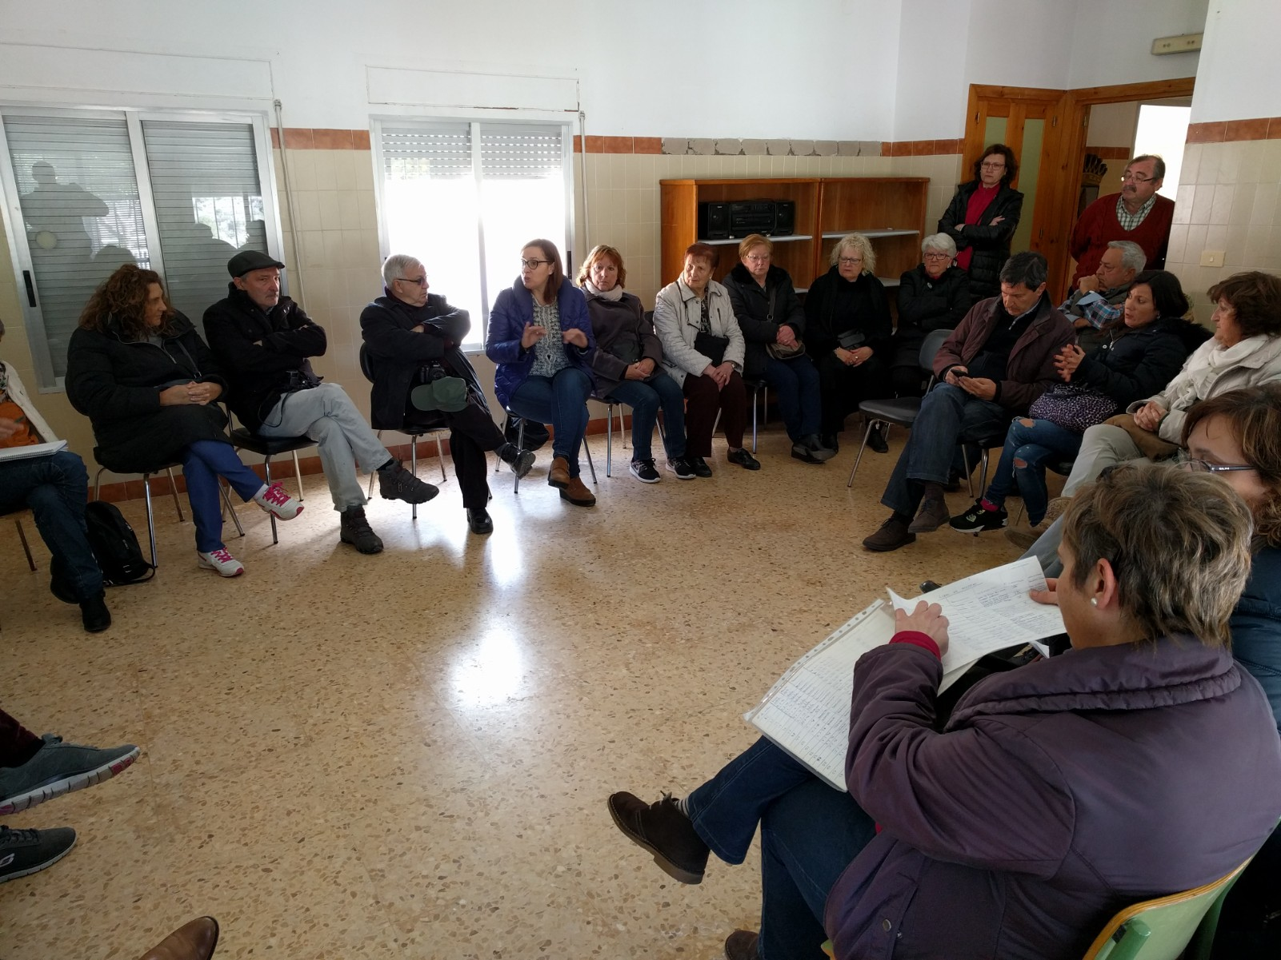
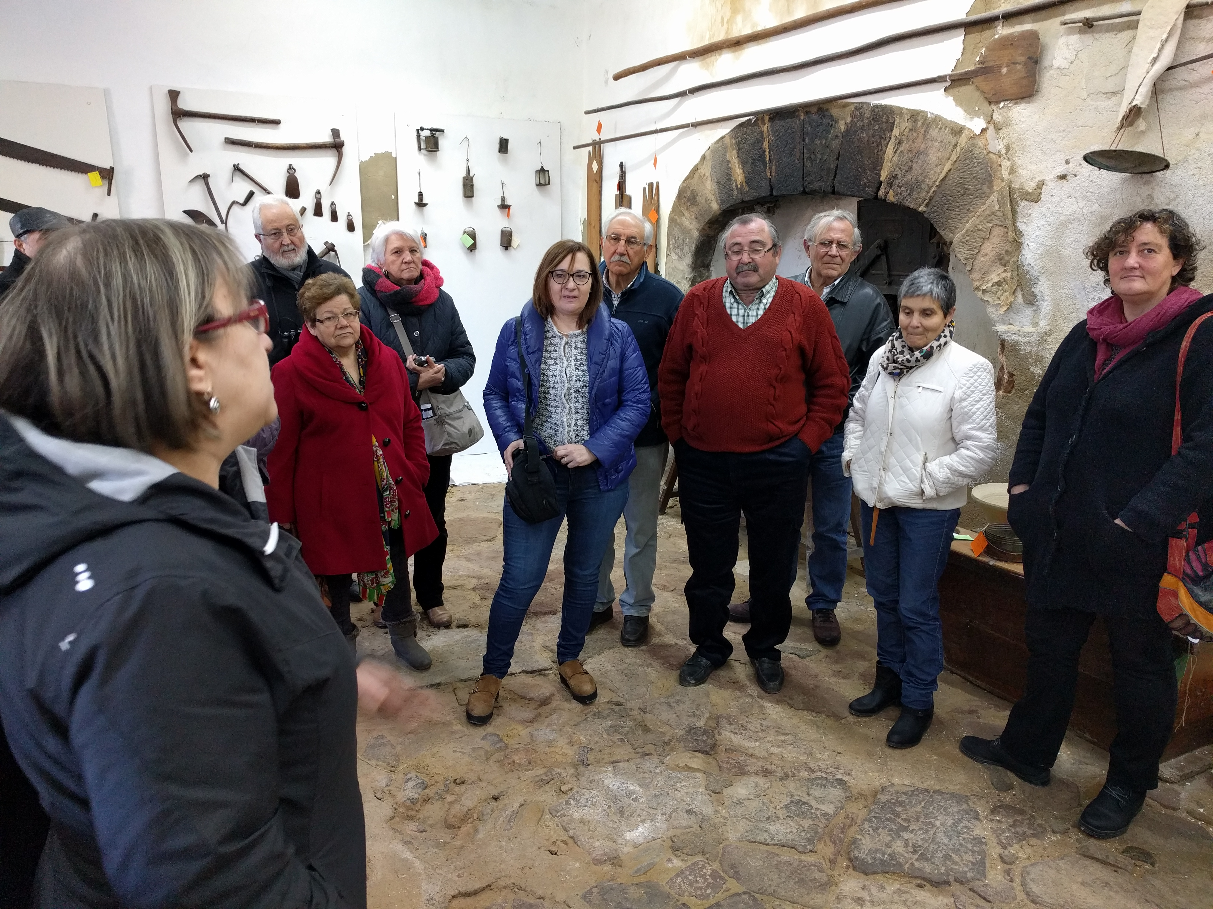
Faro Convention Research Study. Fontecchio, Italy
Damp as an opportunity. A new approach to the Museum of Cirat
During our visit to the museum we saw that the oven walls were seriously affected by damp, which was compromising the integrity and conservation of both the collection and the building itself...

Slide 12
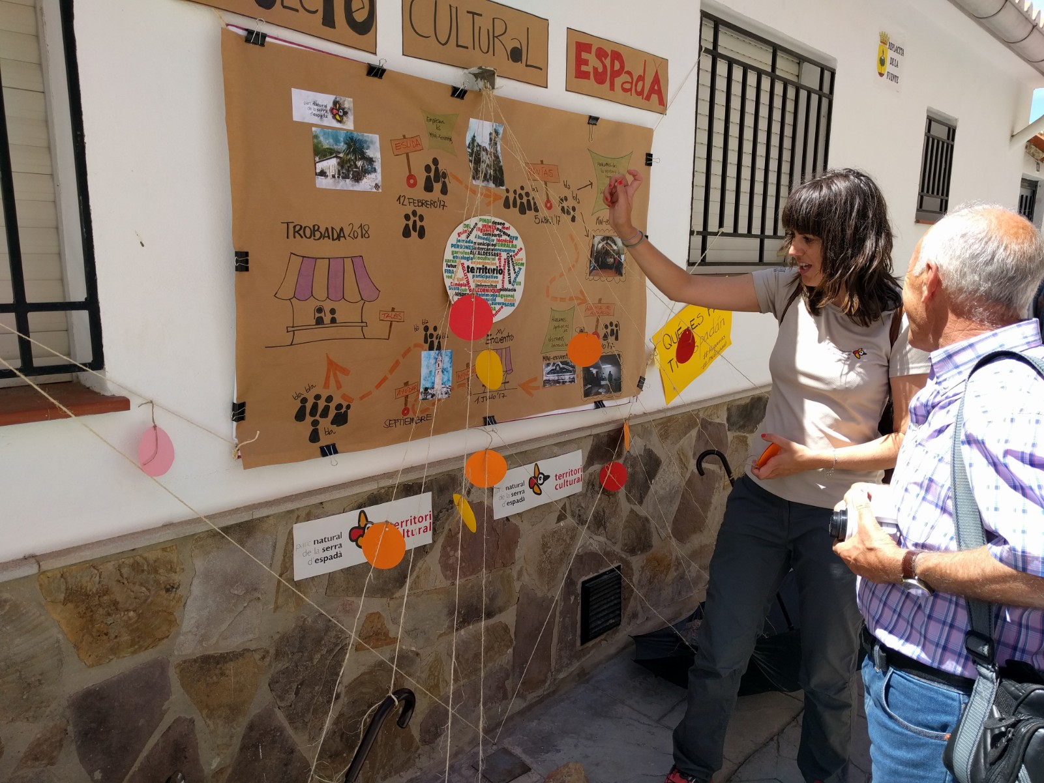
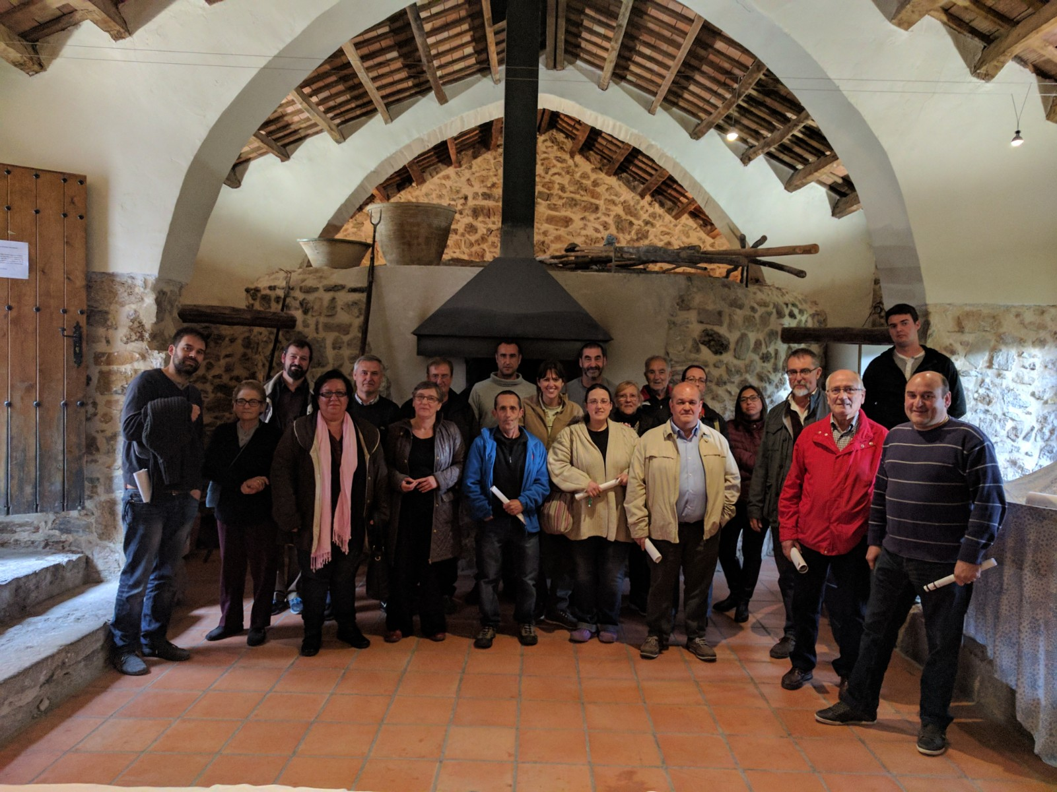
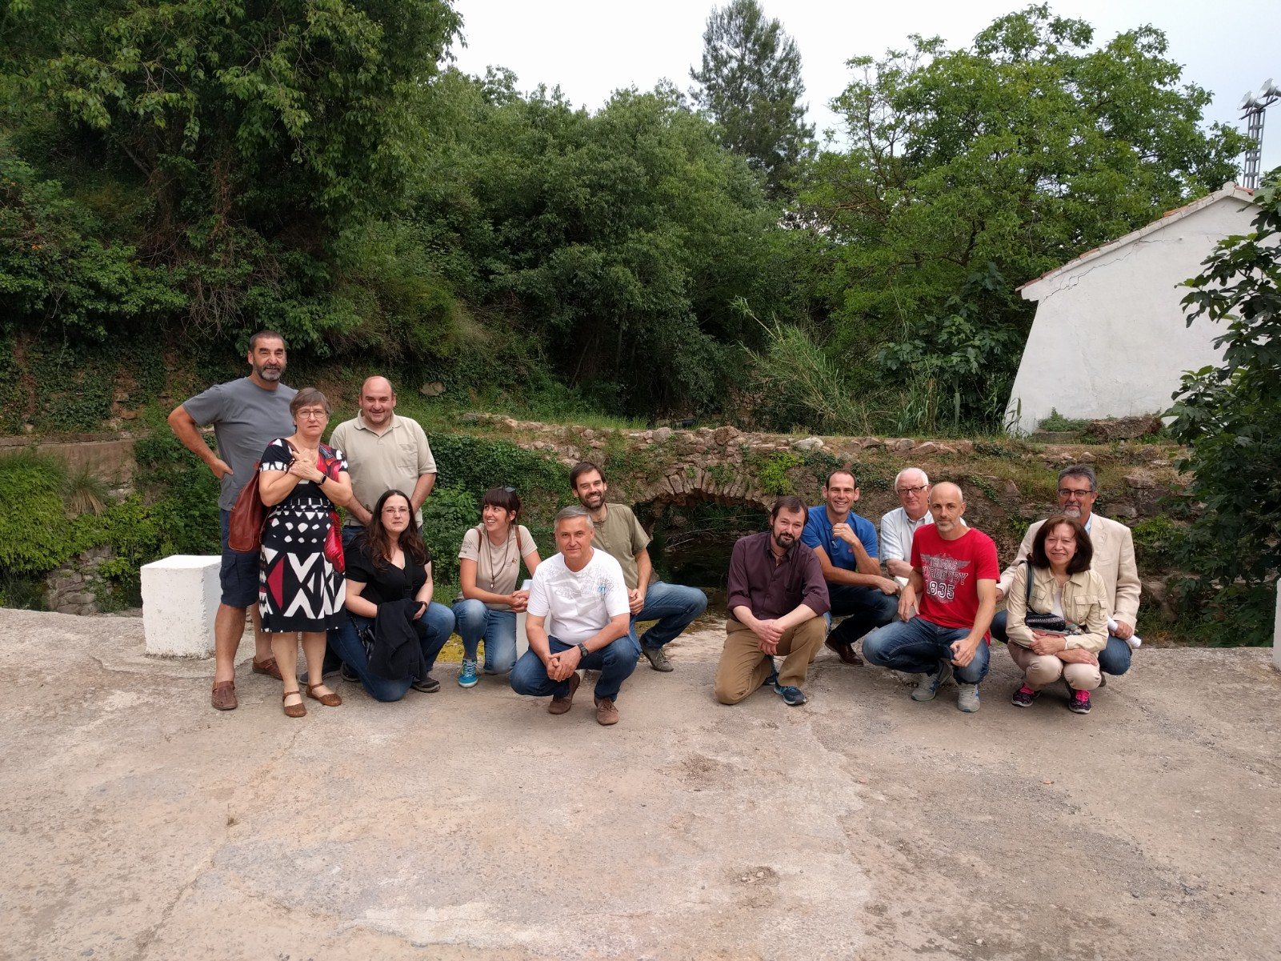
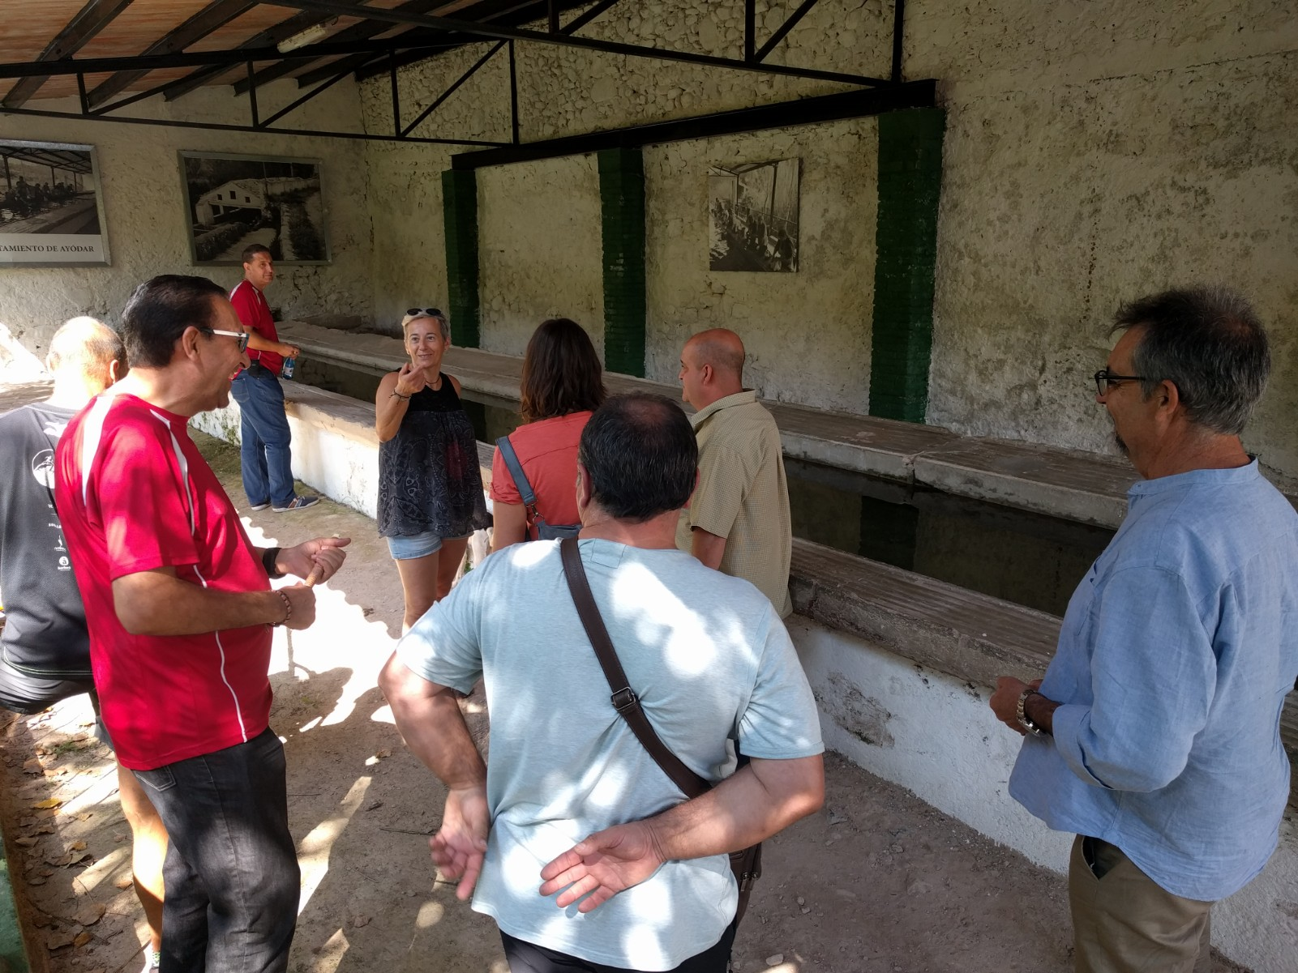
Faro Convention Research Study. Fontecchio, Italy
“Territorio Espadan” project: Participation to plan from the beginning
In 2017, the 19 municipalities located inside the Sierra Espadán Natural Park (population 7.600), have begun a horizontal, participatory process to define the cultural project of the villages inside the park.
This project sprang from the need to define meeting spaces that bring together the various groups in the natural park territory.

Slide 13
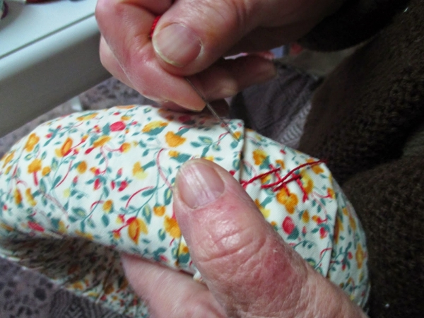
Faro Convention Research Study. Fontecchio, Italy
Key: people are the most important heritage
Key: inclusion
Key: emotion, identification, belonging
Key: horizontality
Key: ongoing processes
Key: collaboration
Key: learning about and promoting their cultural heritage
Key: participation from the beginning
Key: the development of a common context
Key: bottom-up approaches
Key: the search to share and export knowledge and foster interactions
Key: network of heritage communities

