Slide 1
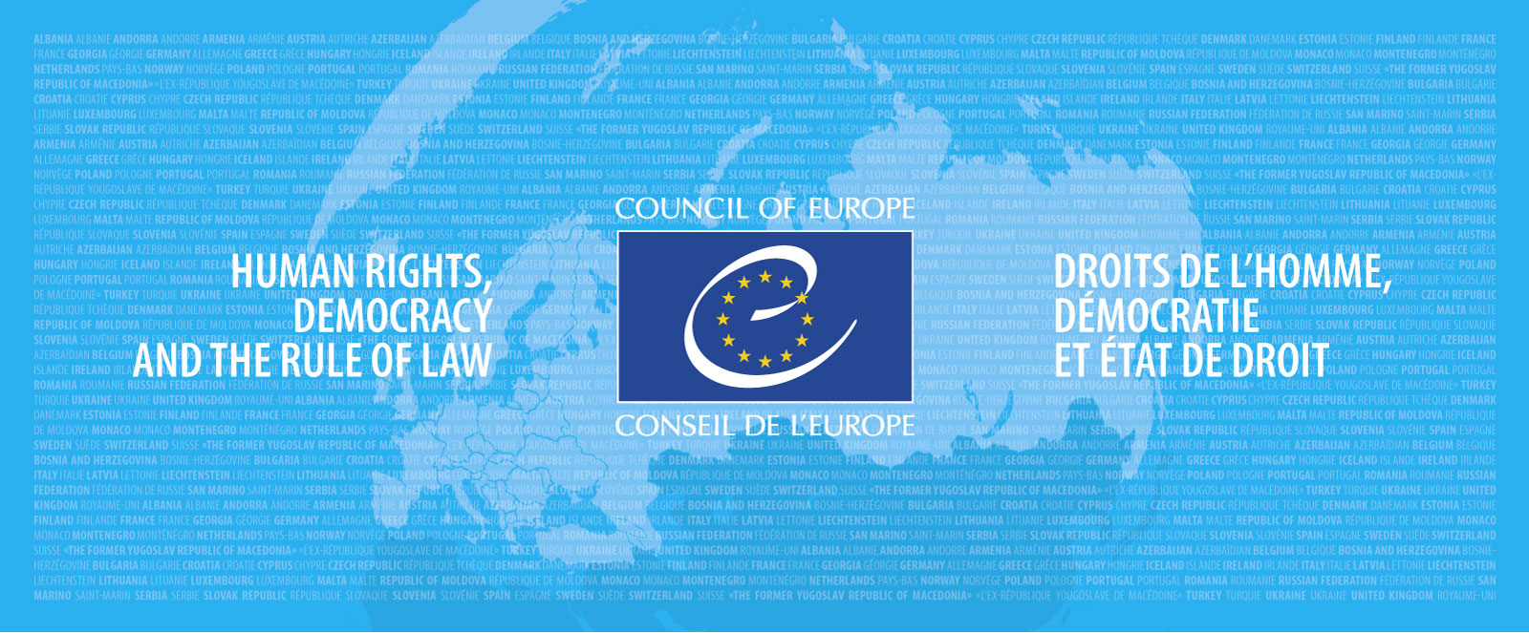
Framework Convention on the Value of Cultural Heritage for Society Vilnius, Lithuania – 15-16 November 2017 Hakan Shearer Demir

Slide 2
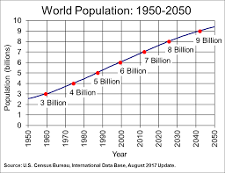
Some facts:
54 % of the world’s population (7.6. billion) lives in urban areas
This amount (9.8 billion) is expected to increase to 66 per cent by 2050
It is estimated that around 3 million people are moving to cities every week
Source: the UN

Slide 3
Is the urban lifestyle sustainable?
With constant mobility of people, increased diversity and regeneration of places and stories, what kind of approach should we have?
Could the Faro Convention be one of the useful frameworks?

Slide 4
Parameters (concept of heritage at the CoE)
Heritage is a social and political construct
Exercise in democracy and human rights
Heritage as means and not as an end in itself
Relations between peoples, places and stories

a. Heritage governance –communities’ central role
b. The role of heritage in addressing societal challenges

Slide 5
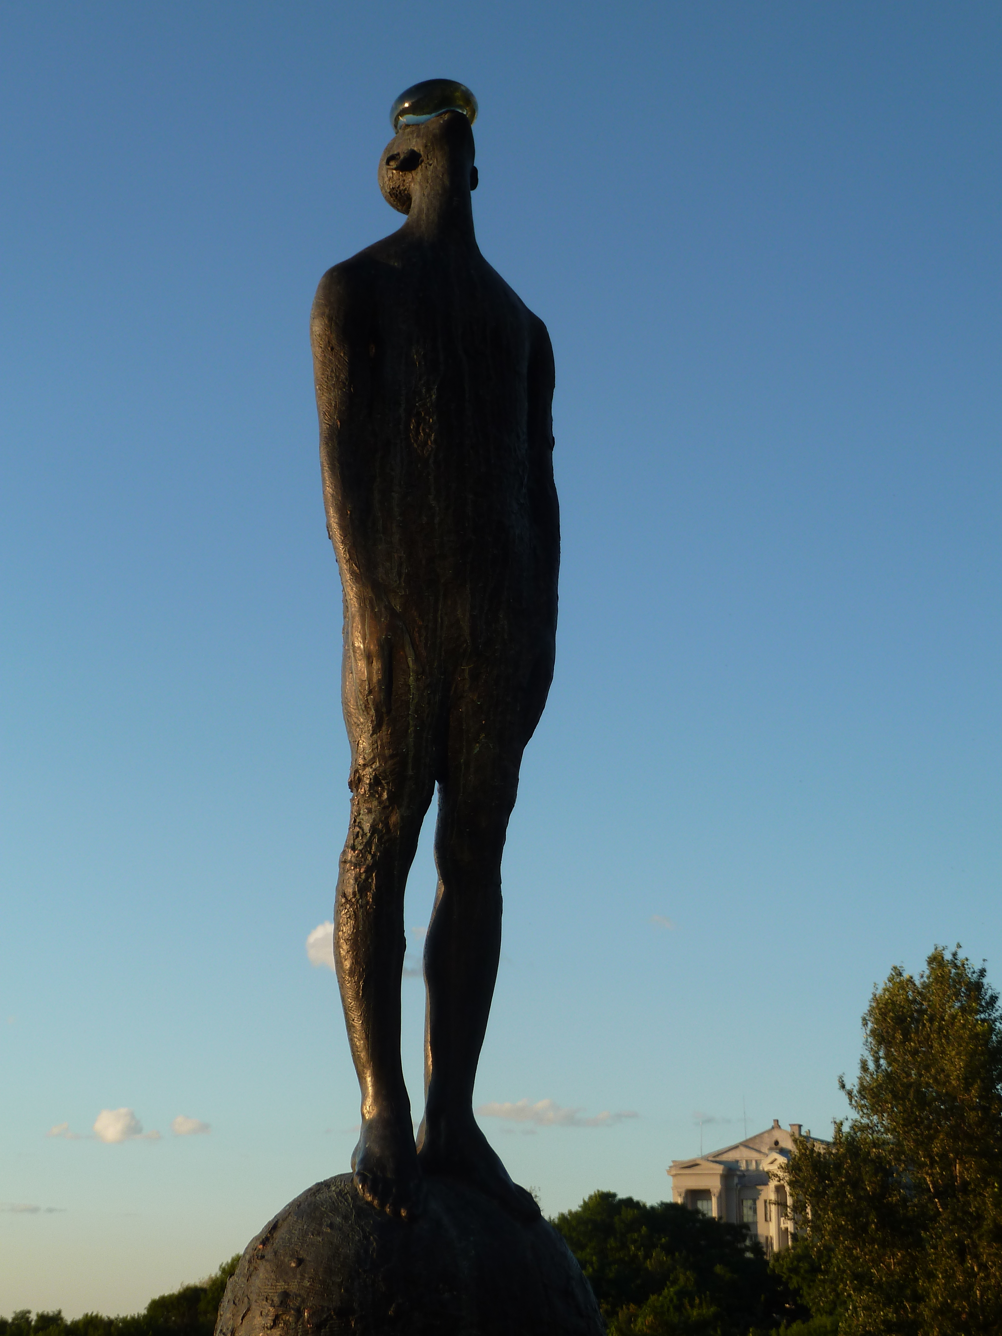
MULTIPLE IDENTITIES
DIVERSITY
DIGNITY
QUALITY OF LIFE
Notes:
From a window of

Slide 6
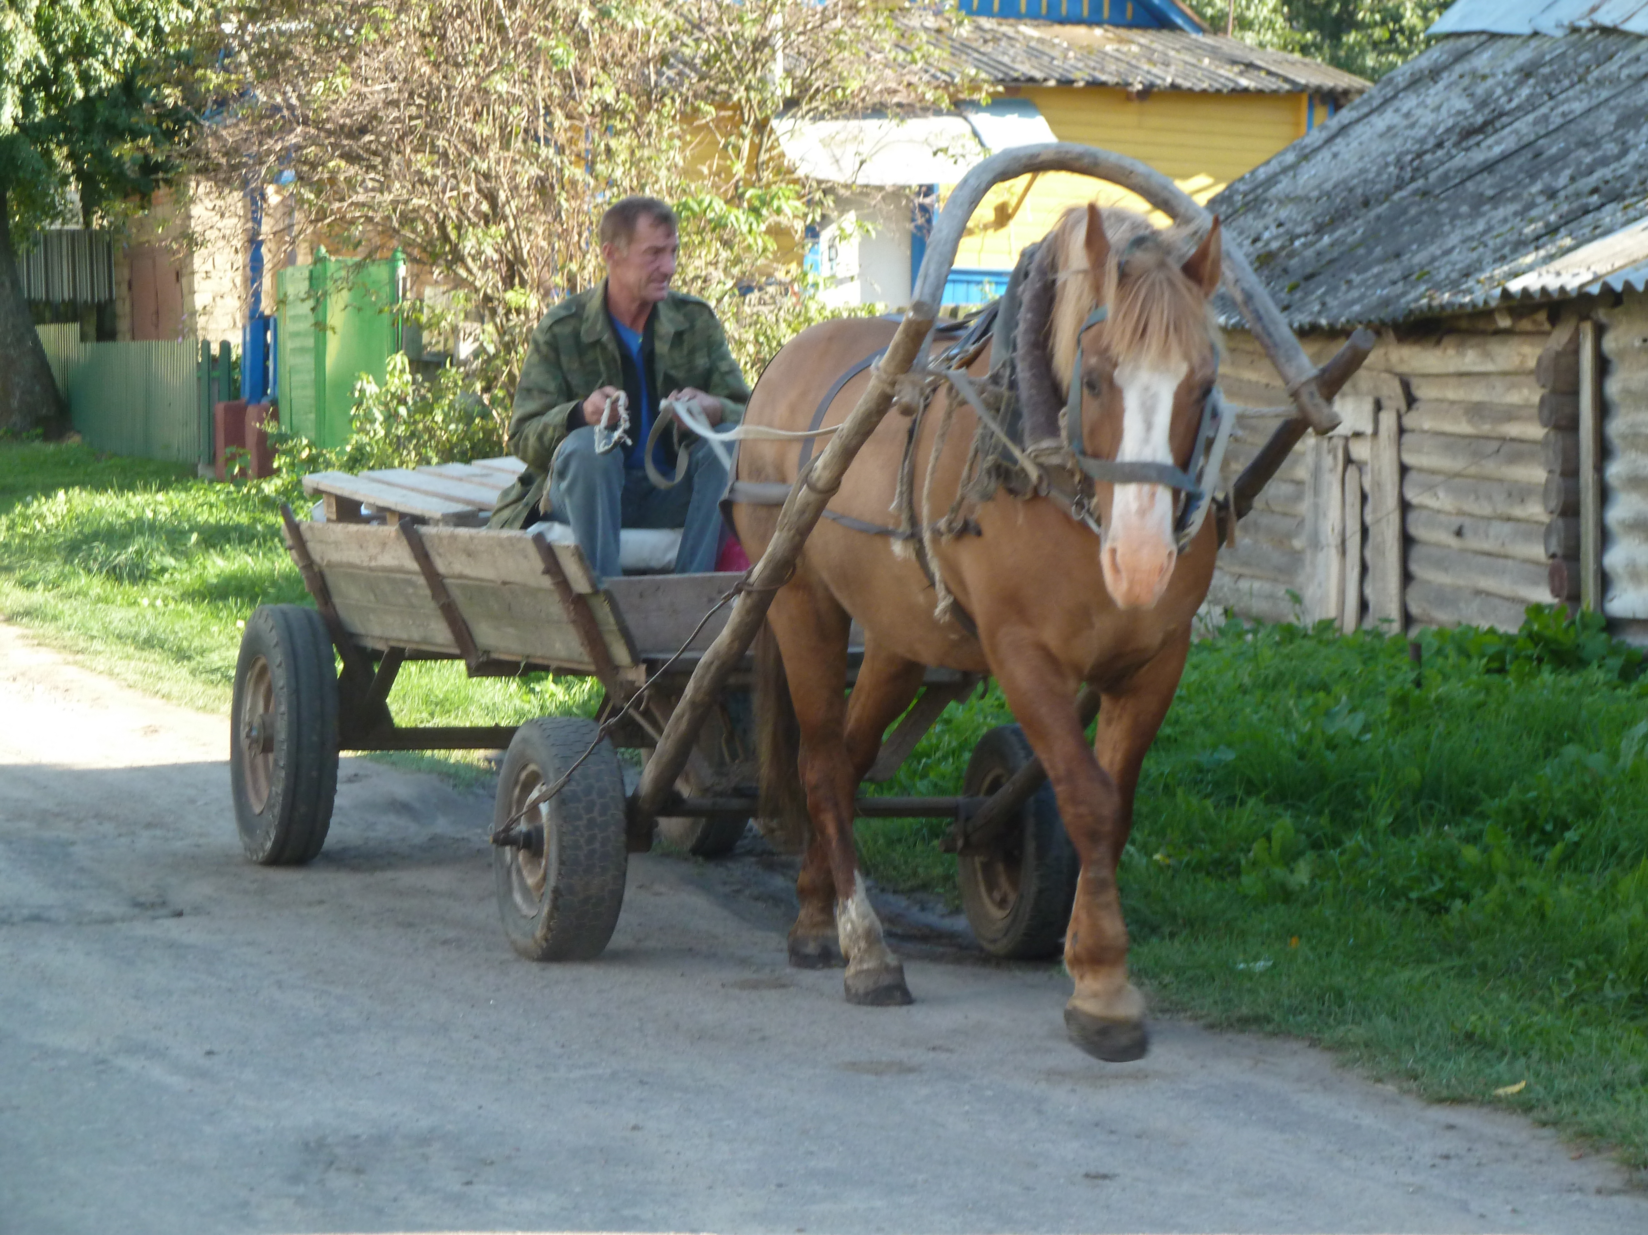
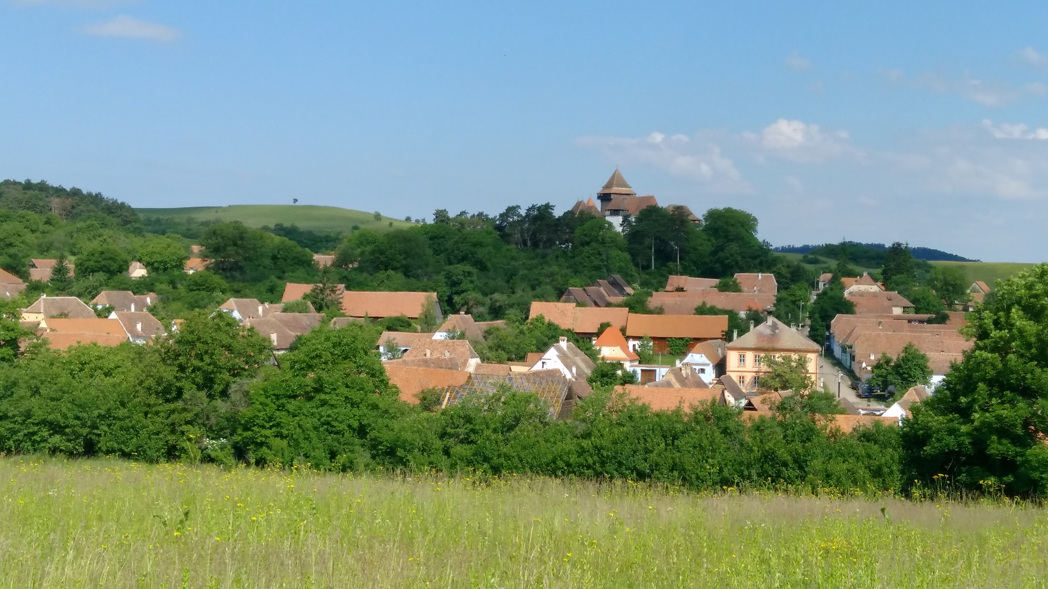
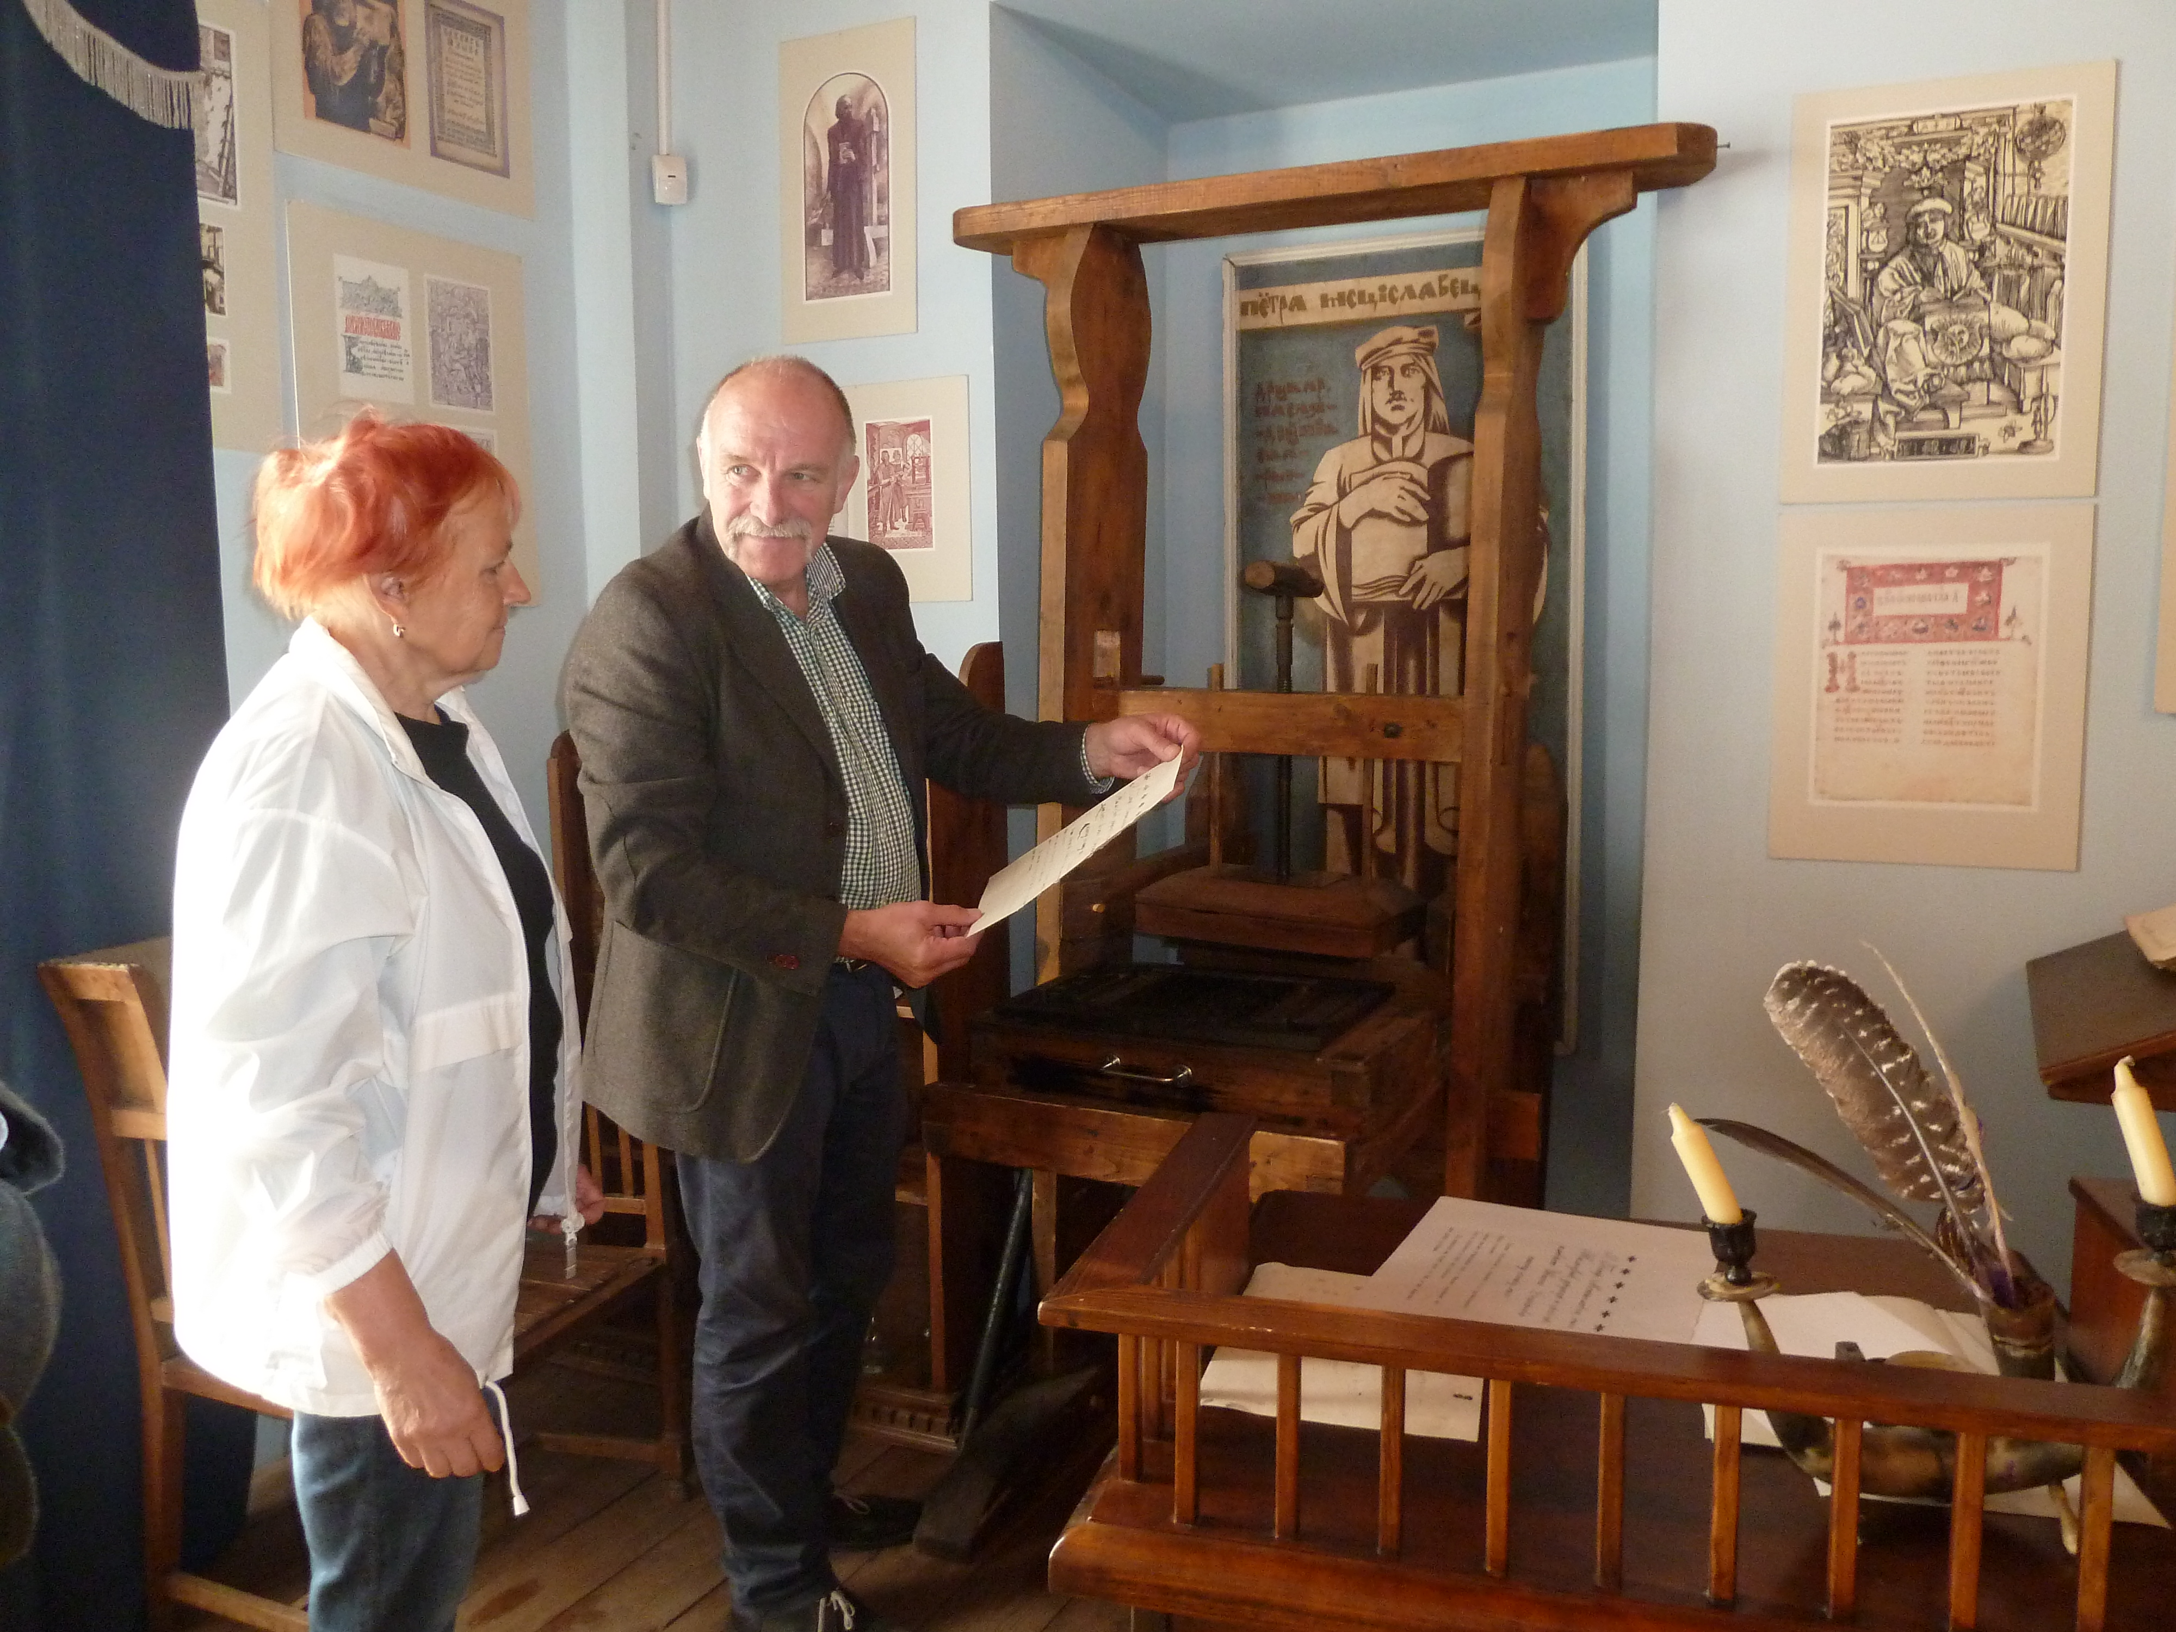
Faro Convention
PEOPLE
PLACES
STORIES
Notes:
Faro Convention is about peoples, places and stories where unique practices and traditions acknowledged, valued and promoted by heritage communities and turned into social and economic opportunities for a better quality of life. It is a process of democratisation of the heritage field together with the civil society local and national institutions and authorities.

Slide 7
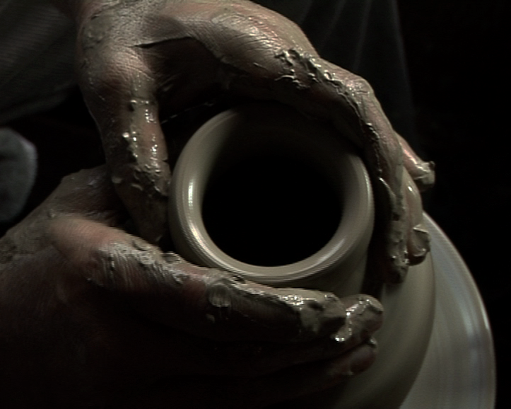
47 MEMBER STATES 820 MILLION EUROPEANS
The Convention
-A vision and a new way of looking
at heritage
-A distinctive approach
-Exercise in participatory democracy
The Action Plan
-Heritage-led, people centered actions
-Societal challenges
-A pan-European Network
-Making Invisible - Visible

Slide 9
The principles:
Connection to a community and territory determines a sense of belonging;
Social cohesion is founded on various levels of cooperation and commitment;
Democracy is practised by engagement of civil society in dialogue and action, through shared responsibilities based on capacities.

Slide 10
The criteria:
Who?
Presence of an active civil society (heritage community) that has a common interest in a specific heritage;
Presence of people who can convey the message (facilitators);
Engaged and supportive political players in the public sector (local, regional, national institutes and authorities);
Engaged and supportive stakeholders in the private sector (businesses, non-profit entities, academia, CSOs, NGOs, etc.).

Slide 11
How?
Consensus on an expanded common vision of heritage;
Willingness of all stakeholders to cooperate (local authorities and civil society);
A defined common interest of a heritage-led action;
Commitment and capacity for resource mobilisation.

Slide 12
What?
Readiness of the group to engage in the process of developing diverse narratives based on the people and places;
Aspirations towards a more democratic socio-economic model;
Commitment to human rights principles in local development processes (respect for dignity and multiple identities);
Improved democratic participation and social inclusion of all inhabitants.

Slide 13
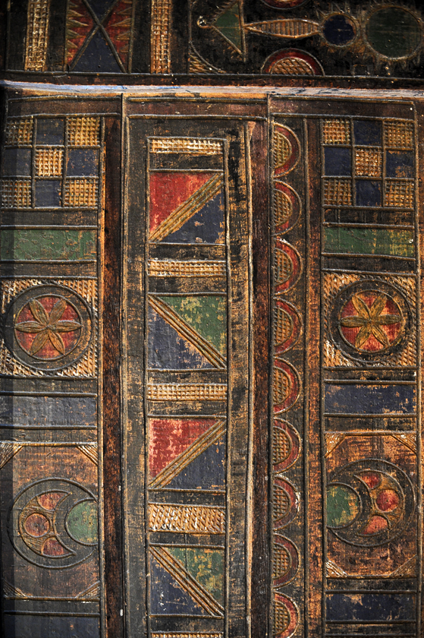
Self Management Process
Self Assessment
Self Monitoring
Self Evaluation

Slide 14
Faro Convention Methodology
Commons – Cooperation – Narratives
Places – People - Stories

Slide 15
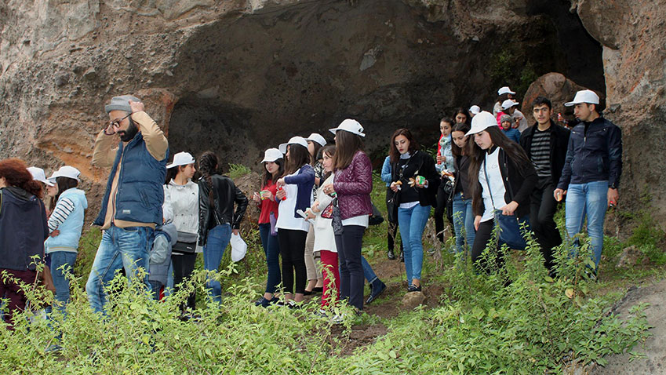
Implementation:
Engagement at all levels
Ministry and institutional support (working with all levels)
Raising awareness
Mapping initiatives in line with the Faro Convention
Incentives
Sharing among Faro Convention Network / CDCPP

Slide 16
SYNERGIES WITH OTHER COE PROGRAMS
European Heritage Days
STRATEGY 21
Intercultural Cities
Cultural Routes
EUR-OPA
CoE Conventions

Slide 17
www.coe.int/faro-action-plan
faro.convention@coe.int
Faro Convention Network

Slide 18
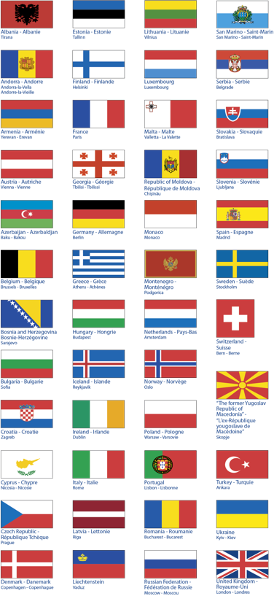
Thank you
BACK

