Slide 1


Supporting young people and youth organisations since 1972

Slide 2
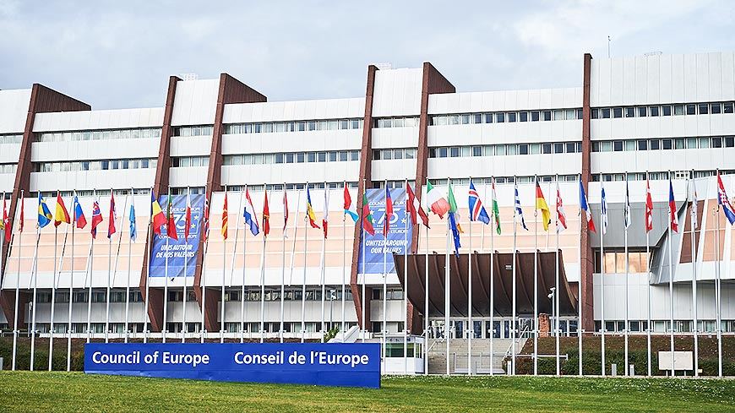

What is the Council of Europe?
Intergovernmental organisation with 46 member States
Since 1949, created in the aftermath of WWII
Based in Strasbourg, France
3 pillars: human rights, democracy, rule of law
For more information: www.coe.int

Slide 3
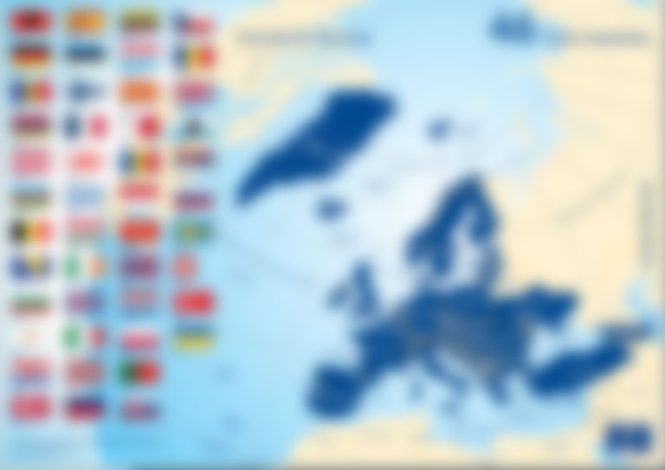
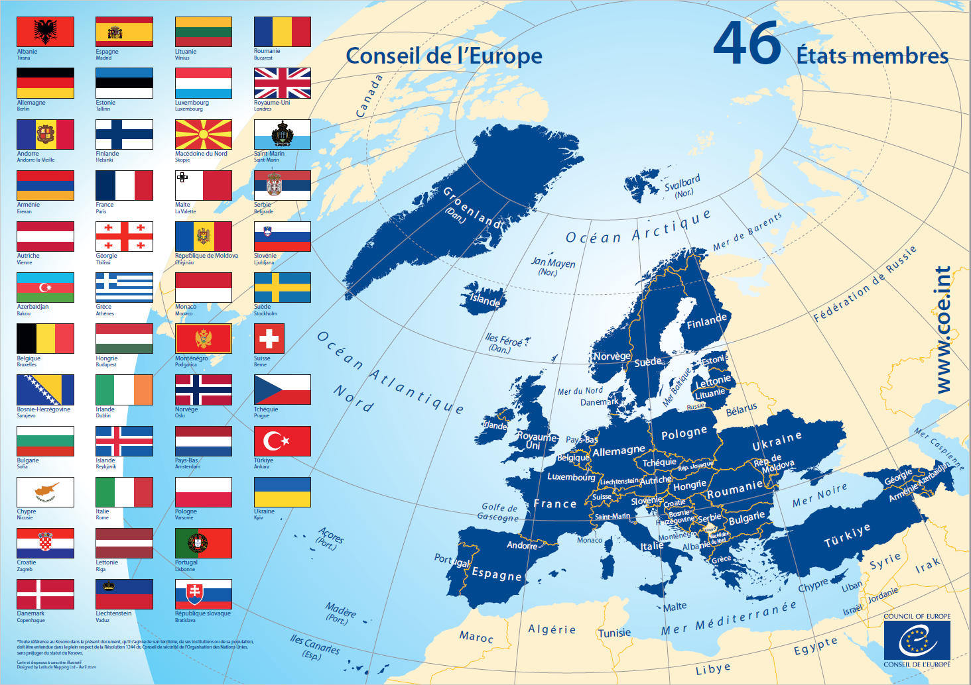

Slide 4
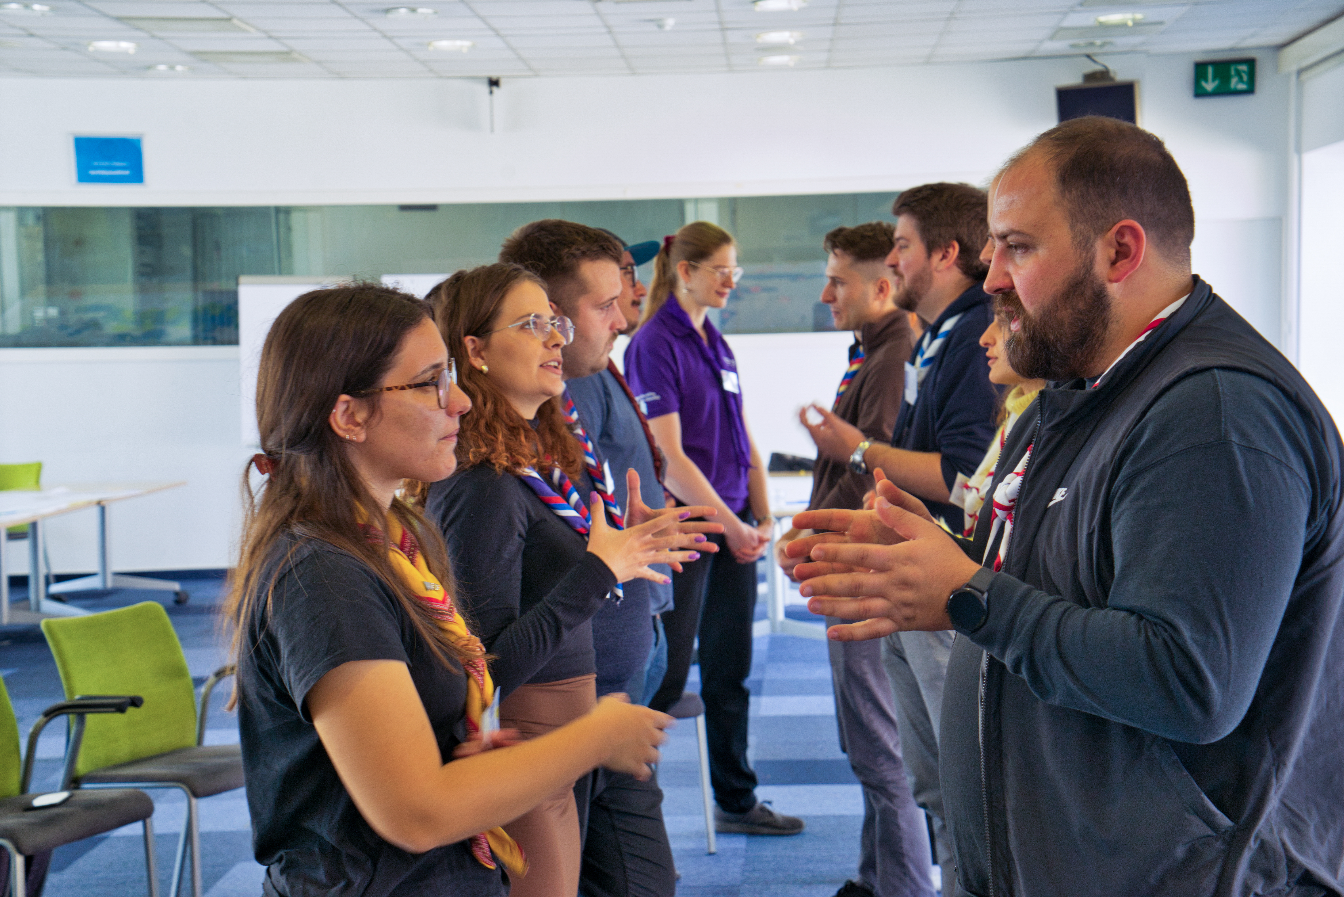
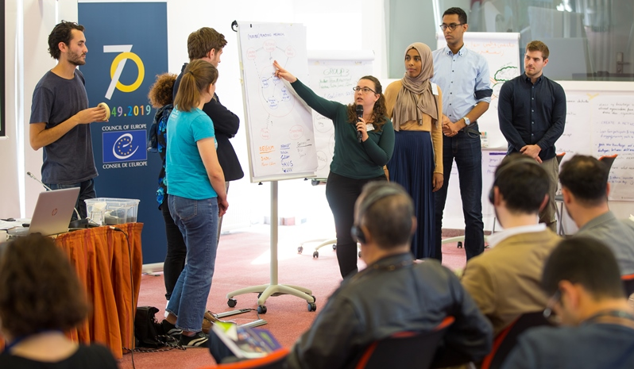
EYF mission
“(…) The aim of the Foundation is to promote youth cooperation in Europe by providing financial support to such European youth activities that serve the promotion of peace, understanding and co-operation between the people of Europe and of the world, in a spirit of respect for human rights and fundamental freedoms”.
Article 1, Statute of the European Youth Foundation

Slide 5
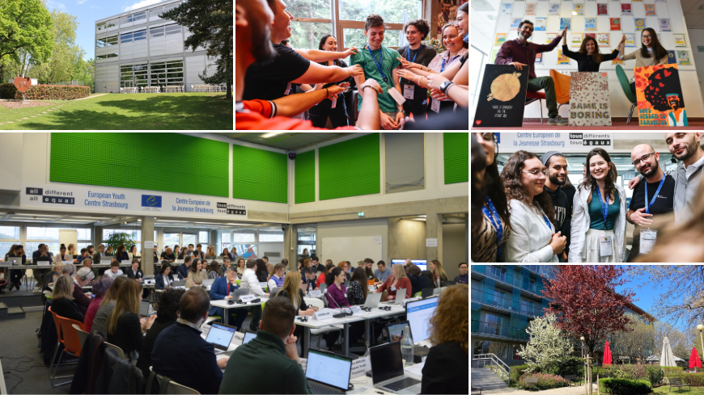
EYF key facts
Partnership and financial support to youth organisations from 46 member States of the Council of Europe for youth-led projects and for their operations
Part of the Council of Europe - Youth Department
Since 1972
Approximately 4 million euro per year
8 staff members
Based in the European Youth Centre Strasbourg

Slide 6
Key documents
Statute: EYF mission and streamlines of work
Operational regulations (2025): granting process
Guide to EYF grants (2026): information for youth organisations

Slide 7
Steps in the EYF granting process
Registration of the NGO to the EYF online grant-management system
support4youth platform · info about work and structure, original statutes and bank account · communication if needed
Call for proposals
support4youth platform· different deadlines depending on calls or grant type · info about project & budget · technical assessment by EYF
Grant decisions
by the Programming Committee on Youth
Awarding the grant
Signing of the grant agreement upon confirmation of legal information, first payment
Grant implementation
Implementation of a grant by the grantee organisation, advice and support from the EYF at any stage
Reporting
Submission of a narrative and financial report, EYF checks Closing of the project and final payment.

Slide 8
Co-management and decision-making for the EYF grants
COMMITTEE OF MINISTERS
ADVISORY COUNCIL
30 youth NGOs’ representatives
STEERING
COMMITTEE
50 government representatives
JOINT COUNCIL
ON YOUTH
PROGRAMMING COMMITTEE
8 YOUTH REPS + 8 GOV REPS
YOUNG
PEOPLE
MEMBER STATES
EYF GRANT
DECISIONS
Notes:
Co-management of the youth sector
In other departments of the Council of Europe, the decisions are made almost exclusively by member States representatives. In the youth sector, young people are also part of the decision process.
Government Representatives from the 50 signatory states of the European Cultural Convention compose the European Steering Committee for Youth (CDEJ). These are usually representatives from the ministries responsible for youth.
The steering committee promotes intergovernmental co-operation and a space for exchanges between countries on youth policy.
Youth representatives coming from 30 youth organisations from all over Europe compose the Advisory Council on Youth (CCJ). The CCJ provides input on all activities of the Youth Sector and assures the involvement of young people in other Council of Europe activities.
Together, the CDEJ and the Advisory Council compose the Joint Council on Youth (CMJ), a co-decision body which establishes the youth sector’s priorities, objectives and budgets.
8 members of the CCJ and 8 members of the CDEJ are elected to sit on the Programming Committee on Youth (CPJ) for a 2-year mandate to establish and monitor the programmes of the European Youth Centres and of the European Youth Foundation … and to take the decisions on all EYF project applications!
More information on co-management: https://www.coe.int/en/web/youth/co-management

Slide 9
What important characteristics of youth projects?
Educational, cultural, social projects by, with and for young people
Contribution to youth sector priorities and using youth sector approaches
European dimension, international solidarity, supporting peace and co-operation
Youth participation

Slide 10
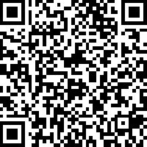
Council of Europe youth sector priorities
1: Revitalising pluralistic democracy
2: Young people’s access to rights
3: Living together in peaceful and inclusive societies
4: Youth work
Scan for detailed info:

Slide 11
Types of grants
One-off youth co-operation activities
International or national NGOs (with partners)
International youth meetings with a purpose that contribute to CoE priorities
Min. 7 CoE countries represented, at least 75% are young people (15-30 years old)
Multiplier effect
Long-term youth co-operation projects
International NGOs or networks
Combination of international meetings and other activites (campaigns, advocacy, publications, local activities, etc)
Multiplier effect and strategic development
Ad hoc initiatives on emerging needs
Local or national NGOs
One-time initiatives or immediate response to specific needs/priorities
European dimension, innovative in thematic focus or approaches, local impact
Structural grants
International NGOs or networks (or emerging networks)
Part of general administrative costs
Under certain eligibility conditions based on past collaboration
Notes:
Also mention
Equal Acess Fund
Direct Awards

Slide 12
Types of project grants
1. International co-operation activities aimed at enhancing international understanding, solidarity and contribute to promotion of human rights and democracy, with a multiplier effect
One-off youth co-operation projects (primarily organising an international meeting of young people, for example youth camps, seminars, conferences, training courses or study visits)
  Prepared and organised by either: an international youth NGO or network; a sub-regional network of youth NGOs; a partnership of at least 4 national youth NGOs or a partnership between a national youth NGO and an international youth NGO or network.
Long-term youth co-operation projects (include a combination of international meetings and other activities such as campaigns, advocacy projects, production of educational and other resources, research, support for local activities, etc).
  Prepared and organised by an international youth NGO or youth network.

Slide 13
Types of project grants
2. Ad hoc initiatives to address emerging needs, priorities and societal phenomena
One-time initiatives – or immediate responses – of young people to specific emerging needs or priorities that relate to young people’s living conditions or broader societal phenomena
Aims to reach one or several of the following objectives:
  Encourage new forms of youth participation and organisation
  Support young people (in particular experiencing exclusion, marginalisation and discrimination) to find ways of addressing the challenges facing them and meeting their own aspirations
  Contributing to social cohesion, in particular by fighting exclusion
  Addressing societal challenges and phnomena affecting young people.
Has a European dimension, innovative in terms of thematic focus or methodology, and an impact for young people at local level.
Prepared and organised by local or national youth NGOs.

Slide 14
Types of structural grants
Cover part of administrative costs for running activities
To international youth NGOs or networks (at least 7 member organisations) (two-year grant)
Based on past collaboration either with EYF (at least three international co-operation activities funded in the past three years) or the annual programme of the European Youth Centers (study sessions)
2. To emerging international youth NGOs or networks (at least 4 member organisations) aiming to establish a European/international platform, including a secretariat function (one-year grant)
Based on past collaboration either with EYF (at least one international co-operation activity in the past two years) or the annual programme of the European Youth Centers (study session)

Slide 15
Equal Access Fund
A fund to enhance the accessibility and inclusion of people with disabilities in the EYF-funded projects
Disability compensation or reasonable adjustment in the form of a grant top-up (maximum 10% of the awarded grant amount) for disability-related support or health-related support.
More information can be found here: Thematic resource on accessibility – the Equal Access Fund

Slide 16
What if I need support?
The EYF supports youth organisations in building their capacities and ensuring information for them to apply for EYF grants.
Type of support that the EYF can provide:
Digital Open Desk of the EYF on any question related to the EYF. Check the EYF website for the schedule of the Digital Open Desk.
Onboarding meetings for new members, representatives, project teams of grantee organisations – upon request.
Information sessions on EYF calls for proposals, regularly organised when a new call for proposals is launched.
Thematic workshops, such as on financial reporting, etc.
Inception sessions for grantee organisations upon starting the grant implementation.
Field visits
Advice for grantee organisations – upon request.

Slide 17



Where can you find out more information?
STAY TUNED FOR OPEN CALLS
website – eyf.coe.int
granting system – support4youth.coe.int
eyf@coe.int
@YouthCOE
@coe_youth
@youth-council-of-europe-action

