Slide 1
European and Mediterranean Major Hazards Agreement (EUR-OPA)
Joint Meeting of the Committee of Permanent Correspondents and
Directors of the Specialized Centers
6-7 November 2017, Paris, France
Project Results 2016-17
New Projects 2018-19
Johann Georg Goldammer
Global Fire Monitoring Center (GFMC)
Secretariat, Global Wildland Fire Network &
International Wildfire Preparedness Mechanism (IWPM)
Freiburg, Germany

Slide 2
Period 2016-2017
Enhancing the national interagency and international cross-boundary dialogue and inter-operability in fire management in Southeast Europe and Eastern Europe (Coordinator: GFMC)
Activities and Outcomes 2016 (I)
Organization of a National Round Table on Fire Management in Former Yugoslav Republic of Macedonia with participation of all stakeholders involved and potentially to be included in fire management
Recommendations for fostering the national inter-agency and civil society cooperation in fire management

Slide 3
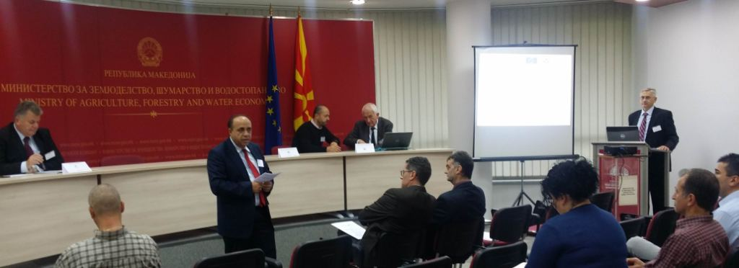
Results 2016 (I)
The first National Round Table on Fire Management was held on 9 September 2016 in the Ministry of Agriculture, Forestry and Water Economy
Establishment of a National Steering Committee for Forest Fire Management and several Working Groups
A number of detailed recommendations / actions proposed

Slide 4
Period 2016-2017
Enhancing the national interagency and international cross-boundary dialogue and inter-operability in fire management in Southeast Europe and Eastern Europe (Coordinator: GFMC)
Activities and Outcomes 2016 (II)
Organization of a Regional Consultation on Cross-boundary Cooperation in Fire Management
Recommendations towards enhancing efficiency and effectiveness of cross-boundary cooperation in fire management in countries bordering Former Yugoslav Republic of Macedonia (Albania, Greece, Bulgaria, Kosovo and Serbia)

Slide 5
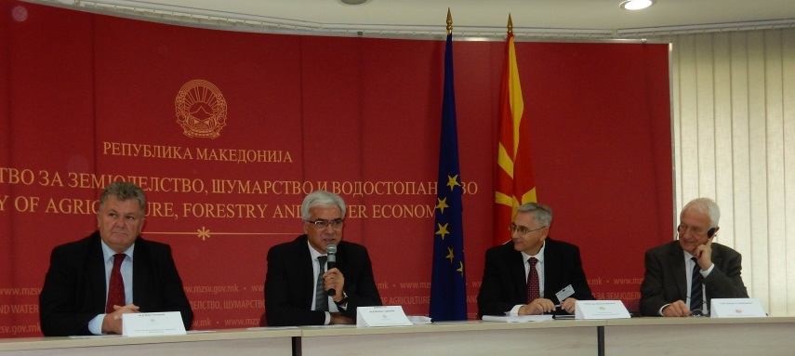
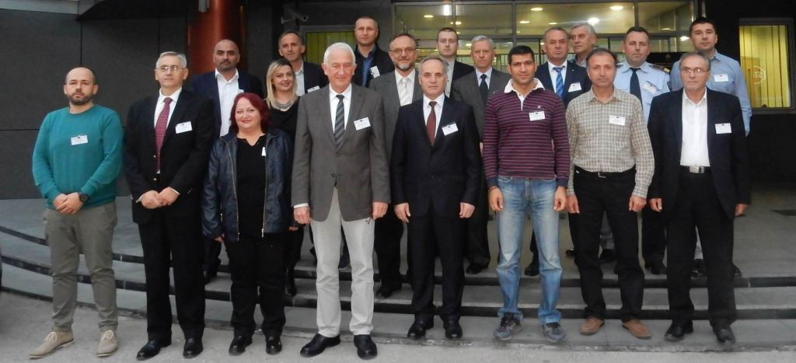
Results 2016 (II)
The first Regional Regional Consultation on Cross-boundary Cooperation in Fire Management was held on 11 September 2016 in the Ministry of Agriculture, Forestry and Water Economy
Participating countries: Albania, Bulgaria, Greece, Kosovo, the former Yugoslav Republic of Macedonia and Serbia.
A number of detailed recommendations / actions proposed

Slide 6
Period 2016-2017
Enhancing the national interagency and international cross-boundary dialogue and inter-operability in fire management in Southeast Europe and Eastern Europe (Coordinator: GFMC)
Activities and Outcomes 2017 (I)
Organization of a National Round Table on Fire Management in Ukraine with participation of all stakeholders involved and potentially to be included in fire management
Recommendations for fostering the national inter-agency and civil society cooperation in fire management, notably address agricultural burning as the main cause of wildfires affecting the landscape and source of atmospheric pollution

Slide 7
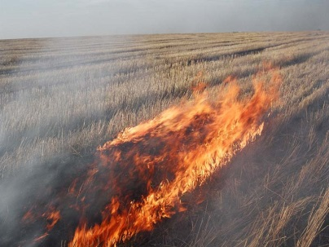
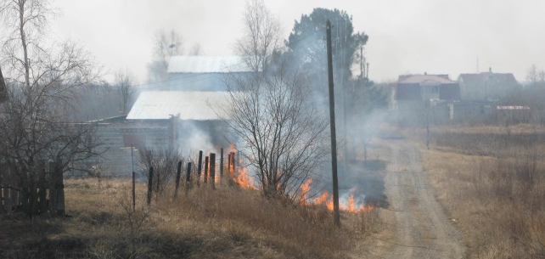
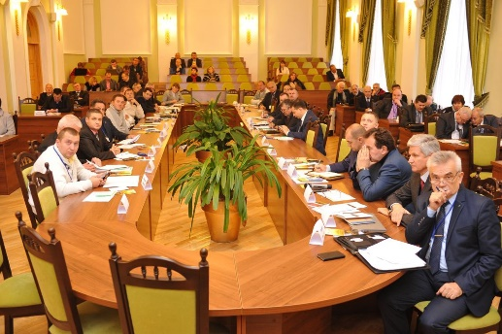
Results 2017 (I)
The first National Round Table on Fire Management Fires in the Natural and Cultural Landscapes of Ukraine: Towards the Development of a National Fire Management Policy was held on 25 October 2017 at the Regional Eastern European Fire Monitoring Center (REEFMC) at the National University for Life and Environmental Sciences of Ukraine
A number of detailed recommendations / actions proposed are focusing on proposals for changing legislation concerning agricultural burning

Slide 8
Period 2016-2017
Enhancing the national interagency and international cross-boundary dialogue and inter-operability in fire management in Southeast Europe and Eastern Europe (Coordinator: GFMC)
Activities and Outcomes 2017 (II)
Organization of a first informal Regional Consultation on Cross-boundary Cooperation in Fire Management
Recommendations towards enhancing efficiency and effectiveness of cross-boundary cooperation in fire management in countries bordering Ukraine (initial focus: Belarus, Hungary and Moldova, Poland)

Slide 9
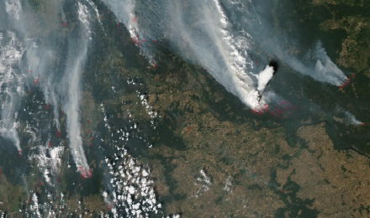
Results 2017 (II)
The first informal Regional Consultation on Cross-boundary Cooperation in Fire Management was held on 27 October 2017 with the participation of Scientific Institutions and National Agencies from Belarus, Hungary and Moldova, Poland
A number of detailed recommendations / actions proposed are focusing on proposals for fostering scientific-technical cooperation in fire management in Eastern Europe, addressing national and transboundary issues, notably ling-range transport of pollutants (e.g. “Black Carbon”)

Slide 10
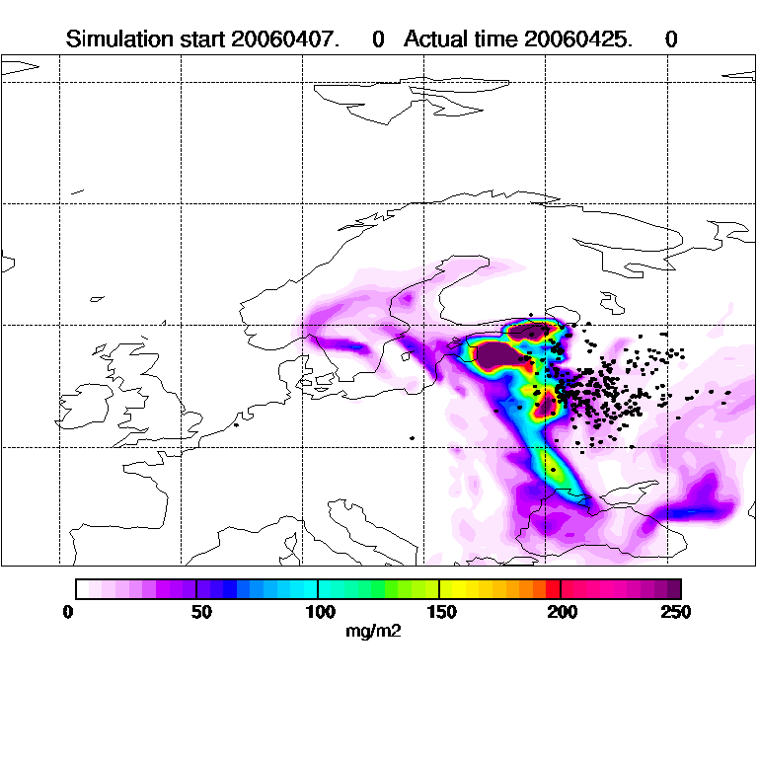
Transport of Fire Emissions to the European Arctic
Satellite images courtesy of Norwegian Meteorological Institute
Notes:
Please click on “View” and then “Slide Show” to see the impact of open burning in European Russia (black dots) and the transmission of emissions to the European Arctic.
10

Slide 11
Additional Activity 2017 (I)
Active participation in the International Conference Protection of Human Settlements and Social Infrastructure from Wildfires (14-15 November 2017, Moscow, Russian Federation)
GFMC contribution Towards Building Holistic Approaches in Landscape Fire Management in Eurasia: Experiences and Prospects
Emphasis: Addressing Wildfire DRR at all types of landscapes: Natural, Cultural and Urban-Industrial

Slide 12
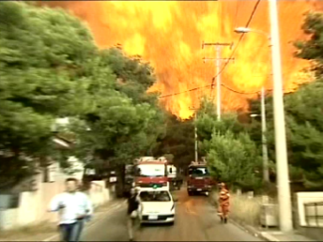
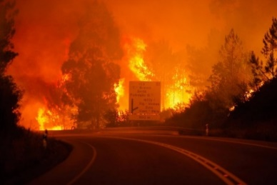
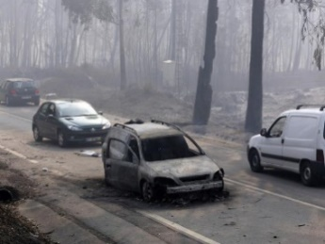
Additional Activity 2017 (II)
GFMC invited by the Prime Minister of Portugal to provide EUR-OPA advisory services to the Government of Portugal in following up the wildfire emergency of 2017
(10 November 2017, Lisbon, Portugal)

Slide 13
Period 2018-2019
Improving governance of wildfire disaster risk reduction through national inter-agency coordination and cross-border cooperation between CoE Member States and adjoining countries (Coordinator: GFMC)
Activities 2018 (I)
A national workshop and consultation in Russia will be organized at the newly established Regional Eurasia Fire Monitoring Center (REFMC) in Krasnoyarsk (Russia). Aim:
Discussion of the lessons identified by the EUR-OPA/GFMC project in 2016-17 and applicability in the Eastern region of CoE Member States
Use of satellite-derived fire information processed by REFMC within Russia and neighbouring countries

Slide 14
Period 2018-2019
Activities 2018 (II)
Conducting a regional consultation between CoE Member States, to be convened at GFMC (Germany). Objective:
Discussion of progress and further sharing of experience in cross-boundary cooperation in fire management of CoE Member States.
This consultation will be co-organized with the OSCE (in following-up the OSCE Ministerial Council Decision 6/2014) and the UNISDR Wildland Fire Advisory Group.

Slide 15
Period 2018-2019
Additional Proposal for 2018-19
Establishment of a European Team of Specialists in Landscape Fire Management
Following up the work of the UNECE Team of Specialists on Forest Fire (1981-2014; GFMC Chair: 1993-2014)
Enlarging the scope to holistic approaches in fire management at landscape level
Emphasis of enhanced cooperation between EUR-OPA, OSCE and UNISDR

Slide 16
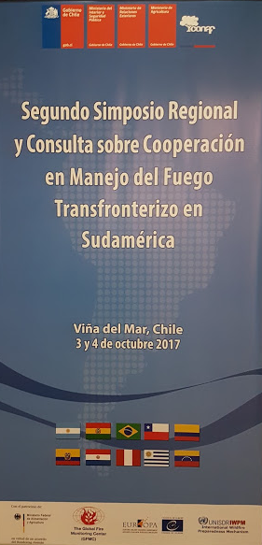
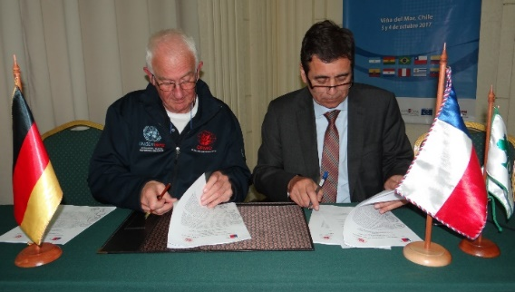
Period 2018-2019
Activities 2019
Organization of a consultation in the format of a side event at the 7th International Wildland Fire Conference (Brazil, May 2019) entitled Sharing Experience in Enhancing National Interagency and International Cross-boundary Dialogue and Inter-operability in Fire Management in Europe with Other Regions. This event would strengthen the international impacts of the EUR-OPA, following the South America consultations in October 2017

Slide 17
The Global Wildland Fire Network
14 Regional Wildland Fire Networks

Slide 18
Sharing of Information and Resources within the Global Wildland Fire Network – 2001

Slide 19
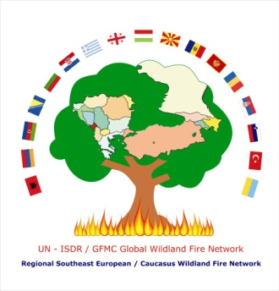
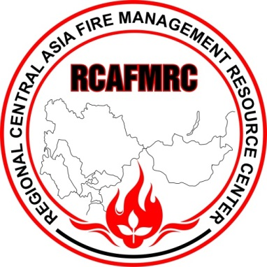
GFMC
Sharing of Information and Resources within the Global Wildland Fire Network – 2017

Slide 20
European and Mediterranean Major Hazards Agreement (EUR-OPA)
Joint Meeting of the Committee of Permanent Correspondents and
Directors of the Specialized Centers
6-7 November 2017, Paris, France
Thanks for Your Attention

