Slide 1
The Social Work Team for Separated Children Seeking Asylum in Ireland
The Irish Model of Care & Protection for Unaccompanied Minors
Seeking International Protection
As an Effective Alternative to the Detention of Migrant Children
Thomas Dunning 4 April 2019
Principal Social Worker EMN/Council of Europe/European Commission
TUSLA Child and Family Agency Strasbourg, France

Slide 2
SERVICE DEVELOPMENT of TUSLA Child & Family Agency’s Team for Separated Children Seeking Asylum
1996 – 1999 First formal or recognized separated children arrive in Ireland. (1, 1, 10, 97)
2000 – CRISIS! 520 UAMs arrive. The State is completely unprepared.
2001 – CRISIS CONTINUES when 1085 UAMs are identified! Service becomes formalized. The children are separated from the adult asylum seekers and are accommodated in substandard, unsafe, dormitory-style hostels specifically for asylum seeking children aged 13-17 while those 12 and under are placed in foster care.
2006 to 2009 – The team grows to 32 clinical staff – based in Dublin, but providing services to many UAMs nationally and all while a two-tier system is in place for these children which was in violation of Ireland’s child protection legislation and national standards regulations for children in care of the State as well as multiple international social work codes of ethics
2010 – EQUITY OF CARE PRINCIPLE is implemented! Following years of campaigning, this development helped us to close the children’s hostels, redirect that funding, open 3 children’s residential units and disburse the SCSA to foster care families and local SW teams around the country.
2012 – Established an even more formal national service for Separated Children within the State’s child protection services now under the Minister for Children.
2014/2016 – The Irish Model with its “Children First” approach is noted in Europe and requests are made for Irish expertise and technical support for other EU member states and children’s service organisations.
2016/2019 – Begin working with the Irish Refugee Protection Programme to receive Syrian UAMs from Greece under EU Relocation Programme as well as UAMs under Ireland’s Calais Special Project (CSP). We currently have 7 residential units and about 40 foster families that we support.
Every separated child in care has an allocated professionally qualified social worker, a care plan which is reviewed regularly and most likely a leaving and aftercare plan in place.

Slide 3
Organisational Structure
National Service Director
Principal Social Worker
Social Work Team Leader Duty
Social Work Team Leader CIC
Social Work Team Leader Foster Care
Social Work Team Leader Aftercare
Social Workers
Social Workers
Social Workers
Aftercare Workers

Slide 4
Child Care Act, 1991 – which outlines various legal child protection measures for people responsible for the safety of children
2. International Protection Act, 2015 (Previously, the Refugee Act, 1996)
Referrals from the Garda National Immigration Bureau (GNIB) or
International Protection Office (IPO) are made under Section 14(1) of the International Protection Act.
Once referred to Tusla the provisions of the Child Care Act, 1991, shall apply in relation to the child.
Legal Framework

Slide 5
Legal framework (contd)
3. New referral sources as a result of the refugee migration crisis in Europe
Irish Refugee Protection Programme – Minors identified by the UNHCR and the EU for possible relocation to various EU member states for the purpose of processing an individual’s application for international protection.
Calais Special Mission – Following a government decision in November 2016, Ireland offered to take up to 200 UAMs from the camp in Calais, France as relocation cases but which actually became Programme Refugees resettlement cases. (41 UAMs participated.)
Malta relief
Social workers and the Irish police service conducting joint missions to Greece, France, Malta for welfare assessments and security screening, respectively, before relocation or resettlement to Ireland.

Slide 6
EXPERIENCES
The children have experienced a massive lack of choice in their lives. Usually, adults have decided to send them overseas and they have travelled illegally so regardless of whatever abuse they may have endured on their journey, they still arrive to the receiving countries already criminalized.
COMMON - Separation from or loss of
Family, friends, neighbours and community, traditions, religion, school.
They have endured abrupt changes in
Culture, language, climate, faces, food, social and physical environment
INDIVIDUAL - Experiences of
Family life, social relationships, health, education
Country of origin experiences may vary
Tribal conflict, racial, political, social or religious persecution, extreme poverty, corruption in political decision making or access to services
All without normal family and community supports…

Slide 7
Other thoughts for consideration when supporting SCSA…
Pre-migration, migration and post-migration experiences.
The ordinary vs. the extraordinary.
Clarity on evolving asylum procedures and legislation relocation and resettlement.
Challenges with age concerns and managing Tusla’s non-invasive, non-medical Child Protection Risk Assessments (which includes a dimension on age).*

Slide 8
CHILDREN MISSING FROM CARE
The team became increasingly concerned at the increase in missing children that began in the latter months of 2008 and continued up to the summer of 2009; some of whom were suspected by social workers to be potential child victims of human trafficking.
To address this situation, along with other risk factors for children, a Joint National Protocol on Children Who Go Missing from Care was developed between An Garda Siochana (the Irish police force) and Tusla, Child and Family Agency (the State’s child protection service).

Slide 9
Joint National Protocol On Children Who Go Missing From Care
Collaborative interviewing at the ports or other appropriate locations between social workers and the Irish police service.
Planned police surveillance of those at risk of going missing from the point of presentation at ports to the initial placement period in units.
Joint training of social workers, police and immigration officers in relation to identifying children at high risk of going missing.
These measures were implemented - and existing processes improved throughout the first half of 2009. Links between local police stations and the children’s accommodations were also strengthened. The police mounted several surveillance operations with the collaboration of social workers and successfully tracked some children who went missing.
81 of 846 (9.6%) children received into care went missing from the service in 2001.
2 of 48 (4%) children went missing in 2012.
1 (or >1%) of 86 in 2014!

Slide 10
Challenges
Cultural, social and religious differences (including issues related to money, gender, leisure, work, sexuality, personal agency, social strata).
Discrimination, racism, xenophobia (fear of others)
Global fear-mongering and sensationalised media reports about migrants, trafficking, social welfare and benefit fraud.
Acts of hostility, violence and aggression against foreigners.
Explaining negative asylum decisions to a child; the legal process; and any delays with getting a decision on their residency status.
Lack of awareness from service providers such as schools, hospitals, taxi drivers and community projects about children in migration.
The shadows…all of the unknowns. ‘The mandate.’ Some children may have adult family living in Ireland yet unknown to the authorities. This can lead to problems with parenting the child. Some children are expected to send money back home to either pay for their smuggling or to support their family or both.
Vulnerability versus resilience.
All of these can challenges can lead to increased risk for children.

Slide 11
Care Planning
Appropriate Placements
Education
Health
Psychological intervention
Integration
Facilitating contact with family members and/or family tracing as an intervention separate from the protection process
Asylum process
Issues related to being a victim of crime

Slide 12
Suggestions and recommendations
Developing rapport and trust with the young person. (Follow through)
Liberal application of benefit of the doubt
Good communication is facilitated by:
Knowledge of respective roles and responsibilities of service providers during interactions
Awareness of the issues surrounding separated children, both specifically and generally
Professional trust, respect and skills should always be taken into account
Cultural competency (Knowing that you don’t know! Ask.)
Assume good will of others (police, professionals, carers) working on the child’s case.

Slide 13
Thank you!
Thomas Dunning
Principal Social Worker
TUSLA Child and Family Agency
Sir Patrick Dun’s Hospital
Lower Grand Canal Street
Dublin 4, IRELAND
+35316477006
thomas.dunning@tusla.ie

Slide 14
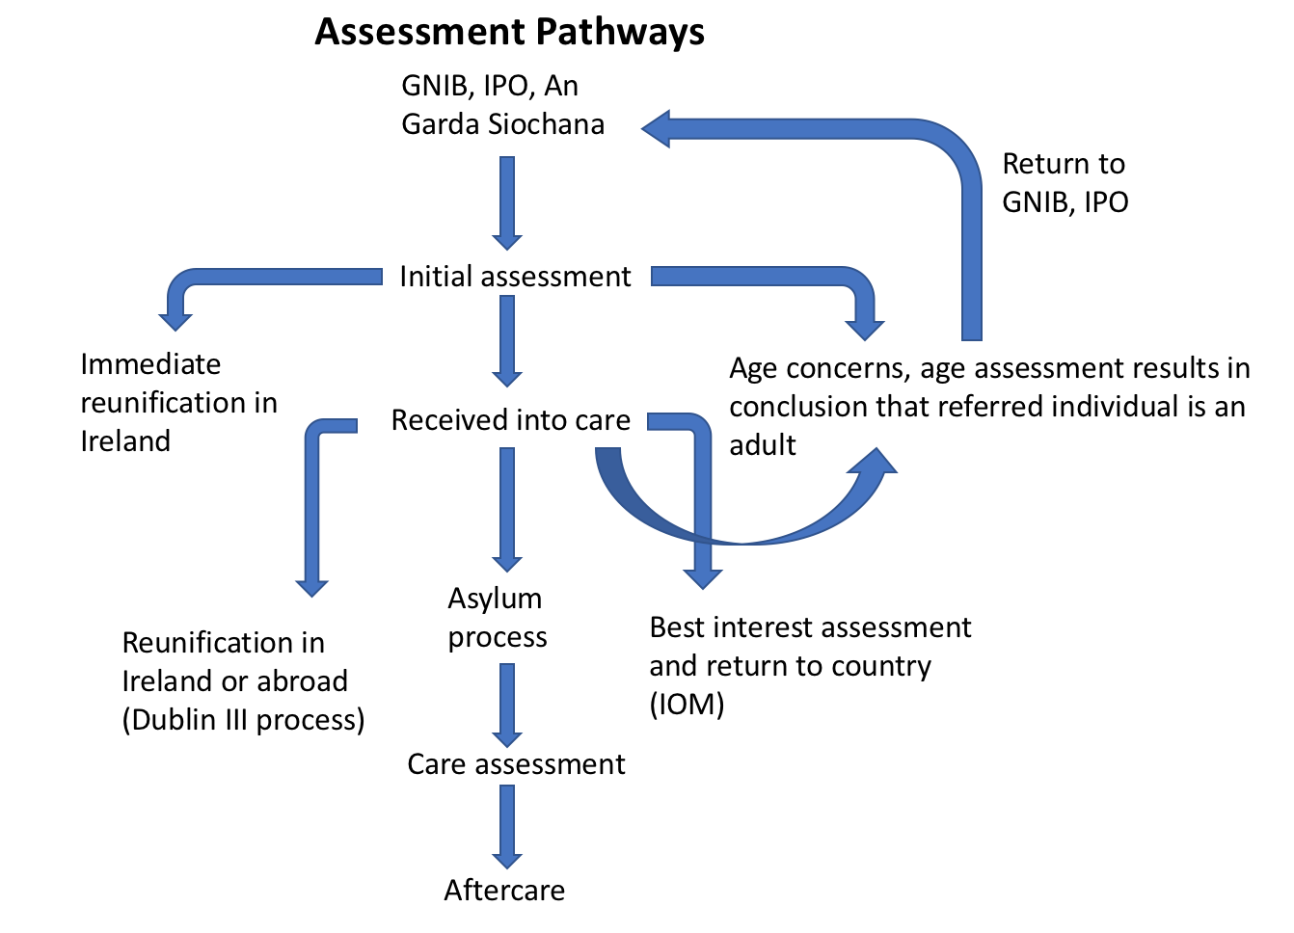
Appendix I Assessment Pathways

Slide 15
Appendix II Separated pregnant girls and/or young mothers
Most of them have no support of a partner, their parents or friends
Sensitive circumstances of pregnancy (e.g. Rape, forced marriage, sexual exploitation, sex work, incest.)
Issues regarding putative father of the unborn child
Almost all of them are having their first baby
Distant from their peers, new to the culture in Ireland
Difficulty connecting with the pregnancy and/or baby due to trauma
Different religious and cultural values related to sex, pregnancy, gender, an individual’s bodily autonomy.

Slide 16
Referrals to TUSLA Child and Family Agency’s Team for Separated Children Seeking Asylum Team 2000 to 2018
Year | Total Referrals to TUSLA’s Team for SCSA | Placed in care | Completed Family reunification service provided, regardless of placement in care status. | Inappropriate Refs / Other
2000 | 520 | 406 | 107 | 7
2001 | 1085 | 846 | 231 | 8
2002 | 863 | 335 | 506 | 22
2003 | 789 | 277 | 439 | 73
2004 | 617 | 174 | 418 | 25
2005 | 643 | 180 | 441 | 22
2006 | 516 | 188 | 308 | 22
2007 | 336 | 130 | 185 | 29
2008 | 319 | 156 | 157 | 26
2009 | 203 | 126 | 66 | 11
2010 | 96 | 70 | 21 | 5
2011 | 99 | 66 | 31 | 7
2012 | 71 | 48 | 31 | 12
2013 | 120 | 62 | 43 | 15
2014 | 97 | 86 | 49 | 14
2015 | 109 | 82 | 32 | 24
2016 | 126 | 82 | 42 | 21
2017 | 175 | 111 | 70 | 36
2018 | 129 | 81 | 35 | 19
TOTALS | 6913 | 3506 | >3181 | 398

