Slide 1
Curriculum (Article 6)
Teachers should be involved in all phases of curriculum development ..(design, piloting, implementation and review). Promote understanding that EDCHRE is a ongoing process that should be constantly reviewed and improved.
To elaborate a package of practical materials for curriculum development,teaching, learning and assessing readily accessible and in different languages, that highlight, for example, subject-specific strategies
Highlight good practices in EDC/HRE that are context-specific, through case studies, visits, peer learning etc. (cf. OECD country reports)
Facilitating a coalition of like-minded organisations working on EDC/HRE curricula development, including use of existing or new online platforms,
States should benefit from NHRI expertise and independence in curriculum development process

Slide 2
Higher Education (Article 7)
Take action of widening interest for EDC/HRE beyond the first disciplines concerned via whole-of-insitution democratic culture and inter-disciplinary approach and co-creation of curriculum and knowledge.
Encourage student organisations to continue to stimulate all other actors in the academic community in participative policy, practice and govenance in HEIs
Target the HEI leadership to ensure that the civic mission to become a higher priority.
Training of academic staff to promote integration of the ECD/HRE perspective in their teaching and research.
Invite COE via CDPPE ad hoc group on HE to work at extending of reference to HE art. 7 of Charter on HE and research.
Formal alliance between international organisations to promote the EDC/HRE values in HE. COE to take the lead in establishing a collaborative expert network of researches and academics whose work is informed by these principles.
Enhance cooperation between HEIs to support institutions under political pressures.

Slide 3
Role of NGOs, youth organisations and other stakeholders (Article 10)
Ensure recognition of the educational expertise of civil society organisations. This should also lead to access to funding from the national budgets and developing quality monitoring and evaluation
The EDC/HRE national coordinators can link and network the formal and non-formal education. Creation of more spaces for NGOs to promote their activities within the formal education institutions
More efforts are needed to disseminate the existing manuals, publications etc. In this regards the expertise from the NHSM to promote HRE should be used as much as possible.
Civil society organisations could provide training to media professionals, influential social media users and parents
Ensure that international NGOs can focus and provide HRE where it is not very accessible, in order to lower the gap of HRE realities

Slide 4
Research (Article 12)
Promote and enable research that engages participants (including young learners) in research design, analysis, interpretation and dissemination
Foster international cooperation in research, in particular promote regional cooperation to build research capacity in democracy and human rights education
Recognise the contribution that researchers can make to policy planning and implementation processes
Encourage national authorities to give priorities to evidence based policies which engage with both researchers and research users

Slide 5
Research (Article 12)
5. Build bridges and coalitions between researchers and civil society
6. Support a broad range of dissemination strategies to make research accessible to policy-makers, practitioners, learners, and civil society ( including use of media, social media, short videos, infographics etc).
7. Recognise that useful research is research with engages with research users
8. Give attention to education research addressing Economic and Social Rights as well as Political rights so as to address current threats to democracy in Europe including conflict and violent extremism and growing inequalities (cf European Social Charter) .

Slide 6
Skills for promoting social cohesion, valuing diversity and handling differences and conflict (Article 13)
In all areas of education, member states should promote educational approaches and teaching methods which aim at learning to live together in a democratic and multicultural society and at enabling learners to acquire the knowledge and skills to promote social cohesion, value diversity and equality, appreciate diﬀerences – particularly between diﬀerent faith and ethnic groups – and settle disagreements and conﬂicts in a non-violent manner with respect for each others’ rights, as well as to combat all forms of discrimination and violence, especially bullying and harassment.

Slide 7
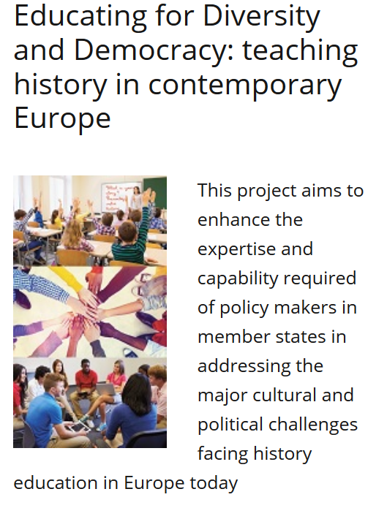
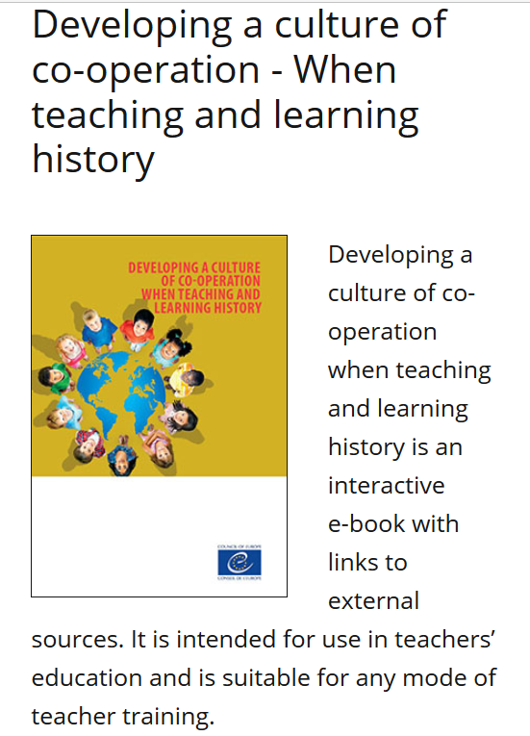
Skills for promoting social cohesion, valuing diversity and handling differences and conflict (Article 13)
Case study 1:
Work of the Council of Europe on History Education
http://www.coe.int/en/web/history-teaching

Slide 8
Skills for promoting social cohesion, valuing diversity and handling differences and conflict (Article 13)
Case study 2: Bookmarks
Combating hate speech online through Human Rights Education

Slide 9
Skills for promoting social cohesion, valuing diversity and handling differences and conflict (Article 13)
Case study 3: Experiences in Ukraine

Slide 10
Skills for promoting social cohesion, valuing diversity and handling differences and conflict (Article 13)
Considering formal, non-formal and informal education
Address the online environment and use adapted tools
Whole school approach and engaging various stakeholders
Experiential learning, reflection, critical thinking
Connection with CDC and particularly the intercultural elements
Consider diversity in a broad sense and adapt approaches to local context based on the common set of values and principles

Slide 11
Co-operation in follow-up activities / international cooperation (Articles 15 and 16)
Continually address current issues and provide responses to them; strengthen the relevance of EDC/HRE as a response to the current challenges.
Provide opportunities and resources in order to improve cooperation between formal and non-formal networks in the field of EDC/HRE.
Improve dissemination of existing knowledge, tools, and materials to the wider variety of stakeholders.
stronger degree of sustainability (e.g. funding) in order to provide more long-term impact and changes in formal and non-formal education

