Slide 1



Presentation on the findings from the national survey on bullying and violent extremism in the education system in Albania

Slide 2
VERBAL BULLYING
BULLIZËM RACOR
VIRTUAL BULLYING
say mean and hurtful things, or make fun of him or her, or call him or her mean and hurtful names
The definition of the concepts
A person is bullied when he or she:
say mean and hurtful things, or make fun of him or her, or call him or her mean and hurtful names
SOCIAL BULLYING
PHYSICAL BULLYING
SEXUAL BULLYING
PSYCHOLOGICAL BULLYING
RACIAL BULLYING
completely ignore or exclude him or her from their group of friends or leave him or her out of things on purpose
bullied with mean names, comments, or gestures with a sexual meaning
hit, kick, push, shove around, or lock him or her inside a room
tell lies or spread false rumors about him or her or send mean notes and try to make other students dislike him or her
bullied with mean names or comments about my race or color
Bullying is an aggressive behavior that has three main characteristics:
  is exposed, repeatedly and over time, to negative actions on the part of one or more other persons
  The aggressive behavior is intentional
  and he or she has difficulty defending himself or herself

Slide 3
VIOLENT EXTREMISM
(UNESCO, 2016).
Violent extremism is the lack of provided opportunities and/or the prohibition of different point of views, overestimation of personal insights and underestimation of others insights, the imposition of personal thoughts without allowing the possibility to give reasons and to make the comparison with other standpoints
“when you do not allow for a different point of view; when you hold your own views as being quite exclusive, when you don’t allow for the possibility of difference and when you want to impose this view on others using violence if necessary”
Violent extremist views can be exhibited along a range of issues, including politics, religion and gender relations. No society, religious community or worldview is immune to such violent extremism

Slide 4




THE MAIN OBJECTIVES OF THE STUDY
To establish the prevalence and types, scope of bullying in schools in Albania
To assess the tolerance`s level to bullying and violence among school stakeholders
To assess the level of extremist attitudes and beliefs among school stakeholders
To identify anti-bullying policies and procedures that are already in place by schools

Slide 5
THE RESEARCH QUESTIONS
01
What percentage of students are bullied and/or bully others ?
02
What are the ways in which students are most often bullied ?
In how many ways are most students bullied ? How long does bullying last?
03
04
Whom do students tell about being bullied?
05
What are the teachers’ attitudes, beliefs and understanding about bullying and violent extremism?
06
What kinds of strategies or interventions do teachers apply when they face bullying by students in the classroom?
07
What methods or techniques do teachers suggest to prevent bullying?
08
What are the parents’ attitudes, beliefs and understanding about bullying?
09
How parents perceived school administrators, teachers, and antibullying policies or programs that were already in place?

Slide 6
METHODOLOGY
The basic instruments: three questionnaires
Teachers
  The questionnaire with closed questions which measures the attitudes and personal beliefs of teachers towards the bullying phenomenon and violent extremism
Quantitative study
Pupils
Parents
  The questionnaire with closed questions for the parents, which measured their attitudes and beliefs towards bullying phenomenon.
  A widely used standardized instrument –Bully/ Victim Questionnaire with students created by Prof. Dan Olweus.

Slide 7


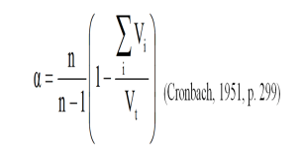
Reliability and Validity
The questionnaires were subjected to two-way translation. Then they underwent a pilot test before we undergo psychometric testing on attributes.
Alpha of Cronbach 0.71, in case of questions about being a victim, and 0.75 in case of questions about being the aggressor.
The test-retest reliability coefficient of Pierson resulted (Pearson) r = 0.78 in the case of being victims and r = 0.77 in the case of being the aggressor. (N = 40, for a 7-day period)

Slide 8
THE SAMPLE SIZE
  Geographical,
  urban/rural,
  Size of schools,
  Type of school, public/private school.
  Primary (4 grade)/secondary/upper secondary
  General gymnasium/VET
The technique of stratified sampling procedure was used
Than the random sample method was used to select the students, teachers and parents form each school.
The questionnaire items were asked of the students in grades four through twelve in all twelve regions of Albania.
Initially a random sample of 144 schools were selected based on the criteria's mentioned above

Slide 9

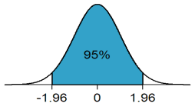
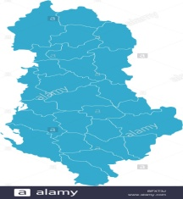

THE SAMPLE FEATURES
7% of schools in national range were selected: 141
Confidence level: 95%
Confidence interval: 4
12 regions of the country

Slide 10
The distribution of sample by regions
 | Students | Students Percent | Teacher | Teacher Percent | Parents | Parents Percent
Berat | 107 | 4.5 | 120 | 3.4 | 46 | 4.7
Dibra | 115 | 4.8 | 146 | 4.1 | 50 | 5.2
Durres | 272 | 11.4 | 380 | 10.7 | 119 | 12.3
Elbasan | 230 | 9.7 | 241 | 6.8 | 54 | 5.6
Fier | 262 | 11.0 | 371 | 10.4 | 110 | 11.3
Gjirokaster | 44 | 1.9 | 68 | 1.9 | 20 | 2.1
Korce | 161 | 6.8 | 191 | 5.4 | 70 | 7.2
Kukes | 99 | 4.2 | 146 | 4.1 | 43 | 4.4
Lezhe | 111 | 4.7 | 162 | 4.6 | 45 | 4.6
Shkoder | 196 | 8.2 | 246 | 6.9 | 78 | 8.0
Tirana | 635 | 26.7 | 1248 | 35.1 | 272 | 28.0
Vlore | 145 | 6.1 | 241 | 6.8 | 63 | 6.5
Total | 2377 | 100.0 | 3560 | 100.0 | 970 | 100.0

Slide 11
SAMPLE DISTRIBUTION BY SCHOOL LEVELS

Slide 12
SAMPLE DISTRIBUTIONS BY AREA URBAN/RURAL

Slide 13
SAMPLE DISTRIBUTION BY THE TYPE OF SCHOOL PUBLIC/PRIVATE

Slide 14
TEACHER’S DISTRIBUTION BY POSITION

Slide 15
Distribution of students by sex

Slide 16

Main findings of the study

Slide 17
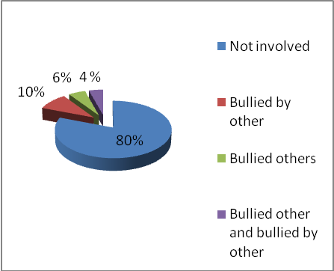
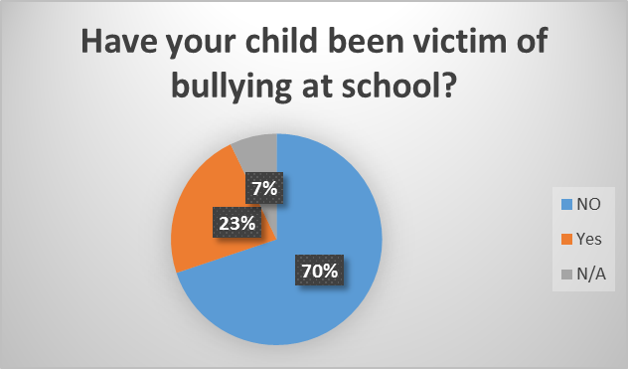
The frequency of bullying by students, teachers and parents

Slide 18
Prevalence of bullying by sex

Slide 19
Prevalence of bullying by grade and category

Slide 20
Prevalence of bullying in urban/ rural area

Slide 21
Forms of bullying by gender

Slide 22
Forms of bullying by type of schools

Slide 23
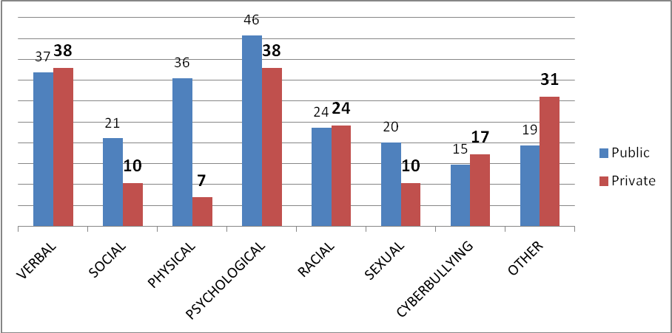
Forms of bullying by private vs public schools

Slide 24
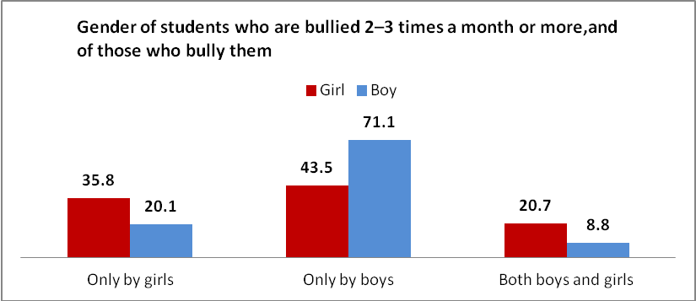
Who bully student by gender?

Slide 25
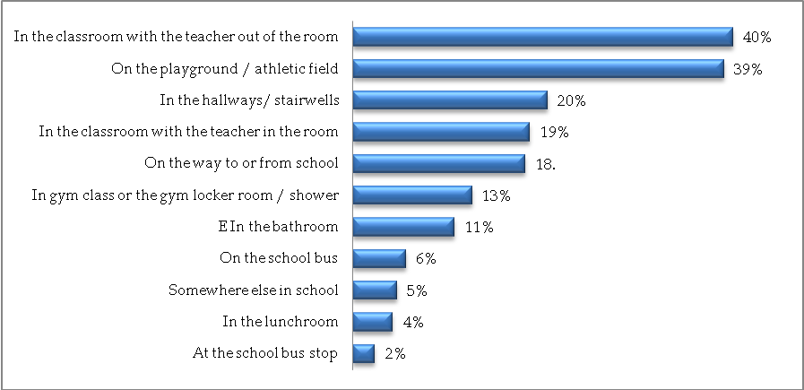
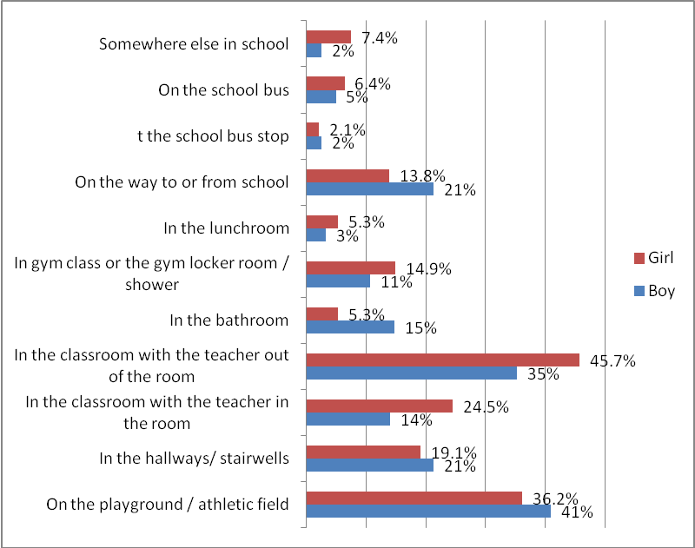
Where bullying takes place by gender

Slide 26
What are the motives of victimization by teachers perspective

Slide 27
Bullying report
Reporting bullying

Slide 28
Whom do students tell about being bullied?

Slide 29
Reporting by grade

Slide 30
To whom do students report by grade?

Slide 31
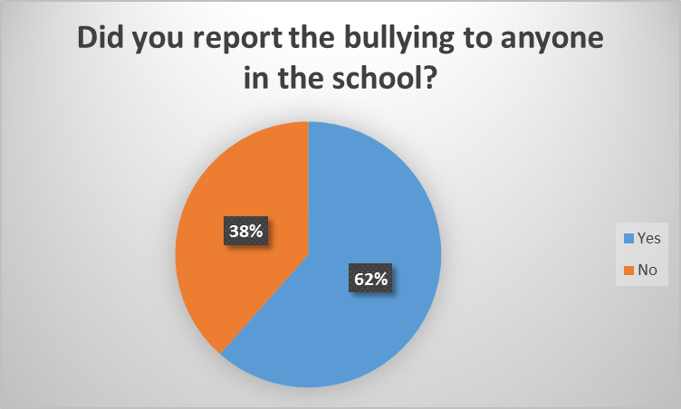
Do parents report the bullying incidence ?

Slide 32
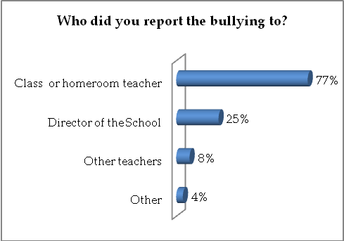
Who did parents report the bullying to?

Slide 33
How peers, teacher and parents respond to bullying

Slide 34
How do teachers respond to bullying?

Slide 35
How do students respond to bullying?

Slide 36
Response to peers’ bullying incidents: desire to help versus taking action to help

Slide 37
Response to peers’ bullying incidents: Empathy with the victims

Slide 38
Intervention and prevention strategy used by schools

Slide 39
What interventions undertake schools to fight bullying?

Slide 41
Please, indicate below whether you believe there is a need for national anti-bullying guidelines in schools?

Slide 42
Strategy used by schools to fight bullying

Slide 43
Violent extremisms in schools

Slide 44
Teacher attitudes about violent extremism (Agree/ Strongly Agree)

Slide 45
Incident occurred in the school during the past 12 months

Slide 46
Strategies for preventing extremism and intolerance by teacher perspective

Slide 47
RECOMMENDATIONS
Developing a coherent anti-bullying policy at national level which would aim at:
  increasing school safety; and
  establishing a supportive social environment
Main Recommendation

Slide 48



CENTRAL AND LOCAL INSTITUTIONS
The establishment of a national mechanism for identification, referral and addressing the bullying phenomenon.
Bullying behaviors and different aspects of it become part of the school curriculum.
01
03
All school personnel should be trained to understand, identify and intervene on issues such as bullying or violent extremism.
04
Preparation of guidelines or manuals for teachers and leaders, so that they can identify and manage bullying behaviors.
RECOMMENDATIONS
02
Strengthening psycho- social support system by increasing the number and presence as well as further professionalization of psychologists and social workers in schools.
05

Slide 49
SCHOOL DIRECTORATES
01
Each school should develop a mid-term plan to combat bullying through awareness and capacity building.
Every school should implement a continuous monitoring for displaying extremist behavior.
03
The internal review of school regulations, where clearly defined bullying behaviors and measures for its prevention.
04
02
Each school must perform regularly, every year, a monitoring and evaluation on the prevalence of bullying, most frequently the places where it happens a lot.
RECOMMENDATIONS

Slide 50
CLASS LEVEL
Teachers should conduct activities in the classroom as well as specific topics and discussions on bullying and extremism, where students are encouraged to share their experiences and their personal attitudes
01
02
Teachers should collaborate with parents and other stakeholders in the community to enhance the effectiveness of intervention
RECOMMENDATIONS
03
Creating a peer support system
in class

Slide 51
Thank you!

