Slide 1
PCF Project Support to increased efficiency of courts, improved training of judges and judicial self-governance in Azerbaijan Baku, 4 April 2017

Slide 2
Objective: To strengthen the independence, efficiency and quality of the judiciary Expected Results: 1. The efficiency and quality of judicial services in five pilot courts are improved through the application of the methodology and tools developed by CEPEJ. 2. Recommendations to roll out the results of the pilot phase for increased efficiency and quality of judicial services are developed in dialogue with the judicial and governmental authorities. 3. The capacities of the Justice Academy to train judges and court staff on efficient court management and quality of justice, in line with CEPEJ tools, are strengthened.

Slide 3
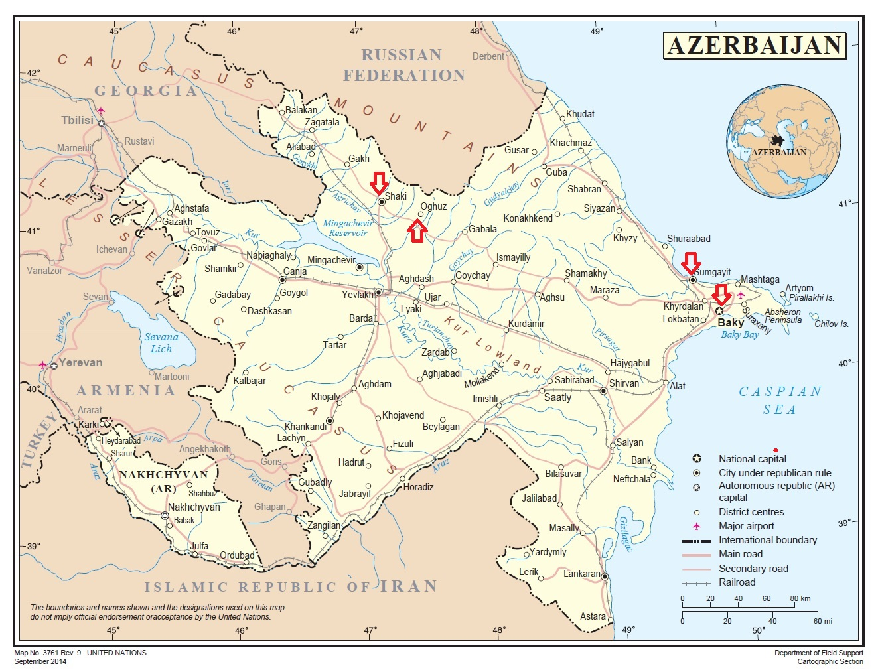
The pilot courts of the CEPEJ project:
5 pilots courts designated by MOJ and Judicial Legal Council :
1.Sheki Appellate Court;
2. Sumgait Appellate Court;
3. Baku City Yasamal District Court;
4. Oghuz District Court;
5.Sumgait City Administrative-Economic Court.
Notes:
Geographical location of the pilot courts creates a challenge, but is a welcomed decision of the MoJ and JLC. The courts outside the capital are less “bothered” by the international partners and seems to be not less committed.

Slide 4
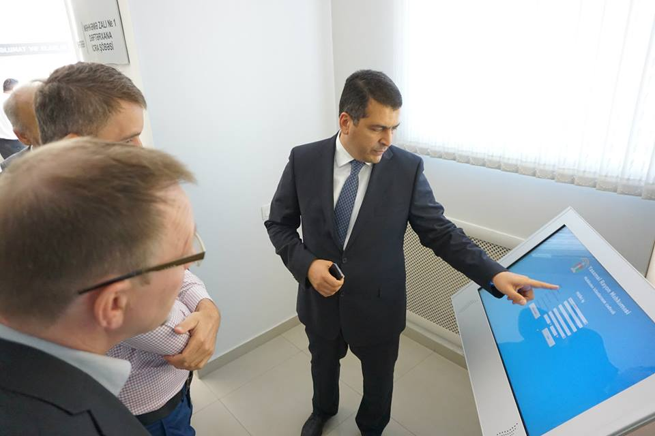
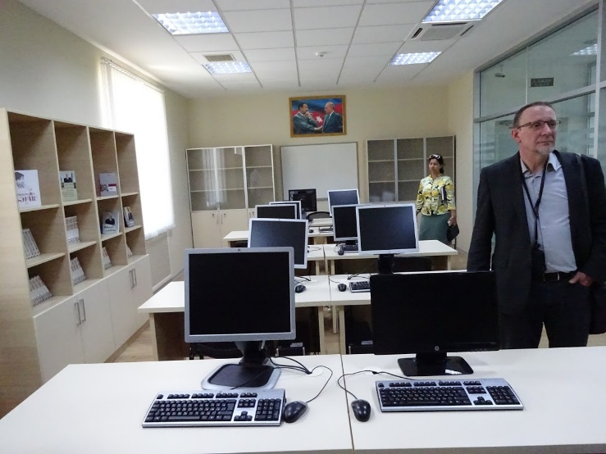
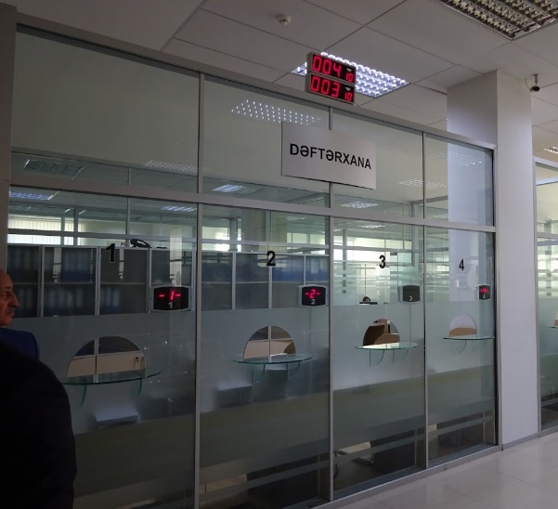
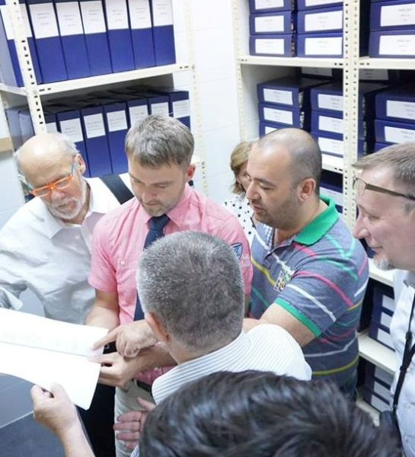
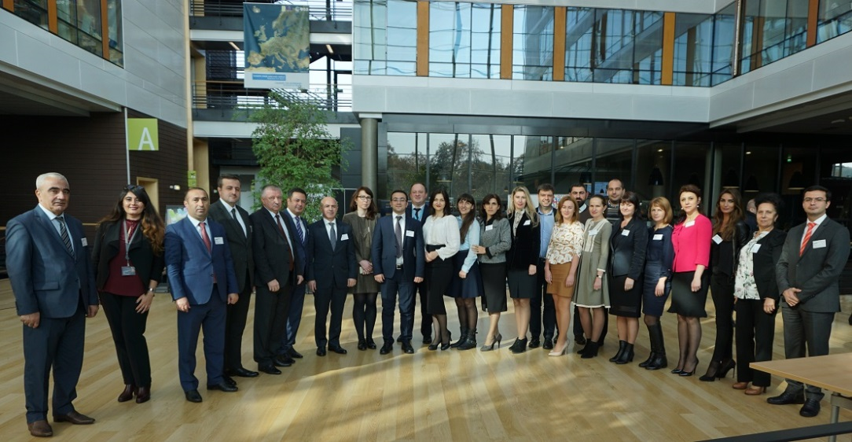
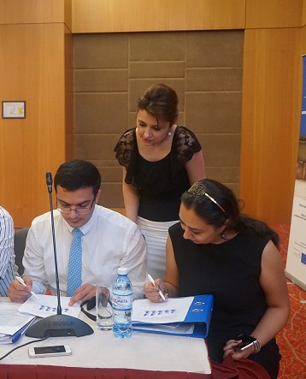
All five pilot court have been visited twice by the CEPEJ experts and Court Coaching Programme was implemented with them.
Notes:
Peculiarities of the courts: new infrastructure against old infrastructure. The capabilities of the ICMS implemented in Yasamal and all courts moving to new facilities.

Slide 5
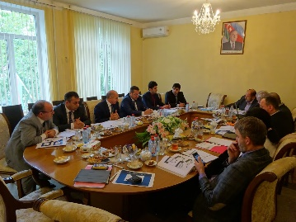
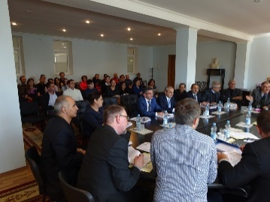
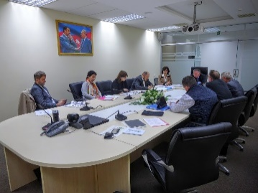
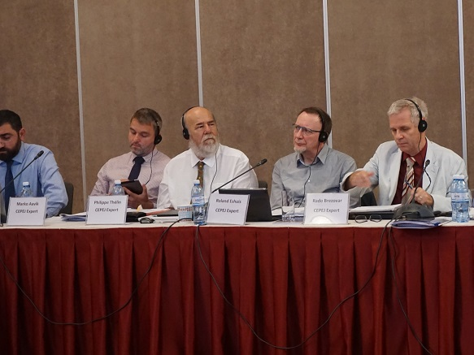
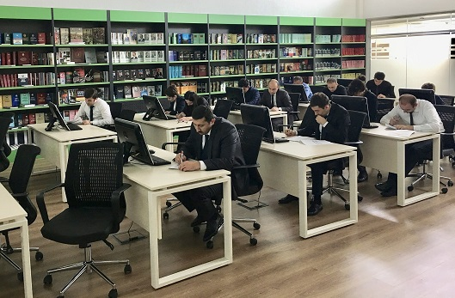
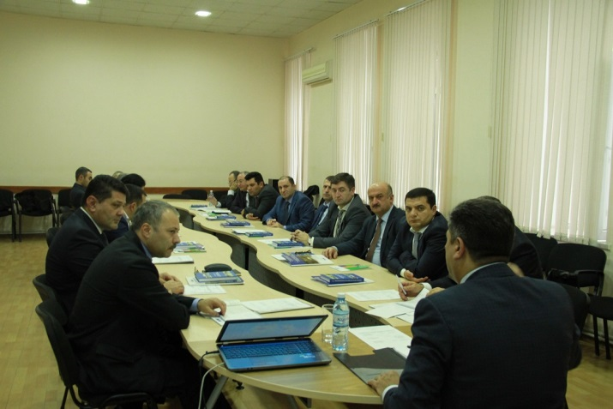
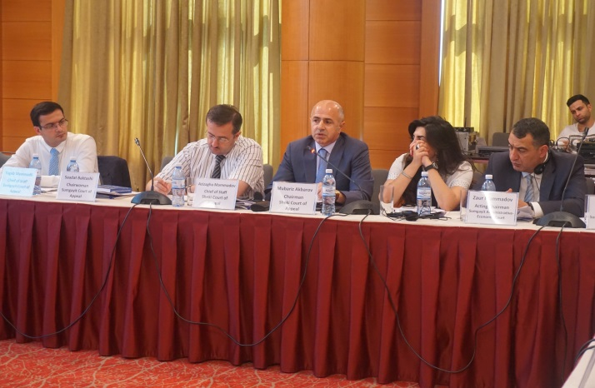
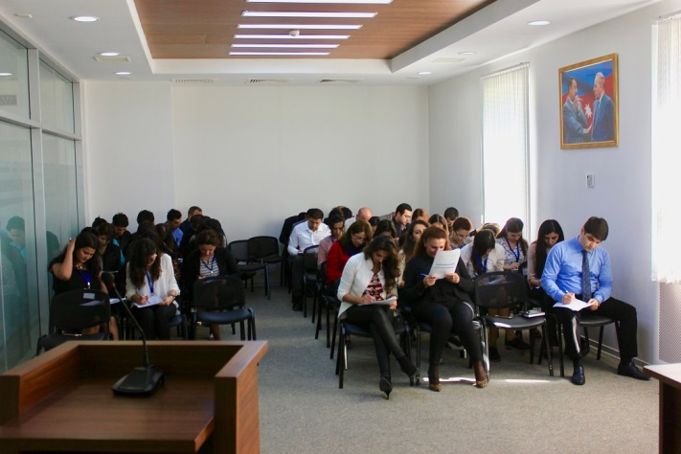
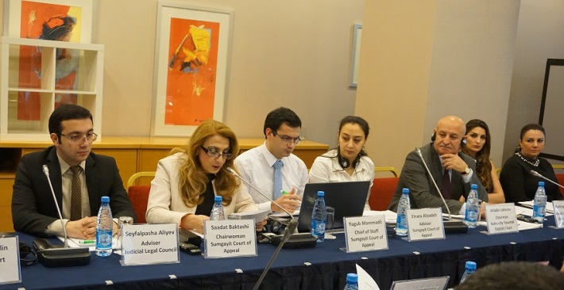
Notes:
A lot of awareness raising and training was provided to the pilot courts in view of successful implementation of the CEPEJ tools.

Slide 6
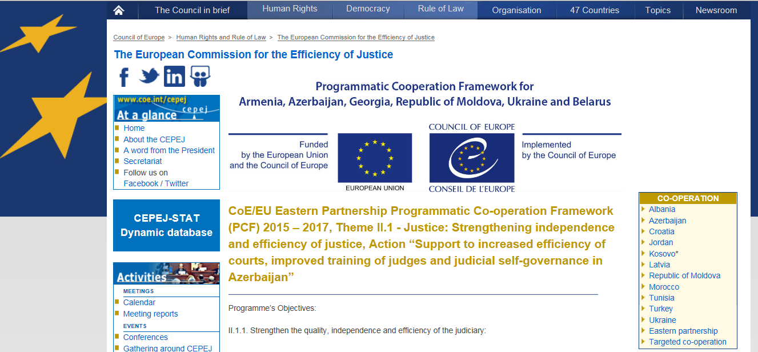
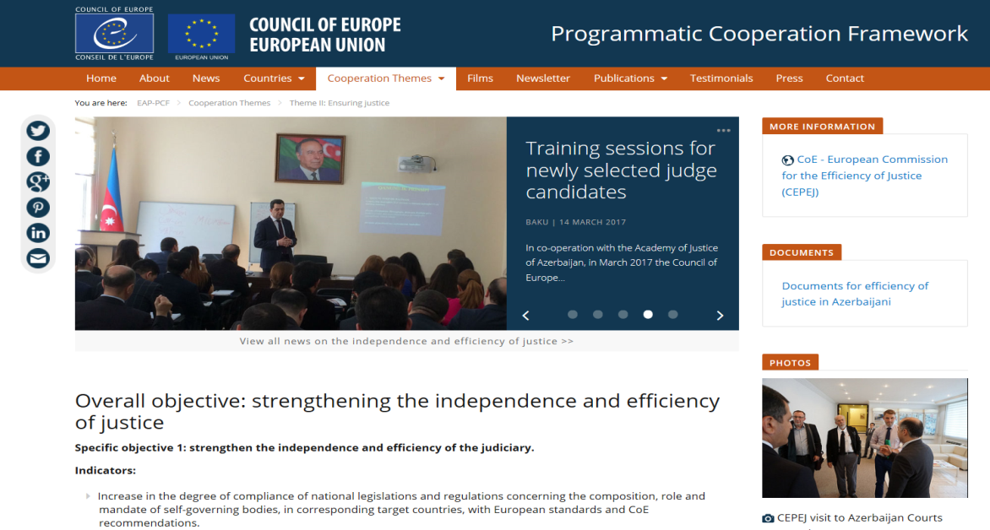
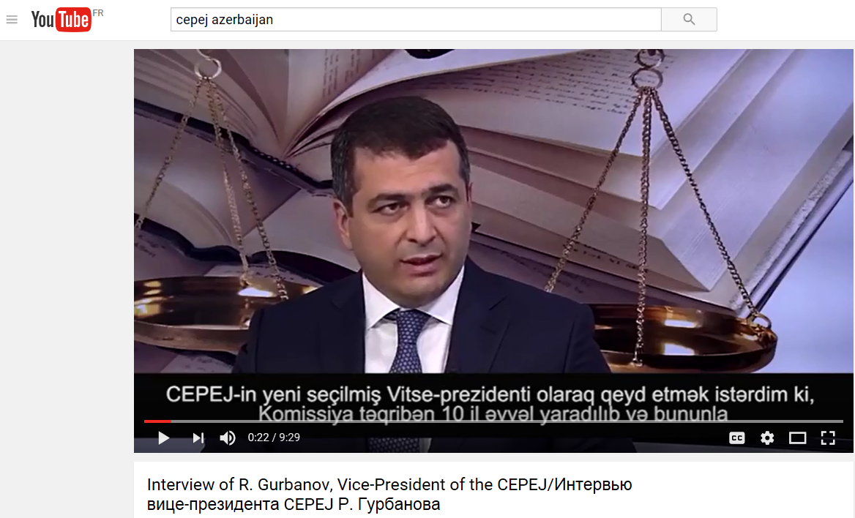
The Project’s visibility is ensured, among other means, through the following Internet recourses: CEPEJ webpage: www.coe.int/cepej, PCF webpage: http://pjp-eu.coe.int/en/web/eap-pcf/home Facebook, Youtube, Flickr etc.

