Slide 1
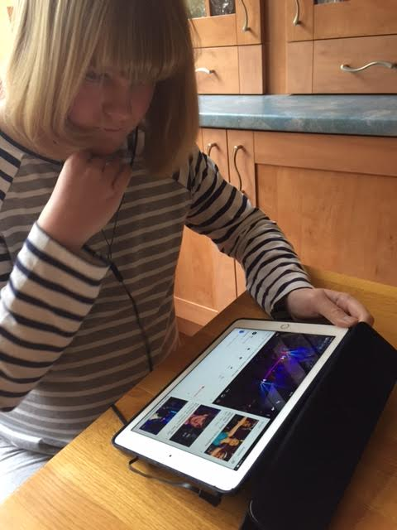
Human rights: A Reality for All Conference to launch the Council of Europe Disability Strategy 2017-2023
Children with disabilities in the digital environment
Gerison Lansdown

Slide 2
The context
But… to date….no research with children with disabilities
Children now grow up in a digital world
Using a wide range of platforms from ever younger ages and increasing amounts of time
Growing body of research and knowledge into usage, impact, risk and harm

Slide 3
Implications of digital media for rights of children: CRC and CRPD
Accessibility rights
Right to access on an equal basis with others to information and communication technologies and systems
General Principles
Right to non-discrimination
Civil and political rights
Freedom of expression
Right to privacy
Best interests
Right to optimum development
Right to be heard and taken seriously
Freedom of association
Right to information
Protection rights
Right to protection from sexual exploitation
Right to protection from violence and abuse
Parents right and duty to advise and guide in line with the child’s evolving capacities
Educational and cultural rights
Right to inclusive education
Right to play and recreation
Right to respect for culture

Slide 4
Potential challenges for children with disabilities
Unequal access to the digital environment
Inequality of opportunity in education
Social exclusion and participation
Inability to engage in arts, culture, recreation and leisure
Impact on opportunities for employment
Lack of support in use of digital media
Heightened vulnerability to abuse, exploitation and bullying
Limited awareness and guidance on risks and harm
Less support from peers
Substitute of online for offline engagement

Slide 5
But without research, not possible to:
Know how they are and want to use digital media
Understand the barriers they face
Optimise opportunities in the digital environment
Support and empower them to minimise risk and protect from harm

Slide 6
What do we need to know…..

Slide 7
Access to the digital world
Physical access
Support and guidance
Do children with disabilities receive comparable training and guidance in accessing and using the Internet as children without disabilities?
What strategies do children with disabilities utilise to overcome the barriers?
Intersectional discrimination
What are the different barriers faced by children with different disabilities
What are the challenges in accessing websites eg complex graphics and design features?
Are there difficulties with the design and size of keyboards, touchpads graphics, touch screens etc?
Has there been sufficient progress in development of universal design in both hardware and software products?
How do other factors of social exclusion impact on access eg children with disabilities living in institutions, or from Roma communities, or who are asylum seekers or refugees?
Are they able to get help with the costs of programmes to facilitate accessibility?

Slide 8
Social inclusion
Type of usage
In what ways are children with disabilities using the digital environment?
Impact of usage
What benefits do they identify from their online access eg education, friendships, music and culture?
Challenges
Are schools over-relying on online communication with children with disabilities?
How much time do they spend online?
Has online activity resulted in significant changes in their lives? And if so, how
Do children with disabilities use online social networks to avoid rejection and discrimination?
Do children with disabilities avoid revealing their disability online – and if so, why?
Does the Internet serve as a liberation or a prison - or both?

Slide 9
Safety and risk online
Access to support
Role of parents
Level of vulnerability
Sexual exploitation,
Impact of disability on privacy
Access to friendships networks of support
Addiction or dependency on online activity
Empowerment and protection
Cyberbullying
Strategies to protect themselves
Collaboration with peers
Privacy and confidentiality
Impact of parental involvement on privacy
Notes:
1 What is the role of parents in the way children with disabilities access and use digital media?
Do they have access to friendships networks of support to provide protection?
2 Does their relative social isolation render them more or less needy of online attention? Does this render them more vulnerable? If so, in what ways?
How vulnerable are they to sexual exploitation and predators? Are they more or less likely to post explicit images, to respond to predatory approaches?
How vulnerable are they to cyberbullying? Do they get involved in such bullying? Are they both perpetrators and victims? What is the impact of cyberbullying? How do these experiences compare with those of children without disabilities?
How vulnerable are they to addiction or dependency on online activity? Gaming? Pornography? If they lack sexual confidence, does pornography play a greater role in their lives? How does that experience impact on their own sense of self esteem?
3 Is their understanding of privacy and confidentiality affected by their disability? For example if they have high levels of care needs? If they are more socially isolated? Does this impact on their behaviour or activity online?
Does the digital environment offer sufficient opportunity for privacy and a private life free from adult involvement or observation?
4 What strategies are they using to protect themselves, to support and protect their peers, to improve their access etc?

Slide 10
Conclusion
Access to digital media for children with disabilities is vital
The lack of research compounds existing social exclusion
Barriers need to be understood in order to be able to remove them
The ‘price’ of access must not be exposure to harm, abuse or exploitation
Focus must be on empowerment not removal from digital environment
Ultimate goal – safe and effective access on an equal basis with other children

