Slide 1
EU / CoE Eastern Partnership Programmatic Co-operation Framework 2015 – 2020
Project “Promoting Human Rights Education and Democratic Citizenship”
Jan 2015 – Dec 2017
6 EaP countries: Armenia, Azerbaijan, Belarus,
Georgia, Moldova, Ukraine

Slide 2
Key strategic objectives
Support integration and/or further development of education for democratic citizenship and human rights education in national education systems (including school curriculum), in accordance with the Council of Europe Charter on Education for Democratic Citizenship and Human Rights Education.

Slide 3
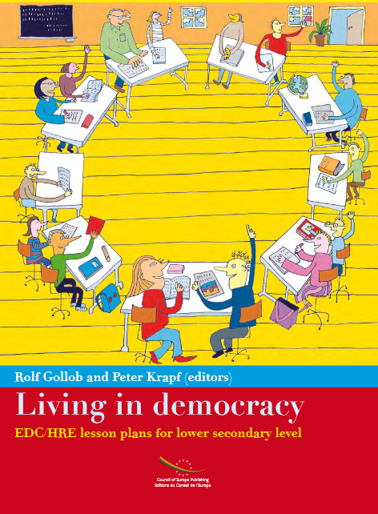
Outcome indicators
School curriculum in 6 countries is improved and integrates the principles of the Charter on EDC/HRE
At least 900 educational professionals, youth leaders and youth workers are capacitated to deliver EDC/HRE

Slide 4
Outcome indicators
In at least 90 target schools (15 schools in 6 countries) EDC/HRE materials are piloted, at least in 50% they are used in practice
EDC/HRE materials are available in at least 6 languages
An increased number of partnerships and networking in the field of human rights and democracy education

Slide 5
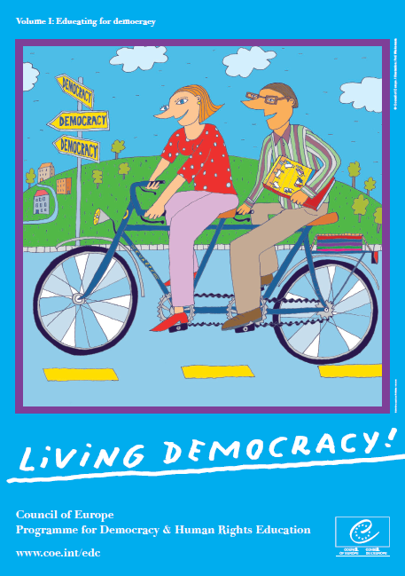
Activities and lessons learnt
Different countries have different needs - mapping studies;
Getting good national experts on board is crucial;
Problems with translation - ‘Glossary’ of the EDC/HRE terms;
Awareness raising is important – thematic launching event (April 2015) and conference on diversity in education (November 2016)
Close involvement of national authorities (Steering Committee meetings);
Tailor-made training seminars
Piloting of the teaching materials in schools

Slide 6
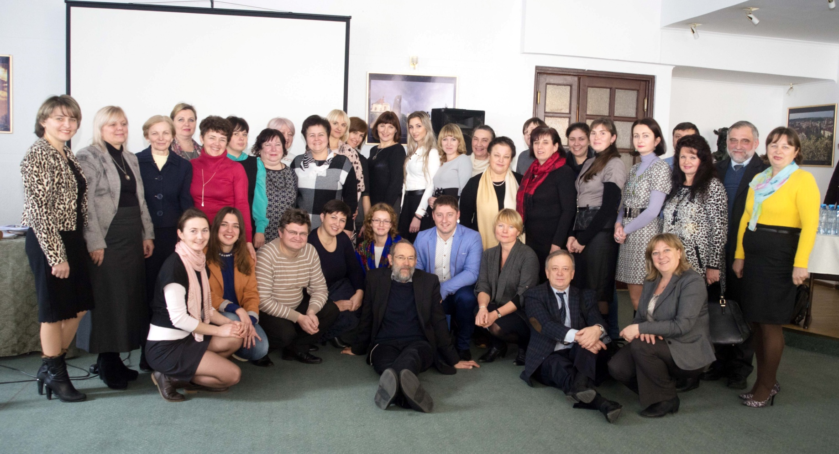
Piloting EDC/HRE and best practices
Ukraine - Moldova: workshops for teachers and school heads
Lviv (December, 2015) – school teams from 11 schools;
Dnipro (February, 2016) - 17 school teams;
Chishinau (April, 2016) – 15 school teams.

Slide 7
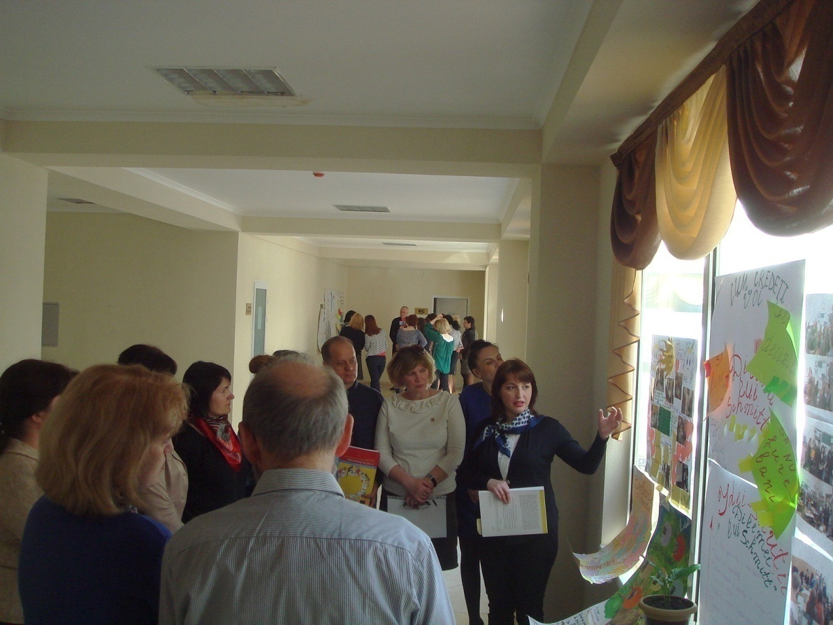
Demonstration lesson on EDC/HRE and teachers presentations
STUDENTS:
- the students gained the experience and the understanding of the balance of rights and duties, and the importance of rules and human rights;
- understand that school life is a piece of their real life experience, including en­couragement and opportunities to participate in school affairs
TEACHERS:
- the whole school approach in teaching education for EDC/HRE;
- the spirit of EDC/HRE positive experience of democratic participation in school life;
- the experience and understanding of teaching, learning and school governance in school

Slide 8
Plans for the future (piloting)
Ukraine - activities in the Eastern Part of Ukraine (under Ukrainian jurisdiction) involving participants from Eastern Ukraine;
Moldova – workshop for the teachers and school heads in in Gagauzia;
Synergy with European Wergeland Center and other EDC/HRE related projects in delivering the workshops for schools.

Slide 9
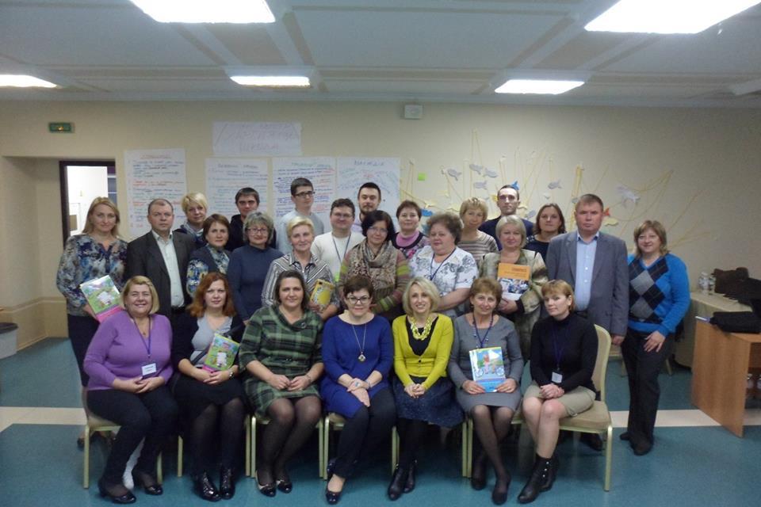
Trainings of education professionals
Ukraine
October 2015 – February 2016
Educators from 25 regional in-service teacher training centres
Aim: to facilitate implementation of the National Action Plan for Human Rights

Slide 10
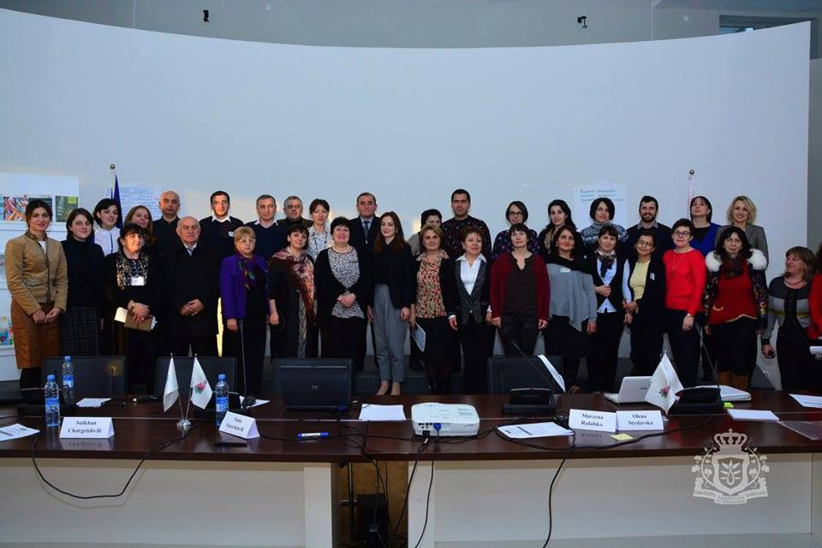
Trainings of education professionals
Georgia
December 2015 – April 2016
15 representatives of pre-service teacher training 15 representatives of in-service teacher training
Aim: to facilitate development of EDC/HRE competences through the pre-service and in-service teacher training systems in Georgia

Slide 11
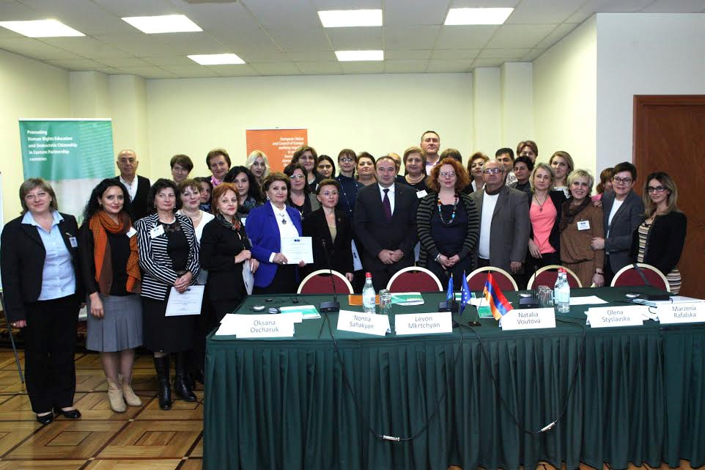
Trainings of education professionals
Armenia
June – October 2016
26 educators from regional in-service teacher training centres, 6 school directors, 4 representatives of the ministry of educaton
Aim: to facilitate development of EDC/HRE competences through the in-service teacher training system in Armenia

Slide 12
Trainings of education professionals
Moldova December 2016 – March 2017
Training of EDC/HRE traininers
Azerbaijan January 2017 – May 2017
EDC/HRE in primary school
Belarus February 2017 – June 2016
Competence based approach

