Slide 1
Responsibility of Professionals in Implementing
the Council of Europe Convention
against Organ Trafficking
Francis L. Delmonico
Professor of Surgery
Harvard Medical School
Massachusetts General Hospital
Transplantation Center
Immediate Past President
The Transplantation Society
Advisor
World Health Organization
Chief Medical Officer
New England Organ Bank
Notes:
Should also note the OPTN

Slide 2
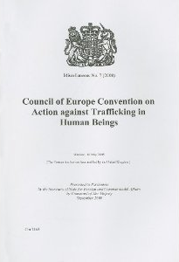
Universal Legal Framework: Trafficking in human
beings for the purpose of Organ Removal
Actions
The recruitment, transportation, transfer, harboring or receipt of persons,
Means
+
by means of the threat or use of force or other forms of coercion, of abduction, of fraud, of deception, of the abuse of power or of a position of vulnerability or of the giving or receiving of payments or benefits to achieve the consent of a person having control over another person
+
Purpose
for the purpose of exploitation…including the removal of organs
Marta López Fraga ©2014 EDQM, Council of Europe, All rights reserved

Slide 3
Trafficking in human beings for the removal of organs
vs trafficking in human organs
The need to distinguish clearly between “Trafficking in Human Organs” (THO) and “Trafficking in human beings for the purpose of the removal of organs” (HTOR)
2009
HTOR: effectiveness of existing international standards and no need for further international legal instruments
THO: need for an internationally agreed definition
Recommendation to elaborate an international legal instrument setting out a definition of THO, the measures to prevent it and protect victims, and criminal law measures to punish the crime
http://www.coe.int/t/dghl/monitoring/trafficking/docs/news/organtrafficking_study.pdf
Marta López Fraga ©2014 EDQM, Council of Europe, All rights reserved
Notes:
Tx tourism

Slide 5
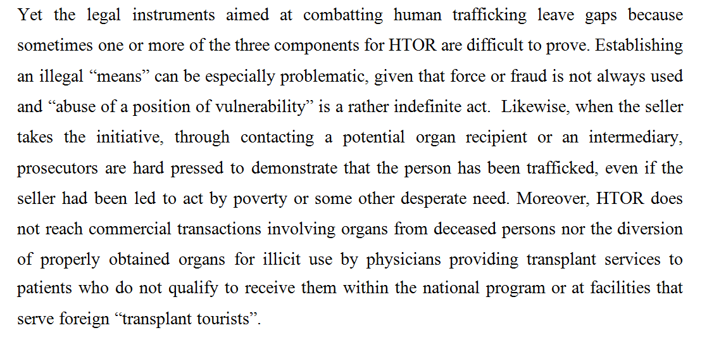

Slide 6
Complementarity to the Existing Legal Framework
LIVING PERSON
DECEASED PERSON
Actions
OTC Trafficking
Human
Trafficking
Cells
Complementarity to HTOR framework, for instance:
when it is difficult to prove that the person whose organ was illicitly removed had been subjected to human trafficking (e.g. when sellers take the initiative, by contacting potential recipients or intermediaries)
when it is difficult to prove that the person concerned has engaged in actions within the scope of the definition of HTOR or has used any of the illegal means set forth in the definition of HTOR
commercial transactions involving organs from deceased persons
diversion of properly obtained organs for illicit use by physicians providing transplant services to patients who do not qualify to receive them within national programs or at facilities that serve “transplant tourists”
Recruitment, transportation, transfer, harboring or receipt of persons
Sexual exploitation
Means
Organ
Removal
(HTOR
+THO)
Threat or use of force or other forms of coercion, of abduction, of fraud, of deception, of the abuse of power or of a position of vulnerability or of the giving or receiving of payments or benefits to achieve the consent of a person having control over another person
Tissues
Forced labour
Slavery
Organs
Purpose
Removal of organs
Recruitment
solicitation
Removal
Preparation / preservation
Transport
Transplantation
Marta López Fraga ©2014 EDQM, Council of Europe, All rights reserved
Notes:
The existing Conventions against HTOR leave evident loopholes for condemnable practices that will now be listed as THO under the Draft Convention (e.g. the recovery of organs from a live person with his free, informed and specific consent, but where the person has been offered/received a financial gain, or from deceased donors with no consent -authorization and/or with a third party having been offered/received a financial gain or comparable advantage)

Slide 7
What Actions Constitute
Trafficking In Human Organs?
The human body and its parts shall not, as such,
give rise to financial gain or comparable advantage.
Illicit removal of organs:
removal without the free, informed and specific consent of the living donor, or, in the case of the deceased donor, without the removal being authorized under its domestic law;
where in exchange for the removal of organs, the living donor, or a third party, has been offered or has received a financial gain or comparable advantage;
where in exchange for the removal of organs from a deceased donor, a third party has been offered or has received a financial gain or comparable advantage.
Marta López Fraga ©2014 EDQM, Council of Europe, All rights reserved

Slide 8
Council of Europe Convention against Trafficking
In Human Organs
Adopted by Committee of Ministers on 9 July 2014
Purpose
To prevent and combat the THO by providing for the criminalisation of certain acts
To protect the rights of the victims
To facilitate co-operation at national and international levels on action against THO
Marta López Fraga ©2014 EDQM, Council of Europe, All rights reserved

Slide 9
The pivotal role of health professionals
in the fight against transplant-related crimes
This identifies the obligation of health professionals to discourage and prevent any harm to individuals by not providing patients with any information or services that could enable them
to purchase illicitly obtained organs and by appropriately screening all potential donors to avoid any transplant related crimes.
Health professionals are further obliged to report illicit conducts by peers or patients to law enforcement authorities when they suspect or know of the illicit origin of the transplanted organ.

Slide 10
DICG working group on transplant tourism

Slide 11
Transplant Tourism
Versus
Ethical Travel for Transplantation
Guidelines from
the Declaration of Istanbul Custodian Group
Beatriz Domínguez-Gil and Elmi Muller

Slide 12
Ethical Travel for Transplantation
In the absence of
Organ Trafficking
Transplant Commercialism
Transplant Tourism
Not undermining the ability of the country of destination to provide transplant services for patients of its own community

Slide 13
Transplant Tourism
Prospectively
who is your doctor
who is your donor
who is going to care for you upon return to the native country
what information should be shared between the centers
that provides appropriate care of the patient
Retrospectively
There's an obligation to report to national authorities
In the absence of this proper clinical information
With the awareness of the illegal activity or clinical complications

Slide 14
The pivotal role of health professionals
in the fight against transplant-related crimes
Establish and promulgate a prospective program that emphasizes care and professional responsibility.
That care entails an awareness of the circumstances of the transplant and the responsibility entails an obligation of reporting when the patient does not fulfil the established plan of referral.
The consequence for the patient and physician is a reporting to appropriate authorities.

Slide 16
Funding of transplant procedures
National health authorities and/or insurance providers should not cover the costs of transplant procedures which involve organ trade or trafficking or which were otherwise inconsistent with the provisions of domestic laws governing organ removal and transplantation.
However, patients should always be provided with necessary healthcare upon their return.

